Slide 1
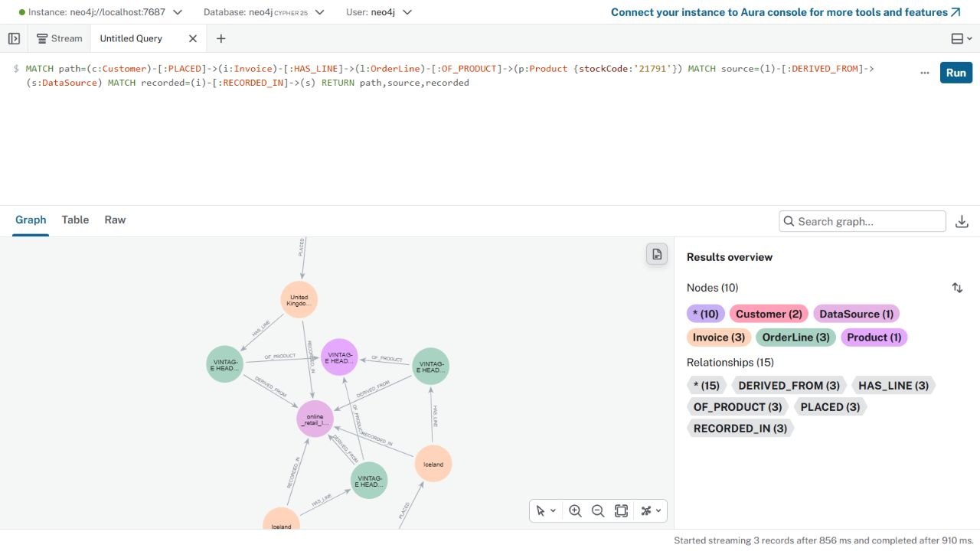
Research problem and existing KG
Question
Which customers bought the same products, and what original purchase records support that comparison?
Existing Neo4j graph
138 nodes, 227 relationships
5 node types; 5 relationship types
UCI Online Retail II sample
2 customers; 4 invoices
Retail360 GraphRAG | CS 5588 1/8
Notes:
Actual local Neo4j graph screenshot. Dataset: https://archive.ics.uci.edu/dataset/502/online+retail+ii. Existing KG covers an illustrative selected UCI sample, not the entire dataset. Customer-product similarity is observed product overlap, not psychological preferences or predictive accuracy.

Slide 2
GraphRAG architecture
User question
Fixed Cypher route
Neo4j retrieval
Evidence + exact
Python facts
Local Qwen
evidence selection
Neo4j graph traversal
Customer → Invoice → OrderLine → Product ← OrderLine ← Invoice ← Customer
Output: verified answer, model-selected evidence, source invoice/row IDs, and limitation.
Retail360 GraphRAG | CS 5588 2/8
Notes:
Implements the Neo4j retrieval-to-LLM pattern using the official Neo4j Python driver and local Ollama. Reference: https://neo4j.com/docs/neo4j-graphrag-python/current/ . Fixed parameterized Cypher is easier to inspect on this small graph than a vector index or generated Cypher. The LLM selects evidence descriptions by index. Python verifies the index and assembles the grounded response. The LLM never calculates Jaccard or writes queries.

Slide 3
Human–AI co-design iteration
Human design
Agentic AI recommendation
Human evaluation and revision
Free local Neo4j, public UCI data, source-row provenance, and a question about observed purchase similarity.
Use reviewed Cypher templates and a local LLM. Add a compact graph context and evidence table in Streamlit.
The first model answer listed only two supporting orders. The graph contained three. A later answer inferred customer interests. We limited the model to selecting evidence and verify each selection.
Decision: Python controls numbers, citations and wording; the LLM chooses relevant graph evidence.
Retail360 GraphRAG | CS 5588 3/8
Notes:
Observed iteration in live local testing: initial shared-purchase LLM text named 549222 and 558996, omitting 562032. Human review found the omission in Neo4j evidence. A later model draft inferred interests from a shared purchase. Revision: exact_answer compiles all invoices; the local model selects product evidence indices; Python verifies indices and renders a fixed grounded sentence. The user previously chose five node types and free local Neo4j.

Slide 4
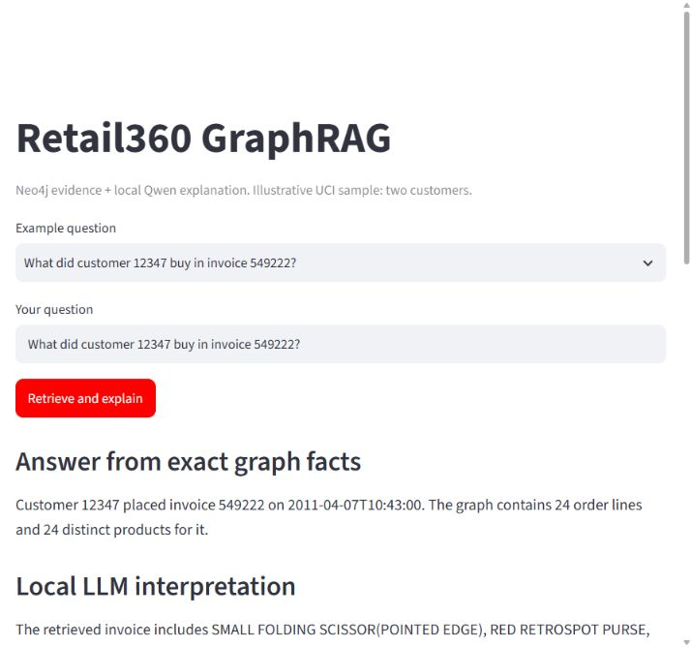
Working local application
Implementation
Python Neo4j driver
Fixed Cypher retrieval
Local Ollama Qwen2.5 1.5B
Validated evidence selection
Streamlit + source RowIDs
Human inspects the result
Local demo: localhost:8503
Retail360 GraphRAG | CS 5588 4/8
Notes:
Actual Streamlit screenshot from local app. Not the prior Challenge 2 cloud app. No paid model API. The user asks a question, reviews exact facts, a model-selected example, source rows, and can revise the question. Code: challenge3/graphrag.py and challenge3/graphrag_app.py.

Slide 5
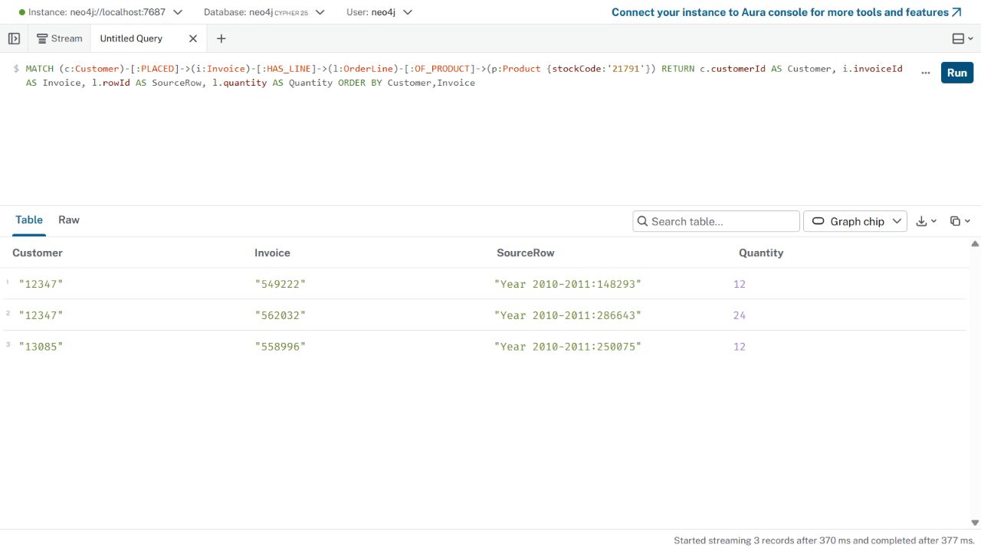
Neo4j retrieval and provenance
Multi-hop Cypher
MATCH (a:Customer)
-[:PLACED]->(:Invoice)
-[:HAS_LINE]->(:OrderLine)
-[:OF_PRODUCT]->(p:Product)
MATCH (p)<-[:OF_PRODUCT]-(:OrderLine)
<-[:HAS_LINE]-(:Invoice)
<-[:PLACED]-(b:Customer)
Rows retain product code, description, invoice IDs, dates, source file and RowID. The app shows these original references.
Retail360 GraphRAG | CS 5588 5/8
Notes:
Actual Neo4j evidence screenshot from the previous KG stage. New GraphRAG SHARED query is in challenge3/graphrag.py and retrieves the complete multi-hop path, including source-line provenance. It uses parameterized customer IDs and date window. Exact row evidence for product 21791 includes Year 2010-2011:148293 and :286643 on customer 12347 and a third source row for customer 13085.

Slide 6
Three live GraphRAG questions
Basic retrieval
Graph evidence: 24 order lines; invoice 549222.
Model-selected evidence: The retrieved invoice includes SMALL FOLDING SCISSOR(POINTED EDGE), RED RETROSPOT PURSE, RED RETROSPOT OVEN GLOVE DOUBLE.
What did customer 12347 buy in invoice 549222?
Multi-hop
Graph evidence: Product 21791; invoices 549222, 562032, 558996.
Model-selected evidence: Both customers bought VINTAGE HEADS AND TAILS CARD GAME in the selected history.
Which orders show both customers bought a shared product?
Research question
Graph evidence: 1 shared of 58 union products; Jaccard 0.017241.
Model-selected evidence: The observed product overlap is low; a shared item is VINTAGE HEADS AND TAILS CARD GAME.
How similar are 12347 and 13085?
Retail360 GraphRAG | CS 5588 6/8
Notes:
All three were executed against the local Neo4j KG and local Qwen model, with rows in challenge3/results/graphrag_evaluation.json. Human evaluation checks exact facts and provenance separately from model-selected evidence. Any invalid selection is explicitly withheld; the exact factual answer remains available.

Slide 7
Evaluation and refinement
4 / 4 factual test cases passed
Basic order retrieval: 24 real source rows
Multi-hop: 1 shared product and 3 supporting invoices
Research: Jaccard 1 / 58 = 0.017241
Failure: missing customer returns insufficient evidence
Observed failure
A small LLM omitted an invoice and inferred customer interests. We moved invoice listing and response wording to Python. The model selects evidence; invalid selections are withheld.
Retail360 GraphRAG | CS 5588 7/8
Notes:
The 4/4 figure is for deterministic facts, provenance, and safe missing-evidence handling, not for all generated prose. Inspect llmVerified for each case in the saved JSON. The test uses the two-customer illustrative sample; this does not show population-level retrieval quality or improved marketing decisions.

Slide 8
Reflection and next steps
What this prototype shows
What remains
A natural-language question can retrieve a real customer–order–product path, calculate a defensible result, and expose source rows and model-selected evidence.
Broaden the customer cohort. Test more question types and ambiguous IDs. Compare graph retrieval with a simpler baseline. Evaluate whether the evidence helps a human make a better decision.
GitHub: github.com/happylinfafa/retail360-challenge2
Local demo: Streamlit at localhost:8503; Neo4j Browser at localhost:7474
Retail360 GraphRAG | CS 5588 8/8
Notes:
The existing Challenge 2 cloud app is separate from this local GraphRAG prototype. The GitHub repository contains the challenge3 code, requirements, import script, queries, README, evaluation, and screenshots after synchronization. Next class demonstration: open Neo4j graph, run three app questions, show evidence table and failure handling.

