Slide 1
RETAIL360 / CHALLENGE 2
Customer evidence explorer
Human–AI Co-Design and Working Application
For retail analysts: calculate customer features, inspect transactions, and review AI explanations.
Free local AI version / no paid API or key required
Xin and Harris / September 21, 2026
Notes:
The local workflow is operational: real Qwen2.5 responses, source evidence and human review. Eight regression tests and five real model cases are documented in the repository. Final Challenge 2 report is due September 30.

Slide 2
CHALLENGE 2 / HUMAN–AI CO-DESIGN
Human Design, AI Design, and interaction
HUMAN DESIGN
AI DESIGN
Retail analysts need usable customer information. First P1 task: turn invoice rows into accurate customer-level behavioral features.
Python calculates. Structured retrieval finds exact evidence. An LLM explains the computed values and their limitations.
HUMAN–AI CO-DESIGN
WHAT THE USER ACCOMPLISHES
The user selects a customer and dates, requests clarification, inspects invoices, and accepts, rejects, or corrects the result.
Understand one customer profile and leave an auditable review, with source transactions available for checking.
02
Notes:
The work builds on the previously accepted Human Design and AI Design. This focused capability supports later segmentation and prediction.

Slide 3
CHALLENGE 2 / HUMAN–AI CO-DESIGN
The human–AI workflow
ASK AND REFINE
CALCULATE AND RETRIEVE
Enter Customer ID, select observation dates, and choose an explanation focus. Dates immediately update the computed evidence.
Select the customer’s records, apply purchase rules, calculate features, and retrieve all-history facts and source rows. The model sees up to ten labeled invoice examples.
EXPLAIN AND INSPECT
REVIEW AND KEEP A RECORD
Use a local Qwen2.5 model to generate an explanation after setup. Check values, invoice references, and limitations beside the source evidence.
Accept, reject, or request correction. Download the review and evidence as JSON. Changing the analysis clears the previous result.
03
Notes:
Without a local model response, reviews are labeled computed_evidence_only. They are never presented as approval of an AI response.

Slide 4
ONE FOCUSED WORKFLOW
Application architecture
Streamlit
Python
Retrieval
Local Qwen
Human
Customer + dates
Clean + calculate
Evidence package
Explain facts
Inspect + review
Local CSV sample + original worksheet and Excel row references
No vector database is needed for exact Customer ID and Invoice lookups.
04
Notes:
Implementation files: app.py, analytics.py, ai.py. The adapter uses Qwen2.5 1.5B through Ollama on loopback, with a JSON schema and explicit error handling. No cloud service or API key is used. Sources: https://docs.ollama.com/capabilities/structured-outputs and https://ollama.com/library/qwen2.5:1.5b.

Slide 5
CHALLENGE 2 / HUMAN–AI CO-DESIGN
Real data and the AI capability
REPRESENTATIVE TASK SAMPLE
TOOLS AND RETRIEVAL
3,178 source rows: full histories for customers 13085, 12347, and 17850, plus six missing-ID audit rows. This is not a population sample.
Decimal calculations produce RFM, average invoice value, and product-code diversity. Exact customer/date filtering supplies the evidence.
AI CONTRIBUTION
DATA SOURCE AND LIMITS
Turn fixed facts into a readable explanation and address clarification requests. Automated checks compare numeric values and reference keys.
UCI Online Retail II, CC BY 4.0
archive.ics.uci.edu/dataset/502/online+retail+ii
Positive purchases only; no churn prediction.
05
Notes:
Dataset attribution: Chen, D. (2012). Online Retail II. https://doi.org/10.24432/C5CG6D. Source sample manifest and extraction script are in the repository. Product text is supplementary, not an instruction source.

Slide 6
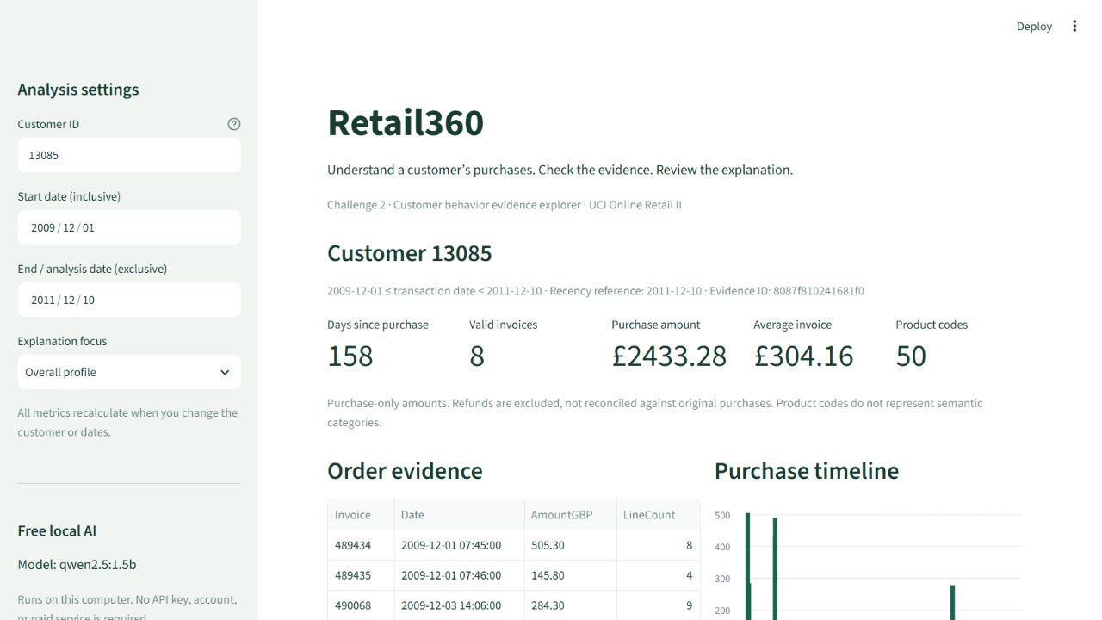
ACTUAL LOCAL APPLICATION
Streamlit application
WORKING CONTROLS
Customer lookup
Date filters
Five computed metrics
Invoice evidence
Purchase timeline
Local Qwen is running. No paid API, key, or account is needed.
06
Notes:
Actual browser screenshot captured from the running Streamlit application at http://127.0.0.1:8501. This address is local to the presenter’s computer. Repository run instructions enable review on another machine.

Slide 7
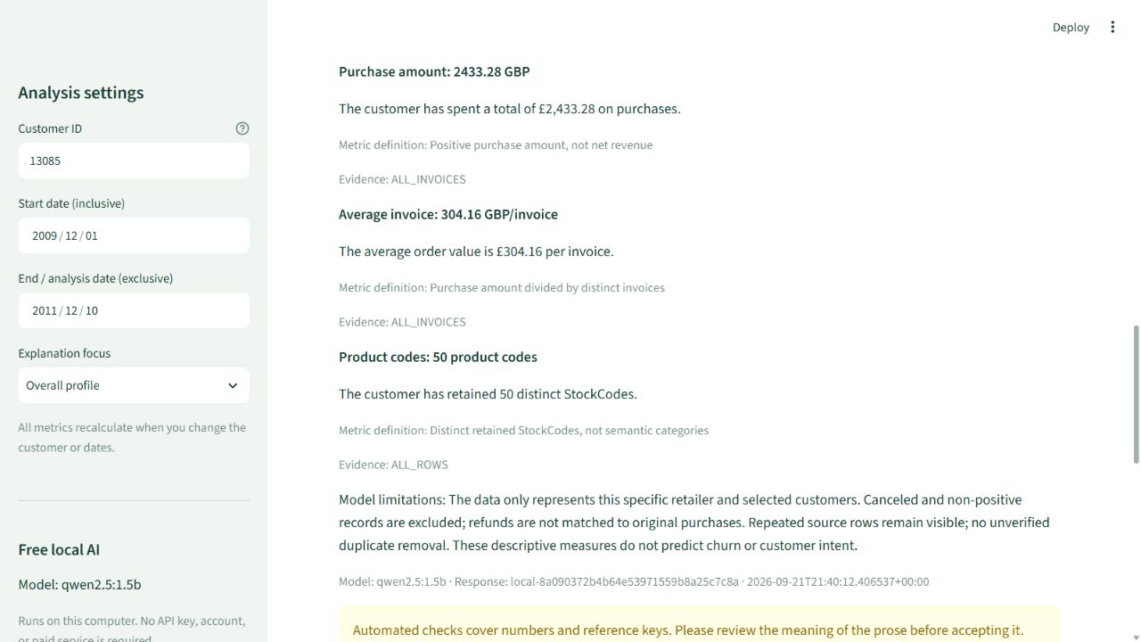
ACTUAL LOCAL MODEL OUTPUT
One grounded example: Customer 13085
SOURCE AND CONTEXT
8 invoices / 84 rows
Recency: 158 days
Reference: Dec. 10, 2011
Invoice 489434: £505.30
Invoice 558996: £137.98
Python supplies figures and references. The model explains. Amounts exclude refunds.
07
Notes:
Actual screenshot of local Qwen2.5 1.5B output. Customer 13085 totals: 2433.28 GBP across eight invoices; AOV 304.16; 50 distinct StockCodes. Source date July 5, 2011; analysis date December 10, 2011. ALL_INVOICES links to the full table in the app; original rows remain inspectable. This descriptive output is not a prediction.

Slide 8
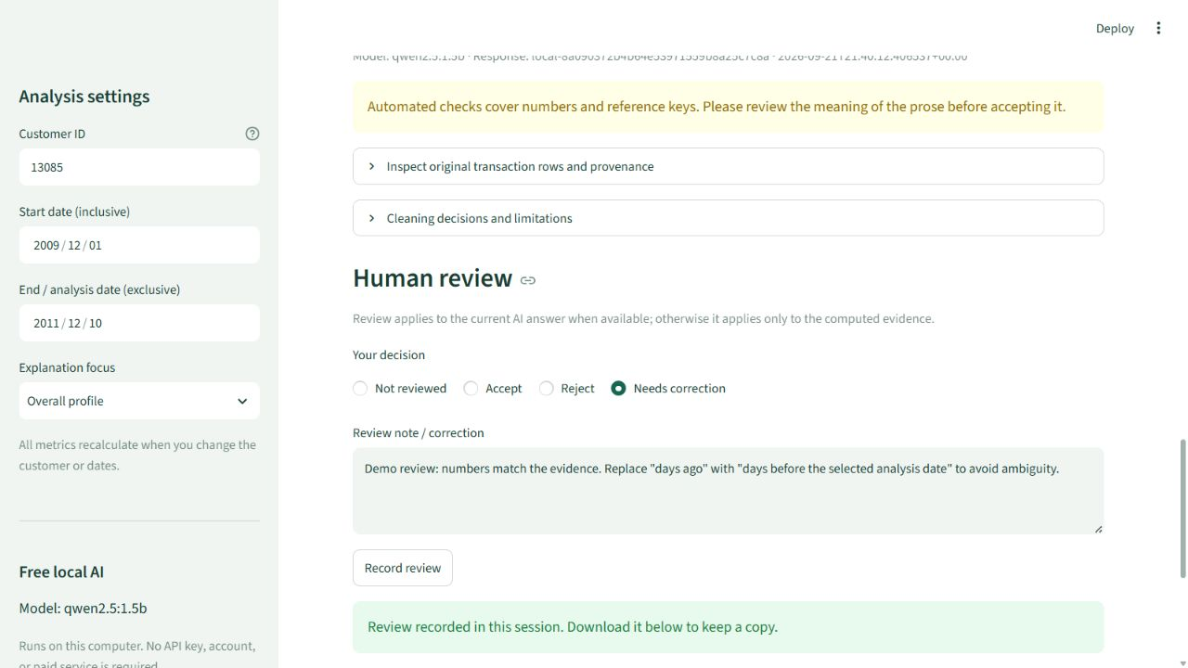
EVIDENCE INSPECTION AND EXPLICIT DECISIONS
Human review and control
USER CONTROLS
Accept or reject
Write a correction
Refine dates or focus
Download evidence
Download review
Demo review: correct ambiguous wording in a real local AI answer.
08
Notes:
This is a demonstration review entered during implementation. The actual local model response is associated with a response ID and evidence hash. The requested correction replaces days ago with days before the selected analysis date; it is not a claim of personal student approval.

Slide 9
CHALLENGE 2 / HUMAN–AI CO-DESIGN
Codex implementation and GitHub
IMPLEMENTATION PARTNER
HUMAN REVIEW IMPROVEMENTS
Codex inspected the workbook, wrote the focused app, added source-row provenance, tested the workflow, and checked browser interactions.
Use free local Qwen. Python attaches values and references. Cap invoice examples at ten, keep all-history facts, and clarify the recency definition.
PUBLIC REPOSITORY
REPRODUCE THE APP
github.com/happylinfafa/retail360-challenge2
Source code, dependencies, README, public sample, extraction script, and tests are available.
Install requirements.txt
Run: streamlit run app.py
Run: ollama pull qwen2.5:1.5b
Run: python -m pytest -q
09
Notes:
Repository: https://github.com/happylinfafa/retail360-challenge2. Secrets are excluded from source, saved evidence, and reviews. No complete dashboard or multiple-agent framework was introduced.

Slide 10
8 REGRESSION TESTS + 5 ACTUAL LOCAL MODEL SCENARIOS
Testing and the next development step
1–2 Data correctness
Real values, invoice ownership, and original row provenance
3–4 User refinement
Recalculation, unknown customer, empty period, reversed dates
5–6 Evidence safeguards
Cancellations, missing IDs, invalid values and citations
7–8 Local service + review
Mocked transport failures; review recording and invalidation
Live Local model scenarios
Five passed numeric checks; observed latency: 20–27 seconds
Lesson: correct numbers do not guarantee a correct explanation
Next: expand semantic review and document corrections for the September 30 final report.
10
Notes:
Executed command: python -m pytest -q --junitxml=docs/test_results.xml. Eight passed. UI also verified in the browser, including a nonexistent customer and recording an evidence review. Mocked provider tests do not measure actual LLM behavior. Five real local scenarios: default customer, shortened window, another customer, unsupported age/future request, and long history. All passed final mechanical checks; timings ranged from 19.73 to 27.22 seconds. Initial long-history invented totals were blocked. Initial recency wording failed manual review and prompted a revision. Remaining ambiguity is shown in the human review demonstration. Model behavior is not guaranteed by this small sample.

