Slide 1
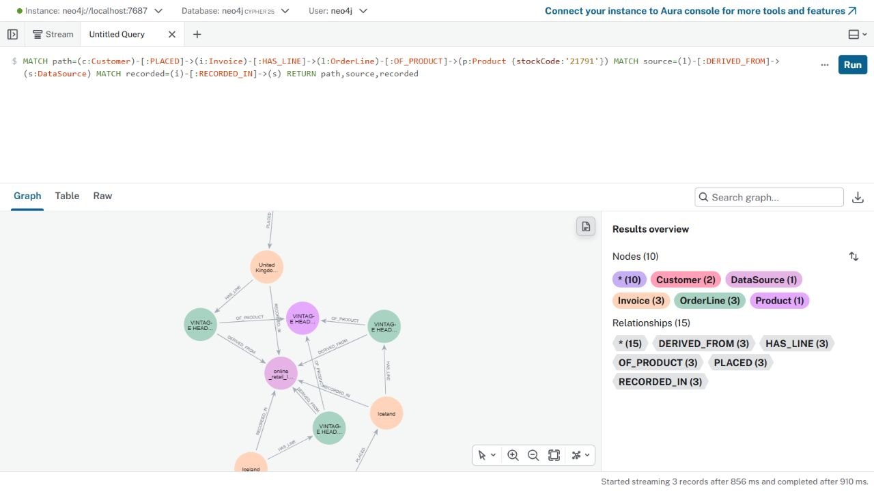
Retail360: GraphRAG and customer similarity
Research question
Can graph-based customer representations help us find relevant customers while keeping purchase evidence visible?
Existing system
Neo4j KG: 138 nodes, 227 links
GraphRAG: Cypher evidence + local LLM
Users inspect invoices and source rows
Retail360 | CS 5588 Challenge 3 1/10
Notes:
Actual screenshot of the existing Neo4j knowledge graph. The project uses an illustrative UCI Online Retail II sample: https://archive.ics.uci.edu/dataset/502/online+retail+ii . The local GraphRAG prototype answers customer questions using reviewed Cypher templates and a local Qwen model. The sample has only two customers.

Slide 2
Why explore a GNN?
Current GraphRAG
Possible GNN role
Cypher retrieves exact paths and evidence.
The similarity query calculates product overlap.
With more customers, it needs a way to rank candidates.
Neighbor information updates customer vectors.
Vectors could rank candidates first.
Cypher still retrieves the invoices and source rows behind each result.
Hypothesis for later testing: learned embeddings may improve candidate retrieval; this tiny sample cannot test it.
Retail360 | CS 5588 Challenge 3 2/10
Notes:
GraphSAGE motivates learning node representations by aggregating neighborhood features: https://arxiv.org/abs/1706.02216 . Neo4j GraphRAG documentation describes retrieval followed by grounded generation: https://neo4j.com/docs/neo4j-graphrag-python/current/ . This slide states a future hypothesis, not an observed improvement.

Slide 3
One-layer GraphSAGE-style experiment
Product nodes
one-hot StockCode
Mean of purchased
product vectors
Customer embedding
58 dimensions
h_customer¹ = mean { h_product⁰ : product purchased by customer }
Fixed weights · one aggregation layer · no training
The experiment uses the same customer–product paths and source rows already stored in Neo4j.
Retail360 | CS 5588 Challenge 3 3/10
Notes:
This is a deliberately limited GraphSAGE-style mean-aggregation demonstration. It is not a trained GraphSAGE model, GCN, or GAT. Initial product features are 58-dimensional one-hot StockCode vectors and initial customer vectors are zero. The original Neo4j graph contains intermediary Invoice and OrderLine nodes; the experiment collapses observed paths to distinct customer–product edges for aggregation. Research: https://arxiv.org/abs/1706.02216 .

Slide 4
Message passing on a real purchase
Product 21791 is the only shared item
Customer 12347
Customer 13085
50 distinct products → product 21791 contributes 1/50 = 0.020 to its matching coordinate.
9 distinct products → product 21791 contributes 1/9 ≈ 0.111 to its matching coordinate.
Their customer vectors overlap at one product coordinate. Each contribution is traceable to original invoices.
Retail360 | CS 5588 Challenge 3 4/10
Notes:
These numbers are computed by challenge3/gnn_experiment.py from the existing Neo4j graph. Shared product 21791 is supported by invoices 549222 and 562032 for customer 12347 and invoice 558996 for customer 13085. Source RowIDs are stored in results/gnn_message_passing.json.

Slide 5
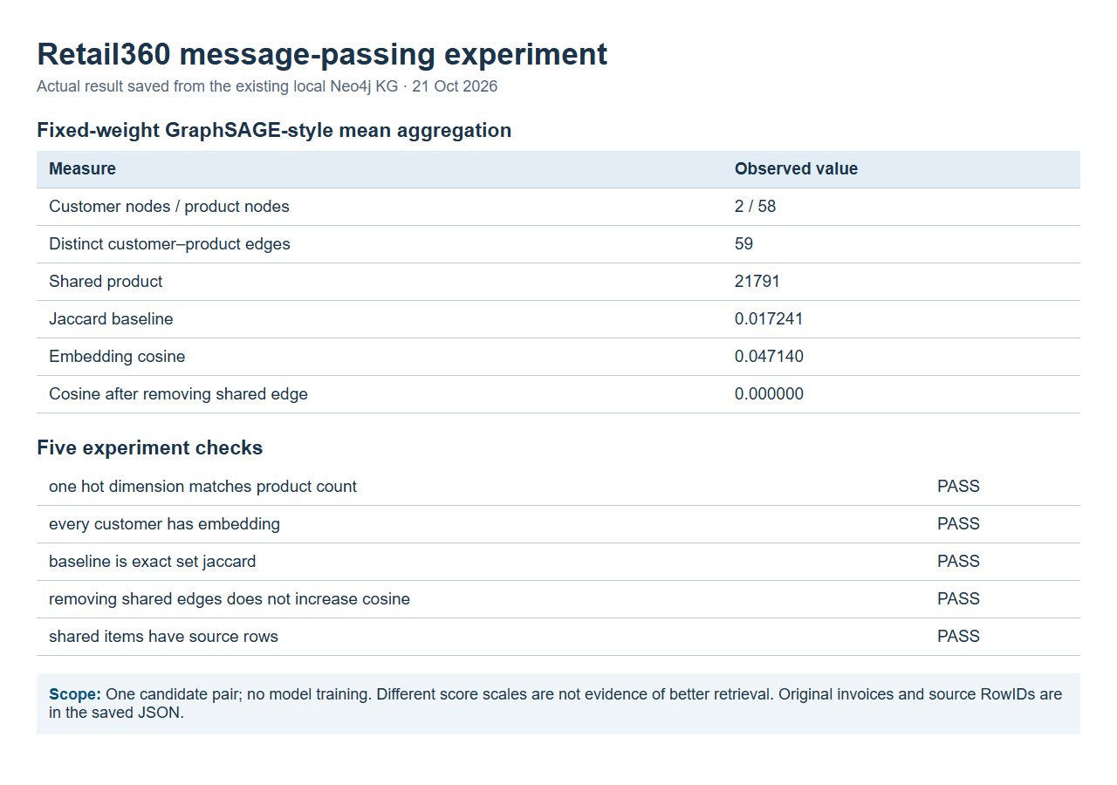
Hands-on result from the existing KG
Retail360 | CS 5588 Challenge 3 5/10
Notes:
Actual screenshot of a local results page generated from the saved, live Neo4j experiment output on 21 October 2026. It is an independent follow-up exercise, not a claim to reproduce materials from the October 20 class, which were not supplied in this chat. Script: challenge3/gnn_experiment.py. Results: challenge3/results/gnn_message_passing.json. Five checks passed. Only two customer nodes exist in this illustrative sample.

Slide 6
How embeddings would enter GraphRAG
Neo4j purchase
paths
GNN customer
embeddings
Rank customer
candidates
Cypher: invoices
+ source rows
Local LLM +
human review
Experiment implemented
Proposed next step
Neo4j paths → fixed-weight embeddings → one candidate score
Train on more customers and test ranking; keep Cypher evidence and existing grounded answer checks.
Retail360 | CS 5588 Challenge 3 6/10
Notes:
Existing GraphRAG code is challenge3/graphrag.py. The message-passing experiment currently stops at candidate scoring and source-row evidence. Full integration of learned embeddings into the live GraphRAG app has not been implemented. The diagram distinguishes observed and proposed stages.

Slide 7
Candidate ranking and edge-removal test
Only one candidate pair exists in this graph
Customer 12347 vs 13085
Shared products
1 of 58 unique products
Jaccard baseline
0.017241
Mean-embedding cosine
0.047140
Cosine after removing shared edge
0.000000
Different score scales cannot show which method retrieves better. The edge test only confirms the representation responds to observed links.
Retail360 | CS 5588 Challenge 3 7/10
Notes:
Observed results, not estimated scores. Jaccard is the existing exact set baseline. Cosine comes from fixed-weight mean product embeddings. Removing the only shared product edge from customer 13085 yields zero cosine. With one candidate pair, there is no meaningful Precision@K or recall test.

Slide 8
GraphRAG compared with the GNN experiment
Existing GraphRAG
GraphRAG + GNN exploration
Direct Cypher paths
Exact shared-product counts
Original invoice and RowID evidence
Local LLM selects evidence
Working local question-answering app
One-step product messages
Customer embedding cosine
Edge-removal sensitivity check
Candidate ranking design
No trained model or quality gain yet
Observation: embeddings react to links; source-backed Cypher remains necessary for explanation.
Retail360 | CS 5588 Challenge 3 8/10
Notes:
Do not interpret 0.047140 cosine exceeding 0.017241 Jaccard as an improvement: these metrics have different scales. The existing GraphRAG app worked last week; this new experiment is offline and is not yet a deployed or trained GNN-enhanced GraphRAG application.

Slide 9
Human–AI co-design and revision
Human goal
Codex suggestion
Review and change
Explain which customers share purchases and show the source records.
Try neighborhood aggregation and use embeddings to rank candidate customers.
The graph has only two customers. We used fixed weights, checked the shared edge, preserved provenance, and avoided a claim of better retrieval.
Result: a reproducible learning experiment with stated limits, rather than an unsupported performance claim.
Retail360 | CS 5588 Challenge 3 9/10
Notes:
Human design from previous work: customer similarity should be based on actual purchases and explainable source evidence. The user authorized a small experiment. Codex assisted with the Python implementation and slides. Review against the actual KG exposed a two-customer limitation, so the implementation uses a transparent aggregator, an ablation check, and explicit limitation text. The course handout itself is user-provided assignment material, not evidence that the October 20 exercise was completed.

Slide 10
Lessons and next steps
What we learned
For the October 26 report
A shared product sends a measurable message to both customer vectors. Removing that edge removes their overlap. Every shared item remains connected to source invoices.
Expand to more customers, train GraphSAGE with a temporal holdout, compare candidate retrieval against Jaccard, and then pass ranked candidates to the existing GraphRAG evidence pipeline.
Code and result: github.com/happylinfafa/retail360-challenge2/tree/main/challenge3
Retail360 | CS 5588 Challenge 3 10/10
Notes:
The proposed study requires more customers and a defensible target for retrieval quality. Candidate metrics could include Precision@K, Recall@K, and evidence coverage. A temporal split would avoid training on future purchases. The October 20 classroom handout was not provided here, so this independent experiment should be compared with any actual classroom exercise before submission.

