Slide 1


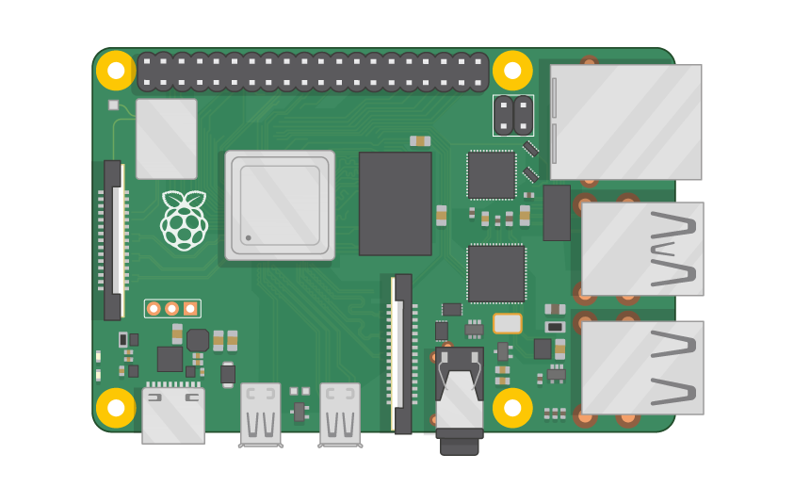
Raspberry Pi Master Class Day-3
Embedded System | Digital I/O

Slide 2
Table of Contents
01
02
03
04
Embedded system
Methodology
Overview
Analyzing sensor Modes
Digital I/O
Discussion & Q&A
Digital Input & Digital Output interface
Interractive session

Slide 3
PREREQUISITES FOR THIS COURSE
Raspberry Pi 3 Model b/B+
16 GB SanDisk class 10 SD Card
Card reader
Laptop with Internet
Power Adapter – 5V 2Amps
USB B-Type Cable
LED
Switch | IR sensor

Slide 4
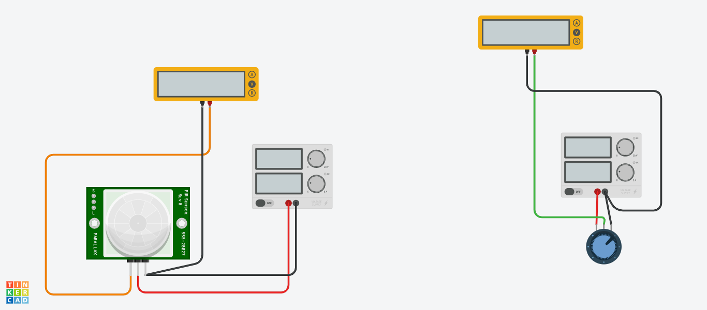
Analyzing Sensors…

Slide 5
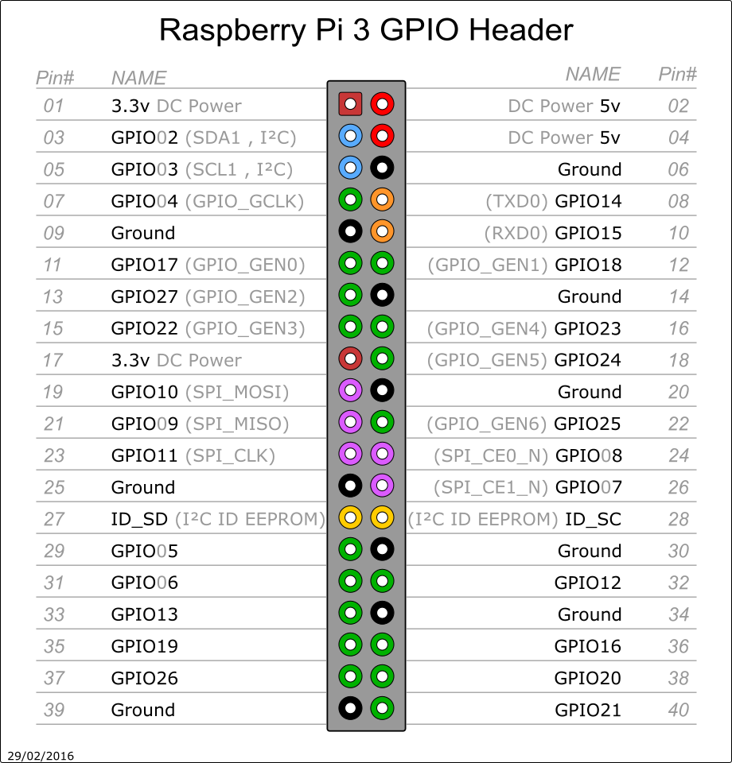
Pin Out of RPi3

Slide 6
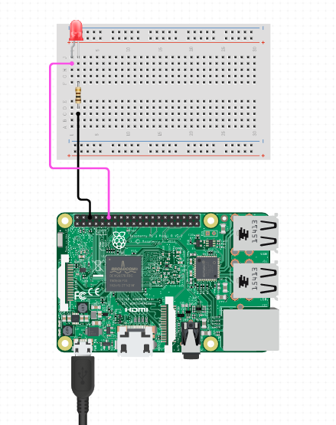
Digital Output –LED

Slide 7
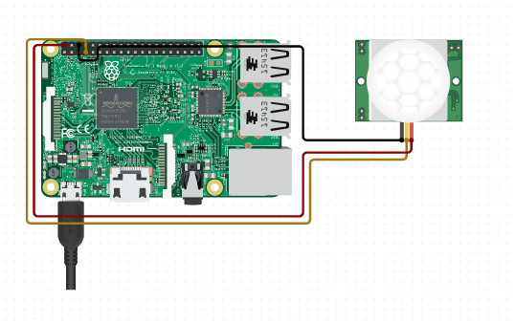
Digital Input - PIR

Slide 8
Informative
Interractive
Interesting
Daily Science Discussion
Question/Day
Discussion on Next Day
Learn Science !

Slide 9

Q2 – Discussion
Relative Motion
Speed of light is constant, nothing can execeed speed of light
Time is not absolute
Time will be different based on the observer
Theory of Relativity

Slide 10

Q3 – Discussion
Black Hole

Slide 11
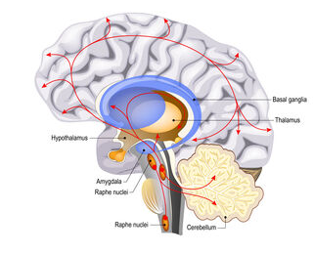
AI-Designed Serotonin Sensor May Help Scientists Study Sleep, Mental Health
Tech News - 3
Dec - 2020
Preclinical experiments showed that the sensor could detect subtle, real-time changes in brain serotonin levels.

Slide 12
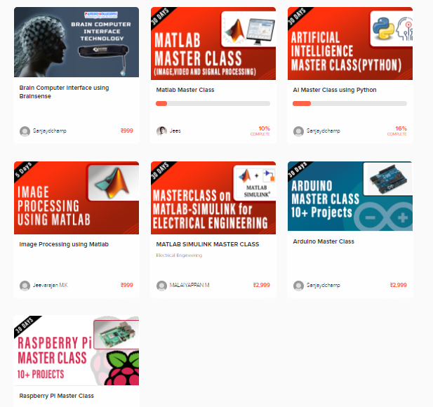
Thanks!
learn.pantechsolutions.net
www.pantechsolutions.net
“The important thing is to never stop questioning”
- Albert Einstein

