Slide 1


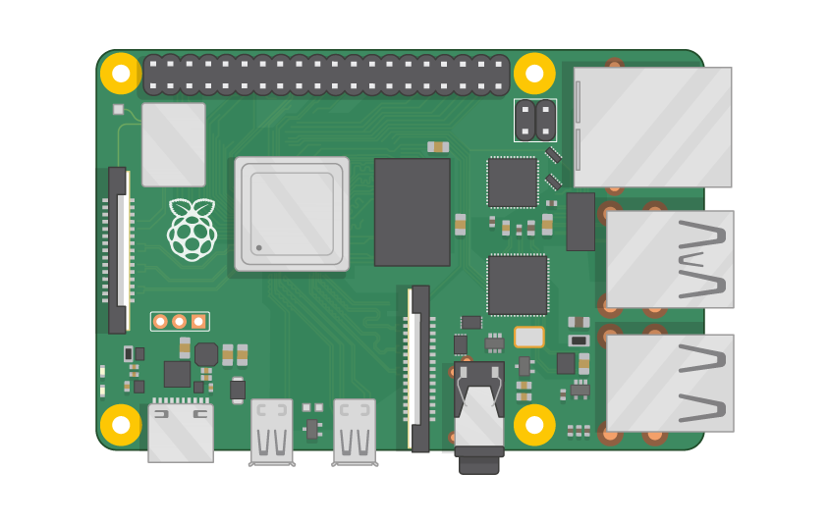
Raspberry Pi Master Class Day-2
Installing Operating System in RPi

Slide 2
Table of Contents
01
02
03
04
Rpi Operating System
How to Install OS
List of Operating System
Procedure to install OS in RPi
Startup with RPi
Discussion & Q&A
Starting with Raspbian
Interractive session

Slide 3
PREREQUISITES FOR THIS COURSE
Raspberry Pi 3 Model b/B+
16 GB SanDisk class 10 SD Card
Card reader
Laptop with Internet
Power Adapter – 5V 2Amps
USB B-Type Cable

Slide 4
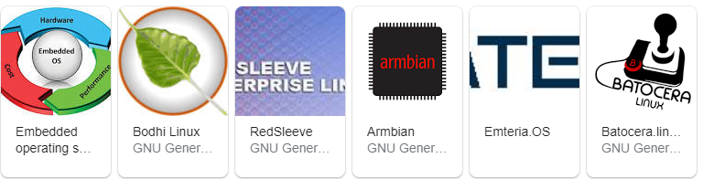
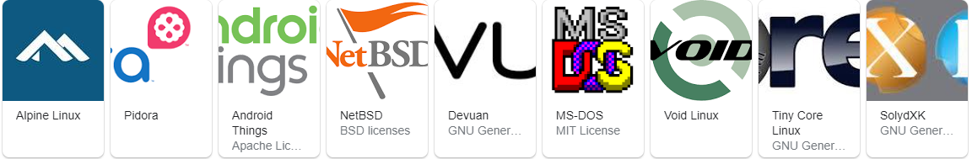
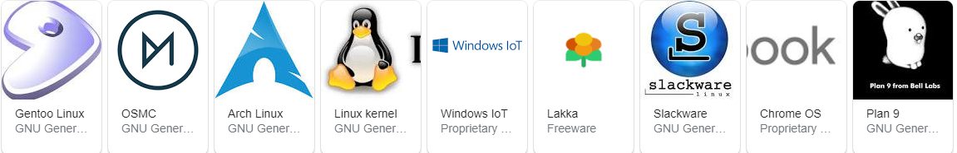
Raspberry Pi OS Version

Slide 5

Raspbian OS
Raspbian is a free operating system based on Debian optimized for the Raspberry Pi hardware.
An operating system is the set of basic programs and utilities that make your Raspberry Pi run.
However, Raspbian provides more than a pure OS: it comes with over 35,000 packages, pre-compiled software bundled in a nice format for easy installation on your Raspberry Pi.
The initial build of over 35,000 Raspbian packages, optimized for best performance on the Raspberry Pi, was completed in June of 2012.
However, Raspbian is still under active development with an emphasis on improving the stability and performance of as many Debian packages as possible.

Slide 6
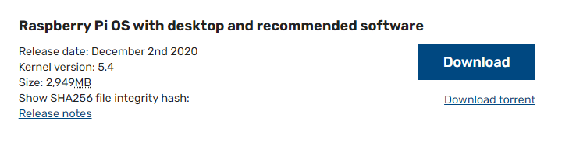
Download Raspbian…
https://www.raspberrypi.org/software/operating-systems/

Slide 7
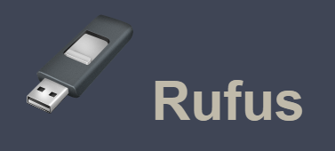
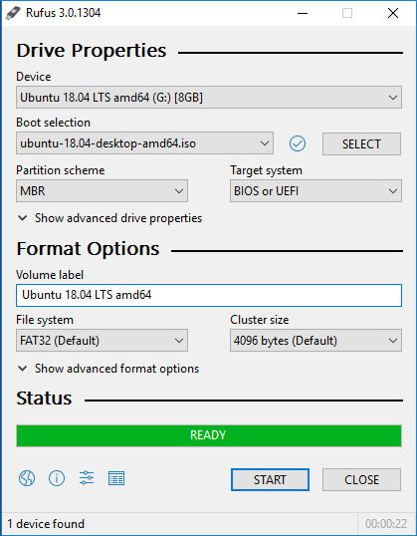
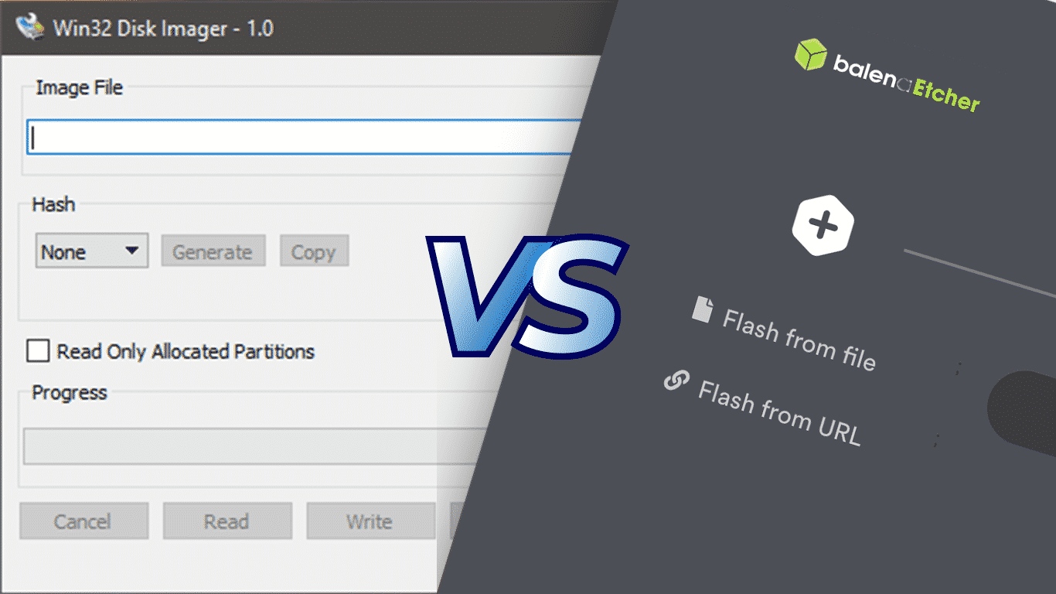
Software Required
RUFUS
Win32 disk Imager / Etcher

Slide 8
Installing Operating System
Download & Burn OS
1
3
Test with RPi
2
4
Format SDCard
Configuring Wifi info for Laptop access

Slide 9
Configuring WiFi…
Create File in root as wpa_supplicant.conf (Note: Without txt extension)
ctrl_interface=DIR=/var/run/wpa_supplicant GROUP=netdev
update_config=1
country=IN
network={
ssid="ZTE-adde78"
psk="885dfbad"
}
To Find COUNTRY CODE : https://en.wikipedia.org/wiki/ISO_3166-1

Slide 10
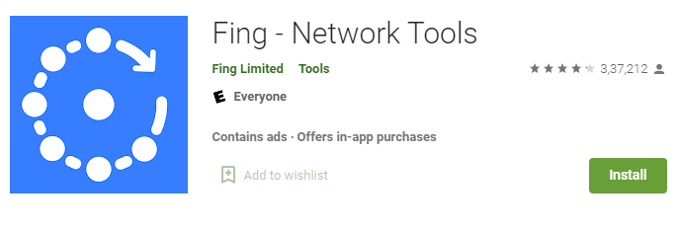
Configuring WiFi…
Create File in root as ssh (Note: Without txt extension)
Empty SSH File
Insert SD Card to Pi and Power UP
Open Fing to find IP Address of Pi
Ssh ipaddress in Putty or Terminal
Putty : https://www.chiark.greenend.org.uk/~sgtatham/putty/latest.html
username : pi
password : raspberry

Slide 11
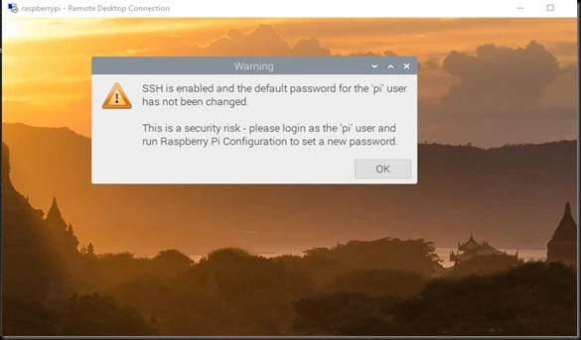
Installing XRDP
sudo apt-get install xrdp
Open Remote desktop
Enter Ipaddress
Enter Username & Password

Slide 12

Installing Python3 Idle
sudo apt-get install idle3
OpenTerminal
Enter above command

Slide 13
Informative
Interractive
Interesting
Daily Science Discussion
Question/Day
Discussion on Next Day
Learn Science !

Slide 14

Q1 – Discussion
Photographic Memory
Alternating-current (AC)
Hydroelectric Power Plant
Tesla Coil
He wanted to illuminate the entire earth
Wireless transmission of power
Who invented Radio???????????
Nikola Tesla

Slide 15

Q2 – Discussion
Theory of Relativity

Slide 16

Thanks!
learn.pantechsolutions.net
www.pantechsolutions.net
“BE ALONE, THAT IS THE SECRET OF INVENTION; BE ALONE, THAT IS WHEN IDEAS ARE BORN.”

