Slide 1


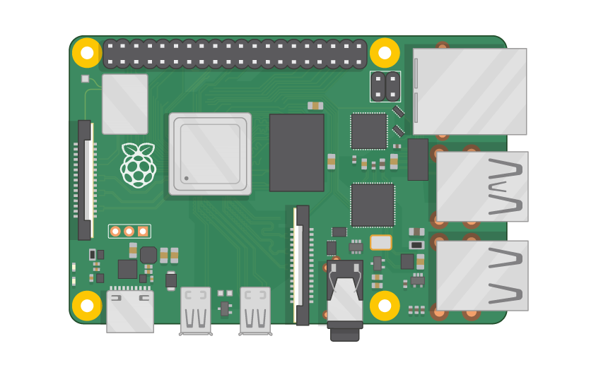
Raspberry Pi Master Class Day-1
Overview about Raspberry Pi

Slide 2
Table of Contents
01
02
03
04
Course Overview
Raspberry Pi
What you will learn? | Why You need to learn?
What | Why | Where
Applications
Discussion & Q&A
AI | Vision | Embedded
Interractive session

Slide 3
About Pantech
Profile
R & D
Training
2000+ Workshops | 250+ FDP | 100+ Seminars
Manufacturer of Lab equipment‘s & Development boards | Industrial & Funded projects | Online retail store of engineering products and projects
Established on 2004 | 7 Branches | 100+ Team | Manufacturer of Lab equipment, Engineering Kits, Components, Sensors and All level Projects

Slide 4

About me
AI BOARDS: NVidia Jetson Boards, Beagle bone, PYNQ FPGA, Google coral, Raspberry Pi TECHNOLOGY: AI, Brain Computer Interface(BCI), Robotic Operating System(ROS), IoT, Autonomous Robot design PROGRAMMING: Python, Matlab, C MICROCONTROLLER: 8051, MSP430, Arduino

Slide 5
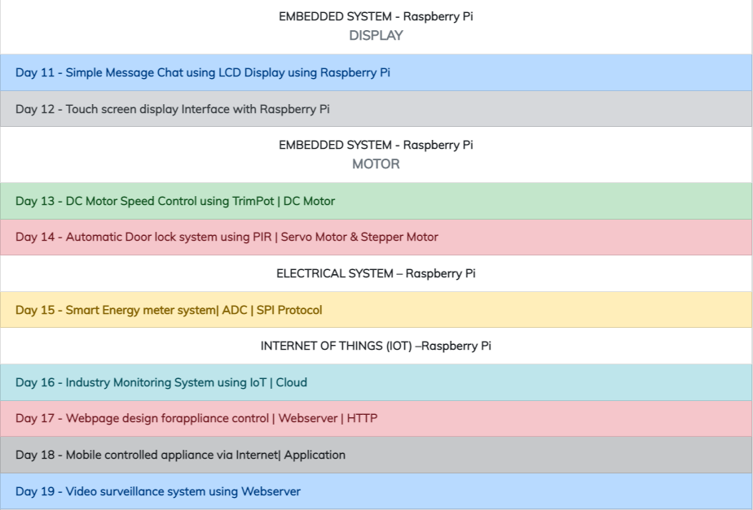
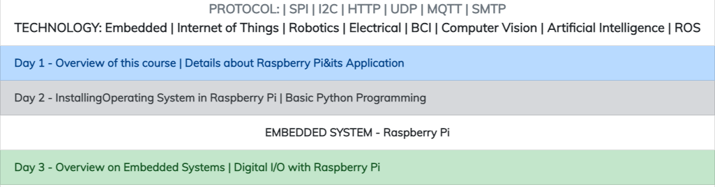
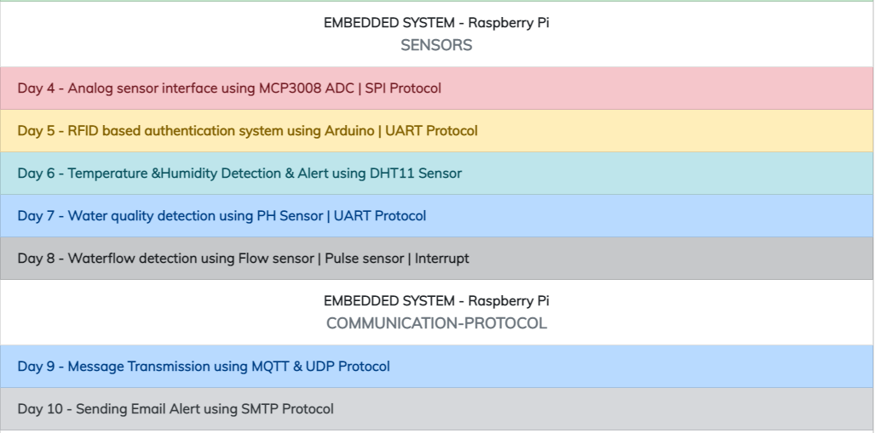
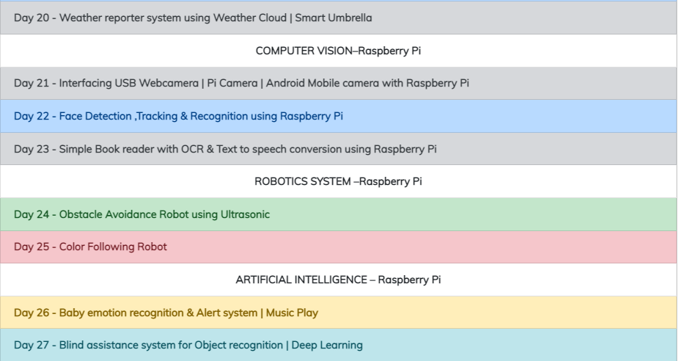
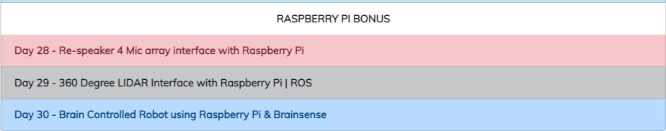
What you will learn

Slide 6
PREREQUISITES FOR THIS COURSE
Raspberry Pi 3 Model b/B+
16 GB SanDisk class 10 SD Card
Card reader
Laptop with Internet
Power Adapter – 5V 2Amps
USB B-Type Cable

Slide 7
Overview about Raspberry Pi
The Raspberry Pi is a very cheap computer that runs Linux, but it also provides a set of GPIO (general purpose input/output) pins that allow you to control electronic components for physical computing and explore the Internet of Things (IoT).

Slide 8
Specification
Broadcom BCM2837B0, Cortex-A53 (ARMv8) 64-bit SoC @ 1.4GHz
1GB LPDDR2 SDRAM
2.4GHz and 5GHz IEEE 802.11.b/g/n/ac wireless LAN, Bluetooth 4.2, BLE
Gigabit Ethernet over USB 2.0 (maximum throughput 300 Mbps)
Extended 40-pin GPIO header
Full-size HDMI
4 USB 2.0 ports
CSI camera port for connecting a Raspberry Pi camera
DSI display port for connecting a Raspberry Pi touchscreen display
4-pole stereo output and composite video port
Micro SD port for loading your operating system and storing data
5V/2.5A DC power input
Power-over-Ethernet (PoE) support (requires separate PoE HAT)

Slide 9
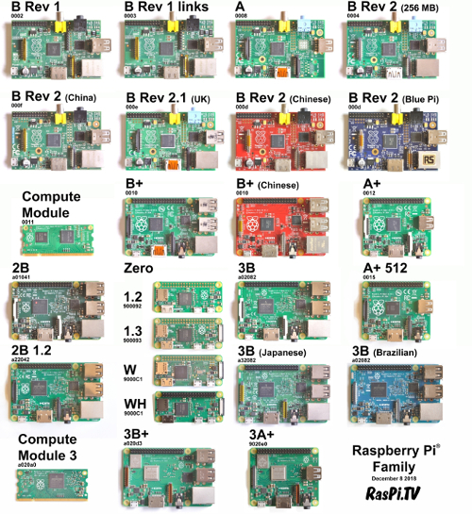
Raspberry Pi Version

Slide 10
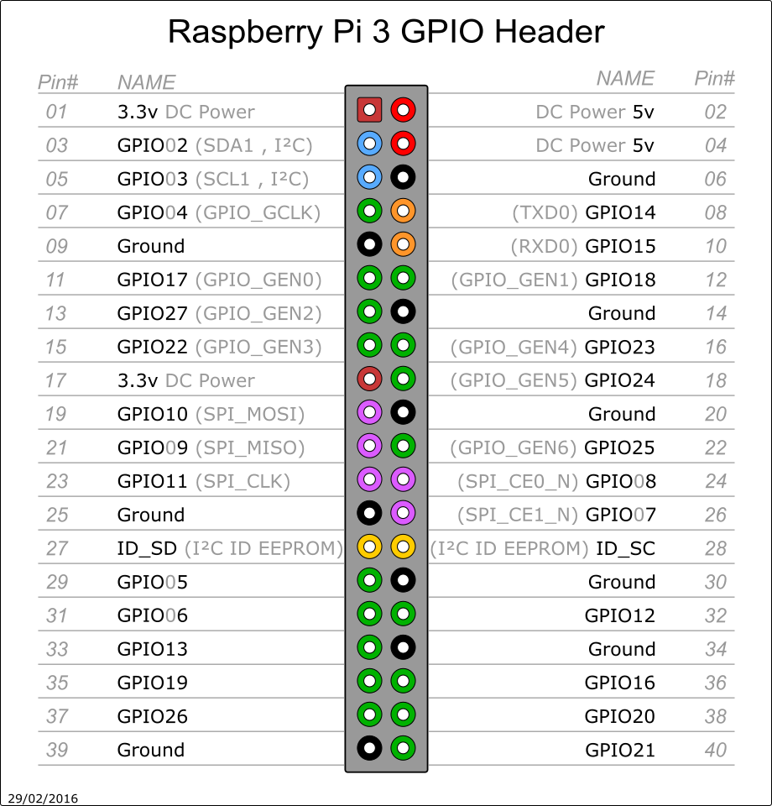
Pin Out of RPi3

Slide 11
Applications of RPi
Interconnecting applications with Internet
Deploying AI in Hardware
1
IoT
3
AI
Embedded
2
Vision
4
Sensor & Other Modules
Giving eyes for Robots

Slide 12

Tiny Story about Rpi Application

Slide 13
Rs. 36,000 | $489
X
EYE CHART DISPLAY IN HOSPITAL
Rs. 18,000 | $244

Slide 14
Informative
Interractive
Interesting
Daily Science Discussion
Question/Day
Discussion on Next Day
Learn Science !

Slide 15

Q1 – About Him
Clue: Electricity

Slide 16
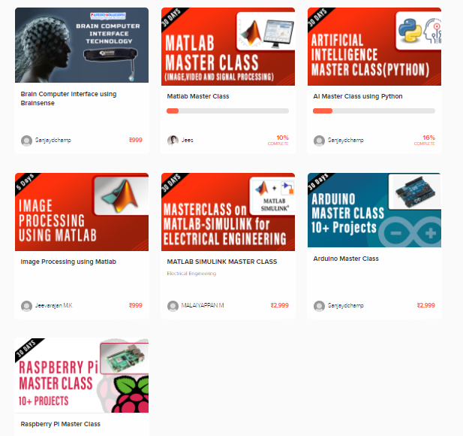
Thanks!
learn.pantechsolutions.net
www.pantechsolutions.net
WORK HARD
IN SILENCE;
LET SUCCESS
MAKE THE NOISE

