Slide 1


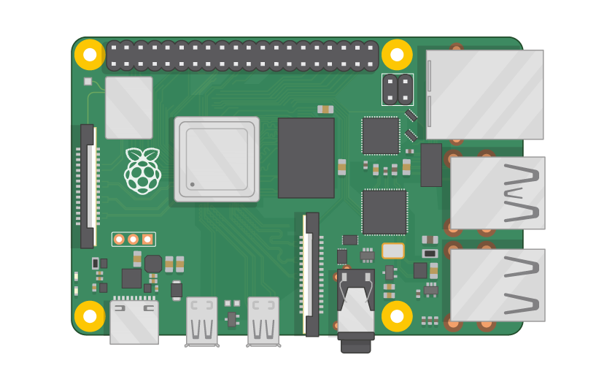
Raspberry Pi Master Class Day-10
Smart Energy meter system

Slide 2
Table of Contents
01
02
03
04
Circuit Design
Voltage & Current Calculation
Overview
Calculation
Smart Energy meter system
Discussion,Q&A & Tech News
Practical session
Interractive session

Slide 3
PREREQUISITES FOR THIS COURSE
Raspberry Pi 3 Model b/B+
16 GB SanDisk class 10 SD Card
Card reader
Laptop with Internet
Power Adapter – 5V 2Amps
USB B-Type Cable
MCP3008 IC
Potential Transformer
Current Transformer
Signal Conditioning Circuit
2 Load
Switch

Slide 4
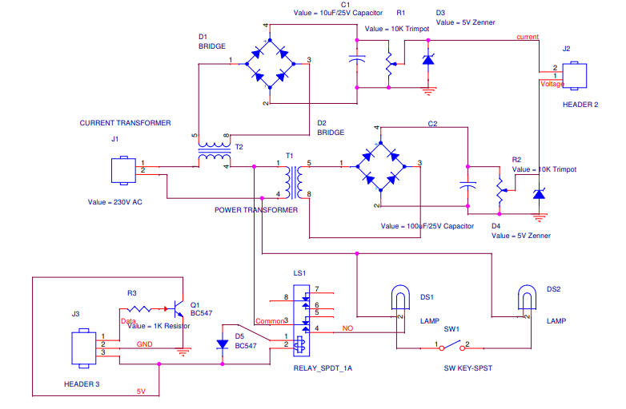
Circuit Design…

Slide 5
Calculations…
Voltmeter measured voltage across diode = 2.26
Voltmeter measured Voltage on line = 238
ADC: 5V = 1023
1V = 1023/5
1V=204
Calc.ADC Voltage = 2.26*204
Calc. ADC Voltage = 462
Scaling:
ACVoltage = Calc.Voltage/X;
X=calc.adcvoltage/Acvoltage
X=462/238=1.94
Ammeter measured voltage across diode = 0.23
Ammeter measured Voltage on line = 0.23
ADC: 5V = 1023
1V = 1023/5
1V=204
Calc.ADCVoltage = 0.23*204
Calc.ADCVoltage= 46
Scaling:
ACVoltage = Calc.ADCVoltage/X;
X=Calc.ADCVoltage/Acvoltage
X=46/0.23=200

Slide 6
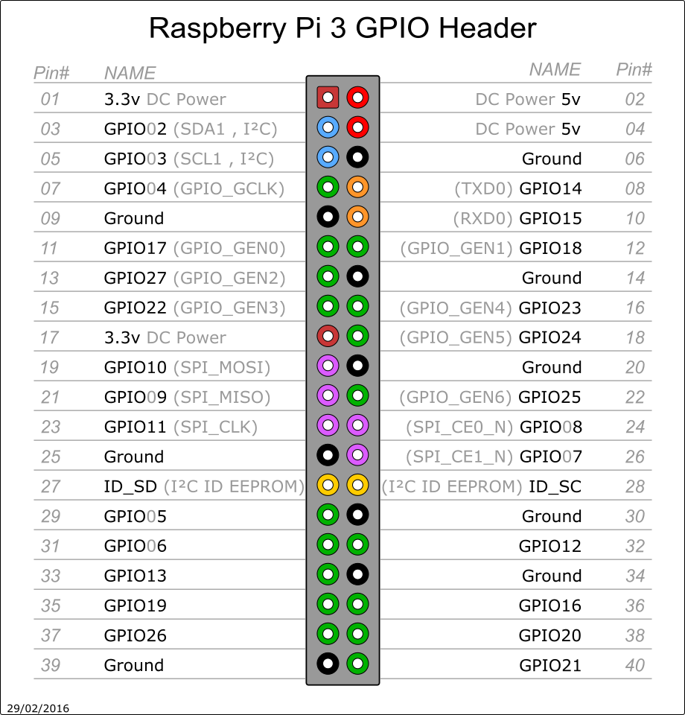
Pin Out of RPi3

Slide 7



Calculation…

Slide 8
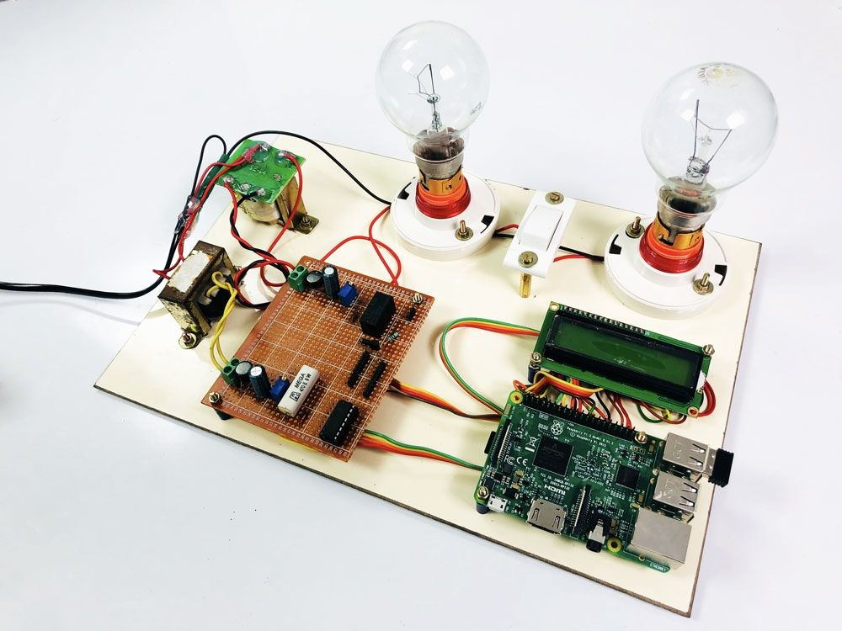
Hardware

Slide 9
Final Year - Project
Source code for Prepaid Energy Meter Project
Source code for Power Theft Identification
BONUS- Intern Participants

Slide 10

Q10 – Discussion
Artificial Intelligence

Slide 11
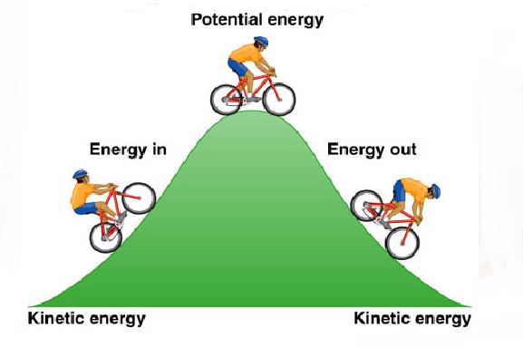
Q11 – Discussion
Kinetic vs Potential Energy

Slide 12
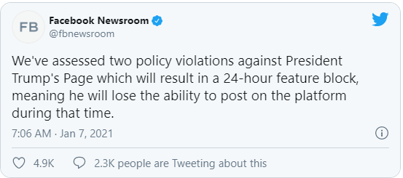
Twitter says Trump’s account is locked, and he’s facing a ban
Tech News - 10
Jan - 2021
Facebook and Instagram ban Trump for 24 hours
Facebook removed a video posted hours after the attack began where Trump called on protestors to “go home” and stated falsely that “we had an election that was stolen from us.” The company also removed a text post asking his supporters to “remember this day forever!”
Twitter has also restricted Trump on its platform, locking his account for 12 hours after removing three tweets that the company said were “severe violations” of its policies.

Slide 13

Thanks!
learn.pantechsolutions.net
www.pantechsolutions.net
“We cannot solve problems with the same thinking we used to create them.”-Albert Einstein

