Slide 1



Raspberry Pi Master Class Day-11
Weather reporter system using weather cloud

Slide 2
Table of Contents
01
02
03
04
Weather Clouds
Text to Speech
Overview
Practical session
Weather reporter
Discussion, Tech news & Q&A
Practical session
Interractive session

Slide 3
PREREQUISITES FOR THIS COURSE
Raspberry Pi 3 Model b/B+
16 GB SanDisk class 10 SD Card
Card reader
Laptop with Internet
Power Adapter – 5V 2Amps
USB B-Type Cable
Laptop Speaker/Headphones

Slide 4

Weather Cloud…
Openweather NWP (numerical weather prediction) allows to calculate weather data for any location. We use proprietary convolutional neural network that collects and processes wide range of data sources to cover any location and consider the local nuances of climate.
ML technology allows us to reach resolution about 500 m and very high accuracy between 90% and 100% with inaccuracy about 1%. Amongst data sources we feed to the NWP are 82,000 weather stations spread globally; national meteorological agencies (NOAA, Environment Canada, Met Office, etc.), radars, weather satellites.

Slide 5
Openweather API
Creating account in OpenWeather
Get API Key

Slide 6
Text to Speech Configuration…
Enabling 3.5mm Audio Jack in Rpi
Installing Libraries…
Sudo apt-get install espeak
Ctrl+Alt+Space

Slide 7
To turn of Narrator
killall orca
or
sudo apt-get remove orca
sudo apt-get remove gnome-orca
killall orca

Slide 8
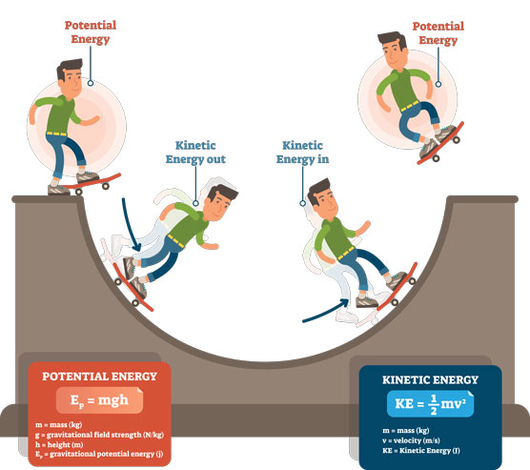
Q11 – Discussion
Kinetic energy is the kind of energy present in a body due to the property of its motion
Potential Energy is the type of energy present in a
body due to the property of its state
It can be easily transferred from one body to another
It is not transferable
Flowing water is one of the examples for kinetic energy
Water present at the top of a hill is an example of
potential energy
Kinetic vs. Potential Energy

Slide 9
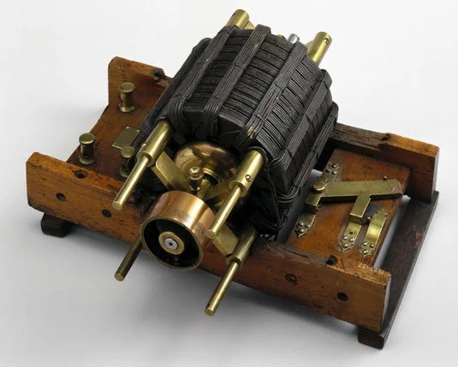
Q12 – Discussion
More about Motors

Slide 10
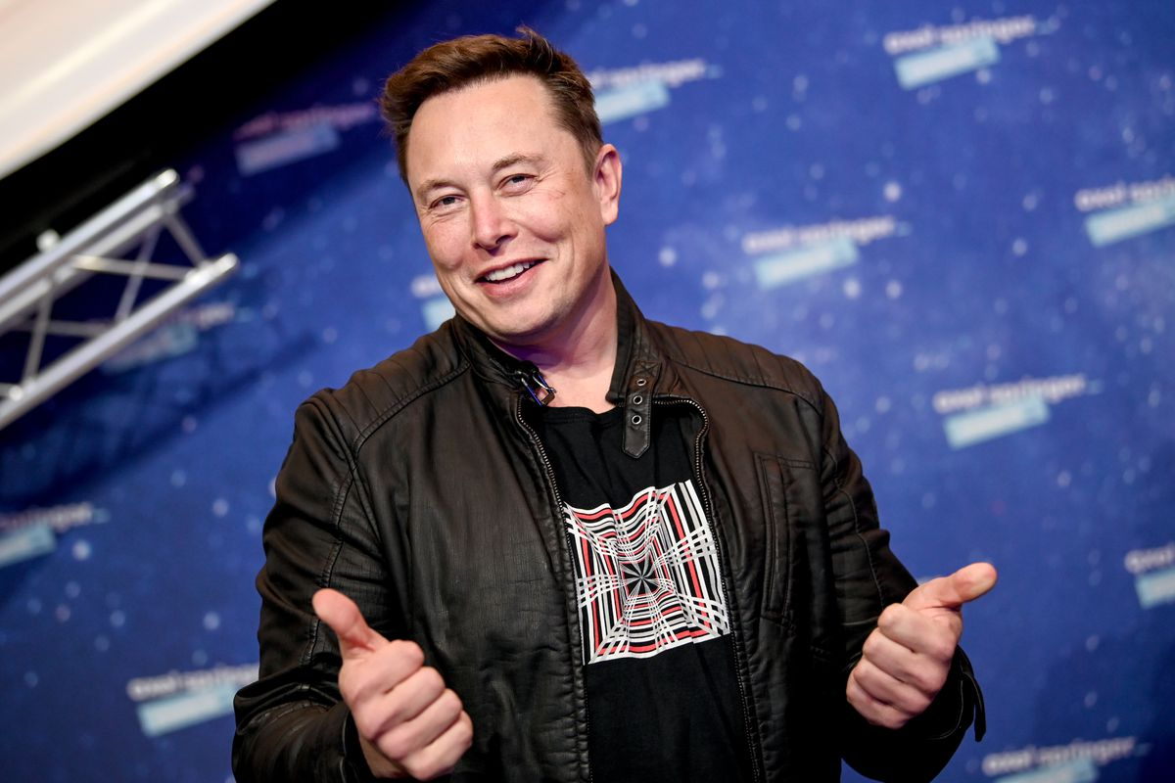
Elon Musk passes Jeff Bezos to become the richest person on Earth
Tech News - 11
Jan - 2021
Elon Musk has become the wealthiest person on the planet, surpassing Amazon CEO Jeff Bezos, thanks to the continued rise in Tesla’s stock price. Musk is now worth around $188 billion, according to Bloomberg’s Billionaires Index.

Slide 11

Thanks!
learn.pantechsolutions.net
www.pantechsolutions.net
“Quiet People have the loudest Minds”
-Stephen Hawking

