Slide 1


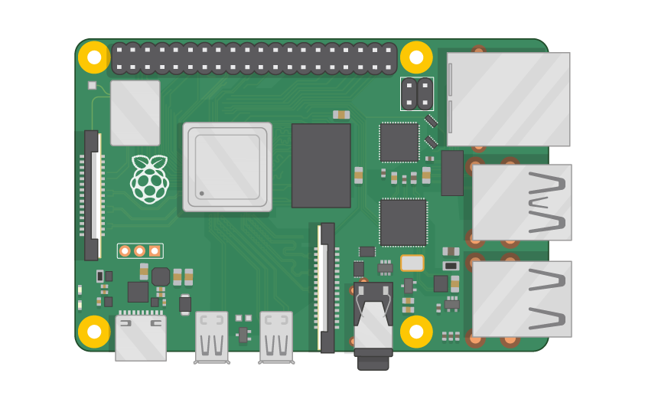
Raspberry Pi Master Class Day-12
Camera Interface – USB | Mobile | Pi Cam

Slide 2
Table of Contents
01
02
03
04
Camera with RPi
USB | Mobile | Pi Camera
Overview
Practical session
Application
Discussion, Tech news & Q&A
Theoretical session
Interractive session

Slide 3
PREREQUISITES FOR THIS COURSE
Raspberry Pi 3 Model b/B+
16 GB SanDisk class 10 SD Card
Card reader
Laptop with Internet
Power Adapter – 5V 2Amps
USB B-Type Cable
USB Camera
Pi Camera
Android Mobile

Slide 4
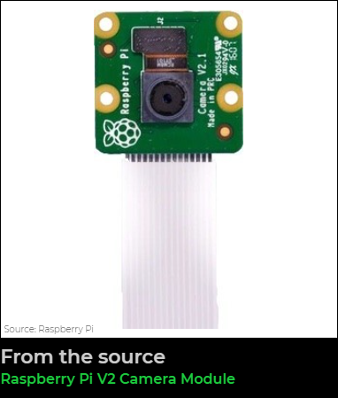
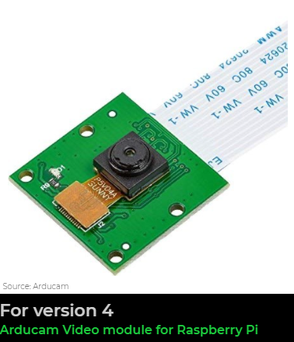
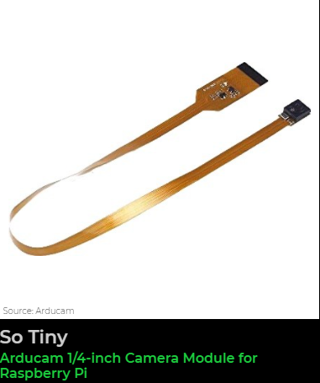
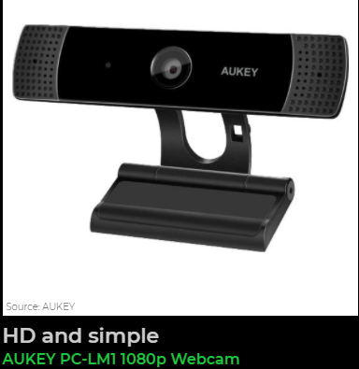
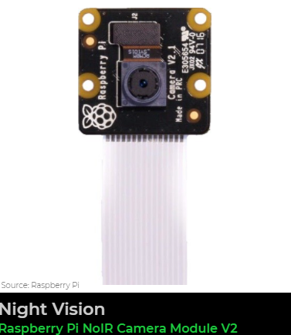
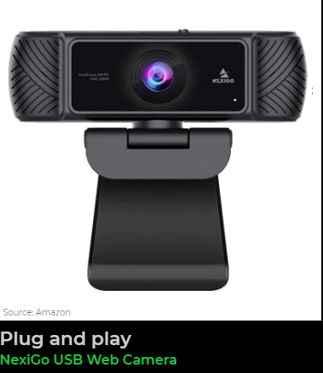
Camera with Rpi…

Slide 5
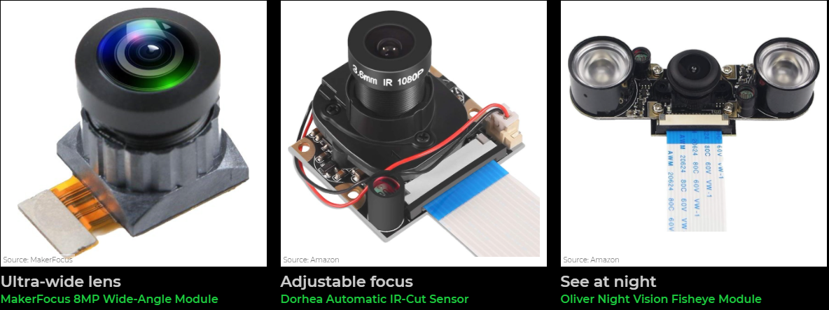
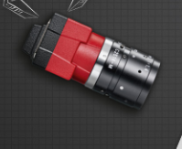
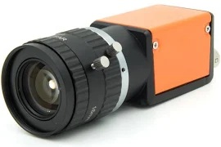
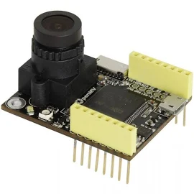
Camera with Rpi…

Slide 6
Camera Interface…
USB Camera
Mobile camera – IP Camera
Pi Camera

Slide 7
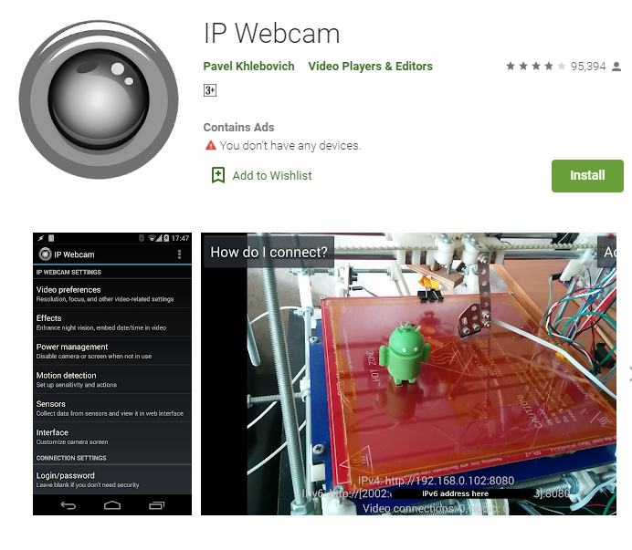
Mobile Camera IP Cam…

Slide 8
Pi Camera…
Enable Camera in Configuration
Capture Image - raspistill -o Desktop/image.jpg
Height Width - raspistill -o Desktop/image-small.jpg -w 640 -h 480
Record Video - raspivid -o Desktop/video.h264

Slide 9
Installing Computer Vision...
\sudo pip3 install opencv-python
\
sudo pip3 install opencv-contrib-python

Slide 10
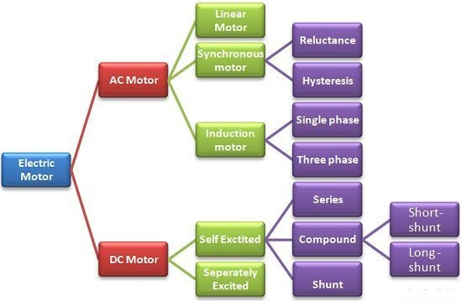
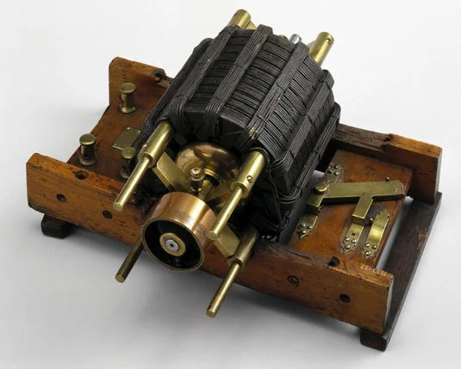
Q12 – Discussion
Motor

Slide 11
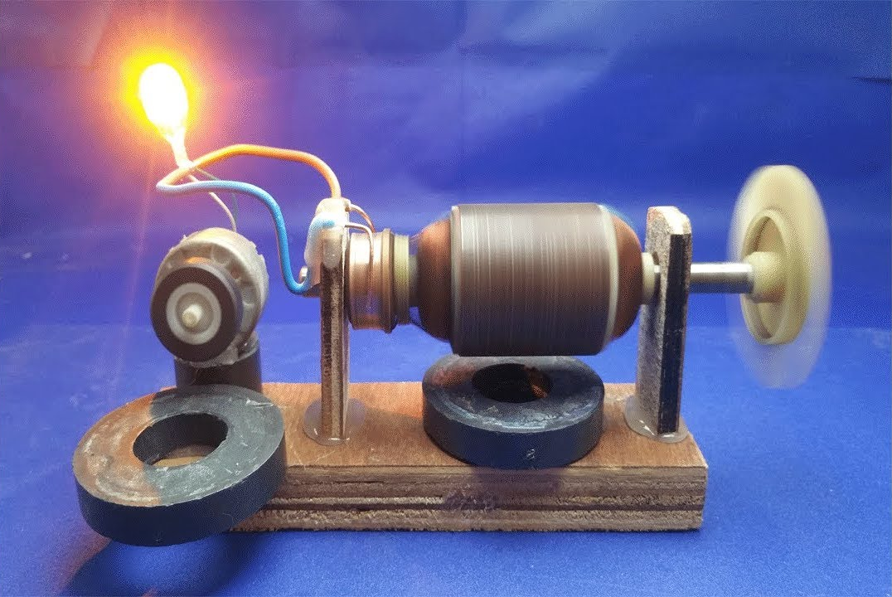
Q12 – Discussion
Generators & Dynamos

Slide 12
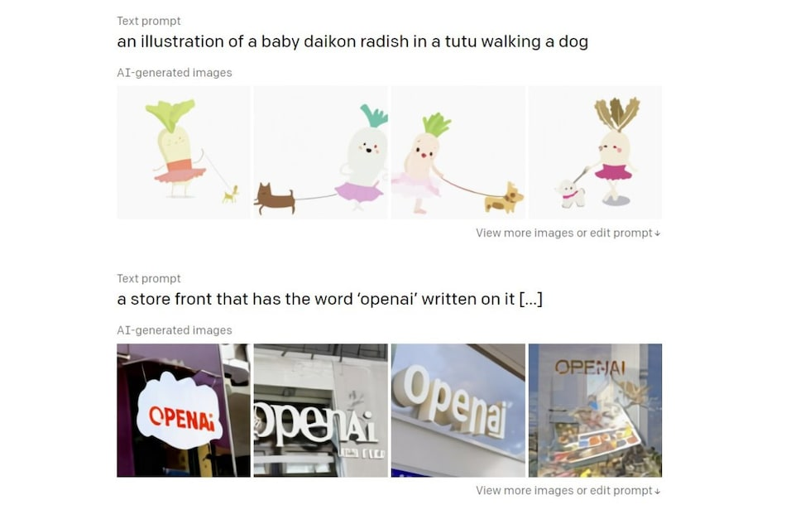
OpenAI Unveils DALL·E and CLIP AI Models That Create and Classify Images
Tech News - 12
Jan - 2021
DALL·E can create images from quirky text descriptions, such as ‘an illustration of a baby daikon radish in a tutu walking a dog’. .

Slide 13
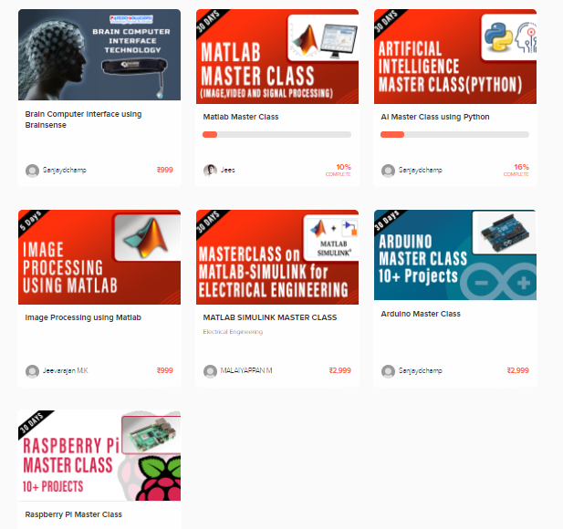
Thanks!
learn.pantechsolutions.net
www.pantechsolutions.net
“the NITROGEN in our DNA
the CALCIUM in our TEETH
the IRON in our BLOOD
the CARBON u know
we are made of STAR STUFF”
-Carl Sagan

