Slide 1


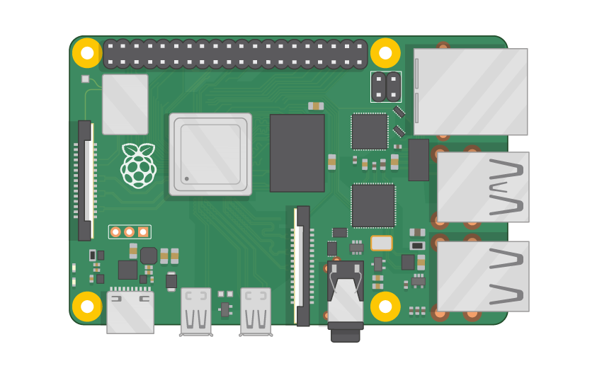
Raspberry Pi Master Class Day-13
Obstacle avoidance Robot

Slide 2
Table of Contents
01
02
03
04
Ultrasound
Distance measurement
Overview
Practical session
Obstacle avoidance Robot
Discussion, Tech news & Q&A
Practical session
Interractive session

Slide 3
PREREQUISITES FOR THIS COURSE
Raspberry Pi 3 Model b/B+
16 GB SanDisk class 10 SD Card
Card reader
Laptop with Internet
Power Adapter – 5V 2Amps
USB B-Type Cable
Robot Kit
Motor Driver
Battery
Ultrasonic

Slide 4
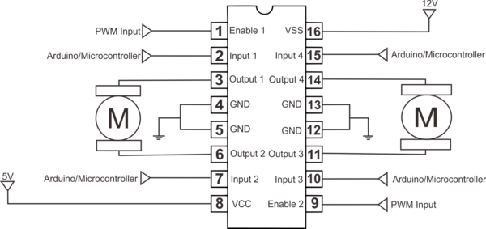
L293D Driver…

Slide 5
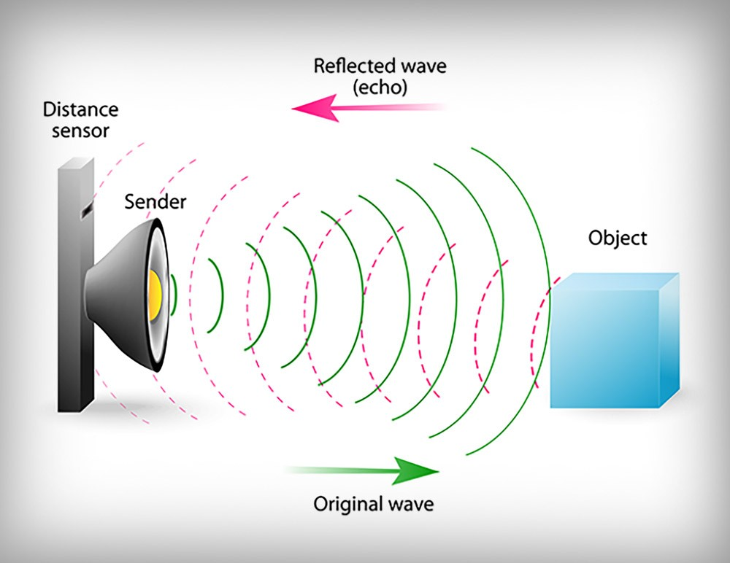
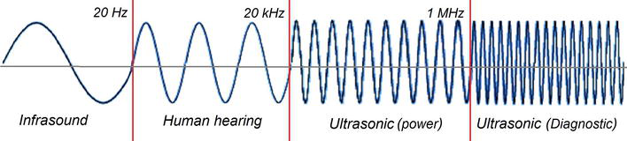
Ultrasonic…
Ultrasound is sound waves with frequencies higher than the upper audible limit of human hearing. Ultrasound is not different from "normal" sound in its physical properties, except that humans cannot hear it.

Slide 6
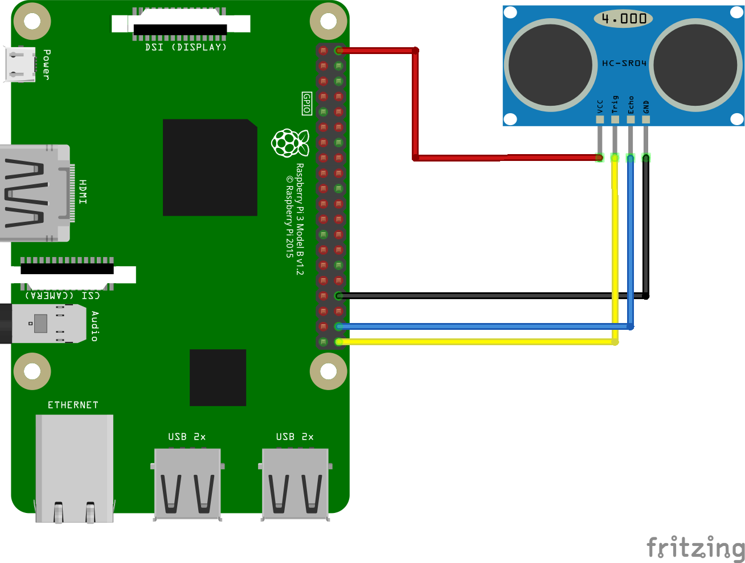
Ultrasonic Rpi….

Slide 7
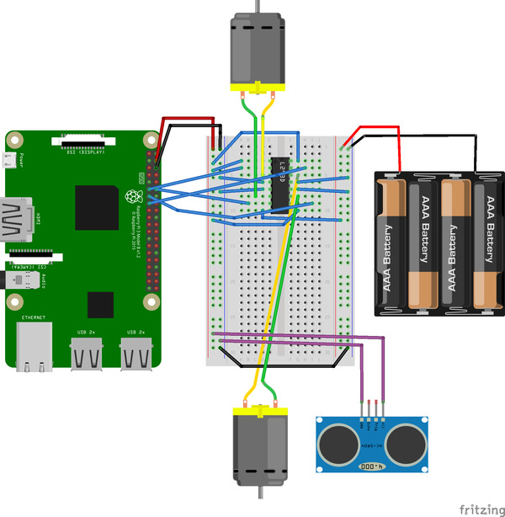
Obstacle avoidance Robot

Slide 8
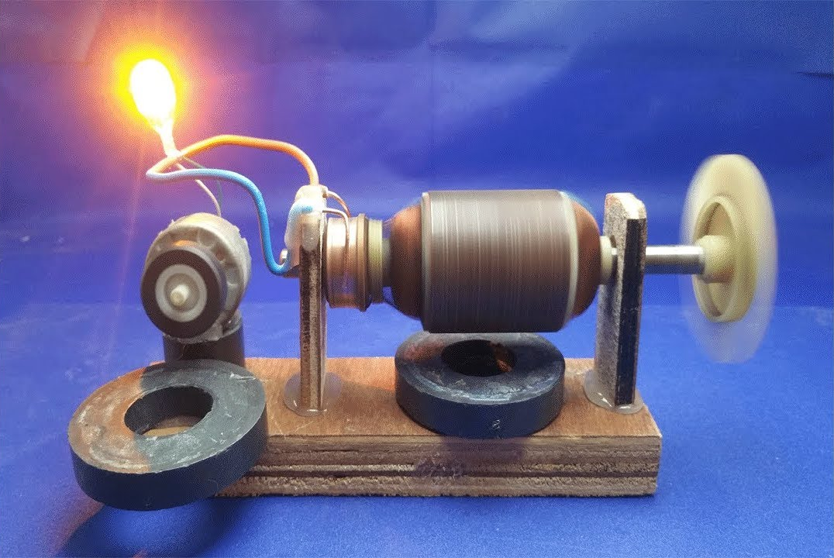
Q13 – Discussion
Generators & Dynamos

Slide 9
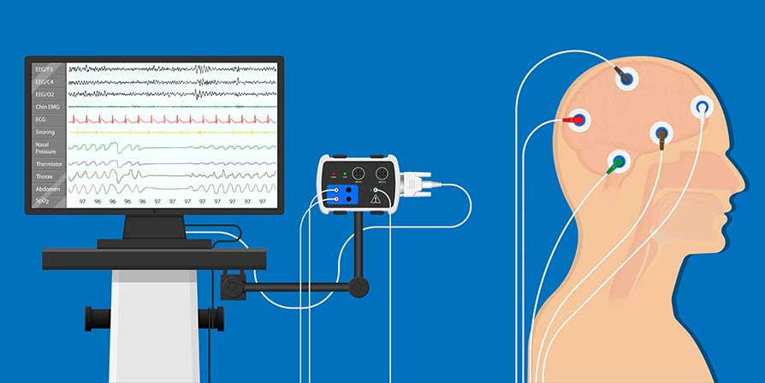
Q14 – Discussion
Brain Computer Interface

Slide 10

WhatsApp's new privacy policy, terms of service update to share your data with Facebook
Tech News - 13
Jan - 2021
As WhatsApp has updated its terms of service and privacy policy, the instant messaging app will now share its user data with its parent firm Facebook. Users will have to accept these terms by 8 February next month in order to continue using the Facebook-owned messaging platform.

Slide 11

Thanks!
learn.pantechsolutions.net
www.pantechsolutions.net
“Nothing in life is to be feared, it is only to be understood. Now is the time to understand more, so that we may fear less.”
-Marie Curie

