Slide 1


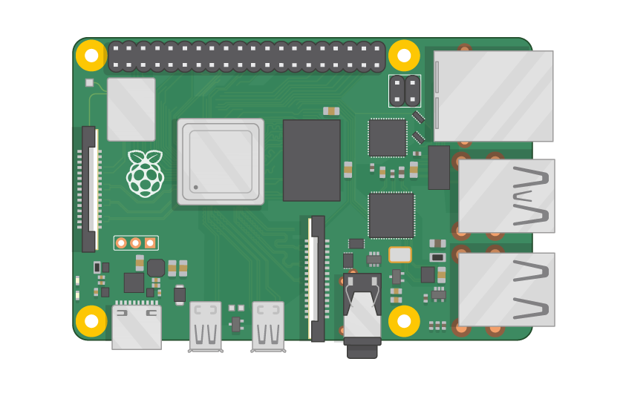
Raspberry Pi Master Class Day-28
Blind assistance system

Slide 2
Table of Contents
01
02
03
04
Robotic Operating System
ROS System components & Tools
Overview
Practical session
Interface Lidar with Rpi, Mapping
Discussion, Tech news & Q&A
Practical session
Interractive session

Slide 3
PREREQUISITES FOR THIS COURSE
Raspberry Pi 3 Model b/B+
16 GB SanDisk class 10 SD Card
Card reader
Laptop with Internet
Power Adapter – 5V 2Amps
USB B-Type Cable
USB Camera
Speaker

Slide 4
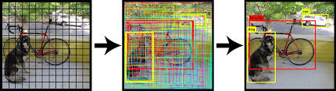
Object Recognition.
Object recognition is a computer vision technique for identifying objects in images or videos. Object recognition is a key output of deep learning and machine learning algorithms. When humans look at a photograph or watch a video, we can readily spot people, objects, scenes, and visual details.

Slide 5
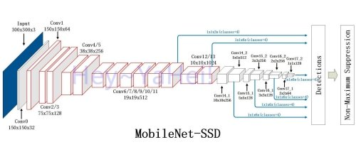
MobileNet SSD Architecture…

Slide 6
DEMO Session

Slide 7
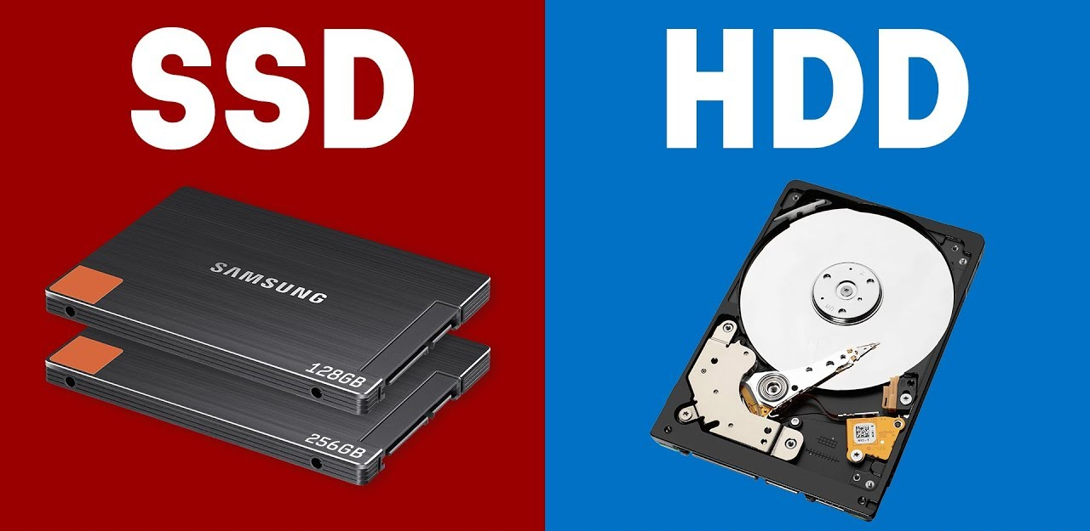
Q28 – Discussion
SSD vs HDD

Slide 8
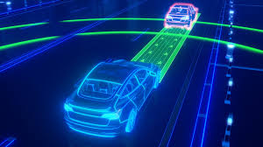
Q29 – Discussion
Autonomous Car

Slide 9
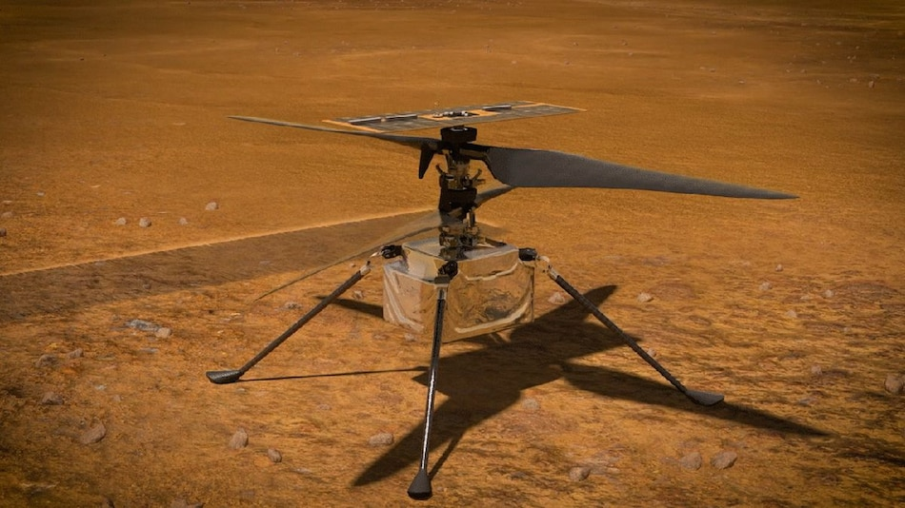
NASA Wants to Fly Ingenuity Helicopter on Mars for the First Time
Tech News - 28
2021
It might be called a helicopter, but in appearance it's closer to mini-drones we've grown accustomed to seeing in recent years.

Slide 10
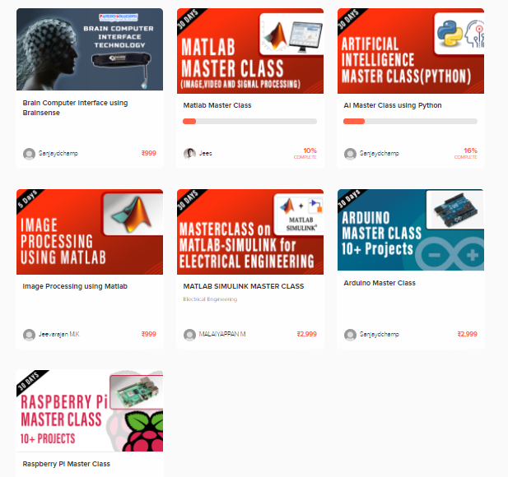
Thanks!
learn.pantechsolutions.net
www.pantechsolutions.net
“Impossible only means that you haven’t found the solution yet.”

