Slide 1

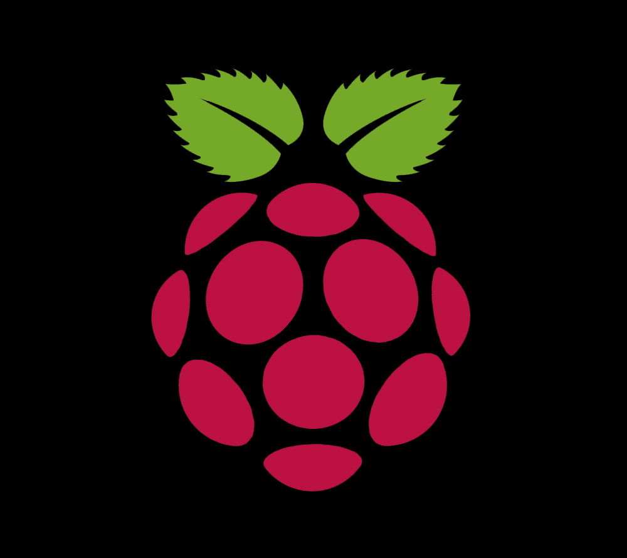
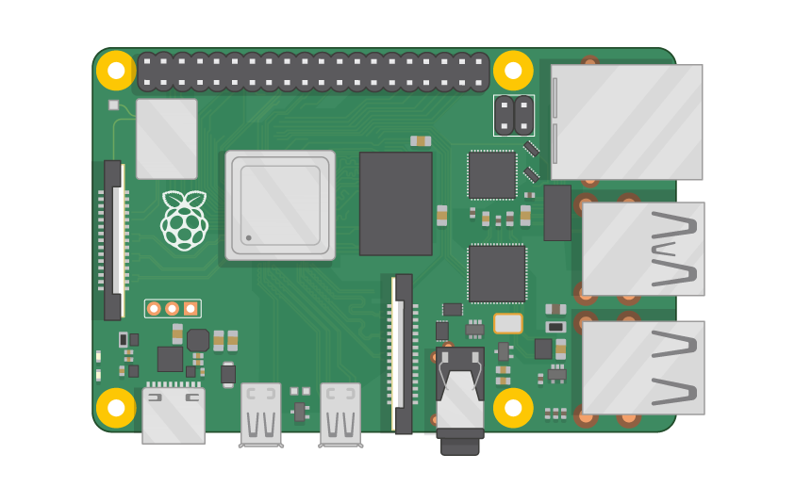
Raspberry Pi Master Class Day-29
LIDAR Interface with Rpi using ROS

Slide 2
Table of Contents
01
02
03
04
Robotic Operating System
ROS System components & Tools
Overview
Practical session
Interface Lidar with Rpi, Mapping
Discussion, Tech news & Q&A
Practical session
Interractive session

Slide 3
PREREQUISITES FOR THIS COURSE
Raspberry Pi 3 Model b/B+
16 GB SanDisk class 10 SD Card
Card reader
Laptop with Internet
Power Adapter – 5V 2Amps
USB B-Type Cable
Rplidar A1
USB B-type cable

Slide 4
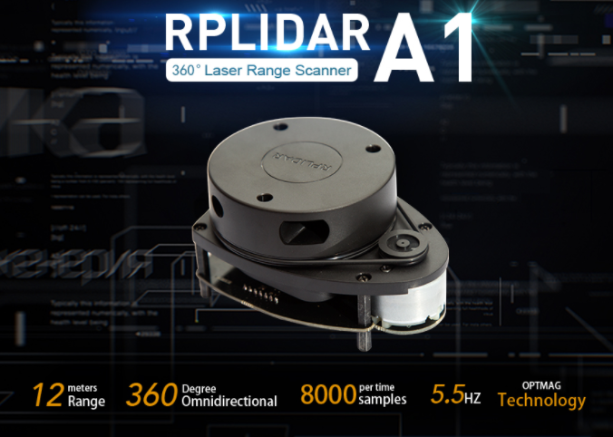
LIDAR
Light Detection and Ranging
It is a remote sensing method used to examine the surface of the Earth.
It is a remote sensing method that uses light in the form of a pulsed laser to measure ranges (variable distances) to the Earth.

Slide 5
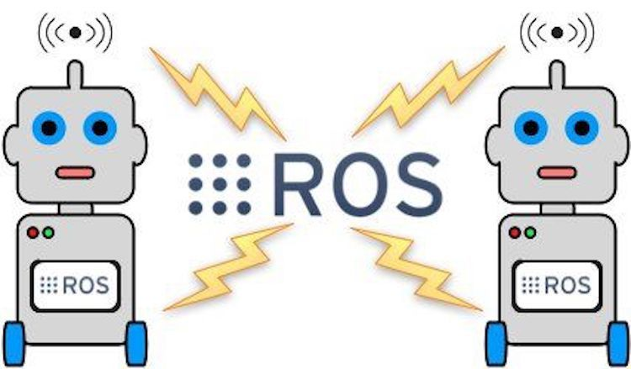
Robotic Operating System…
The Robot Operating System (ROS) is not an actual operating system, but a framework and set of tools that provide functionality of an operating system on a heterogeneous computer cluster.
Its usefulness is not limited to robots, but the majority of tools provided are focused on working with peripheral hardware.

Slide 6
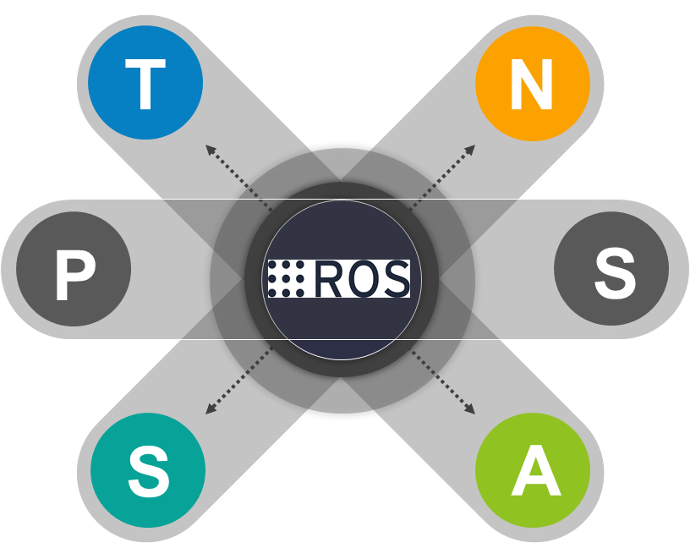
ROS System components
NODE
NODE
TOPIC
An executable file within the ROS system to allow communication among another node.
The publishing and subscribing of a message of a specific name type is known as a topic.
PUBLISHER
SUBSCRIBER
A message that is transmitted by a node or topic within a ROS system is known as a publisher.
A message that is received by a node or topic within a ROS system is known as a subscriber.
SERVICE
ACTION
Services are another way to pass data between nodes in ROS. Services are just synchronous remote procedure calls; they allow one node to call a function that executes in another node.
An action is an asynchronous call to another node's functionality. “Asynchronous” means you don't have to wait for the result. You can do other things pending the result.

Slide 7
ROS Topic.
rostopic list - It displays the available ros topic list which can be subscribed to receive the data published via the same topic
rostopic info </topic name> : It displays the type of the specific ros topic. For example: rostopic info /scan results the type like Sensor_msgs/LaserScan
rostopic echo </topic name>: It continuously displays the message data published in the topic. For example rostopic echo /scan results the complete scan data obtained from the sensors like Ranges, angles, minimum angles, maximum angles etc.
/rosout & /rodout_agg are internal topic of ros
It is the topic in which the scan or any type of data which gets published or subscribed.
For example: LIDAR scan data is published in the name of ROS topic "/scan", which can be received from any ROS Network subscribed to the same ROS topic "/scan"

Slide 8
ROS Node.
ROS Node are the node points which resembles the publishers and subscribers that shows the name of the node acts as publishers and name of the node acts as subscribers.
Publishing and subscribing will occur between 2 nodes through the ros topic
rosnode list - It displays the available ROS Nodes
rqt_graph - rqt_graph shows the connectivity tree diagram of current networks of ROS, which includes ROS Nodes with its connecting ROS topics etc.

Slide 9
ROS Service.
Service is one type of function can be start or stop by calling the service.
For example: If we supposed to move the car forward, we can call the forward service, then if supposed to turn right suddenly we can call the right service. So that car breaks the current service and do the latest service command received.
For example: To Start the service:
roslaunch service_demo service_launch.launch
To call the service, below command should be run in another terminal.
rosservice call /service_demo "{}"

Slide 10
ROS Action.
Actions are similar to services, in the sense that they also allow you to code a functionality for your robot, and then provide it so that anyone can call it.
The main difference between actions and services is that when you call a service, the robot has to wait until the service has ended before doing something else.
On the other hand, when you call an action, your robot can still keep doing something else while performing the action.
For example: To Start the Action:
roslaunch action_demo action_launch.launch
To call the action, below command should be run in another terminal.
roslaunch action_demo_client client_launch.launch

Slide 11
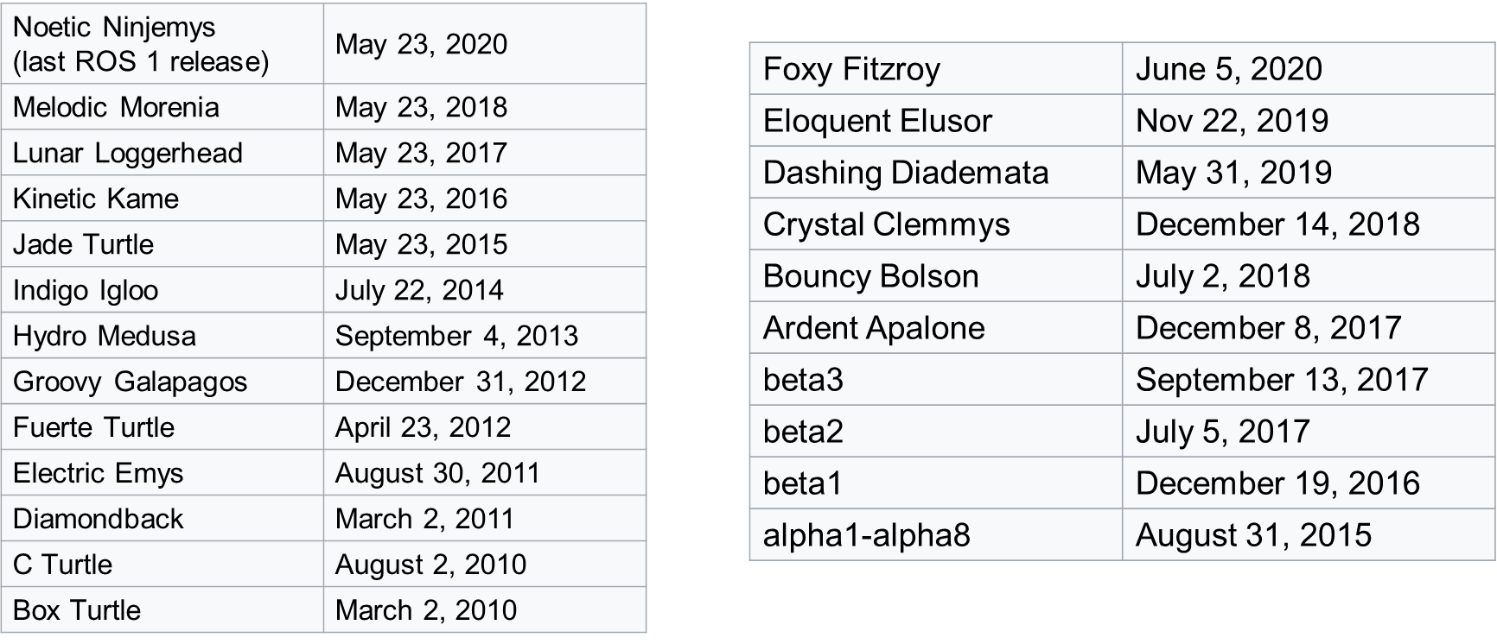
ROS Version…
ROS
ROS 2

Slide 12
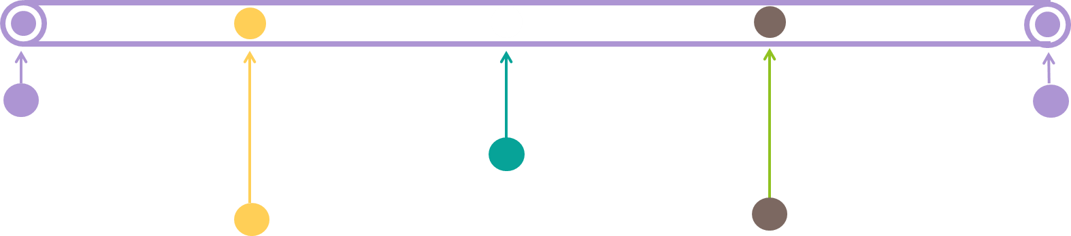
Tools of ROS.
rviz
roslaunch
It is a three-dimensional visualizer used to visualize robots, the environments they work in, and sensor data. It is a highly configurable tool, with many different types of visualizations and plugins.
catkin
roslaunch is a tool used to launch multiple ROS nodes both locally and remotely, as well as setting parameters on the ROS parameter server.
Catkin is a collection of CMake macros and associated code used to build packages used in ROS.
rosbag
rosbash
It is a command line tool used to record and playback ROS message data. rosbag uses a file format called bags
The rosbash package provides a suite of tools which augment the functionality of the bash shell.

Slide 13
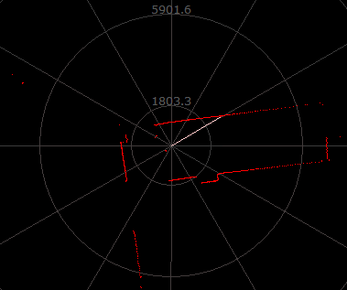
DEMO Session

Slide 14

Q29 – Discussion
Autonomous Car

Slide 15

Q30 – Discussion
Future World - Technology

Slide 16
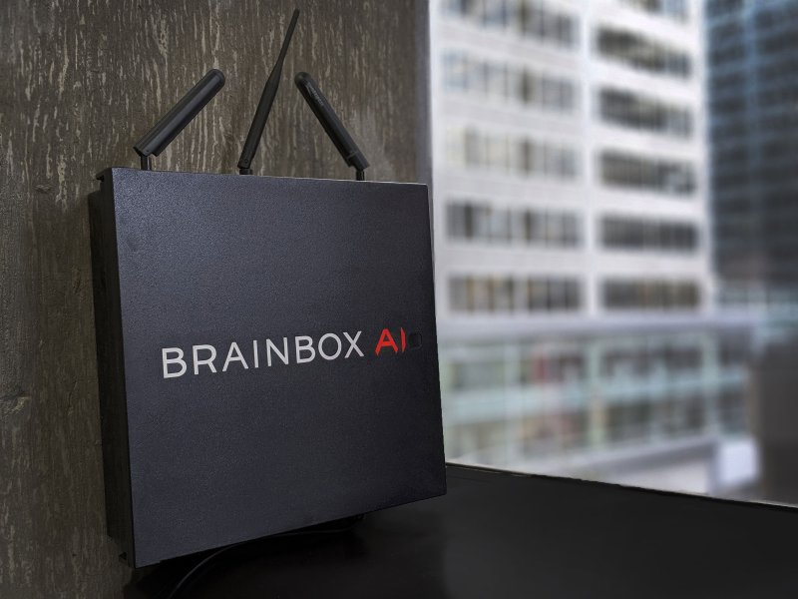
BrainBox AI Built for the Climate
Tech News - 29
2020
Five years ago, advances in autonomous cars inspired the founders of BrainBox AI to pursue a related goal: autonomous buildings. The company’s AI system uses data like weather forecasts to predict a building’s thermal conditions, then adjusts its AC or heating output accordingly. Launched last year, the technology now controls temperatures for more than 40 million sq. ft. of building space, helping reduce carbon footprints by as much as 20% to 40%. —Alejandro De La Garza

Slide 17
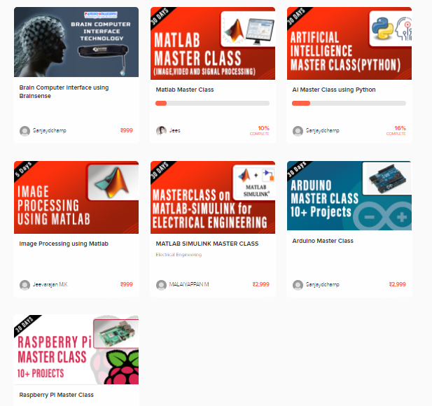
Thanks!
learn.pantechsolutions.net
www.pantechsolutions.net
“Dream Dream Dream
coz, Dreams transform into thoughts & thoughts result in action”
-A.P.J Abdul Kalam

