Slide 1


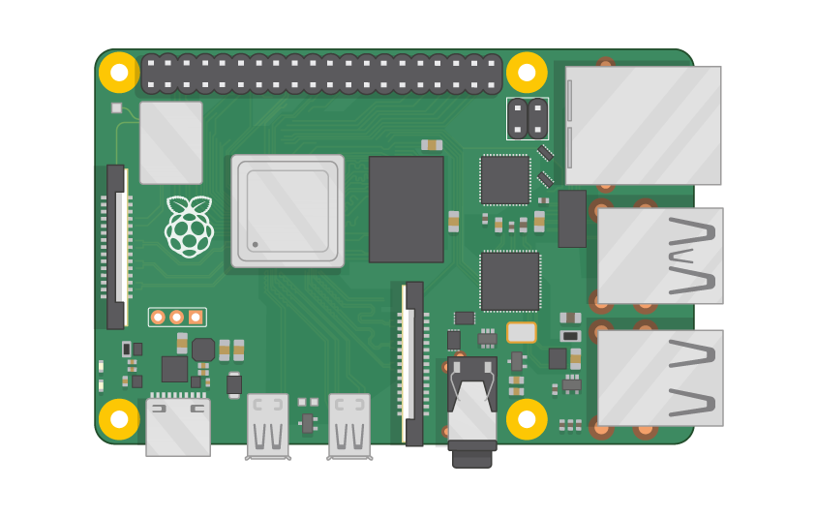
Raspberry Pi Master Class Day-16
Water Quality detection using PH Sensor

Slide 2
Table of Contents
01
02
03
04
Water Quality
Sensor
Overview
Theory
Water quality detection
Discussion, Tech news
Practical session
Interractive session

Slide 3
PREREQUISITES FOR THIS COURSE
Raspberry Pi 3 Model b/B+
16 GB SanDisk class 10 SD Card
Card reader
Laptop with Internet
Power Adapter – 5V 2Amps
USB B-Type Cable
PH Sensor

Slide 4
Water Quality Detection…
pH, turbidity, conductivity, total suspended solids (TSS), total dissolved solids (TDS), and heavy metals such as Cu, Zn, Mg, Fe, Cd, Pb, Cr, As, Hg, and Sn were analysed for each water sample collected during winter and summer periods.

Slide 5
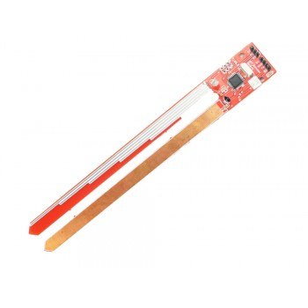
PH Value - sensor
In chemistry, pH - 'potential of hydrogen' or 'power of hydrogen') is a scale used to specify the acidity or basicity of an aqueous solution. Acidic solutions (solutions with higher concentrations of H+ ions) are measured to have lower pH values than basic or alkaline solutions.
This PH rod is designed on ATMEGA8.
On board LDR for light value, Thermistor for temperature value.
It gives Serial data at its Tx pin
PH value W: depth of rod immersed L : light value T temperature value
PH W L T

Slide 6
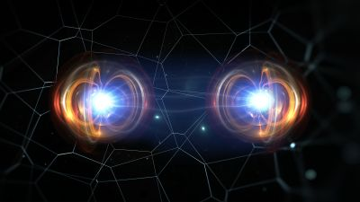
Q16 – Discussion
Quantum mechanics is a fundamental theory in physics that provides a description of the physical properties of nature at the scale of atoms and subatomic particles.
Quantum Theory?

Slide 7

Q17 – Discussion
LASER
Quantum Theory ?

Slide 8
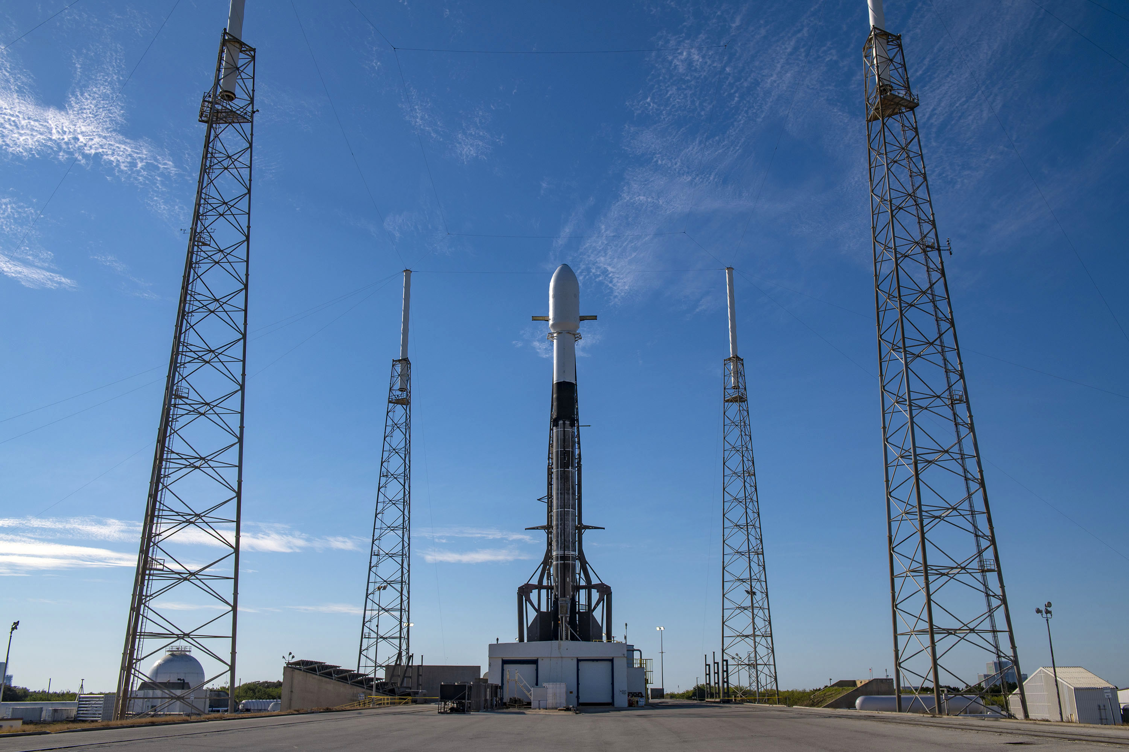
SpaceX Launches Falcon 9 Rocket With Record 143 Spacecraft in Cosmic Rideshare Program
Tech News - 15
Jan - 2021
The Falcon 9 reusable rocket ferried 133 commercial and government spacecraft and 10 Starlink satellites. a new record for the most spaceships deployed on a single mission, according to the companySpaceX has previously launched to orbit more than 800 satellites of the several thousand needed to offer broadband Internet globally, a $10 billion.

Slide 9

Thanks!
learn.pantechsolutions.net
www.pantechsolutions.net
“Education is not the learning of facts, but the training of the Mind to Think”
-Albert Einstein

