Slide 1


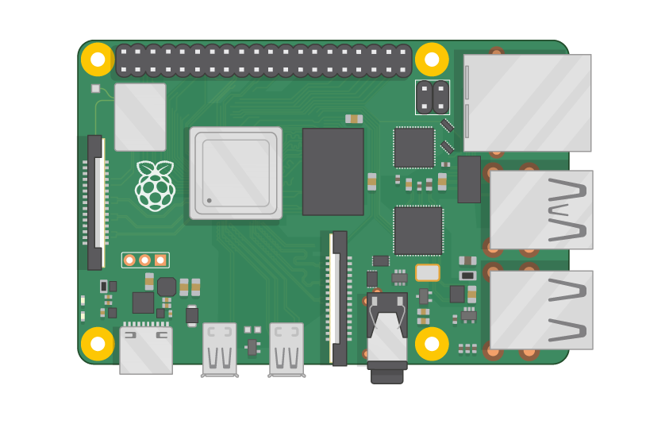
Raspberry Pi Master Class Day-17
Water flow detection using Flow sensor

Slide 2
Table of Contents
01
02
03
04
Water flow sensor
Flow calculation
Overview
Theory
Water flow detection
Discussion, Tech news
Practical session
Interractive session

Slide 3
PREREQUISITES FOR THIS COURSE
Raspberry Pi 3 Model b/B+
16 GB SanDisk class 10 SD Card
Card reader
Laptop with Internet
Power Adapter – 5V 2Amps
USB B-Type Cable
Water flow detection

Slide 4
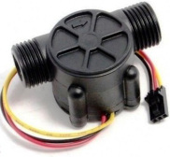
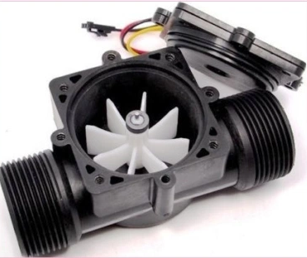
Water Flow Sensor…
YFS201 Hall Effect Water Flow Sensor
This sensor sits in line with the water line and contains a pinwheel sensor to measure how much water has moved through it. There is an integrated magnetic Hall-Effect sensor that outputs an electrical pulse with every revolution.

Slide 5
Flow calculation
The basis relationship for determining the liquid’s flow rate in such cases is Q=VxA,
Q - flow rate/total flow of water through the pipe
V - average velocity of the flow and A is the cross-sectional area of the pipe
Pulse frequency (Hz) = 7.5Q, Q is flow rate in Litres/minute – in Minute
Flow Rate (Litres/hour) = (Pulse frequency x 60 min) / 7.5Q – Q in hour
Pulses=7.5×Q
Q=Pulses/7.5 (This is flow rate in Litres/min)
Q=Pulses/(7.5×60) (This is flow rate in Litres/hour

Slide 6
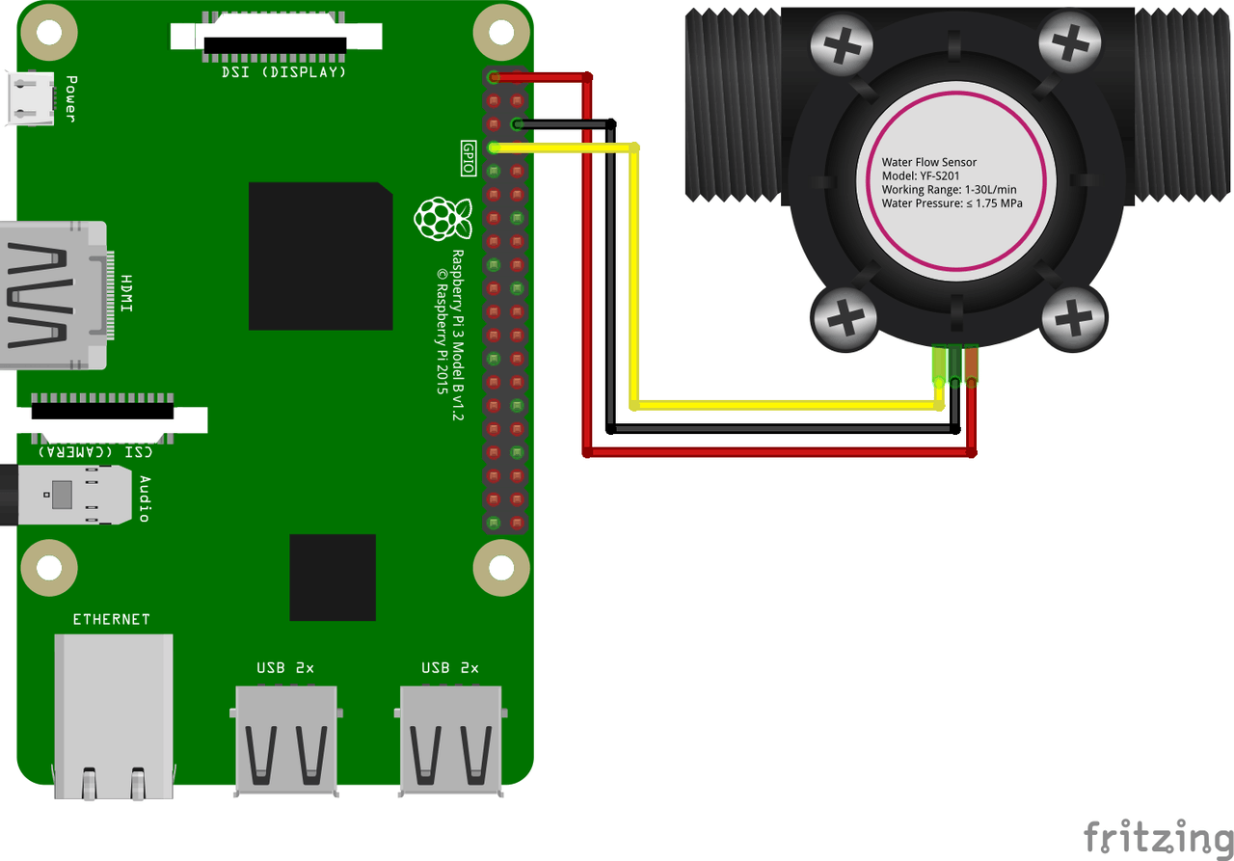
Flow sensor with RPi

Slide 7

Q17 – Discussion
Light Amplification by Stimulated Emission of Radiation
A laser is a device that emits light through a process of optical amplification based on the stimulated emission of electromagnetic radiation.
Laser

Slide 8

Q18 – Discussion
Thermodynamics
Quantum Theory ?

Slide 9
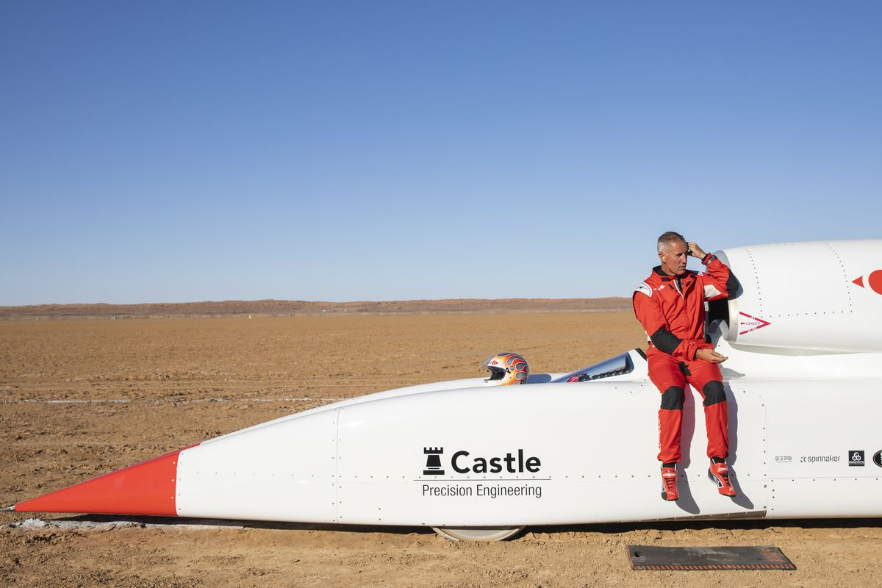
Bloodhound’s 1,000 mph rocket car being sold for $11 million
Tech News - 17
Jan - 2021
For sale: a rocket-powered car named Bloodhound built specifically to break the land speed record. Theoretical top speed of 1,000 miles per hour. Seats one. Price? A paltry $11 million.
The tortured saga of the Bloodhound Land Speed Record project has reached a sadly predictable impasse: the current owner is done spending money trying to set a new record after saving the project from bankruptcy in 2018. It’s hard to blame him. The Bloodhound program has been going for the better part of a decade at this point and has yet to break the 763 mile-per-hour record, let alone scratch at the group’s ultimate stated goal of 1,000 miles per hour.

Slide 10

Thanks!
learn.pantechsolutions.net
www.pantechsolutions.net
“Nothing in life is to be feared, it is only to be understood. Now is the time to understand more, so that we may fear less”
-Marie Curie

