Slide 1


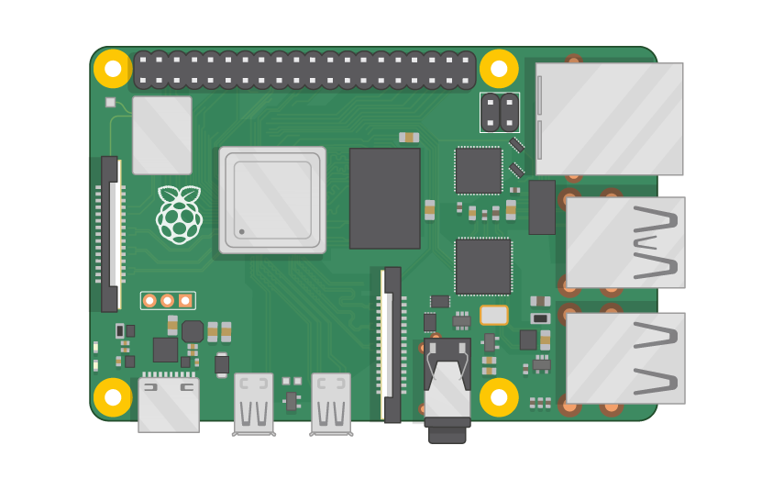
Raspberry Pi Master Class Day-18
Sending Email alert using SMTP Protocol

Slide 2
Table of Contents
01
02
03
04
SMTP Protocol
Sending Text Message
Overview
Practical
Sending Image
Discussion, Tech news
Practical session
Interractive session

Slide 3
PREREQUISITES FOR THIS SESSION
Raspberry Pi 3 Model b/B+
16 GB SanDisk class 10 SD Card
Card reader
Laptop with Internet
Power Adapter – 5V 2Amps
USB B-Type Cable

Slide 4
SMTP Protocol…
SMTP is an application layer protocol. The client who wants to send the mail opens a TCP connection to the SMTP server and then sends the mail across the connection.
The SMTP server is always on listening mode. As soon as it listens for a TCP connection from any client, the SMTP process initiates a connection on that port (25). After successfully establishing the TCP connection the client process sends the mail instantly.

Slide 5
DEMO SESSION

Slide 6
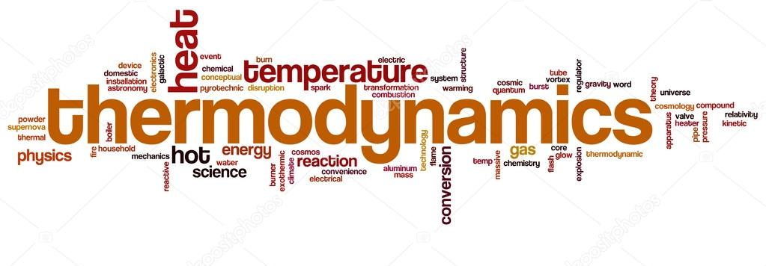
Q18 – Discussion
Thermodynamics is a branch of physics that deals with heat, work, and temperature, and their relation to energy, radiation, and physical properties of matter.
1st Law: Energy is not created or destroyed
2nd Law: Entropy(disorder) of the universe is always increasing
3rd Law: Perfectly crystalline solid at absolute zero has an entropy of zero – Gibbs free energy
Thermodynamics

Slide 7
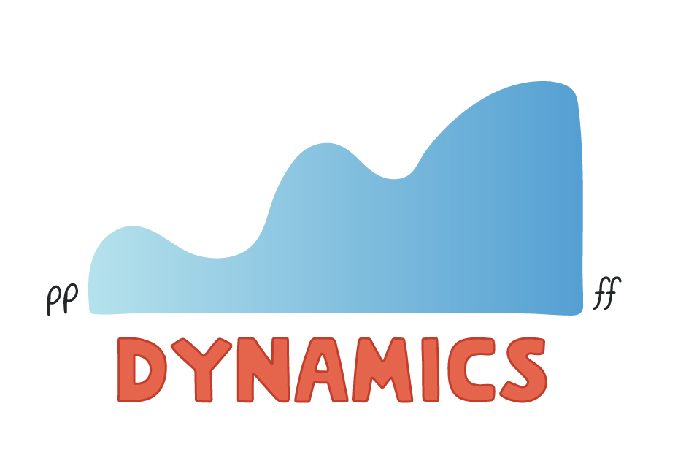
Q19 – Discussion
Dynamics
Quantum Theory ?

Slide 8
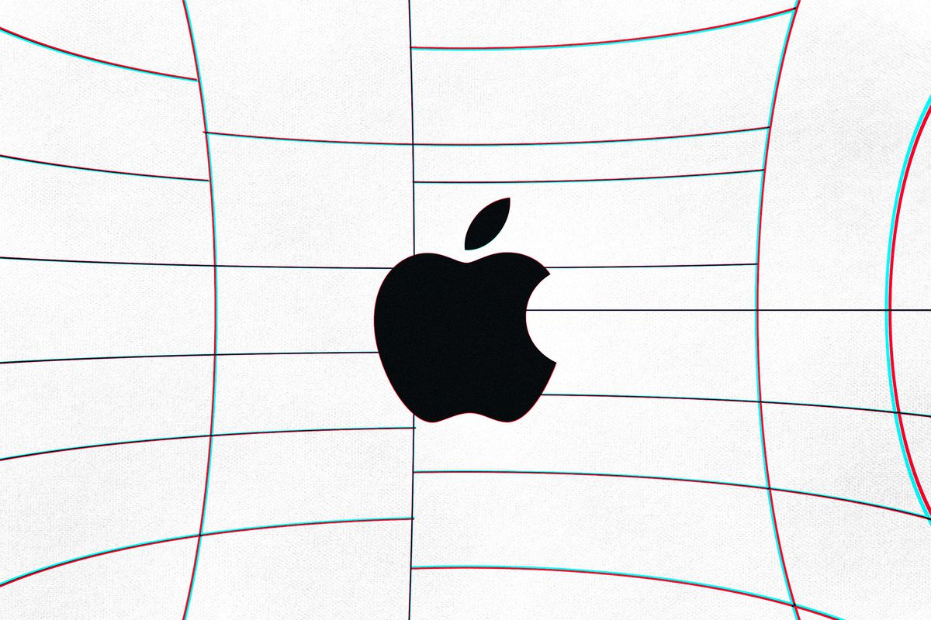
Apple’s next iOS 14 beta will begin forcing developers to ask for permission to track you
Tech News - 18
Jan - 2021
Apple’s new privacy feature requiring developers ask for permission to track iOS users for ad targeting is at last going live in the next iOS 14 beta with a planned full release some time this spring for non-beta users,

Slide 9
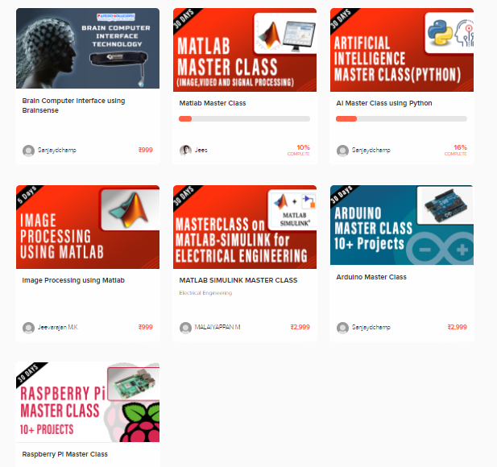
Thanks!
learn.pantechsolutions.net
www.pantechsolutions.net
“The Bad news is time Flies
The Good news is you’re the Pilot”
-Michael Altshuler

