Slide 1


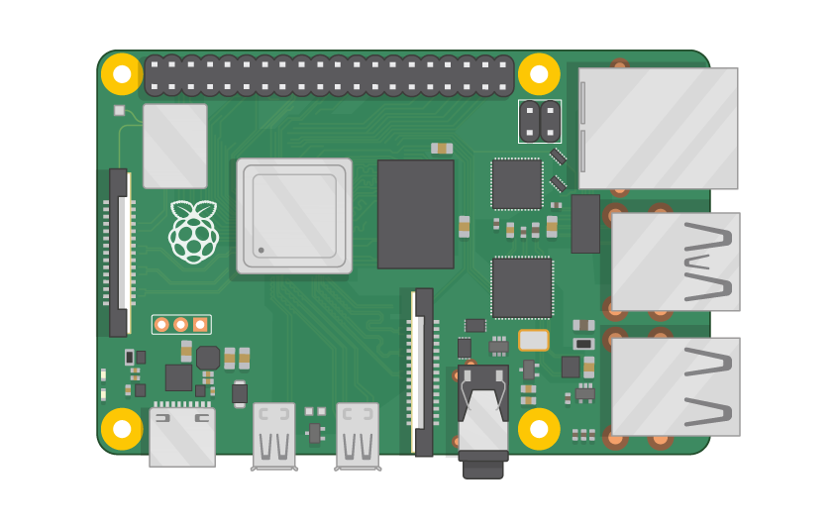
Raspberry Pi Master Class Day-19
Touch screen display Interface with RPi

Slide 2
Table of Contents
01
02
03
04
Touch Screen Display
Installing Packages
Overview
Practical
Interfacing Touch screen
Discussion, Tech news
Practical session
Interractive session

Slide 3
PREREQUISITES FOR THIS SESSION
Raspberry Pi 3 Model b/B+
16 GB SanDisk class 10 SD Card
Card reader
Laptop with Internet
Power Adapter – 5V 2Amps
USB B-Type Cable
3.5” LCD Touch screen

Slide 4
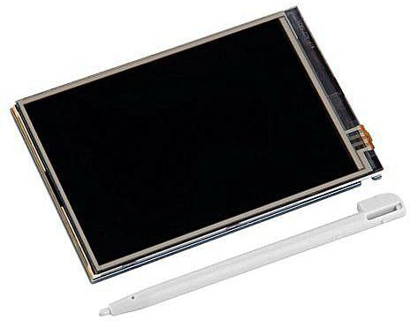
Touch screen LCD Display…
This small 3.5 inch touch screen Raspberry Pi Display module is designed especially for Raspberry Pi, using the latest Linux Core system.
The module sits right on top of Pi and an ideal alternative solution for HDMI monitors.
The screen also comes with a stylus to interact with the small screen.
LCD Type: TFT.
Touch Screen Type: Resistive Screen.
Backlight: Yes, LED.
Resolution (Pixel): 320 x 480.
Aspect Ratio: 8:5.
Touch Controller: XPT2046.

Slide 5
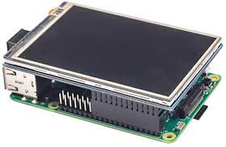
PinOut
1, 17 3.3V 3.3V power input
2,4 5V 5V power input
3,5,7,8,10,12,13,15,16 NC No connection – used for support
6,9,14,20,25 GND Ground
11 TP_IRQ Active low interrupt pin for touch screen
18 LCD_RS Register select pin of Display controller
19 LCD_SI SPI data input for the LCD display
21 TP_SO SPI data output from the LCD display
22 RST Reset
23 LCD_SCK Clock sync pin of SPI communication
24 LCD_CS Chip select pin of SPI LCD
26 TP_CS Chip select pin of SPI Touch screen

Slide 6
DEMO SESSION

Slide 7
Configuration
sudo raspi-config
System options -> Boot Options -> Desktop/CLI -> Desktop Autologin Desktop GUI
Ok
Interfacing options -> SPI
Enable SPI – Yes
sudo rm -rf LCD-show
git clone https://github.com/goodtft/LCD-show.git
chmod -R 755 LCD-show
cd LCD-show/
sudo ./LCD35-show
Sudo reboott
cd LCD-show/
sudo dpkg -i -B xinput-calibrator_0.7.5-1_armhf.deb
Preference -> Calibrate Touchscreen.

Slide 8

Q19 – Discussion
Kinematics – Motion of object without reference to forces
Dynamics – Forces and their influence on the motion of objects
Force, mass, momentum, energy
Dynamics

Slide 9
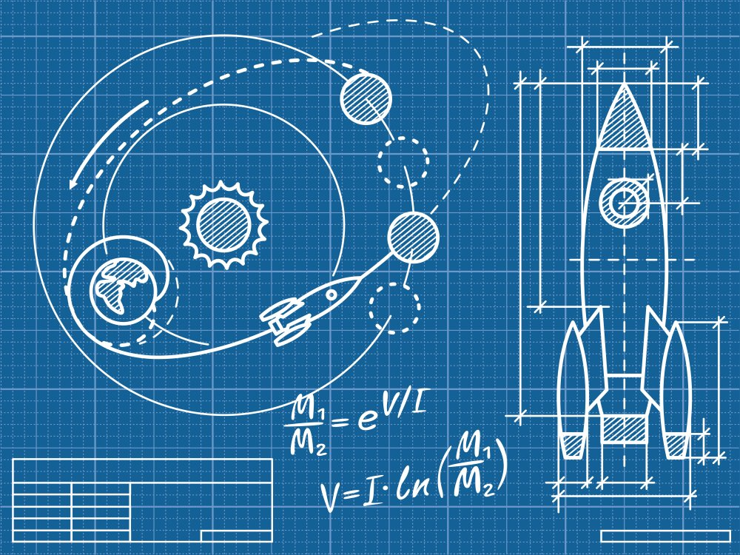
Q19 – Discussion
Rocket Science
Quantum Theory ?

Slide 10
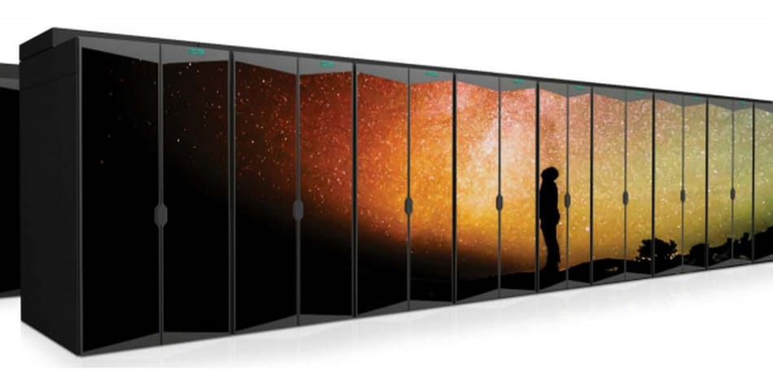
Supercomputer HPE-Cray EX to Rank Among World’s Fastest; Will Help Study Climate Change, Wildfires, More
Tech News - 19
Jan - 2021
The HPE-Cray EX supercomputer will theoretically be able to perform almost 20 quadrillion calculations per second — 3.5 times faster than the existing machine at the NCAR-Wyoming Supercomputing Center.

Slide 11
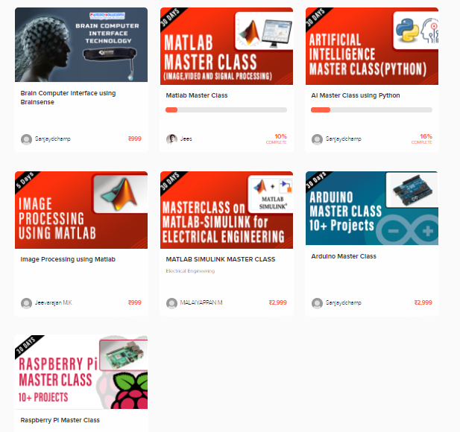
Thanks!
learn.pantechsolutions.net
www.pantechsolutions.net
“A Person who never made a mistake never tried anything new”
-Albert Einstein

