Slide 1


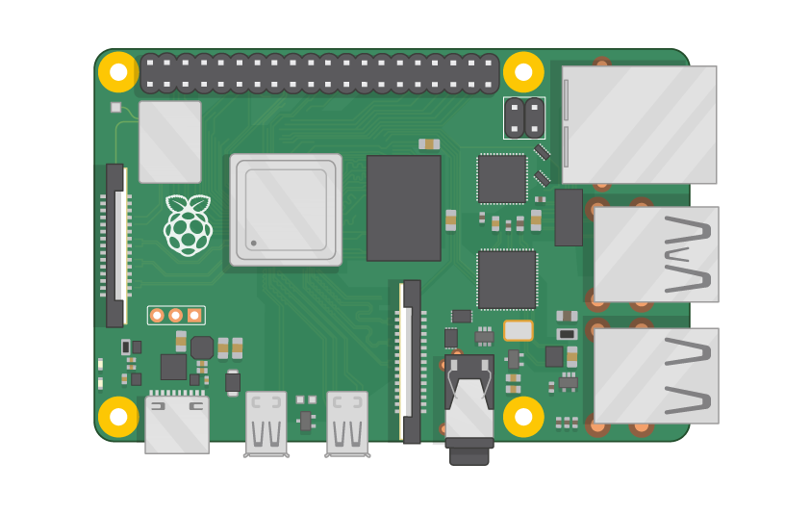
Raspberry Pi Master Class Day-20
Automatic Door lock system

Slide 2
Table of Contents
01
02
03
04
Door lock system
Motors & Sensors
Overview
Practical
Door lock system
Discussion, Tech news
Practical session
Interractive session

Slide 3
PREREQUISITES FOR THIS SESSION
Raspberry Pi 3 Model b/B+
16 GB SanDisk class 10 SD Card
Card reader
Laptop with Internet
Power Adapter – 5V 2Amps
USB B-Type Cable
DC Motor | Servo Motor
PIR Sensor

Slide 4
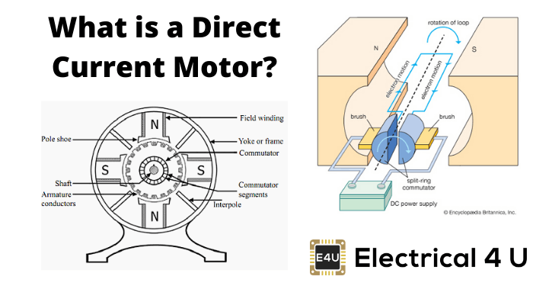
DC Motor
An electric motor operated by DC (direct current) is known as a DC motor (unlike an induction motor that operates via an alternating current). A DC motor converts DC electrical energy into mechanical energy.
When a current-carrying conductor is placed in a magnetic field, it experiences a torque and has a tendency to move.
In other words, when a magnetic field and an electric field interact, a mechanical force is produced. The DC motor or direct current motor works on that principle. This is known as motoring action.

Slide 5
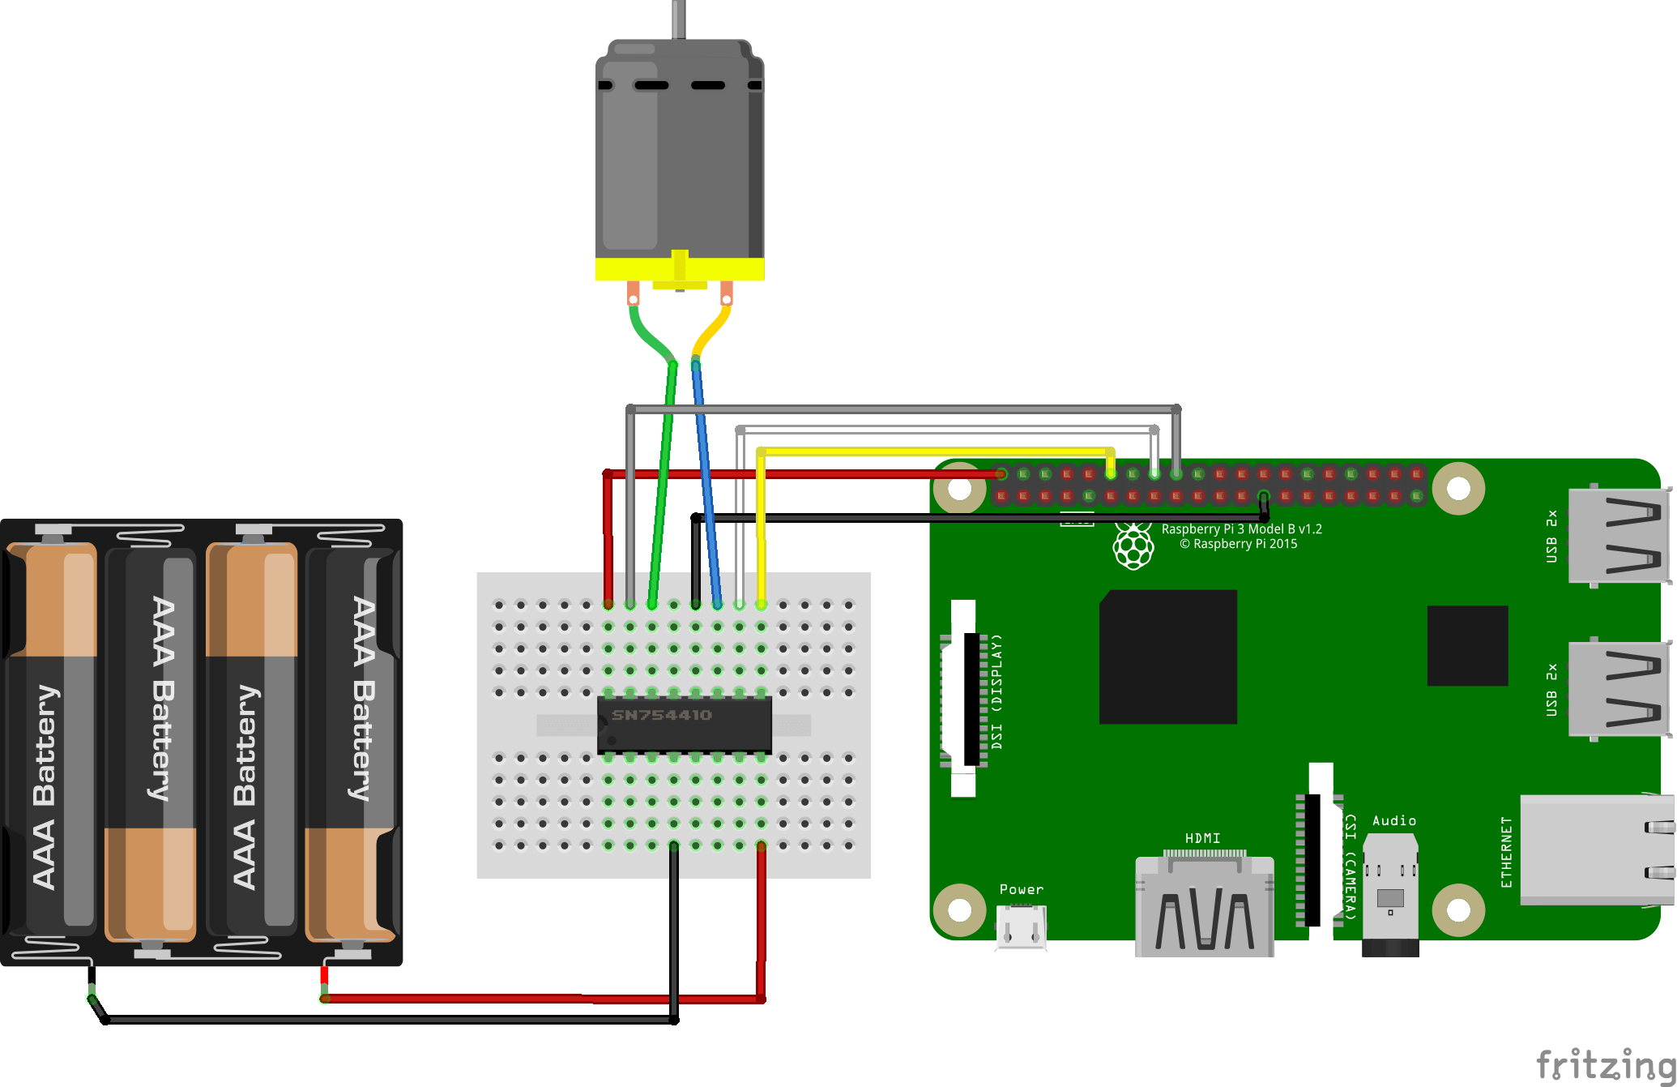
Circuit…

Slide 6
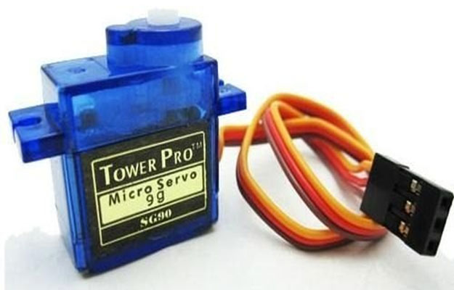
Servo Motor
It can rotate with great precision.
It consists of a control circuit that provides feedback on the current position of the motor shaft, this feedback allows the servo motors to rotate with great precision.
It is a closed-loop system where it uses a positive feedback system to control motion and the final position of the shaft. Here the device is controlled by a feedback signal generated by comparing output signal and reference input signal.
It consists of three parts:
Controlled device
Output sensor
Feedback system

Slide 7
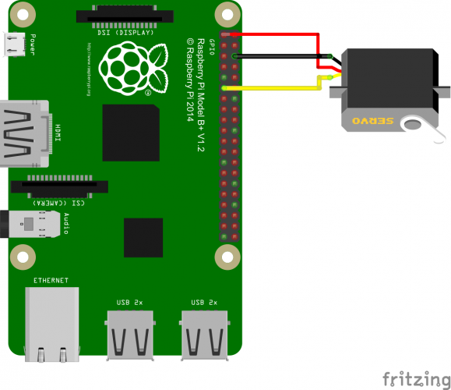
Circuit…

Slide 8
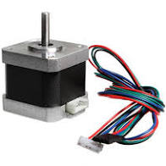
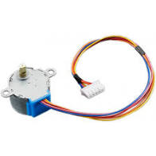
Stepper Motor
A Stepper Motor or a step motor is a brushless, synchronous motor, which divides a full rotation into a number of steps. Unlike a brushless DC motor, which rotates continuously when a fixed DC voltage is applied to it, a step motor rotates in discrete step angles.
The stepper motor is used for precise positioning with a motor, such as hard disk drives, robotics, antennas, telescopes, and some toys.
Stepper motors cannot run at high speeds, but have a high holding torque.

Slide 9
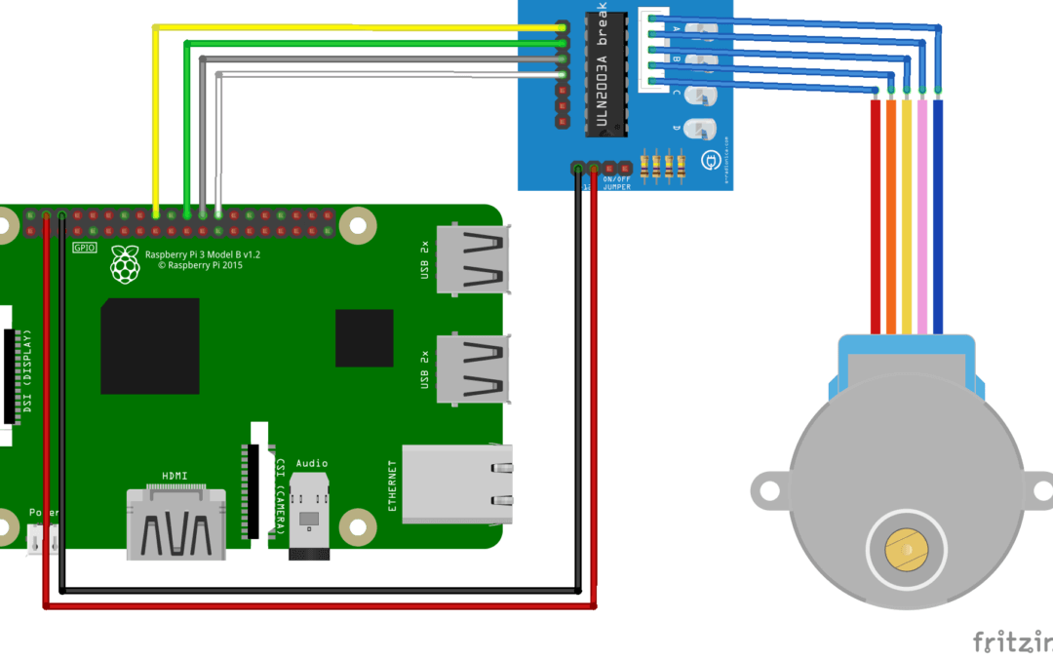
Circuit…

Slide 10
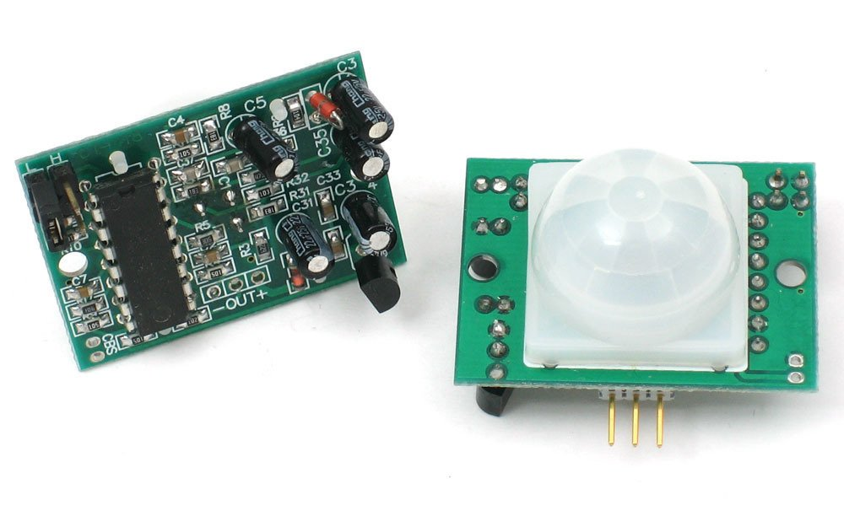
PIR Sensor
PIR sensors allow you to sense motion, almost always used to detect whether a human has moved in or out of the sensors range.
Output: Digital pulse high (3V) when triggered (motion detected) digital low when idle (no motion detected). Pulse lengths are determined by resistors and capacitors on the PCB and differ from sensor to sensor.
Sensitivity range: up to 20 feet (6 meters) 110° x 70° detection range

Slide 11
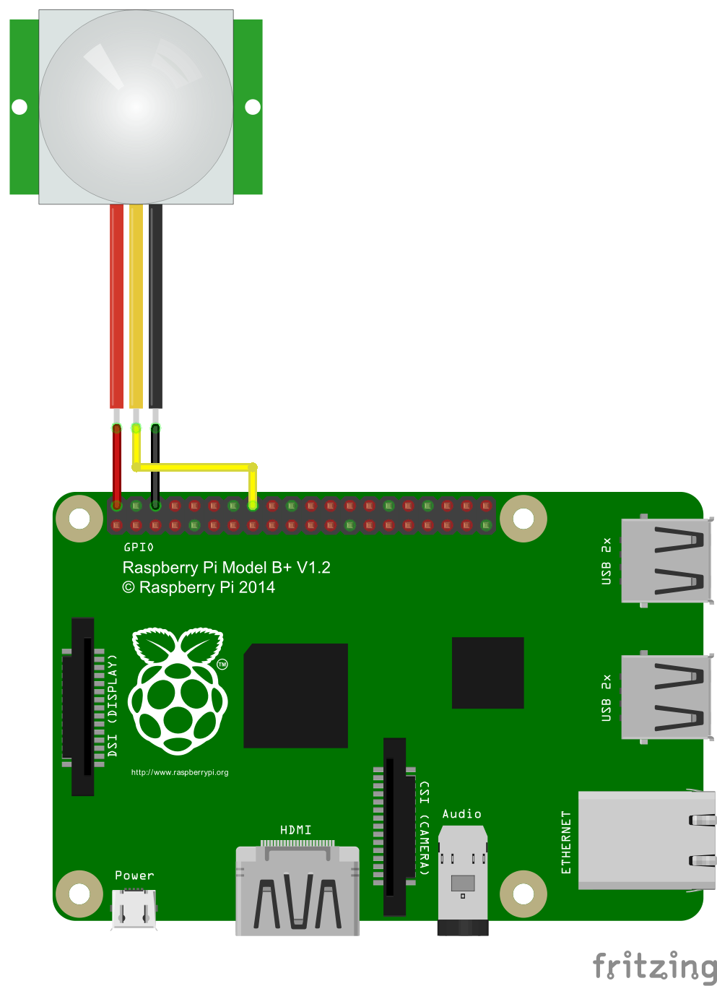
PIR Sensor

Slide 12
DEMO SESSION

Slide 13
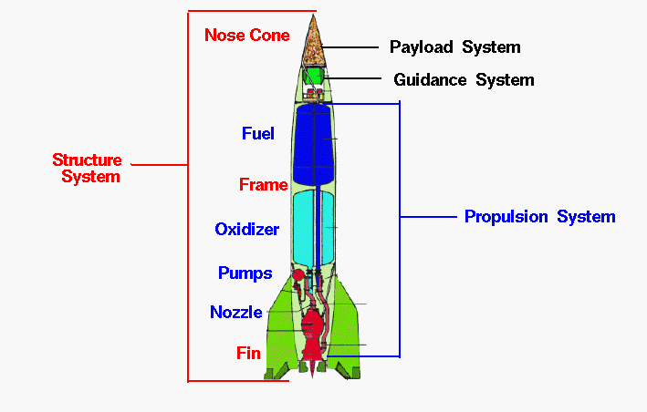
Q20 – Discussion
Rocket science

Slide 14

Q19 – Discussion
Stones in Railway Tracks
Quantum Theory ?

Slide 15

Elon Musk’s SpaceX violated its launch license in explosive Starship test, triggering an FAA probe
Tech News - 20
Jan - 2021
SpaceX’s upcoming test launches are getting extra scrutiny
SpaceX’s first high-altitude test flight of its Starship rocket, which launched successfully but exploded in a botched landing attempt in December, violated the terms of its Federal Aviation Administration test license, according to two people familiar with the incident. Both the landing explosion and license violation prompted a formal investigation by the FAA, driving regulators to put extra scrutiny on Elon Musk’s hasty Mars rocket test campaign.

Slide 16

Thanks!
learn.pantechsolutions.net
www.pantechsolutions.net
“Don’t let the noise of others,
Opinion drown out your own inner voice”
-Steve Jobs

