Slide 1

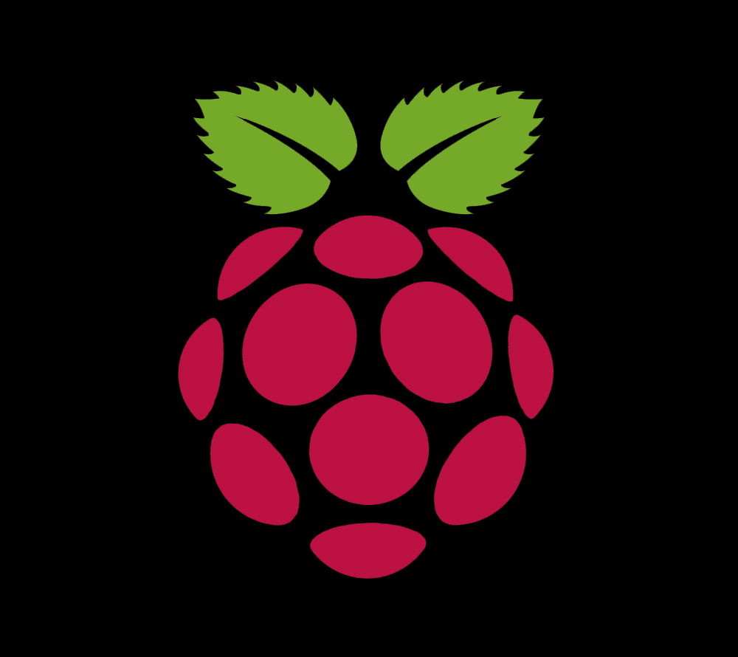
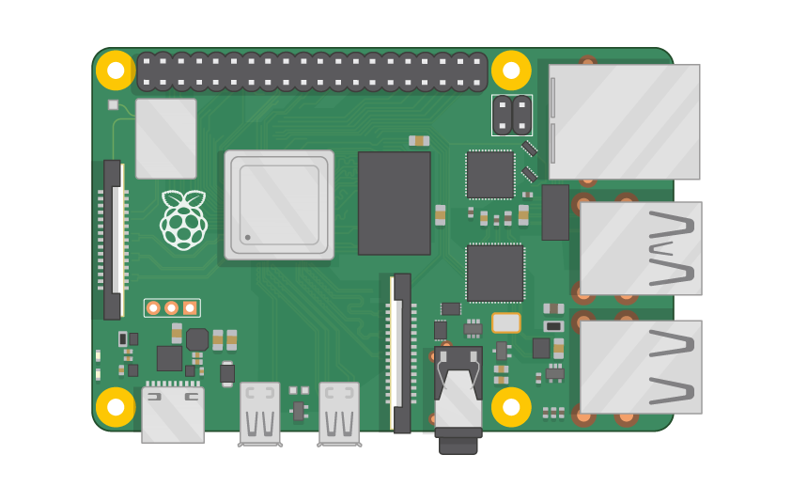
Raspberry Pi Master Class Day-21
Industry monitoring system using IoT

Slide 2
Table of Contents
01
02
03
04
Internet of Things
ThingSpeak
Overview
Practical
Industry Monitoring system
Discussion, Tech news
Practical session
Interractive session

Slide 3
PREREQUISITES FOR THIS SESSION
Raspberry Pi 3 Model b/B+
16 GB SanDisk class 10 SD Card
Card reader
Laptop with Internet
Power Adapter – 5V 2Amps
USB B-Type Cable
Sensors

Slide 4
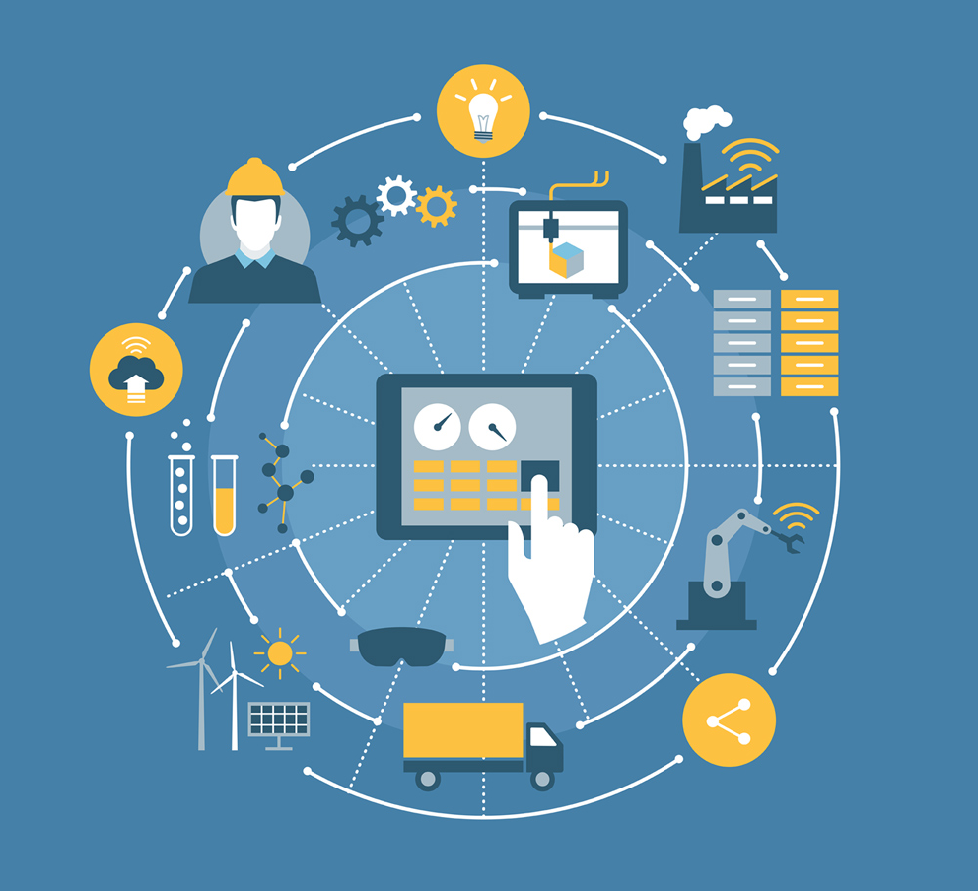
IoT
The Internet of things describes the network of physical objects—“things”—that are embedded with sensors, software, and other technologies for the purpose of connecting and exchanging data with other devices and systems over the Internet.

Slide 5
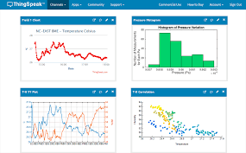
Thingspeak
ThingSpeak is an open-source Internet of Things application and API to store and retrieve data from things using the HTTP and MQTT protocol over the Internet or via a Local Area Network
ThingSpeak is an IoT analytics platform service that allows you to aggregate, visualize, and analyze live data streams in the cloud. You can send data to ThingSpeak from your devices, create instant visualization of live data, and send alerts.

Slide 6
DEMO SESSION

Slide 7

Q21 – Discussion
Rock ballasts Holds the sleepers
Load Distribution
Prevent Water clogging
Prevents vegetation
Minimize heat expansion
Stones in Railway Tracks

Slide 8

Q22 – Discussion
How Helicopter works?
Quantum Theory ?

Slide 9

Your WhatsApp chat history can be imported to Telegram with this new feature
Tech News - 21
Jan - 2021
As new users are hopping on to messaging services to try the variations in the technology services, the freeware cloud-based instant messaging software and application service Telegram has launched a new feature that can import user's chat history from WhatsApp.

Slide 10
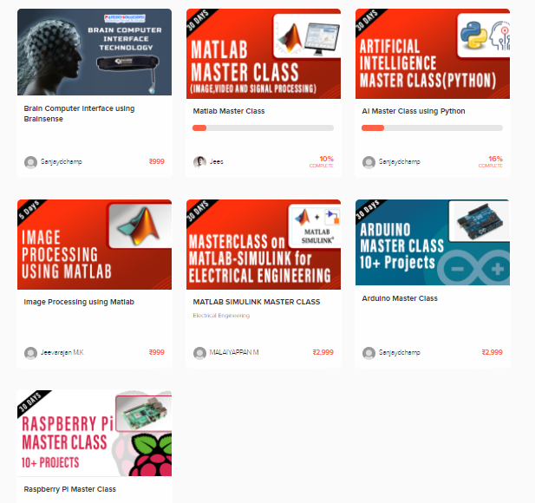
Thanks!
learn.pantechsolutions.net
www.pantechsolutions.net
“Every scientist dreams of doing something that can help the world ”
-Tu YouYou

