Slide 1


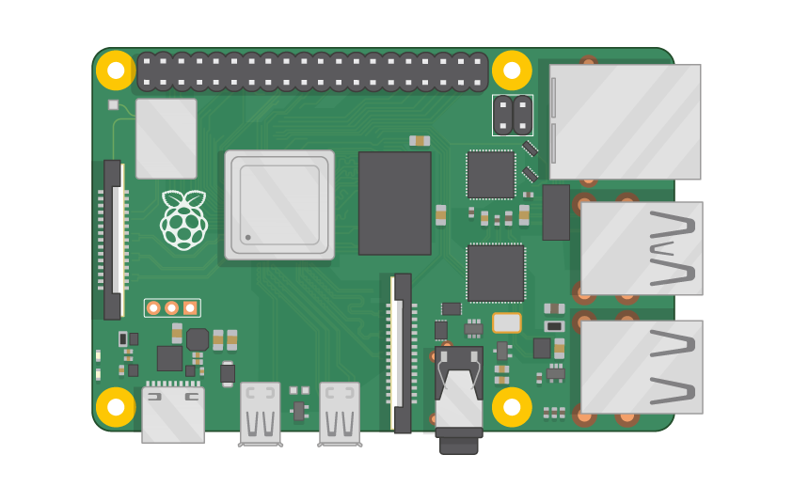
Raspberry Pi Master Class Day-22
Webpage design for appliance control

Slide 2
Table of Contents
01
02
03
04
Web server
Installing webserver library
Overview
Practical
Webpage controlled appliance
Discussion, Tech news
Practical session
Interractive session

Slide 3
PREREQUISITES FOR THIS SESSION
Raspberry Pi 3 Model b/B+
16 GB SanDisk class 10 SD Card
Card reader
Laptop with Internet
Power Adapter – 5V 2Amps
USB B-Type Cable
LED

Slide 4
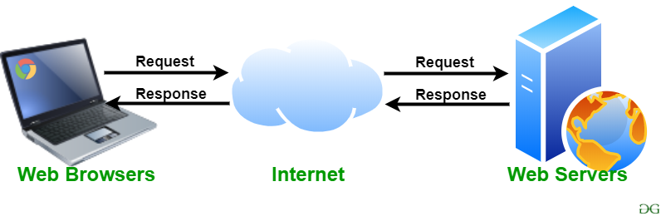
Webserver
A web server is software and hardware that uses HTTP (Hypertext Transfer Protocol) and other protocols to respond to client requests made over the World Wide Web. The main job of a web server is to display website content through storing, processing and delivering webpages to users.

Slide 5
Installing Libraries
sudo apt-get install apache2
sudo apt-get install php libapache2-mod-php
sudo apt-get purge wiringpi
hash -r
git clone --branch final_official_2.50 https://github.com/WiringPi/WiringPi.git ~/wiringpi
cd ~/wiringPi
./build
Sudo chown pi: /var/www/html
Paste gpio.php file inside the directory

Slide 6
DEMO SESSION

Slide 7

Q22 – Discussion
How Helicopter works?

Slide 8

Q23 – Discussion
How Google map works?

Slide 9
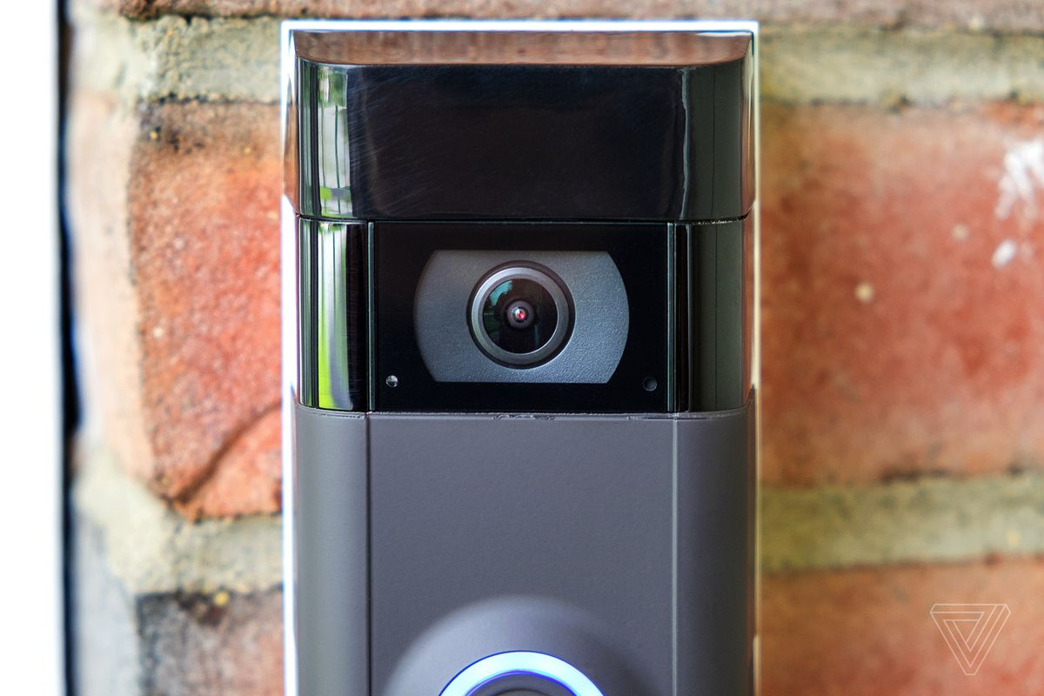
Amazon’s Ring now reportedly partners with more than 2,000 US police and fire departments
Tech News - 22
Jan - 2021
All but two US states — Montana and Wyoming— now have police or fire departments participating in Amazon’s Ring network, which lets law enforcement ask users for footage from their Ring security cameras to assist with investigations, the Financial Times reported, Figures from Ring show more than 1,189 departments joined the program in 2020 for a total of 2,014. That’s up sharply from 703 departments in 2019 and just 40 in 2018. The FT reports that local law enforcement departments on the platform asked for Ring videos for a total of more than 22,335 incidents in 2020

Slide 10

Thanks!
learn.pantechsolutions.net
www.pantechsolutions.net
“Don’t confuse schooling with education. I didn’t go to Harvard but the people that work for me did ”
-Elon Musk

