Slide 1


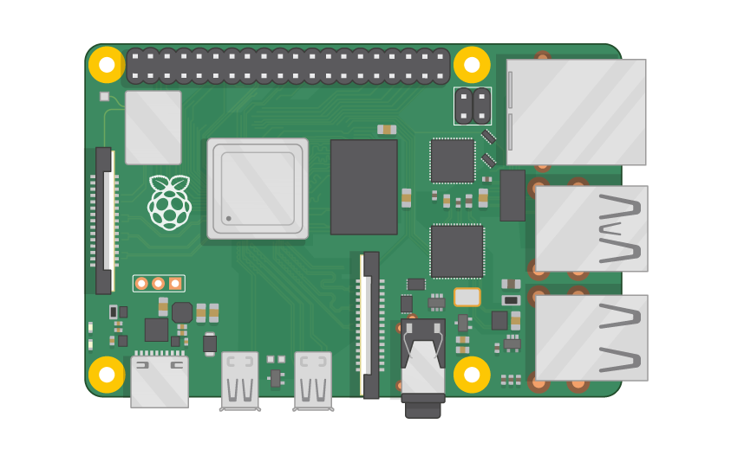
Raspberry Pi Master Class Day-23
Mobile controlled appliance via Internet

Slide 2
Table of Contents
01
02
03
04
Blynk
Installing library
Overview
Practical
Mobile controlled appiance
Discussion, Tech news
Practical session
Interractive session

Slide 3
PREREQUISITES FOR THIS SESSION
Raspberry Pi 3 Model b/B+
16 GB SanDisk class 10 SD Card
Card reader
Laptop with Internet
Power Adapter – 5V 2Amps
USB B-Type Cable
LED

Slide 4
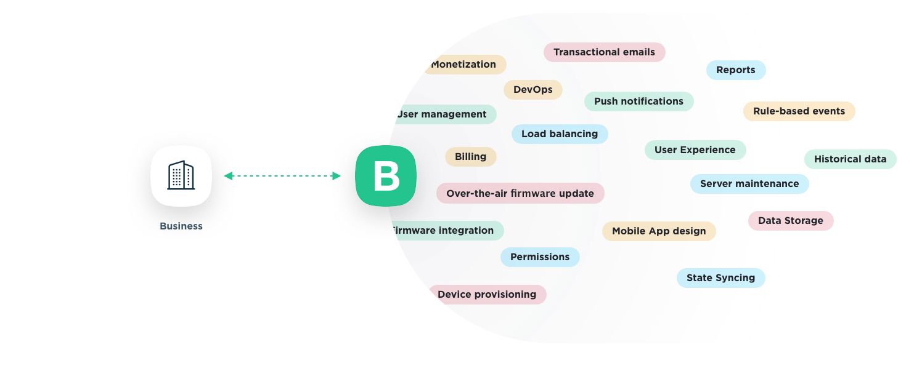
Blynk
Blynk is a hardware-agnostic IoT platform with white-label mobile apps, private clouds, device management, data analytics, and machine learning.

Slide 5
Installing Libraries
sudo apt-get update && sudo apt-get upgrade
sudo apt-get install git-core
git clone https://github.com/blynkkk/blynk-library
cd blynk-library/linux
make clean all target=raspberry
sudo ./blynk --token=your-token-from-ur-mail

Slide 6
DEMO SESSION

Slide 7

Q23 – Discussion
Crowd sourcing
How Google map works?

Slide 8
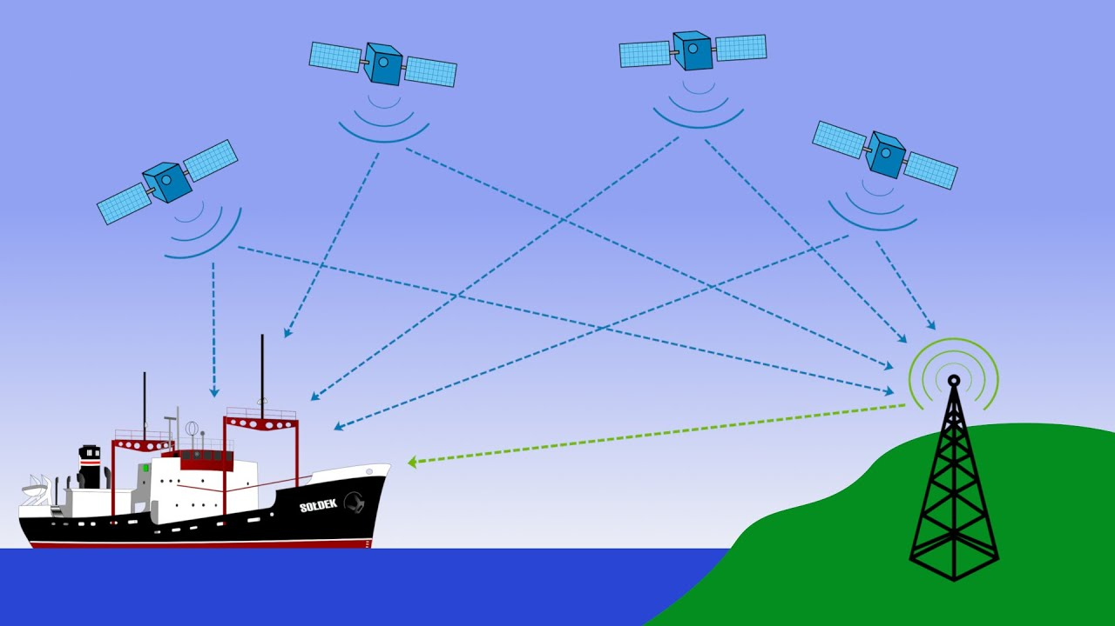
Q24 – Discussion
How GPS works?

Slide 9
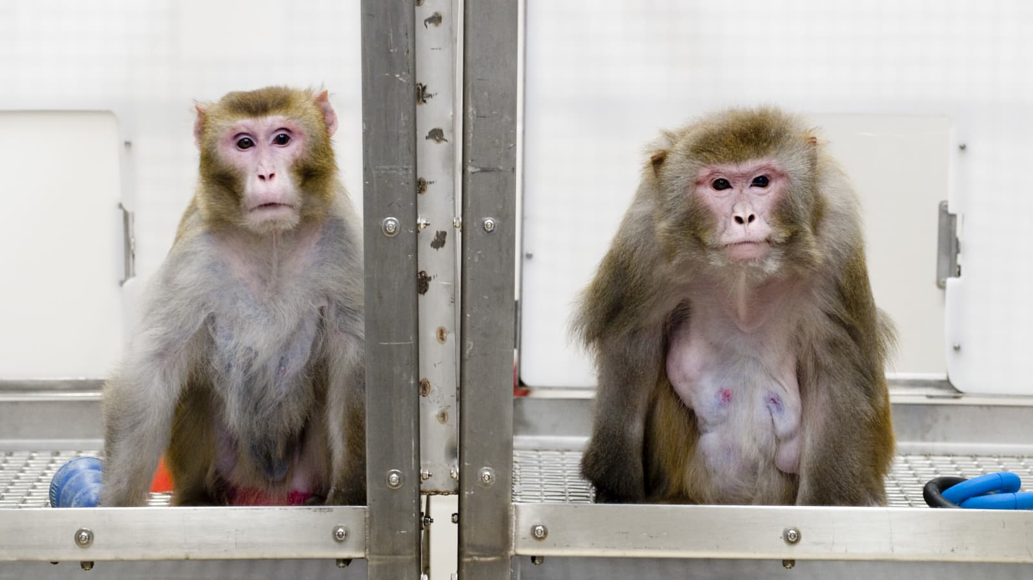
Elon Musk says his start-up Neuralink has wired up a monkey to play video games using its mind
Tech News - 23
Jan - 2021
Elon Musk said in an interview that a monkey has been wired up to play video games with its mind by a company he founded called Neuralink.
Neuralink put a computer chip into the monkey’s skull and used “tiny wires” to connect it to its brain, Musk said.

Slide 10
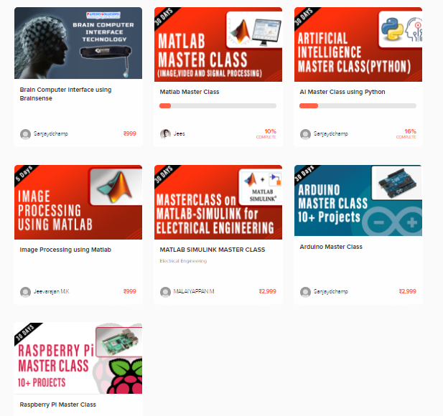
Thanks!
learn.pantechsolutions.net
www.pantechsolutions.net
“The only way to do great work
is to love what you do ”
-Steve Jobs

