Slide 1


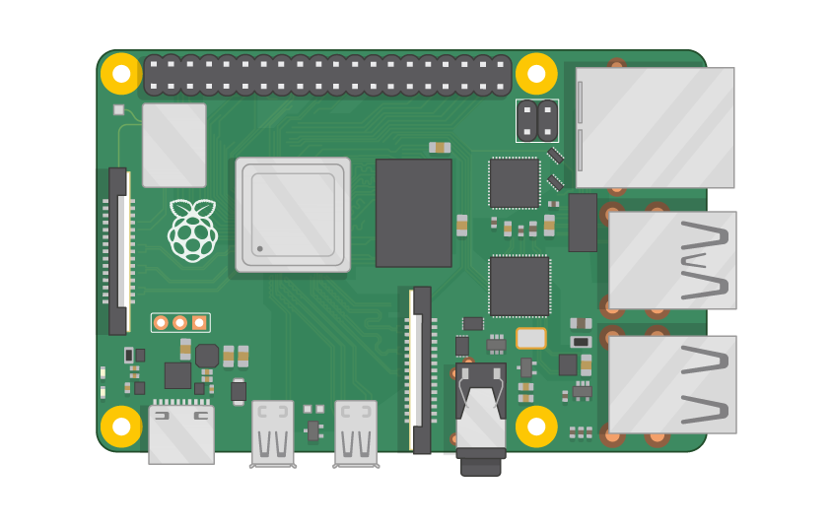
Raspberry Pi Master Class Day-24
Video surveillance system using webserver

Slide 2
Table of Contents
01
02
03
04
Video surveillance
Installing library & Configurations
Overview
Practical
Video surveillance system using webserver
Discussion, Tech news
Practical session
Interractive session

Slide 3
PREREQUISITES FOR THIS SESSION
Raspberry Pi 3 Model b/B+
16 GB SanDisk class 10 SD Card
Card reader
Laptop with Internet
Power Adapter – 5V 2Amps
USB B-Type Cable
USB Camera

Slide 4
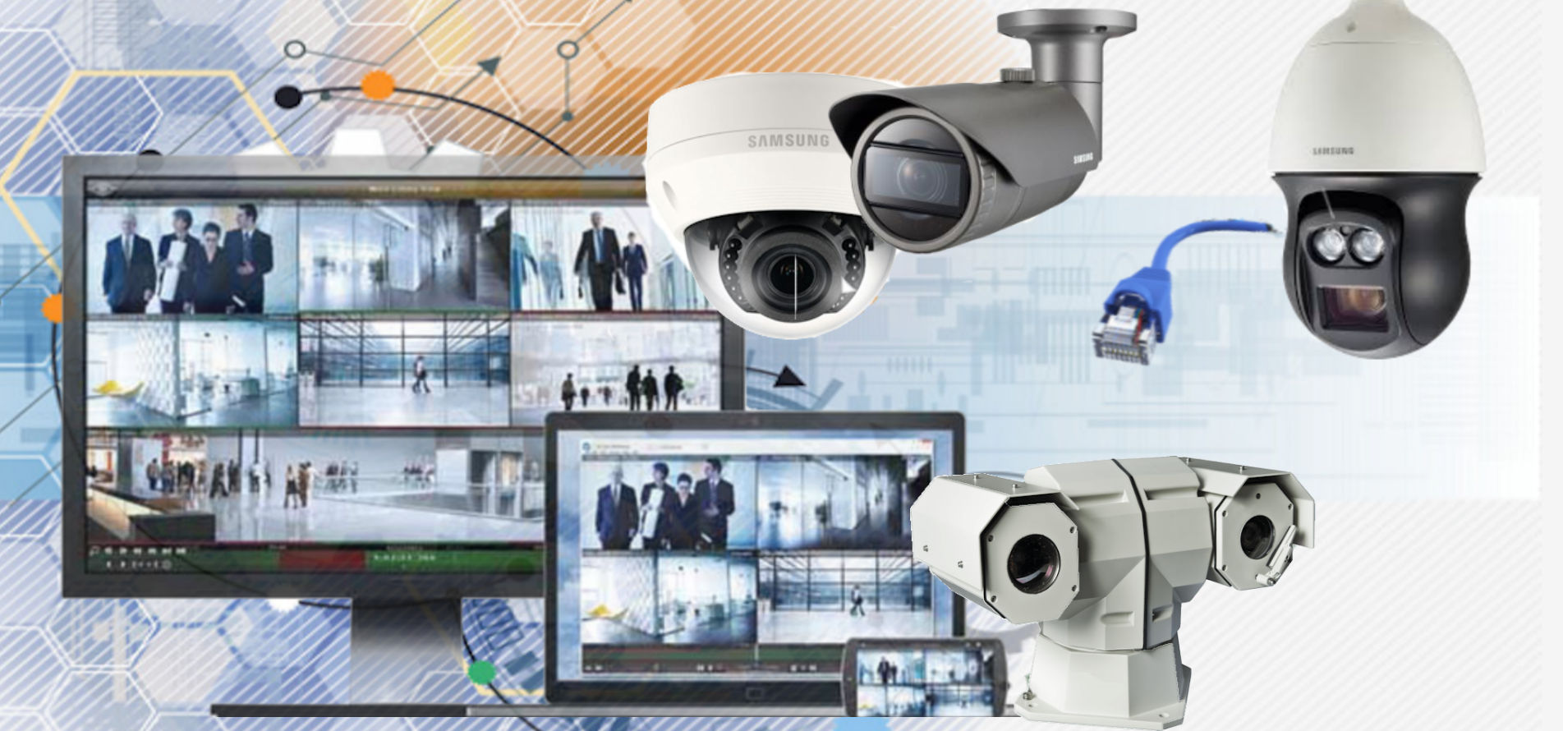
Surveillance system
Surveillance systems are an essential part of securing your home or business. These systems can range from wireless home security cameras to sophisticated alarm systems that notify law enforcement at the first sign of trouble.

Slide 5
Library & Configuration
sudo apt-get install motion
lsusb
sudo nano /etc/motion/motion.conf
ctrl + w
daemon' is ON
Set 'width' & 'height' to 640 & 480.
'framerate' anywhere in between 1000 to 1500.
Keep 'Stream_port' to 8081.
'Stream_quality' should be 100.
Change 'Stream_localhost' to OFF.
Change 'webcontrol_localhost' to OFF.
Set 'quality' to 100.
Set 'post_capture' to 5.
ctrl + x
sudo nano /etc/default/motion
start_motion_daemon ' to yes.
sudo service motion restart
sudo motion
192.168.0.107:8081

Slide 6
DEMO SESSION

Slide 7
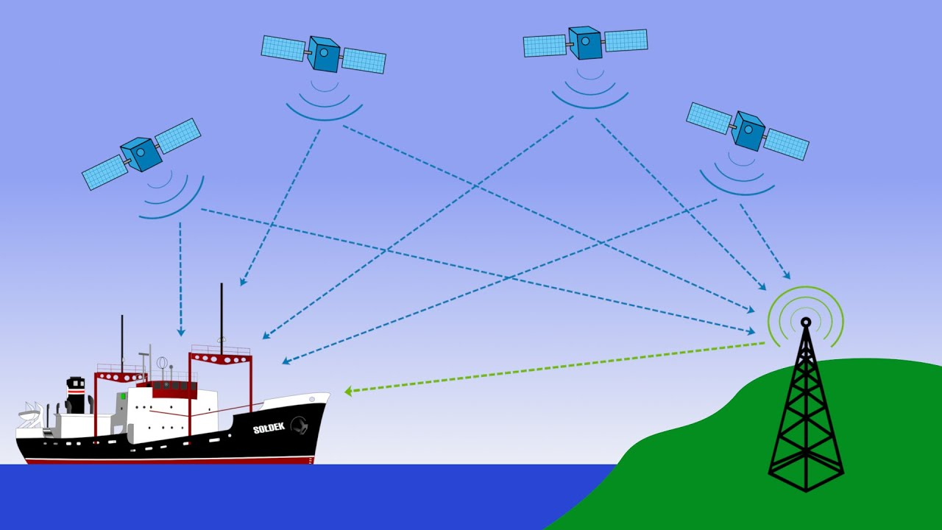
Q24 – Discussion
No Internet or mobile Network
Satellite
Ground station - Uses radar to
find satellite location
Receiver
32 Satellite
4 Satellite minimum
3-D Trilateration
How GPS works?

Slide 8
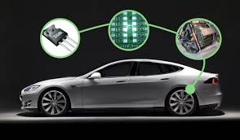
Q24 – Discussion
How Electric car works?

Slide 9
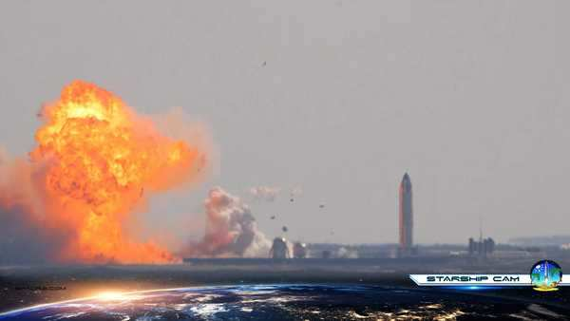
SpaceX Starship prototype rocket explodes on landing after test launch
Tech News - 24
Jan - 2021
SpaceX launched a 16-story prototype of its Starship Mars rocket system 10 kilometers (6.2 miles) above Boca Chica, Texas on Tuesday.
The prototype, called SN9, was supposed to attempt a soft landing, but the spaceship slammed into the ground sideways and exploded.
This is the second time the aerospace company, founded by Elon Musk, has launched such an ambitious Starship flight and seen the vehicle destroyed upon landing.

Slide 10

Thanks!
learn.pantechsolutions.net
www.pantechsolutions.net
“Don’t compare yourself with anyone in this world… if you do so, you are insulting yourself.”
-Bill Gates

