Slide 1


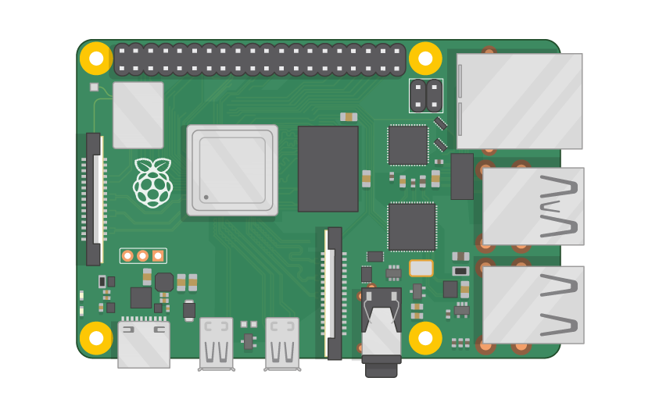
Raspberry Pi Master Class Day-25
Face Detection, tracking & Recognition

Slide 2
Table of Contents
01
02
03
04
Face recognition
Installing library
Overview
Practical
Face recognition
Discussion, Tech news
Practical session
Interractive session

Slide 3
PREREQUISITES FOR THIS SESSION
Raspberry Pi 3 Model b/B+
16 GB SanDisk class 10 SD Card
Card reader
Laptop with Internet
Power Adapter – 5V 2Amps
USB B-Type Cable
Camera

Slide 4
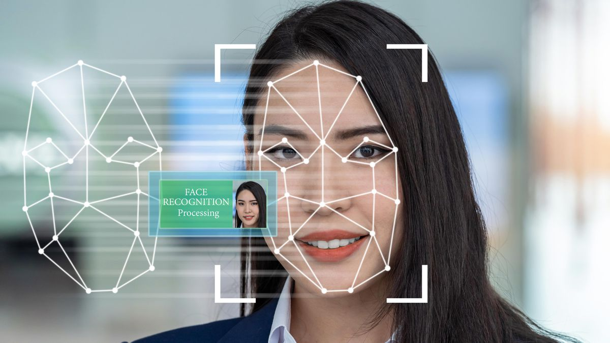
Face recognition
Face recognition is a method of identifying or verifying the identity of an individual using their face. Face recognition systems can be used to identify people in photos, video, or in real-time.

Slide 5
Installing Library
sudo pip3 install opencv-python
sudo pip3 install opencv-contrib-python

Slide 6
DEMO SESSION

Slide 7
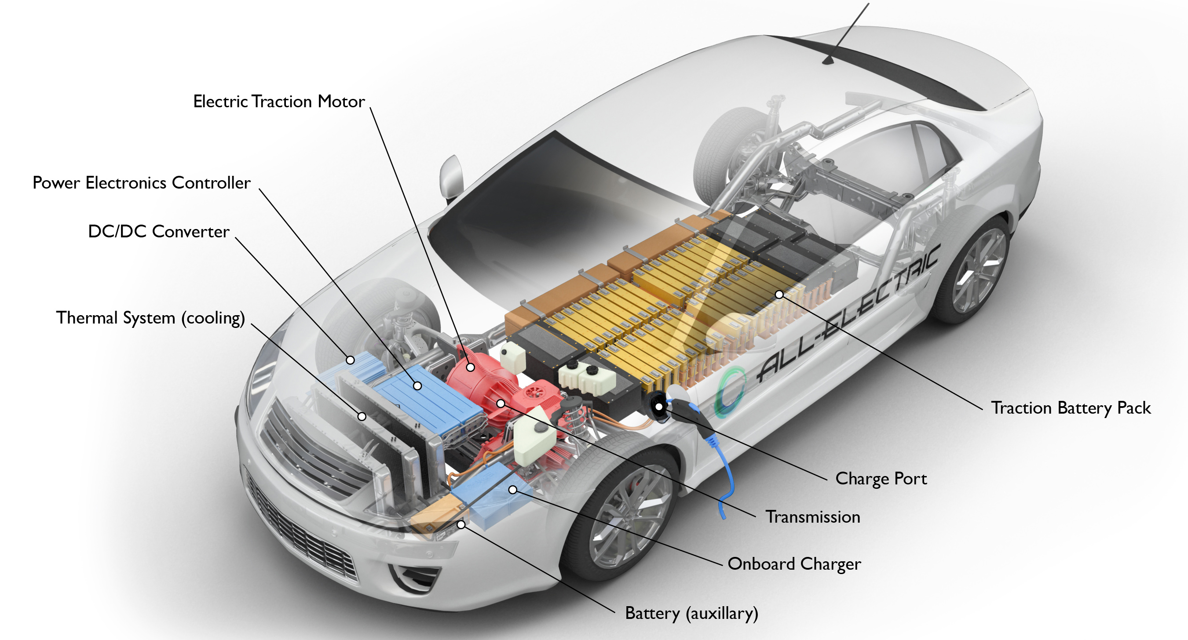
Q25 – Discussion
How Electric car works

Slide 8

Q26 – Discussion
CPU vs GPU

Slide 9
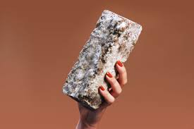
One day, your home could be made with mushrooms
Tech News - 25
Feb- 2021
Mushrooms are helping architects and engineers solve one the world’s biggest crises: climate change. These fungi are durable, biodegradable, and are proving to be a good alternative to more polluting materials.
“Our built environment needs these kinds of materials,” says David Benjamin, founding principal architect at the firm The Living. “Different countries have really ambitious climate change goals, and this material could really help jump-start some of that progress.”

Slide 10

Thanks!
learn.pantechsolutions.net
www.pantechsolutions.net
"People don't care about what you say, they care about what you build.“
-Mark zuckerberg

