Slide 1


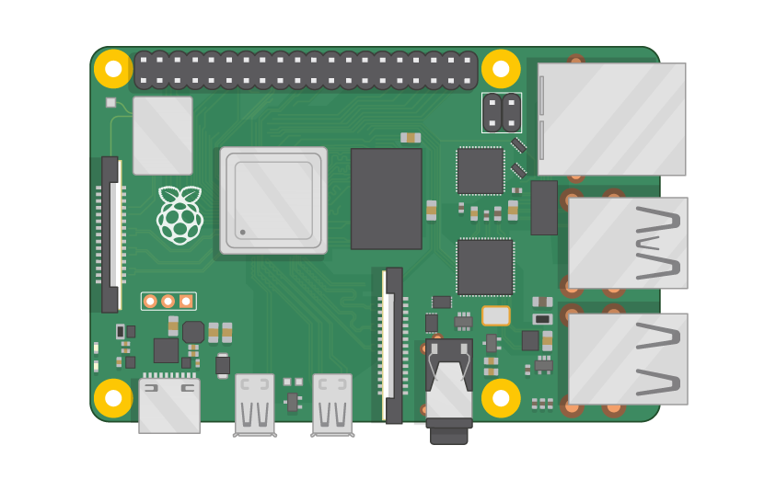
Raspberry Pi Master Class Day-26
Book reader using OCR

Slide 2
Table of Contents
01
02
03
04
Tesseract OCR
Installing library
Overview
Practical
Book Reader
Discussion, Tech news
Practical session
Interractive session

Slide 3
PREREQUISITES FOR THIS SESSION
Raspberry Pi 3 Model b/B+
16 GB SanDisk class 10 SD Card
Card reader
Laptop with Internet
Power Adapter – 5V 2Amps
USB B-Type Cable
Camera
Laptop speaker

Slide 4
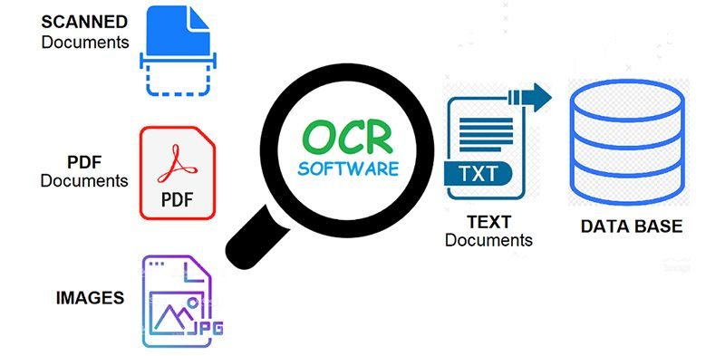
OCR
Optical Character Recognition. In other words, OCR systems transform a two-dimensional image of text, that could contain machine printed or handwritten text from its image representation into machine-readable text. OCR as a process generally consists of several sub-processes to perform as accurately as possible. The subprocesses are:
Preprocessing of the Image
Text Localization
Character Segmentation
Character Recognition
Post Processing

Slide 5
Installing Library
sudo apt-get install tesseract-ocr
Sudo apt-get install festival

Slide 6
DEMO SESSION

Slide 7
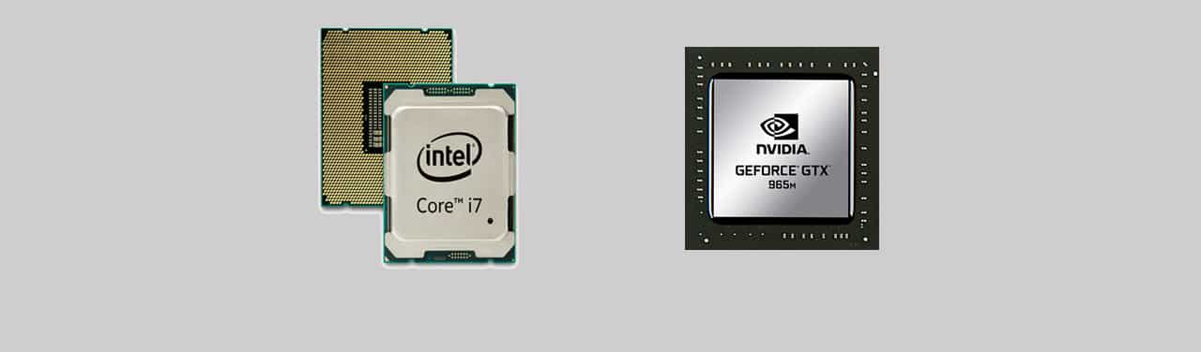
Q26 – Discussion
CPU vs GPU

Slide 8
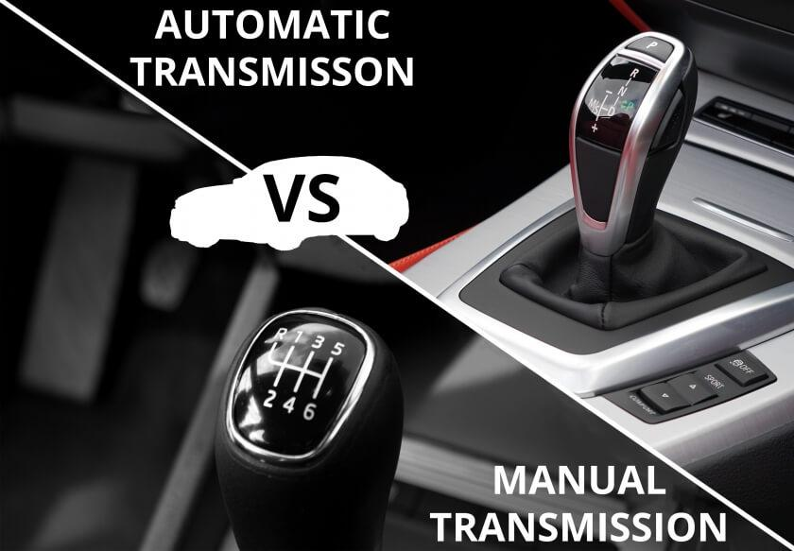
Q26 – Discussion
Automatic vs Manual Transmission

Slide 9
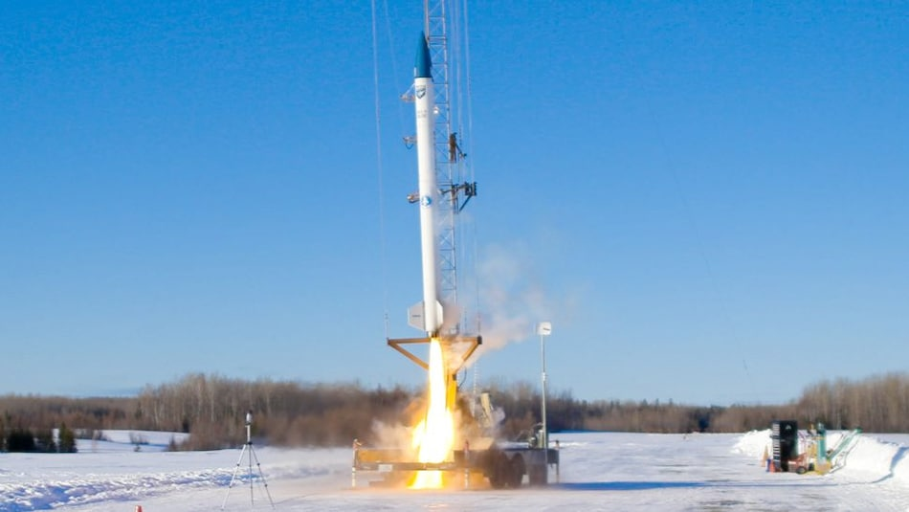
First Biofuel-Powered Commercial Rocket Successfully Test Launched in Maine
Tech News - 26
Feb- 2021
A Maine company that's developing a rocket to propel small satellites into space passed its first major test on Sunday.
Brunswick-based bluShift Aerospace launched a 20-foot (6-metre) prototype rocket, hitting an altitude of a little more than 4,000 feet (1,219 metres) in a first run designed to test the rocket's propulsion and control systems.
It carried a science project by Falmouth High School students that will measure flight metrics such as barometric pressure, a special alloy that's being tested by a New Hampshire company — and a Dutch dessert called stroopwafel, in an homage to its Amsterdam-based parent company. Organisers of the launch said the items were included to demonstrate the inclusion of a small payload.

Slide 10
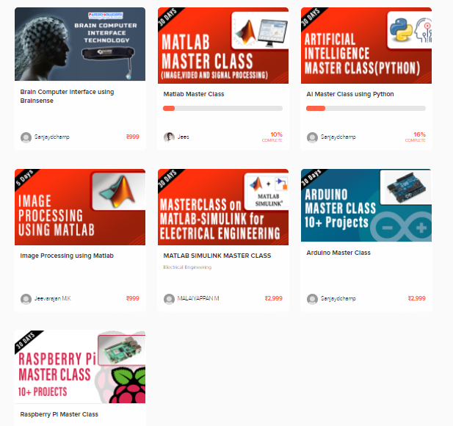
Thanks!
learn.pantechsolutions.net
www.pantechsolutions.net
“The True sign of Intelligence is not knowledge, But Imagination “
-Albert Einstein

