Slide 1


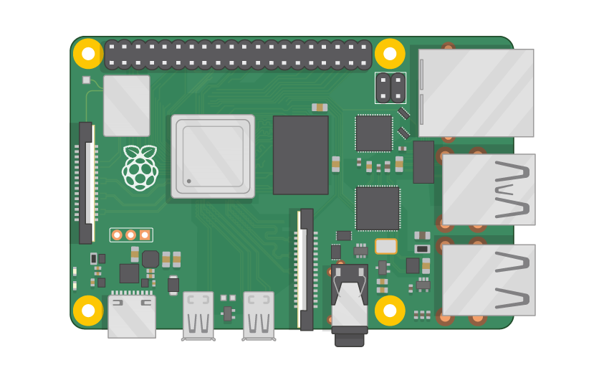
Raspberry Pi Master Class Day-27
Color Following Robot

Slide 2
Table of Contents
01
02
03
04
Object Tracking
Installing library
Overview
Practical
Color object following Robot
Discussion, Tech news
Practical session
Interractive session

Slide 3
PREREQUISITES FOR THIS SESSION
Raspberry Pi 3 Model b/B+
16 GB SanDisk class 10 SD Card
Card reader
Laptop with Internet
Power Adapter – 5V 2Amps
USB B-Type Cable
Camera
Robot Setup

Slide 4
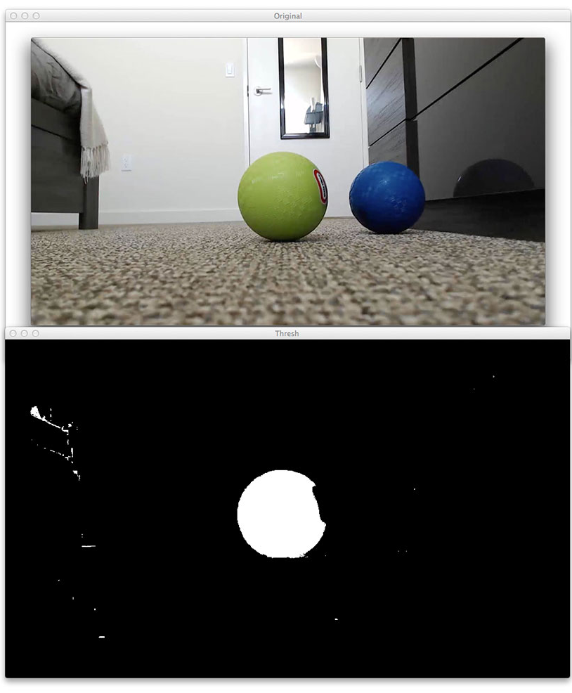
Object Tracking
Object detection and tracking are the task that is important and challenging such as video surveillance and vehicle navigation.
Image processing is a method of extracting some useful information by converting image into digital inform by performing some operations on it.

Slide 5
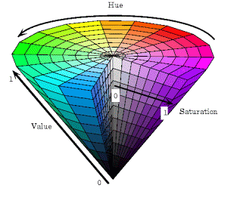
HSV Value
HSL and HSV are alternative representations of the RGB color model, designed in the 1970s by computer graphics researchers to more closely align with the way human vision perceives color-making attributes
HSV Color Space. The HSV color space (hue, saturation, value) is often used by people who are selecting colors (e.g., of paints or inks) from a color wheel or palette, because it corresponds better to how people experience color than the RGB color space does.

Slide 6
Installing Library
Sudo pip3 install pyautogui

Slide 7
DEMO SESSION

Slide 8
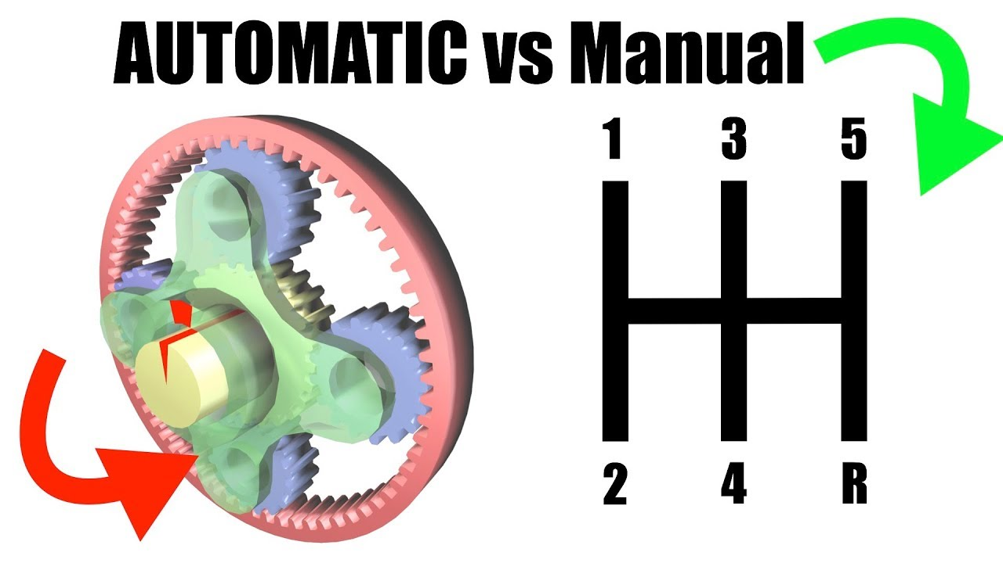
Q27 – Discussion
Automatic vs Manual Transmission

Slide 9

Q28 – Discussion
SSD vs HDD

Slide 10
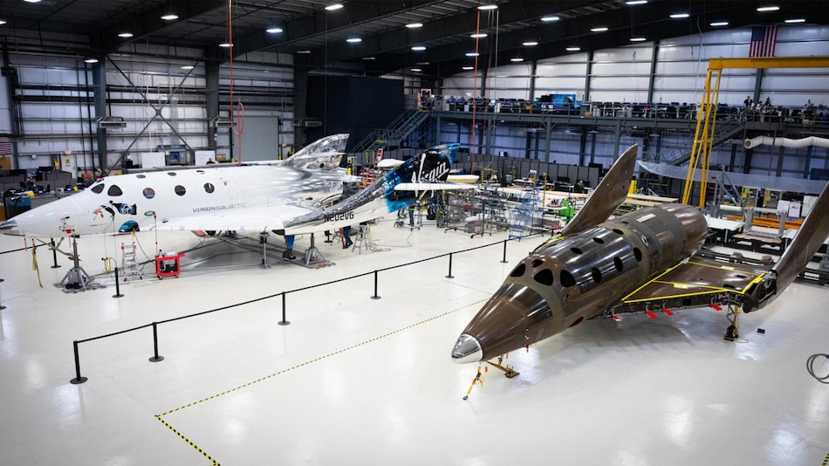
Richard Branson’s Virgin Galactic Plans New Test Flight for SpaceShipTwo Craft
Tech News - 27
Feb- 2021
SpaceShipTwo was earlier expected to take its first passengers into space later this year.
Space tourism company Virgin Galactic said Monday it planned a new test flight for its SpaceShipTwo craft this month after an aborted test in early December.
"The flight window will open on February 13 with opportunities to fly throughout February, pending good weather conditions and technical readiness," Richard Branson's company said.
"Pre-flight preparations are already underway at Spaceport America, New Mexico."

Slide 11
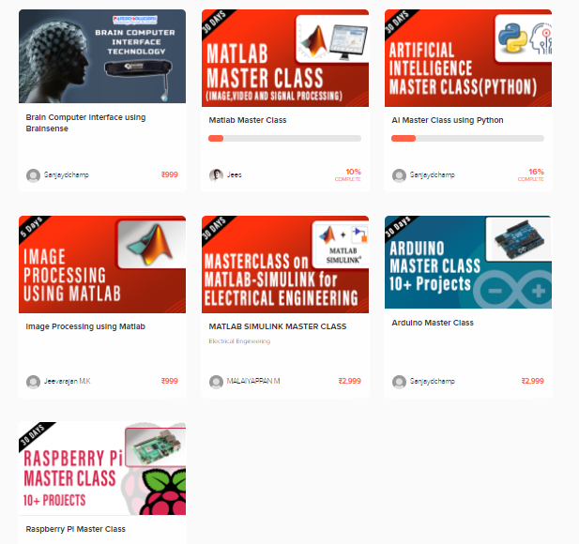
Thanks!
learn.pantechsolutions.net
www.pantechsolutions.net
“If you can dream it,
You can do it“
-Walt Disney

