Slide 1

Please wait...
Lindows 11.1 Pro
Returning the freedom of choice that users deserve

Slide 2
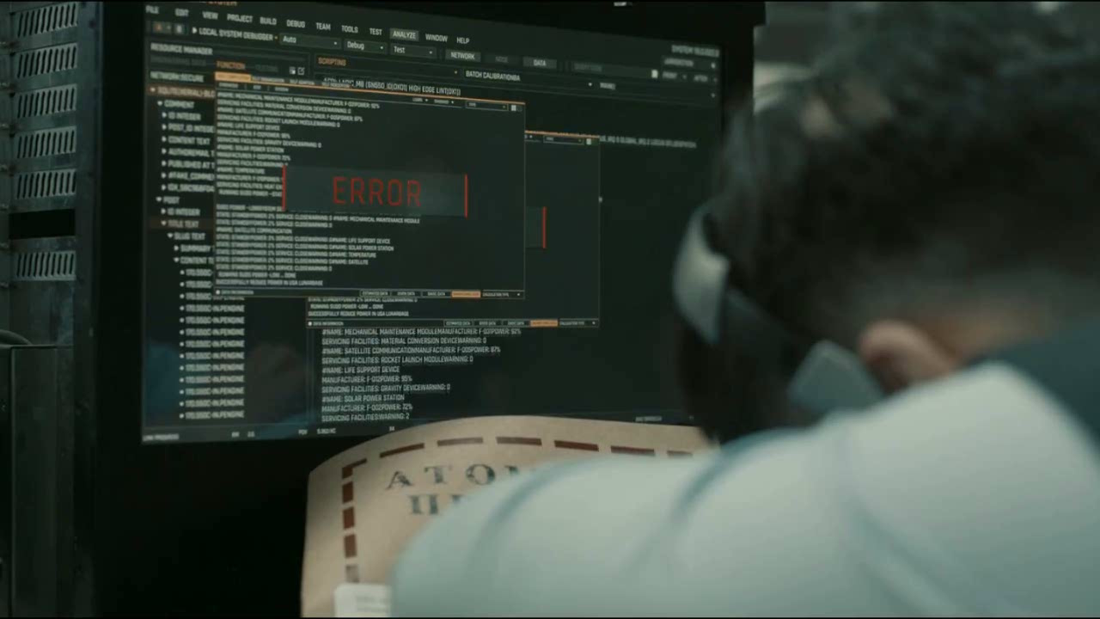
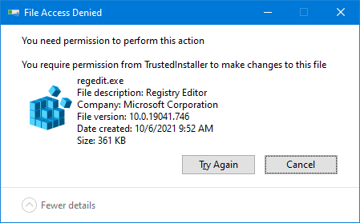
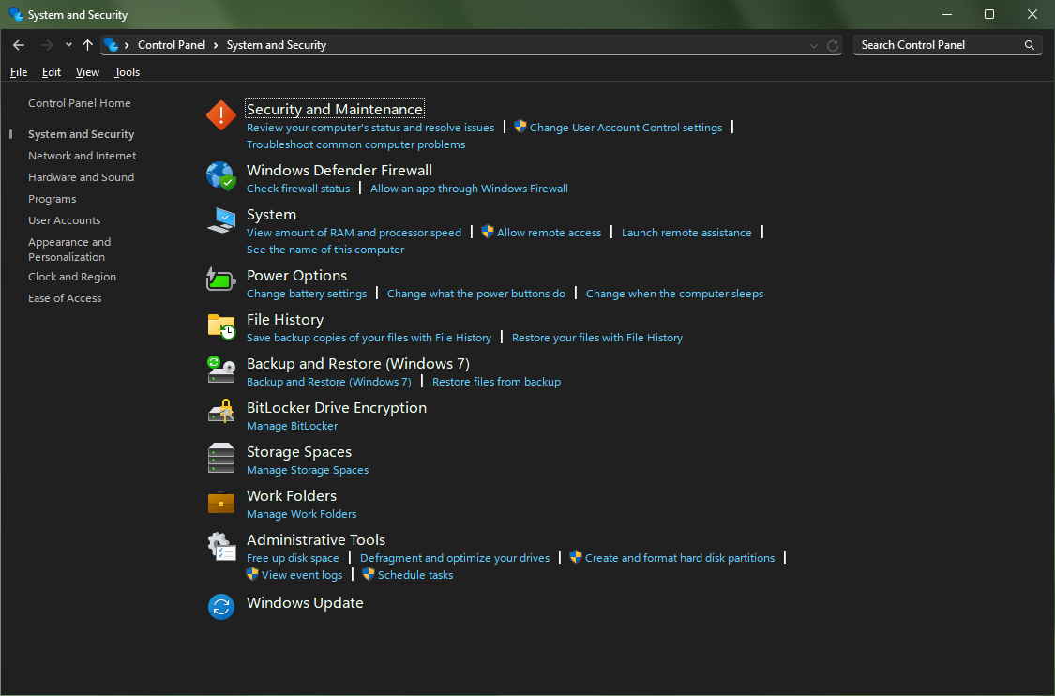
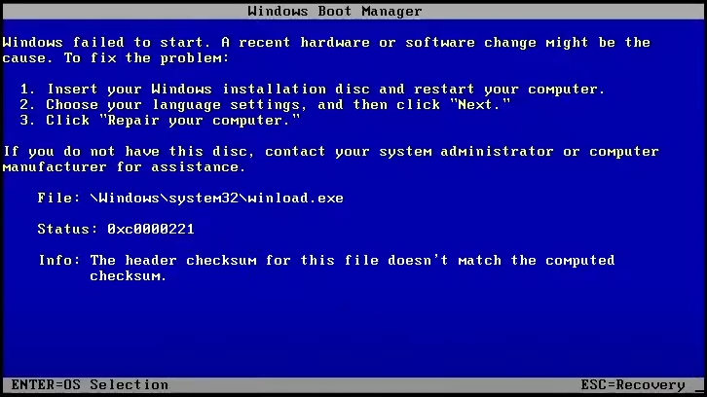
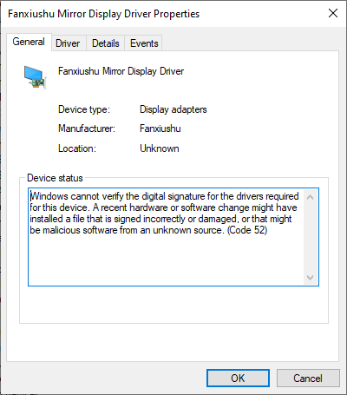
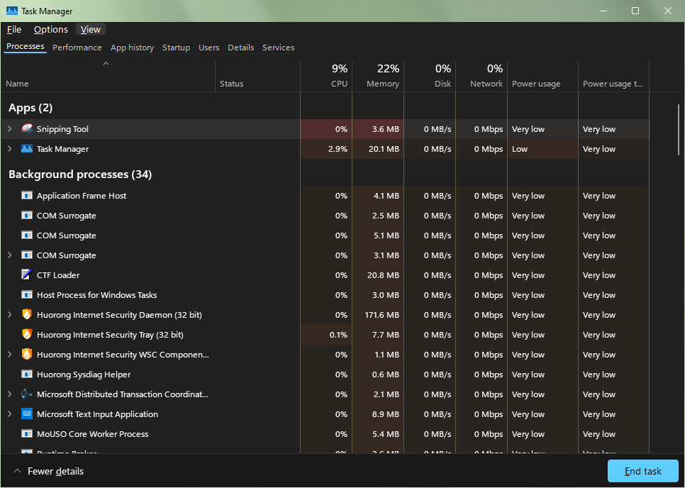
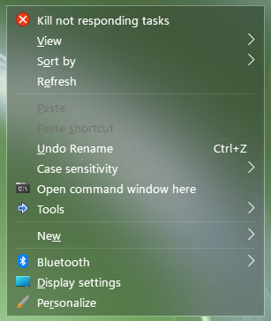
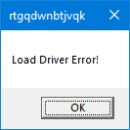
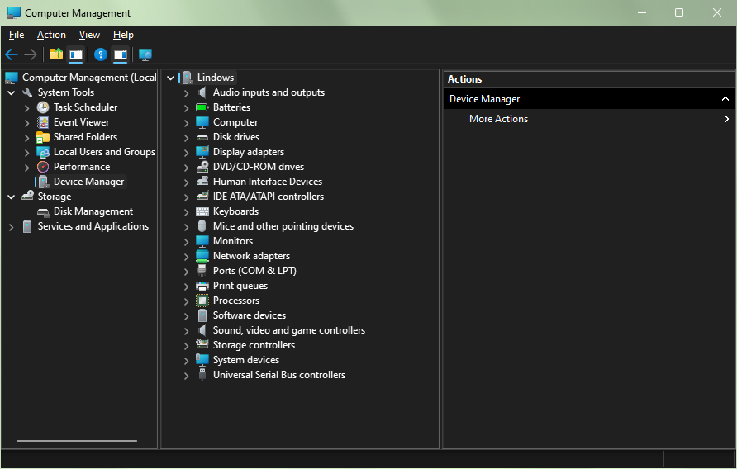
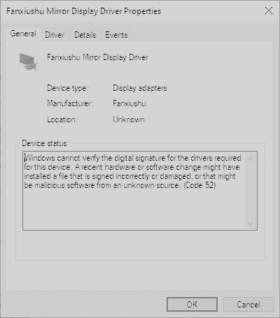
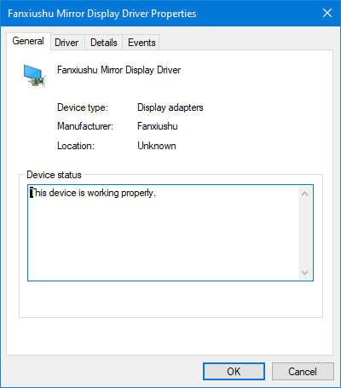
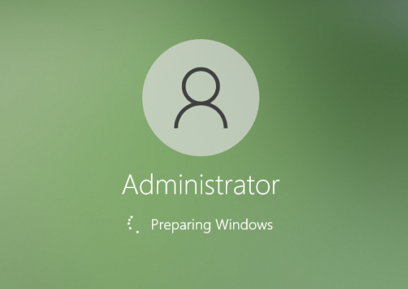
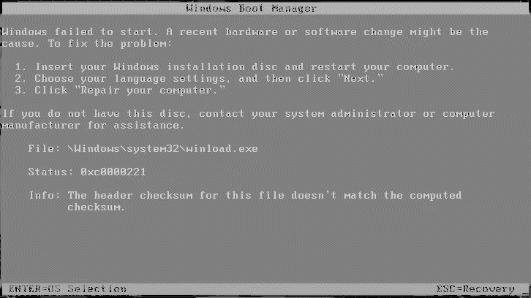
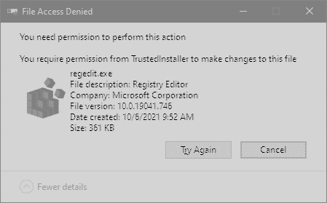
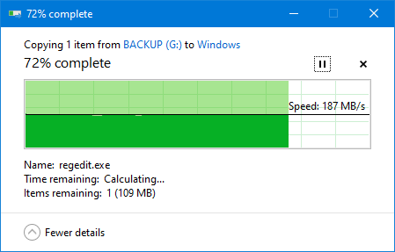
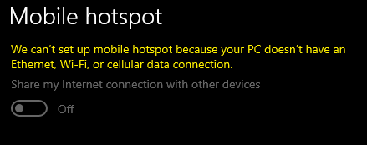
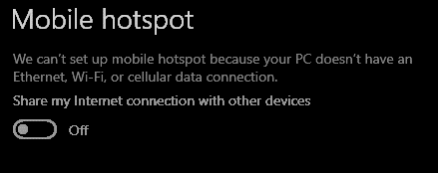
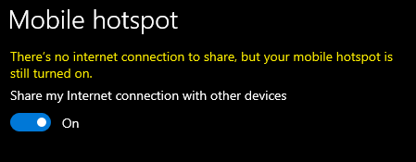
Tap anywhere to skip
In Lindows 11.1:
Why I’m not allowed to use Mobile Hotspot
without internet connection?
THIS
IS
And…
Build 1001
December ??th 2024
But…
UNACCEPTABLE!!!
Lindows 11.1 Pro
Let’s avoid
AND I SHALL OWN IT!
From the beginning!
Why, Microsoft?
This is my PC
Introducing…
Lindows 11.1 Pro
I bought it!
Huge UI improvements!
Dark mode EVERYWHERE!
More consistent icon design
中国航天飞行中队，50岁以上的，出列。
I care about freedom more than security.
✖
✔
Chinese squadron, everyone aged over 50, step forward.
Why the f**k I need permission from
“TrustedInstaller” to modify some system files?
Why I cannot use any unsigned drivers?
Why I cannot modify the system kernel?
No more stupid integrity checks! In Lindows, the system always
boots normally no matter the checksum and the signature is valid or not!
Driver Signature Enforcement is completely removed in Lindows 11.1!
You are now free to use any unsigned drivers as much as you like.
We allow user to enable mobile hotspot at any time at any place.
The switch is now completely UNCONDITIONAL!
We provide a take ownership option in the context menu out of the box.
As well the ability to run anything as TrustedInstaller!

Slide 5
Lindows 11.1 Pro - Setup
Lindows 11.1 Pro
Let’s setup your account:
Choose a memorable password:
Confirm your password:
Apply
Powered By Microsoft PowerPoint

Slide 6
Lindows 11.1 Pro - Setup
Let’s setup your account:
Choose a memorable password:
Confirm your password:
Powered By Microsoft PowerPoint

Slide 7
Lindows 11.1 Pro - Setup
Let’s tweak Lindows to suit your needs:
Let’s setup your account:
Replace Legacy On-Screen Keyboard (osk.exe) with Command Prompt
Choose a memorable password:
Use OmniMIDI as the default MIDI playback device (improves MIDI playback)
The new password has been set
Confirm your password:
Use Lindows XP mode to provide support for some old applications
Setup Shadow Defender to minimize damage caused by misuse
Configure more advanced options in WinaeroTweaker
Customize how aero glass looks like in Lindows
Customize file explorer behavior in ExplorerPatcher
Apply
Setup remote desktop connection with RDP Warper
Powered By Microsoft PowerPoint

Slide 8
Lindows 11.1 Pro - Setup
Let’s tweak Lindows to suit your needs:
Replace Legacy On-Screen Keyboard (osk.exe) with Command Prompt
Use OmniMIDI as the default MIDI playback device (improves MIDI playback)
Use Lindows XP mode to provide support for some old applications
Setup Shadow Defender to minimize damage caused by misuse
Configure more advanced options in WinaeroTweaker
Customize how aero glass looks like in Lindows
Customize file explorer behavior in ExplorerPatcher
Setup remote desktop connection with RDP Warper
Powered By Microsoft PowerPoint

Slide 9
Lindows 11.1 Pro - Setup
Let’s setup your development environment:
Let’s tweak Lindows to suit your needs:
DotNet, C/C++, UWP, and Windows Drivers development with Visual Studio 2019
Replace Legacy On-Screen Keyboard (osk.exe) with Command Prompt
Python development with PyCharm
Use OmniMIDI as the default MIDI playback device (improves MIDI playback)
Changes applied
Use Lindows XP mode to provide support for some old applications
Reverse engineering with IDA Pro
Setup Shadow Defender to minimize damage caused by misuse
Batch scripting with IBAT IDE
Configure more advanced options in WinaeroTweaker
msdos/win3x development with MSVC 1.52c
Customize how aero glass looks like in Lindows
Adobe Flash development
Customize file explorer behavior in ExplorerPatcher
HTML/JavaScript development with Expression Web
Install
Apply
Setup remote desktop connection with RDP Warper
Powered By Microsoft PowerPoint

Slide 10
Lindows 11.1 Pro - Setup
Let’s tweak Lindows to suit your needs:
DotNet, C/C++, UWP, and Windows Drivers development with Visual Studio 2019
Python development with PyCharm
Reverse engineering with IDA Pro
Batch scripting with IBAT IDE
msdos/win3x development with MSVC 1.52c
Adobe Flash development
HTML/JavaScript development with Expression Web
Powered By Microsoft PowerPoint

