Slide 1

MWC
React Fundamentals
Rupesh Mishra
Ankita Masand

Slide 2
React
Developed by Engineers at Facebook
Why Facebook needed something like react?

Slide 3
Why React is so popular?
Simple & Easy to Learn
Component Based Approach
Virtual DOM
Server Side & Client Side Rendering
One Way Data flow
React Native

Slide 4
What are React Elements?

Slide 5
What are Components?

Slide 6
JSX

Slide 7
Props
States
Events

Slide 8
Component Lifecycle methods
Mounting Phase
-- getDefaultProps()
-- getInitialState()
-- componentWillMount()
-- render()
-- componentDidMount()

Slide 9
Component Lifecycle methods
2. Update Phase
-- componentWillReceiveProps()
-- shouldComponentUpdate()
-- componentWillUpdate()
-- render()
-- componentDidUpdate()

Slide 10
Component Lifecycle methods
3. UnMount Phase
-- componentWillUnmount()

Slide 11
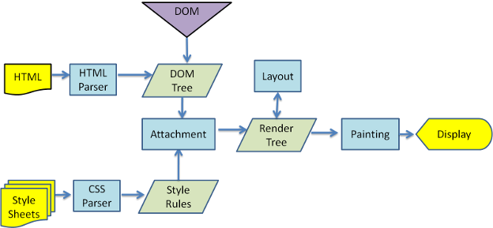
Why updating Real DOM is slow?

Slide 12
Why React.js is faster compared to other libraries and frameworks?
Virtual DOM
Diffing Algorithm
-- Breadth first search
-- Components
-- Batch Update
-- Subtree rendering

Slide 13
Why React.js is faster compared to other libraries and frameworks?
3. Heuristic Based Approach
-- Two elements of different types will produce different trees
-- Hints can be provided with the help of key props

Slide 14
Thank you! ☺

