Slide 1
EEP5C22 Computational Methods
Assignment II
Unittests in Python
Comments or Docstrings in Python
How to write a Readme File

Slide 2
Introduction to Assignment II
Audio Restoration using different interpolation methods

Slide 3
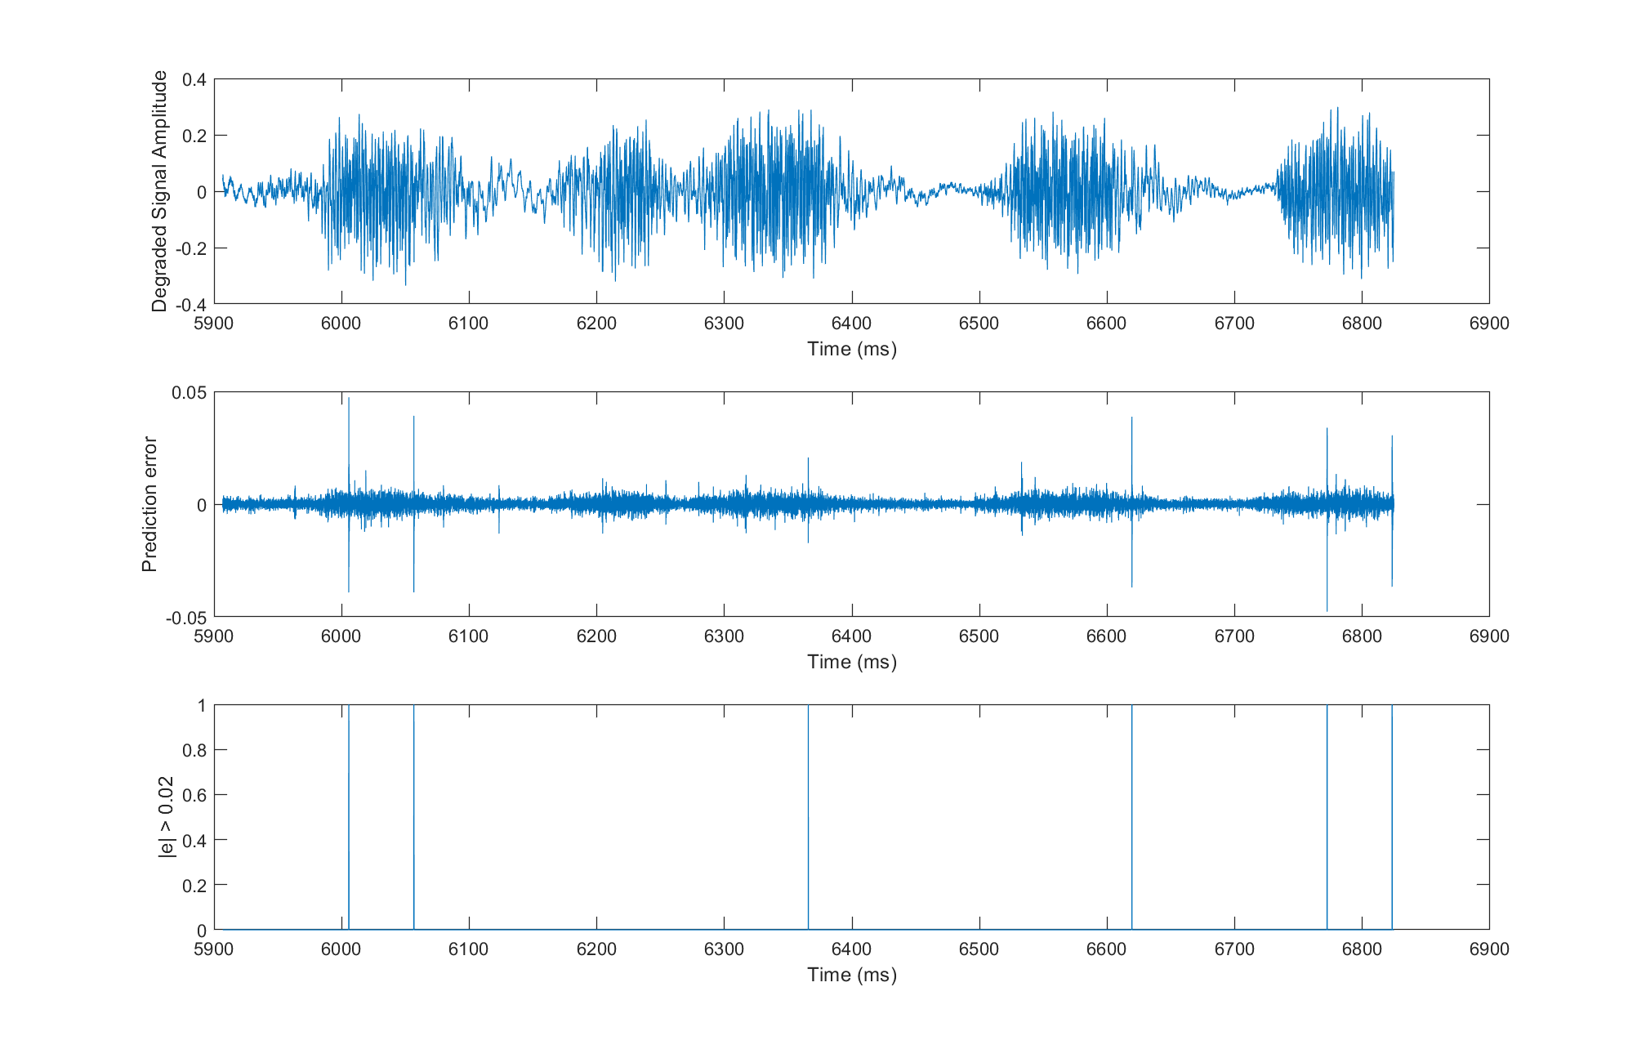
Reminder

Slide 4
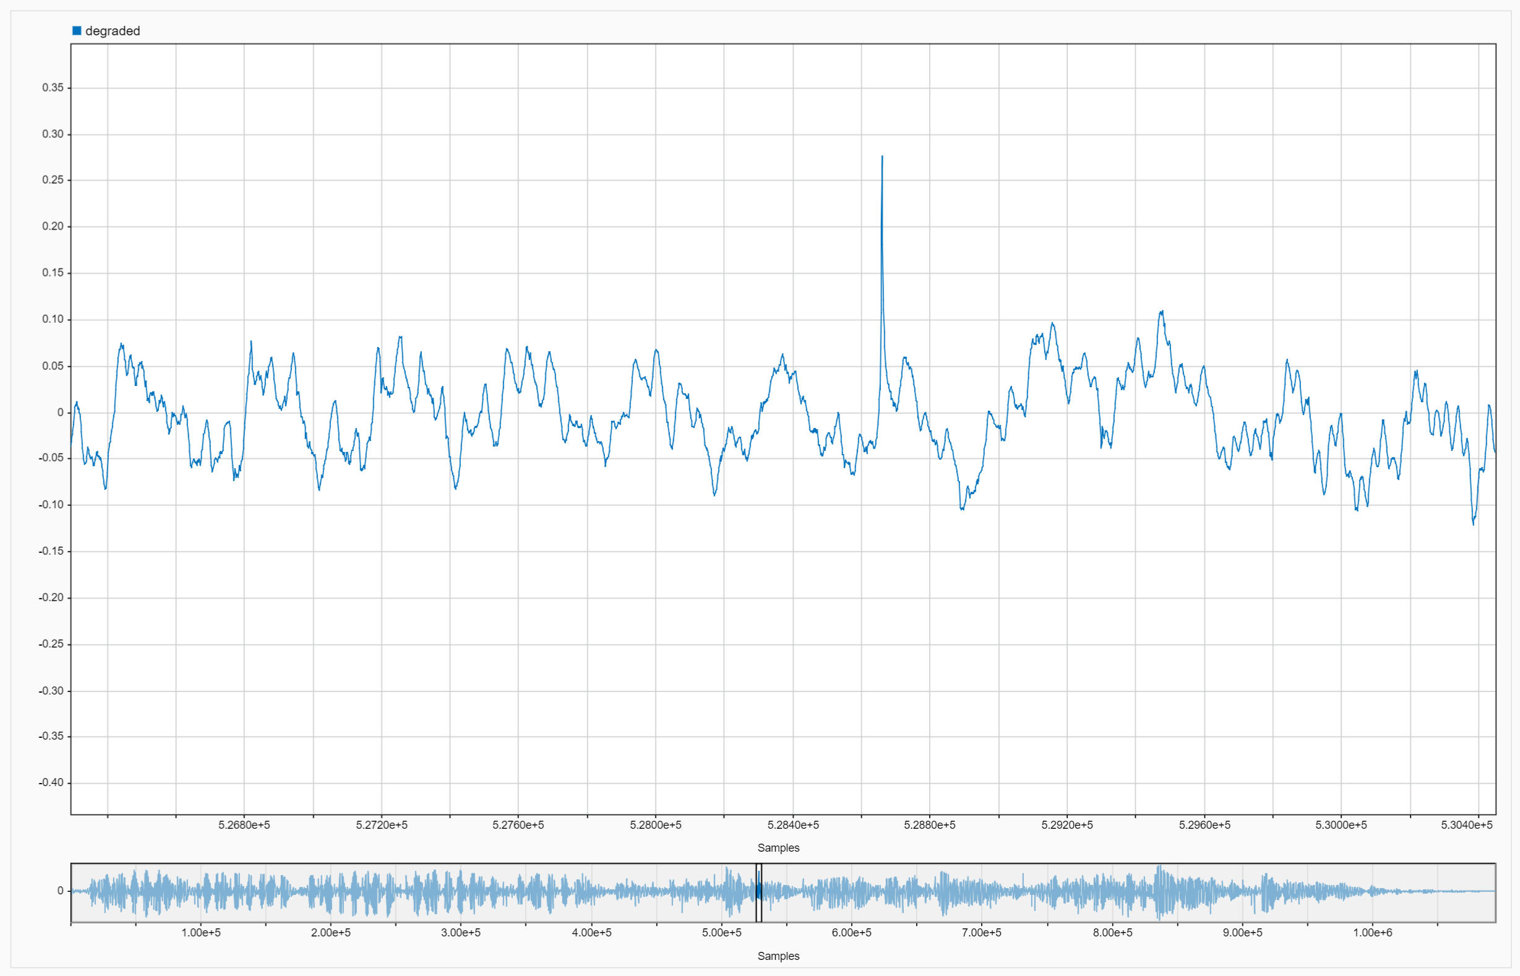

Median - An alterative interpolator
Reminder
We didn’t have to propose that the model for the signal was AR. We could have instead tried to use a simpler idea : filter the signal in such a way that we reject outliers.
This sample is an “outlier” in the distribution of nearby samples
$$y_{k}$$
k

Slide 5
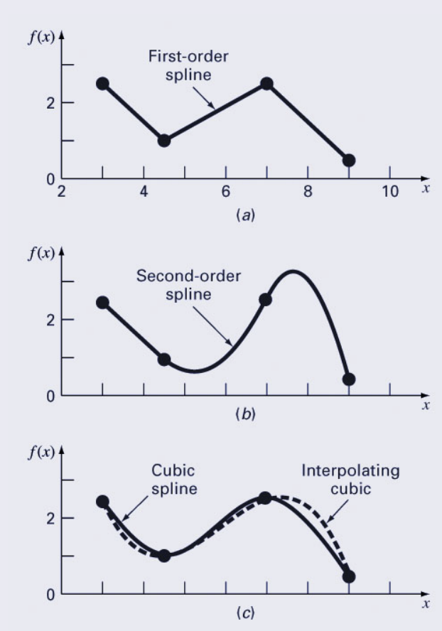
Splines – Another Interpolator
Concept similar to piecewise polynomial interpolation, but can be controllable by using “knots”
In polynomial regression, we had to choose the degree
For cubic splines, we need to choose the knots

Slide 6
Splines – Another Interpolator
Concept similar to piecewise polynomial interpolation, but can be controllable by using “knots”
In polynomial regression, we had to choose the degree
For cubic splines, we need to choose the knots
How complex is a cubic spline with K knots?
A cubic spline with K knots is as complex as a polynomial of degree K + 3.

Slide 7
Splines – Another Interpolator

Slide 8
Splines – Another Interpolator

Slide 9
Another Example

Slide 10
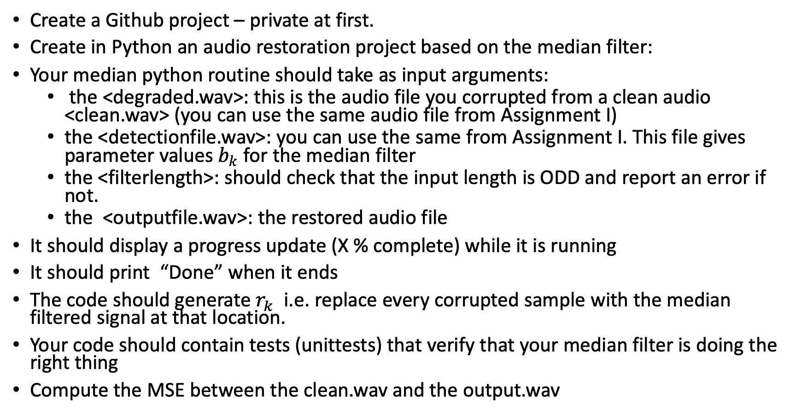
First Task – Median Filter
Create a Github project – private at first.
Create in Python an audio restoration project based on the median filter:
Your median python routine should take as input arguments:
the <degraded.wav>: this is the audio file you corrupted from a clean audio <clean.wav> (you can use the same audio file from Assignment I)
the <detectionfile.wav>: you can use the same from Assignment I. This file gives parameter values $b_{k}$ for the median filter
the <filterlength>: should check that the input length is ODD and report an error if not.
the <outputfile.wav>: the restored audio file
It should display a progress update (X % complete) while it is running
It should print “Done” when it ends
The code should generate $r_{k}$ i.e. replace every corrupted sample with the median filtered signal at that location.
Your code should contain tests (unittests) that verify that your median filter is doing the right thing
Compute the MSE between the clean.wav and the output.wav
Deadline: 29/11/2022
Assessment: 30/11/2022

Slide 11
Second Task – Cubic Splines Filter
Deadline: 29/11/2022
Assessment: 30/11/2022
Follow the exact same process as with the median filter, but this time use the cubic splines.
Compare MSE and execution time for the two different interpolators.
FOR THIS EXERCISE YOU ARE NOT ALLOWED TO USE THE MEDIAN() FUNCTION IN NUMPY. But you can use it to test your code if you want.
You are allowed to use a numpy function for the cubic splines interpolation.
You MUST apply autopep8 formatting
Optional : Your programme can autoplay the degraded and restored audio files after execution completion.
Create a Readme file that follows the structure from the template.
Apply version control during the development and push the code to your github project.
Submit your finalised files and make the project Public

Slide 12
Unit Testing in Python

Slide 13
Unit Testing
supports test automation;
sharing of setup and shutdown code for tests
aggregation of tests into collections
independence of the tests from the reporting framework.
The developers are expected to write automated test scripts, which ensures that each and every section or a unit meets its design and behaves as expected.

Slide 14
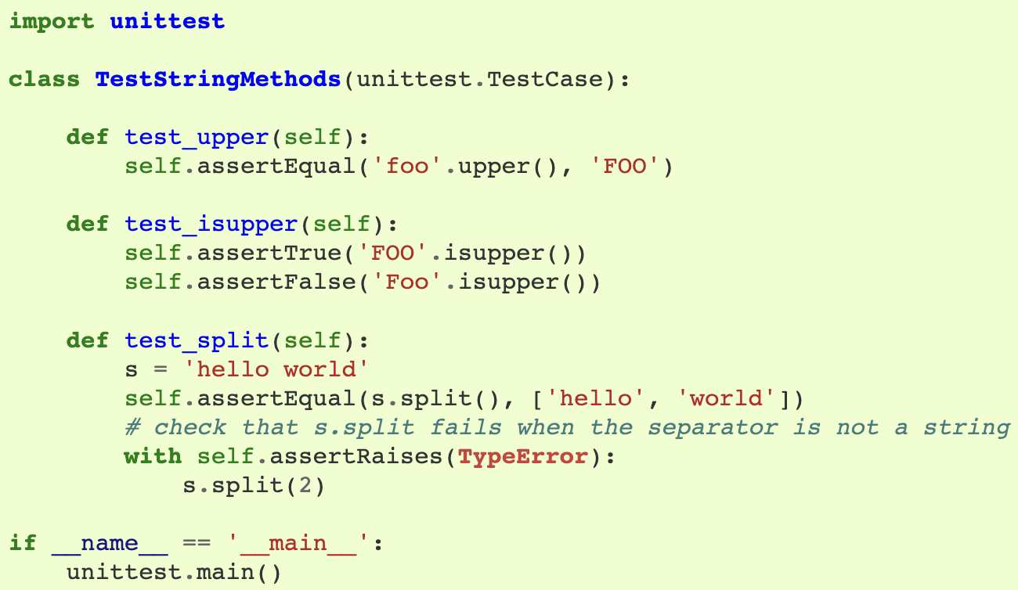
Unit Testing
Usually, a separate file is used for unit testing
The three individual tests are defined with methods whose names start with the letters test.
This naming convention informs the test runner about which methods represent tests.

Slide 15
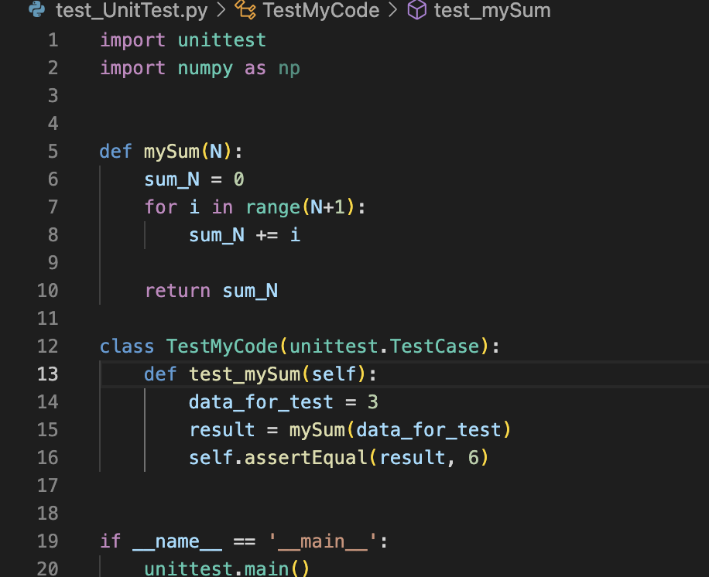
Example of Unit Testing

Slide 16
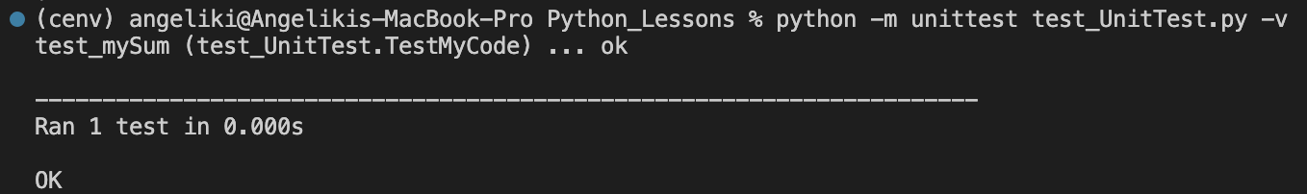
Example of Unit Test

Slide 17
Comments and Docstrings in Python

Slide 18
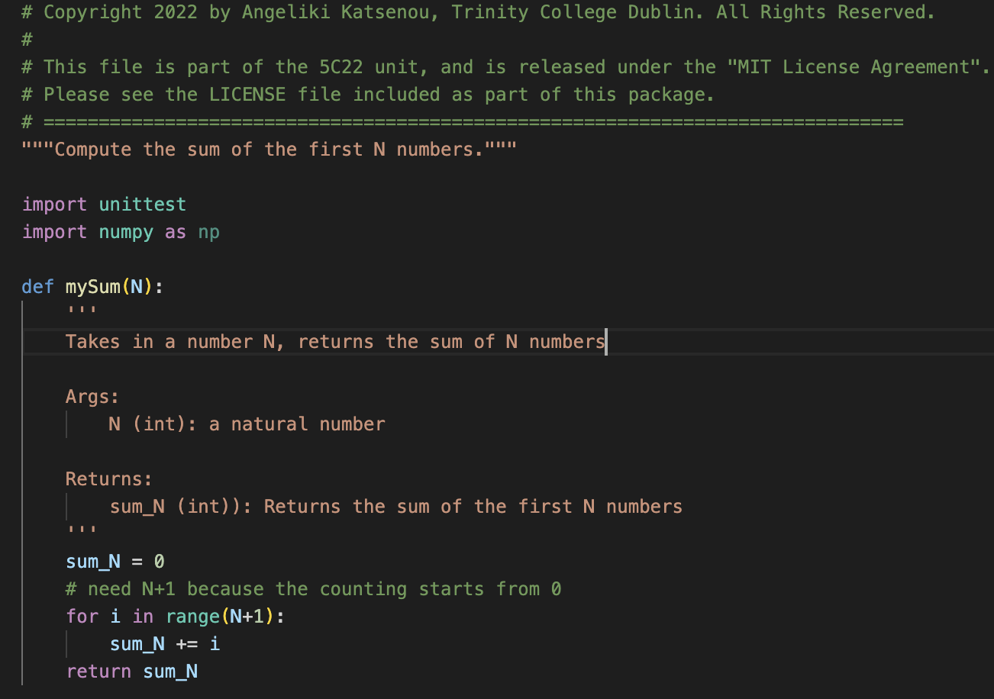
Comments or Docstrings?
comments
docstrings
docstrings
comments

Slide 19
Comments or Docstrings?
Comments for preamble of the document
Comments on specific lines of code - help programmers better understand the intent and functionality of the program.
Comments are completely ignored by the Python interpreter.
Docstrings for general description of scripts and functions
Typically used right after the definition of a function, method, class, or module.
Docstrings are used to document our code.
We can access these docstrings usin:
the print(myFunction.__doc__) attribute or
through import myFunction and then help(myFunction)

Slide 20
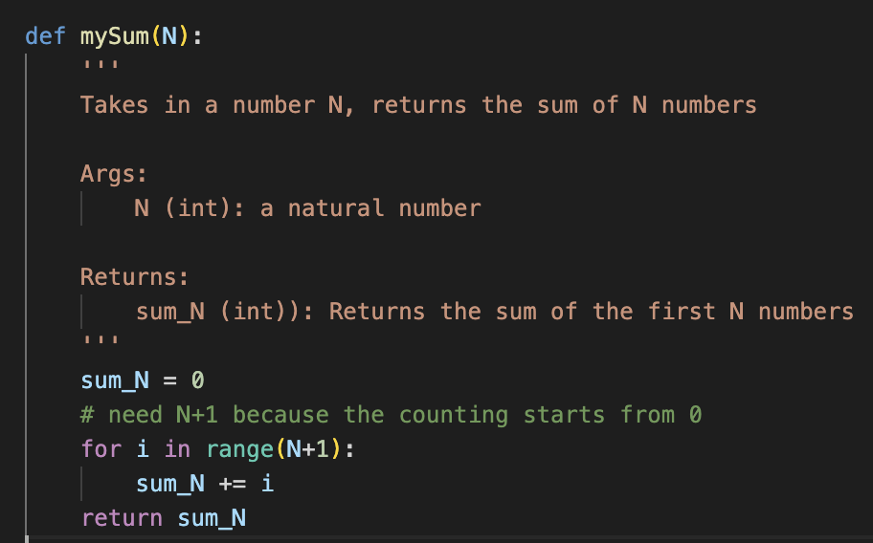

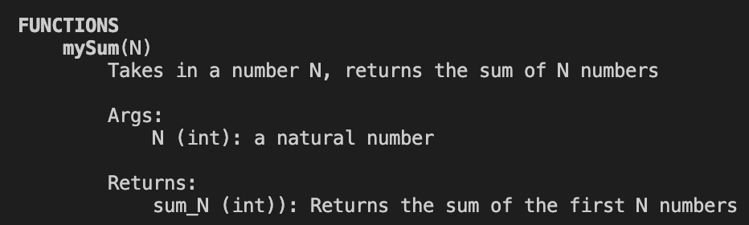
Example of using docstrings

Slide 21
Readme files

Slide 22
Readme Files – Basics to Include
Use Markdown Language to write - it is a text-to-HTML conversion tool for web writers.
Can be written in VS Code editor
You can render them through VS Code before pushing on Github (right click on the file and select Preview)

Slide 23
Readme Files – Basics to Include
1. Project's Title
It describes the whole project in one sentence, and helps people understand what the main goal and aim of the project is.
2. Project Description
Your description is an extremely important aspect of your project. It gives more information on the algorithms, design, and methodology

Slide 24
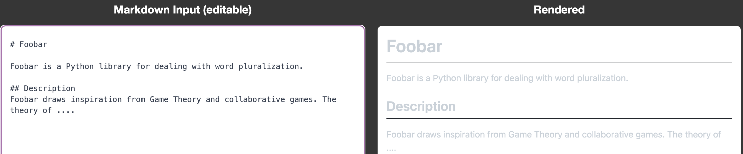
Example

Slide 25
Readme Files – Basics to Include
3. How to Install and Run the Project
You should include a file with the requirements/dependencies or include the steps required to install your project.
Provide a step-by-step description of how to get the development environment set and running. Give also a demo file or examples to run.
4. Include Credits
If you worked on the project as a team or an organization, list your collaborators/team members.
Also include references you used that might help others to build that particular project.

Slide 26
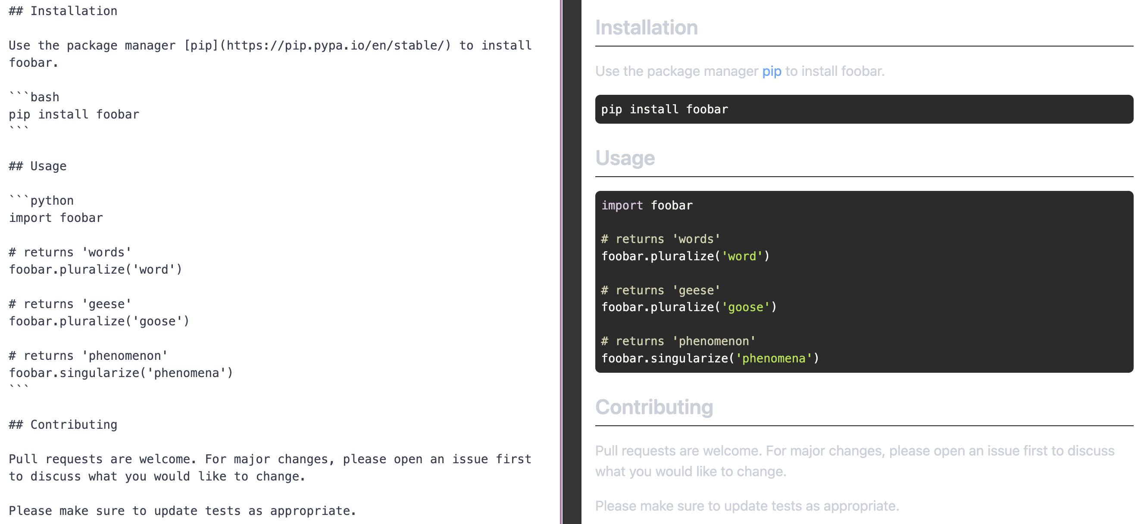
Example

Slide 27
Resources
https://en.wikipedia.org/wiki/Markdown
https://docs.github.com/en/get-started/writing-on-github/getting-started-with-writing-and-formatting-on-github/basic-writing-and-formatting-syntax
Online Readme Editors: https://dillinger.io/ , https://www.makeareadme.com
https://www.freecodecamp.org/news/how-to-write-a-good-readme-file/
Docstrings: https://www.programiz.com/python-programming/docstrings
https://numpy.org/doc/stable/user/quickstart.html
Numpy for matlab users https://numpy.org/doc/stable/user/numpy-for-matlab-users.html
Progress bars: https://pypi.org/project/progress/
Audio Basics in Python: https://www.it-jim.com/blog/audio-processing-basics-in-python/
Unittesting:
https://docs.python.org/3/library/unittest.html
https://colab.research.google.com/github/damorimRG/practical_testing_book/blob/master/testgranularity/unittesting.ipynb

