Slide 1

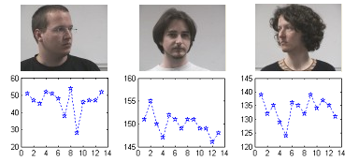
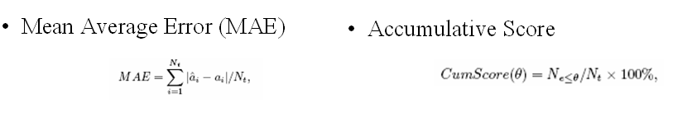
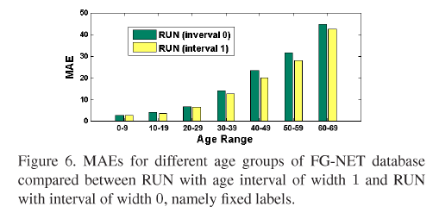
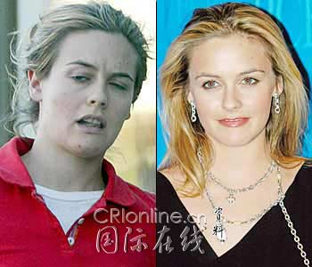

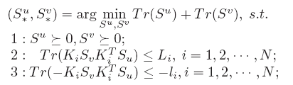
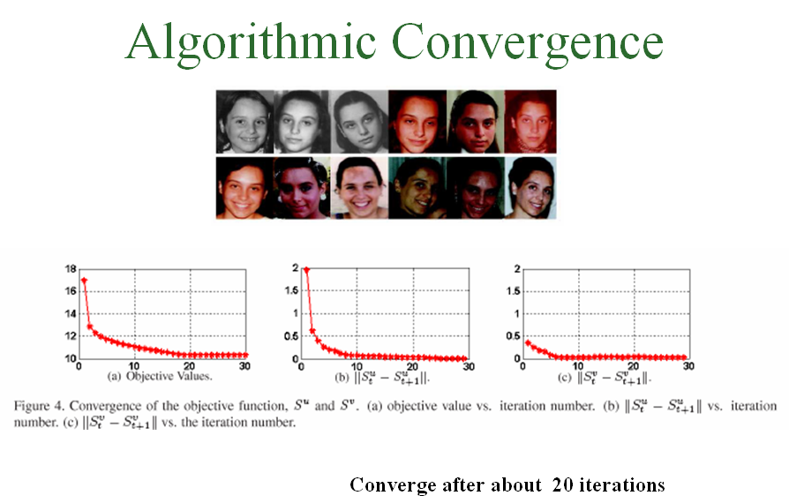

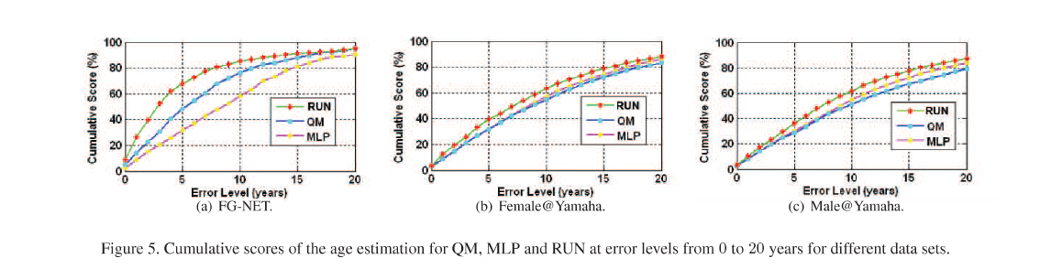
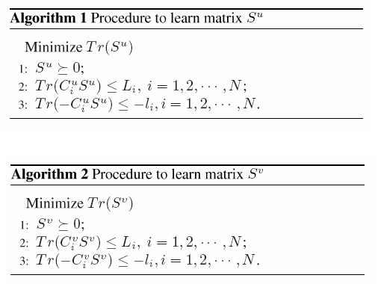
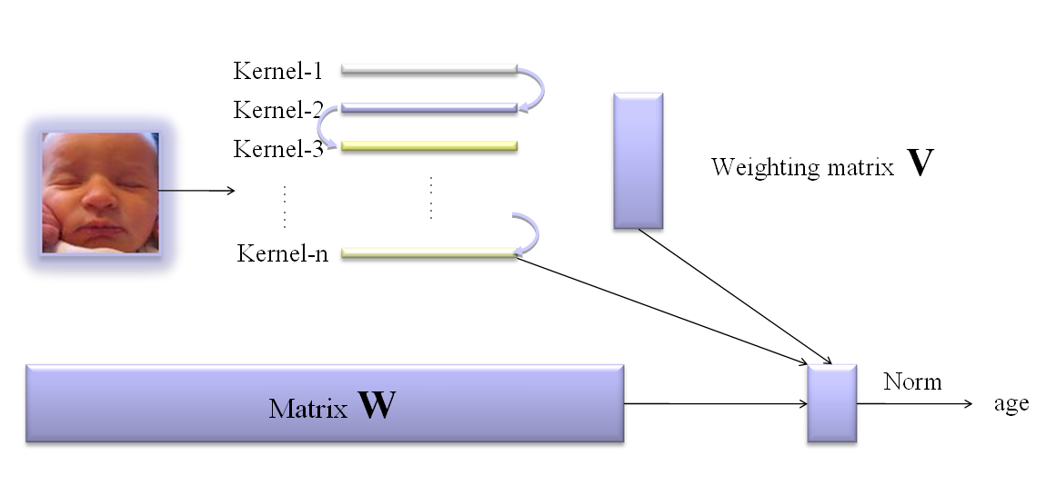
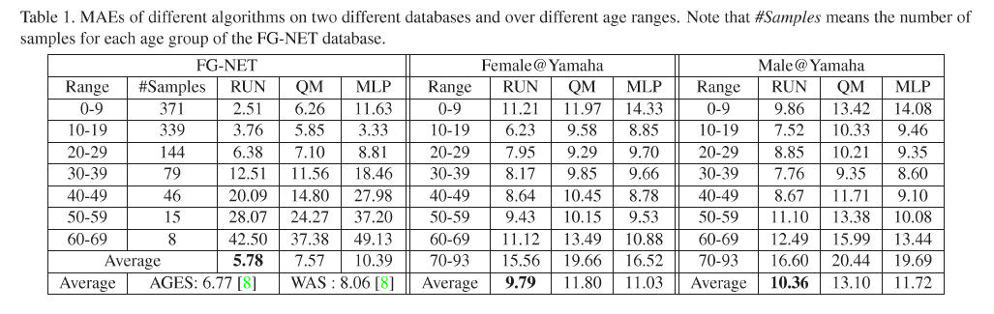

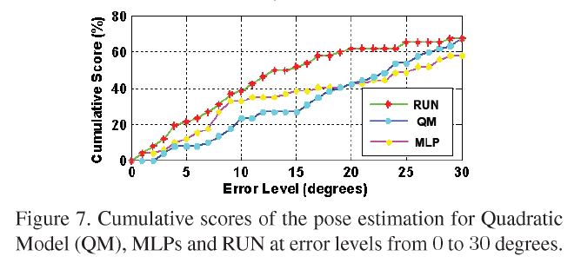

Learning Auto-Structured Regressor from Uncertain Nonnegative Labels Shuicheng Yan, Huan Wang, Xiaoou Tang, Thomas S. Huang
Beckman Institute and ECE Department
University of Illinois at Urbana-Champaign
405 N. Mathews Ave., Urbana, IL 61801
scyan@ifp.uiuc.edu
Department of Information Engineering
Chinese University of Hong Kong
Shatin, Hong Kong
hwang5@ie.cuhk.edu.hk
Learning with Uncertain Labels
Mathematical Formulation
Evaluation Criteria
Experiment Results
Uncertainty Effectiveness
Estimated pose labels of the three images in Pointing04 from 13 different observers by rotating a 3D head model. We can see that large standard deviations exist for these labeled ground truths.
Algorithm Convergence
Label is Uncertain and Nonnegative !!!
Makeup greatly affects observed age
Living condition affects observed age
An integer age l means the age within [l, l+1)
Without ground truth, the age estimation is subject-dependent
Iterative Procedure
Flowchart
Age Estimation
Pose Estimation

