Slide 1

UML BasicsIIII：综合实践和问题解答
项目成员：郭岳、杨海波、杨寒凌、
周南、李骏、叶瑶毓

Slide 2
Contents
1. What is UML？
2. Why use UML？
3. How to use UML

Slide 3
GOAL!
Review & Practice

Slide 4
What is UML？

Slide 5
What is UML?
Unified Modeling Language（统一建模语言）
OMG Standard, Object Management Group
Based on work from Booch, Rumbaugh, Jacobson
UML is a modeling language to express and design documents, software
Particularly useful for OO design
Not a process, but some have been proposed using UML
Independent of implementation language

Slide 6
Why use UML
Open Standard, Graphical notation for
Specifying, visualizing, constructing, and documenting software systems
Language can be used from general initial design to very specific detailed design across the entire software development lifecycle
Increase understanding/communication of product to customers and developers
Support for diverse application areas
Support for UML in many software packages today (e.g. Rational, plugins for popular IDE’s like NetBeans, Eclipse)
Based upon experience and needs of the user community

Slide 7
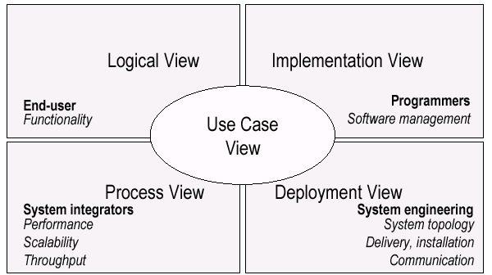
UML Models, Views, Diagrams
UML is a multi-diagrammatic language
Each diagram is a view into a model
Diagram presented from the aspect of a particular stakeholder
Provides a partial representation of the system
Is semantically consistent with other views
Example views

Slide 8
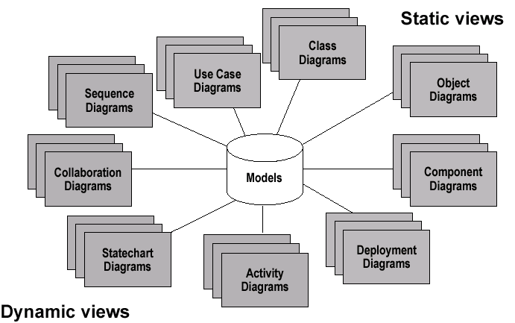
Models, Views, Diagrams

Slide 9
How to use UML?

Slide 10
Basic Modeling Steps
Use Cases
Capture requirements（获取需求）
Domain Model
Capture process, key classes
Design Model
Capture details and behaviors of use cases and domain objects
Add classes that do the work and define the architecture
Notes:
Consist of
用例
捕获需求（获取需求）
领域模型
捕获过程，关键类
设计模型
捕获用例和域对象的详细信息和行为
添加完成工作的类并定义体系结构

Slide 11
UML Baseline
Use Case Diagrams（用例图）
Class Diagrams（类图）
Interaction Diagrams（交互图）
Sequence（顺序图）
Collaboration（通信图）
Activity Diagrams（活动图）
State Transition Diagrams（状态转换图）
Notes:
contain

Slide 12
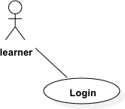
Use Case Diagrams
Used during requirements elicitation to represent external behavior（在需求获取过程中表示外部行为）
Actors represent roles, that is, a type of user of the system
Use cases represent a sequence of interaction for a type of functionality; summary of scenarios（情景）
Notes:
As we can see from this figure
Next we will describe actor usecase in detail

Slide 13
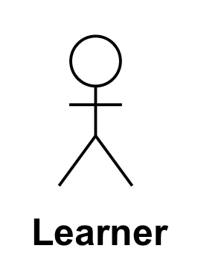

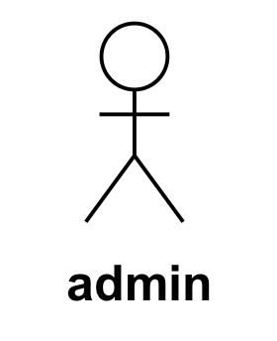
Actors
An actor models an external entity which communicates with the system:
User
External system
Physical environment
An actor has a unique name and an optional description.
Examples:
Learner:PBCLS 中的学习者
GPS satellite: Provides the system with GPS coordinates

Slide 14

Use Case
A use case represents a class of functionality provided by the system as an event flow.
A use case consists of:
Unique name
Participating actors
Entry conditions
Flow of events
Exit conditions
Special requirements

Slide 15
Use Case Diagram: Example
Name: PBCLS学习者用户登录
Participating actor: PBCLS学习者用户
Entry condition:
学习者用户已下载app
学习者用户希望使用app
Exit condition:
学习者用户登录成功
Event flow:
1. 学习者用户进入登录页面
2. 学习者用户输入邮箱
3. 学习者用户输入密码
4. 用户点击登录按钮
Anything missing?
Exceptional cases!

Slide 16
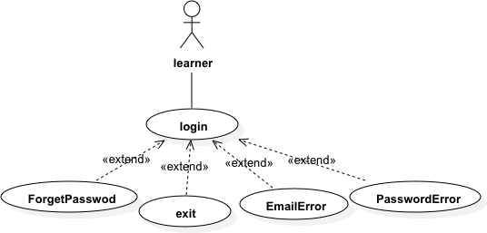
The <<extends>> Relationship
<<extends>>关系是可选的系统行为，通常代表异常或很少调用的情况。（ <<extends>> is relationships optional system behavior,represent exceptional or seldom invoked cases.)
The exceptional event flows are factored out of the main event flow for clarity.（为了清晰起见，将异常事件流从主事件流中分离出来。）
Use cases representing exceptional flows can extend more than one use case.
The direction of a <<extends>> relationship is to the extended use case

Slide 17
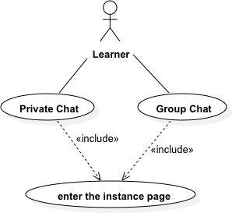
The <<includes>>Relationship
<<includes>> relationship are used to segment a reusable series of steps, thus reducing the complexity of basic use cases.
If no use case is included, the basic use case is incomplete
Basic use cases know the existence of the contained use cases. However, the included use case is not known 。 因此The direction of a <<includes>> relationship is to the using use case (unlike <<extends>> relationships).
Notes:
relationship 用于分割出可重复使用的一系列步骤，因此可以降低基本用例的复杂性。
如果没有包含用例，则基本用例不完整
基本用例知道所包含的用例的存在。但是，包含的用例不知道包含它的用例

Slide 18
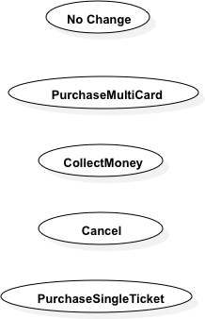

连连看
请根据给出的参与者以及用例，补充参与者和用例
之间，用例与用例之间的关系。

Slide 19
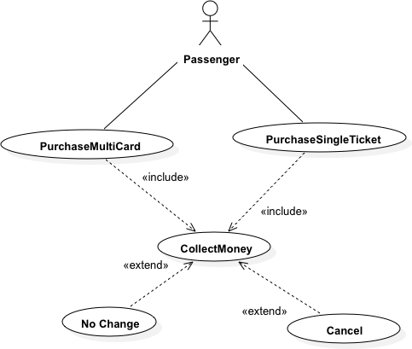

Slide 20
Class Diagrams
Gives an overview of a system by showing its classes and the relationships among them.
Class diagrams are static
they display what interacts but not what happens when they do interact
Also shows attributes and operations of each class(还显示每个类的属性和操作)
Good way to describe the overall architecture of system components(描述系统组件整体架构的好方法)

Slide 21
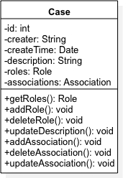
Name
Type
Attributes
Operations
Signature
A class represent a concept
A class encapsulates state (attributes 属性) and behavior (operations 操作).
Each attribute has a type（类型）.
Each operation has a signature（签名）.
The class name is the only mandatory information.
Notes:
强制性的

Slide 22
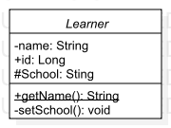
UML Class Notation
A class is a rectangle divided into three parts
Class name
Class attributes (i.e. data members, variables)
Class operations (i.e. methods)
Modifiers
Private: -
Public: +
Protected: #
Static: Underlined (i.e. shared among all members of the class)
Abstract class: Name in italics（斜体）
Notes:
Hashtag

Slide 23


Binary Association（二元关联）|| Bidirection Association（双向关联）in textbook
Binary Association: Both entities “Know About” each other
myB.service();
myA.doSomething();
Notes:
Both entities “Know About” each other意思是两个类可以彼此联系，类A的doSomething方法用私有域中的myB调用B类中的Service()，类B也类似的调用。而对于Case与Instance来说，给出一个Case我们应该可以得到他拥有的Instance，给定Instance我们也应该可以得到他属于的Case
For Case and Instance, given a Case, we should get the Instance that he owns, and given the Instance, we should also get the Case that he belongs to.
invoke

Slide 24

Unary Association（一元关联）|| Unidirection Association（单向关联）in textbook
A knows about B, but B knows nothing about A
myB.service();
Arrow points in direction
of the dependency

Slide 25
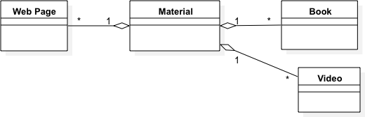
Aggregation
Aggregation describes the relationship of "has a",
using project data as an example
Aggregation is expressed as one end of the whole with one
Hollow diamond association
Notes:
聚合描述了“has a”的关系，以项目资料为例聚合被表示为整体的一端用一
个空心菱形关联
打比方的话就是人和公司的关系，公司由人聚合而成。用UML表示，是一个空心的框框。

Slide 26

Composition
Composition is Aggregation with:
Lifetime Control (owner controls construction, destruction)
Part object may belong to only one whole object
Filled diamond on side of the Collection
Notes:
成员对象的生命周期取决于聚合的生命周期，成员对象对象只属于一个组合对象。聚合不仅控制着成员对象的行为，而且控制着成员对象的创建和撤销。比如说，pbcls中在创建一个任务时，必须选择该任务所属于的里程碑，而当某一个里程碑被删除时，必须撤销这个里程碑下的所有任务。 How to distinguish 打比方的话就是人和大脑的关系，人由大脑组合而成，如果人死了，大脑也活不成
人和公司的关系，公司由人聚合而成。用UML表示，是一个空心的框框

Slide 27
Association Details
Can assign names to the ends of the association to give further information
Team
-
Employee
group
-
Name
-
:
string
members
:
Employee
-
individual
+
ID
:
long
#
Salary
1
:
double
-
adfaf
*
:
bool
+
getName
() :
string
+
setName
()
-
calcInternalStuff
(
in x
:
byte
,
in y
:
decimal
)

Slide 28
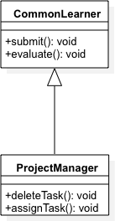
Inheritance
Standard concept of inheritance
Base Class
Derived Class
class ProjectManager extends CommonLearner
…
Notes:
继承和面向对象的继承一致，普通用户具有提交任务文档和评价任务的方法，而PM是普通用户的子类他也具有评价和提交两个方法，但PM还具有只属于PM的方法

Slide 29
UML Multiplicities
Links on associations to specify more details about the relationship
Multiplicities | Meaning
0..1 | zero or one instance. The notation n . . m indicates n to m instances.
0..* or * | no limit on the number of instances (including none).
1 | exactly one instance
1..* | at least one instance
Notes:
The next page will show what he means

Slide 30
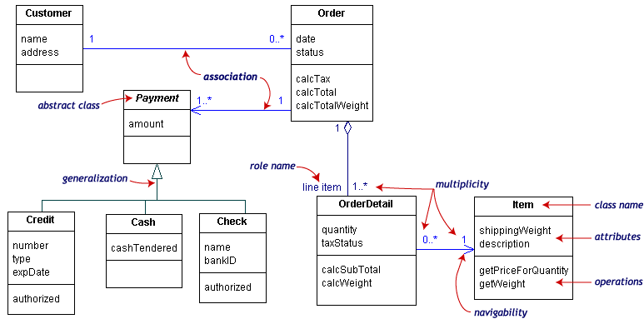
UML Class Example
Multiplicities | Meaning
0..1 | zero or one instance. The notation n . . m indicates n to m instances.
0..* or * | no limit on the number of instances (including none).
1 | exactly one instance
1..* | at least one instance
Notes:
顾客可以知道有哪些订单，订单也知道属于哪个客户，所以是双向关系。order has orderdetails。

Slide 31
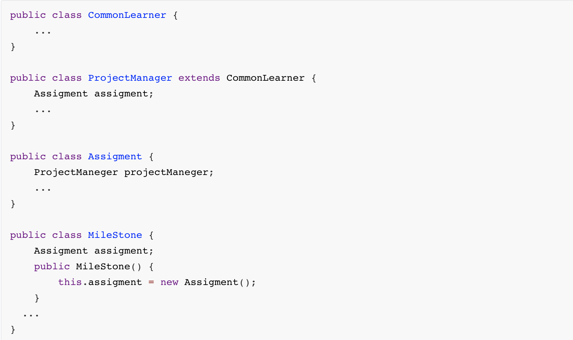
人工逆向
请根据代码画出类图。

Slide 32
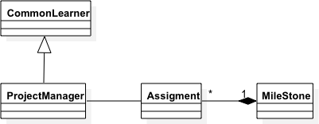

Slide 33
Object Diagrams
Shows instances of Class Diagrams and links among them
An object diagram is a snapshot of the objects in a system
Show the object state at a point in time
With a selected focus
Interactions – Sequence diagram
Message passing – Collaboration diagram
Notes:
Here we talk about对象图是类图的实例，一个对象图就是系统中的快照。快照：某一时刻的状态。表示对象在交互过程中某一时刻的状态。Emphasize on

Slide 34
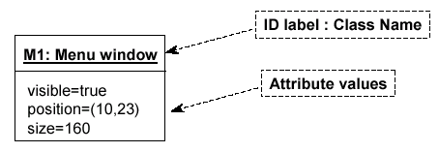

Object Diagrams
Format is
Instance name : Class name
Attributes and Values
Example:

Slide 35
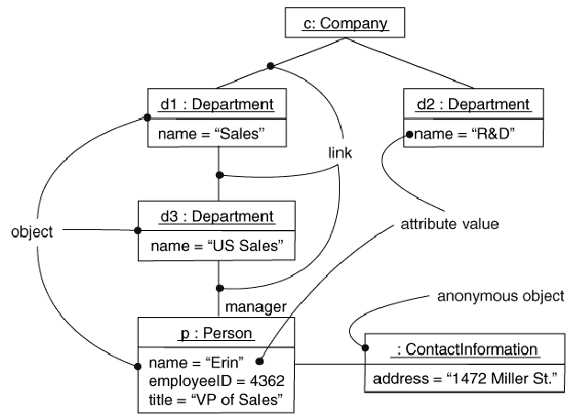
Objects and Links
Can add association type and also message type

Slide 36
Interaction Diagrams（交互图）
Interaction diagrams are dynamic -- they describe how objects collaborate（协作）.
A Sequence Diagram:
Indicates what messages are sent and when
Time progresses from top to bottom
Objects involved are listed left to right
Messages are sent left to right between objects in sequence
Notes:
Indicates what messages are sent and when：指示发送什么消息以及何时发送
Time progresses from top to bottom：时间从上到下
Messages are sent left to right between objects in sequence：

Slide 37
Sequence Diagram（顺序图） Format
Actor from
Use Case（角色）
Objects（对象）
Activation（激活）
Calls = Solid Lines（同步消息）
Returns = Dashed Lines（返回
消息）
Lifeline（生命线）
Notes:
Lifeline：代表对象在一段时间内的存在
Action：代表对象执行一项操作的时期

Slide 38
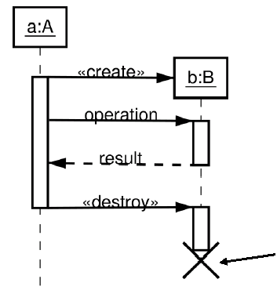
Sequence Diagram : Create and Destroy
发送消息创建对象
Shows Destruction of b
(and Construction)

Slide 39
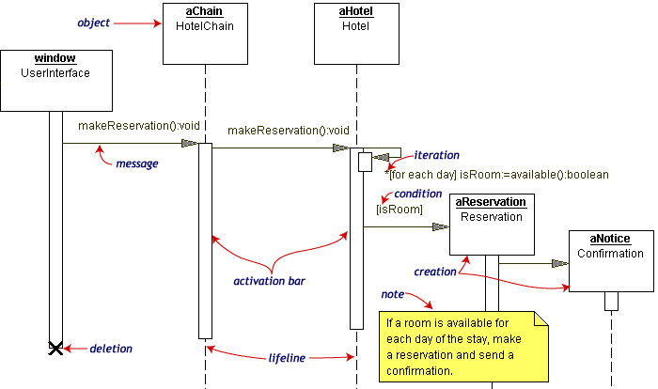
Sequence Diagram Example
Hotel Reservation

Slide 40
画图题
请根据步骤画出学习者查询PBCLS系统案例顺序图。
学习者想要查询某个案例
1.进入系统探索页面
2.输入关键字，查询案例
3.页面显示案例案例列表
actor：Learner
action：进入探索页面、查询书籍、返回查询到的结果、
显示列表
object：页面、案例、案例列表

Slide 42
Collaboration Diagram
Collaboration Diagrams show similar information to sequence diagrams, except that the vertical sequence is missing. In its place are:
Object Links - solid lines between the objects that interact
On the links are Messages - arrows with one or more message name that show the direction and names of the messages sent between objects
Emphasis on static links as opposed to sequence in the sequence diagram（强调静态链接，而不是序列图中的序列）

Slide 43
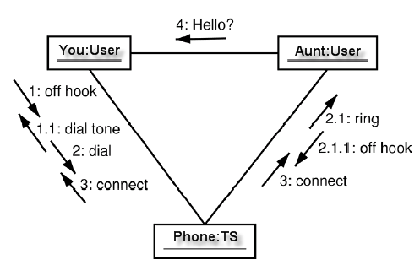
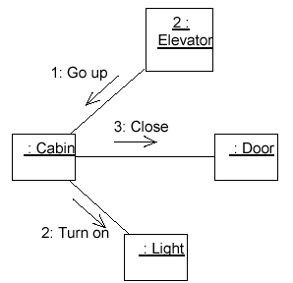
Collaboration Diagram
Notes:
Object Links - solid lines between the objects that interact
On the links are Messages - arrows with one or more message name that show the direction and names of the messages sent between objects

Slide 44
将以下顺序图转化为通信图

Slide 46
Activity Diagrams
Fancy flowchart
Displays the flow of activities involved in a single process
States（状态）
Describe what is being processed
Indicated by boxes with rounded corners
Swim lanes（泳道）
Indicates which object is responsible for what activity（指示哪个对象负责什么活动）
Branch（分支）
Transition that branch
Indicated by a diamond
Fork（分叉）
Transition forking into parallel activities
Indicated by solid bars
Start and End

Slide 47
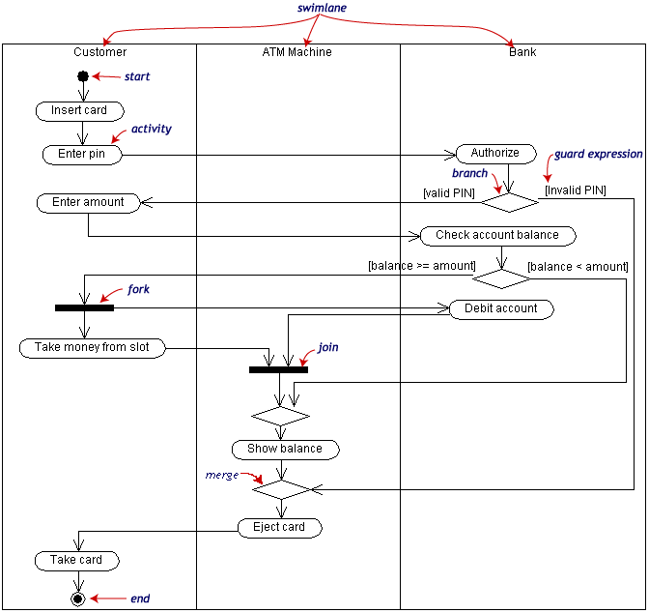
Activity Diagram Example
Notes:
States（状态）
Describe what is being processed
Indicated by boxes with rounded corners
Swim lanes（泳道）
Indicates which object is responsible for what activity（指示哪个对象负责什么活动）
Branch（分支）
Transition that branch
Indicated by a diamond
Fork（分叉）
Transition forking into parallel activities
Indicated by solid bars
Start and End

Slide 48
请使用活动图的基本元素完成活动图补全
PBCLS项目经理对任务的操作
1.进入任务总览
2.选择任务分配或评价
3.选择任务分配则进入任务分配页面
1.选择分配对象
2.完成退出
4.选择评价进入评价页面
1.若任务已完成则可开始评价
2.若任务未完成则退出
3.完成对任务的操作
Notes:
Please use the essential elements to complete the activity diagram

Slide 49

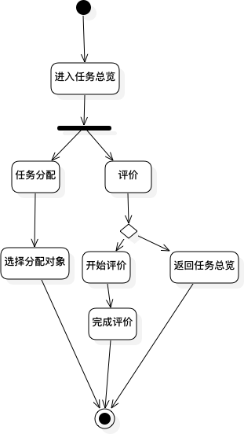

Slide 50
State Transition Diagrams
Shows the possible states of the object and the transitions that cause a change in state
i.e. how incoming calls change the state
Notation
States are rounded rectangles
Transitions are arrows from one state to another. Events or conditions that trigger transitions are written beside the arrows.
Initial and Final States indicated by circles as in the Activity Diagram
Final state terminates the action; may have multiple final states
Notes:
显示对象的可能状态以及引起状态变化的过渡
即来电如何更改状态
符号
状态是圆角矩形
过渡是从一种状态到另一种状态的箭头。 触发转换的事件或条件写在箭头旁边。
如活动图中所示，用圆圈表示的初始状态和最终状态
最终状态将终止操作； 可能有多个最终状态

Slide 51
State Representation
The set of properties and values describing the object in a well defined instant are characterized by
Name
Activities (executed inside the state)
Do/ activity
Actions (executed at state entry or exit)
Entry/ action
Exit/ action
Actions executed due to an event
Event [Condition] / Action ^Send Event
Notes:
在明确定义的瞬间描述对象的一组属性和值的特征在于
名称
活动（在州内执行）
做/活动
动作（在状态进入或退出时执行）
输入/动作
退出/动作
由于事件而执行的动作
事件[条件] /动作^发送事件

Slide 52
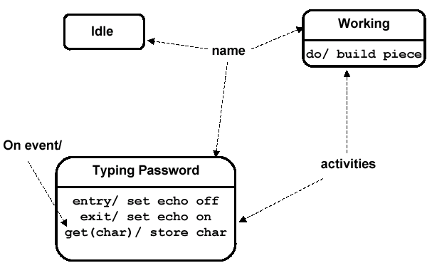
Notation for States
Notes:
Name
Activities (executed inside the state)
Do/ activity
Actions (executed at state entry or exit)
Entry/ action
Exit/ action
Actions executed due to an event
Event [Condition] / Action ^Send Event

Slide 53
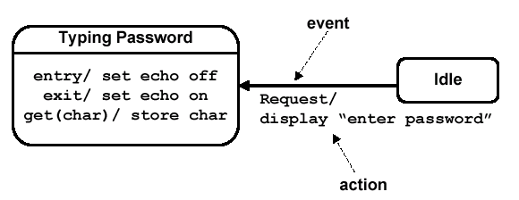
Simple Transition Example
Notes:
Transitions are arrows from one state to another. Events or conditions that trigger transitions are written beside the arrows.

Slide 54
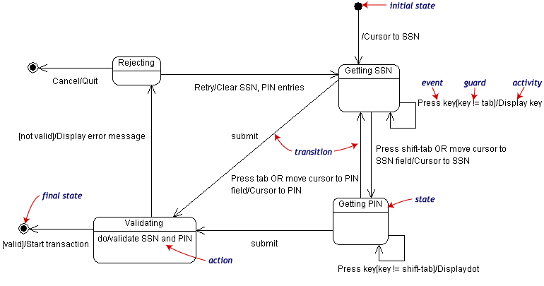
State Transition Example
Validating PIN/SSN
Notes:
Notation
States are rounded rectangles
Transitions are arrows from one state to another. Events or conditions that trigger transitions are written beside the arrows.
Initial and Final States indicated by circles as in the Activity Diagram
Final state terminates the action; may have multiple final states
The set of properties and values describing the object in a well defined instant are characterized by
Name
Activities (executed inside the state)
Do/ activity
Actions (executed at state entry or exit)
Entry/ action
Exit/ action
Actions executed due to an event
Event [Condition] / Action ^Send Event

Slide 55
请根据状态转换表画出状态机图
源目标 | 已开始 | 已完成 | 已评价
未开始 | 到达时间
已开始 |  | 提交任务文档
已完成 |  |  | 指导者完成评价

Slide 56
Summary and Tools
UML is a modeling language that can be used independent of development
Adopted by OMG and notation of choice for visual modeling
http://www.omg.org/uml/
Creating and modifying UML diagrams can be labor and time intensive.
Lots of tools exist to help
Tools help keep diagrams, code in sync
Repository for a complete software development project
Examples here created with Microsoft Visio, starUML
Notes:
398/5000
UML是一种可以独立于开发使用的建模语言 被OMG通过，并为视觉建模选择符号 http://www.omg.org/uml/ 创建和修改UML图可能会很费力和时间。 有很多工具可以帮助您 工具可帮助保持图表，代码同步 完整软件开发项目的存储库 使用Microsoft Visio starUML创建的示例

Slide 57
参考资料
[1]杨弘平, 吕海华, 李波, 史江萍, 代钦.UML2 基础、建模与设计教程[M]北京：清华大学出版社
[2]Grady Booch, James Rumbaugh, Ivar Jacobson.UML用户指南(第2版·修订版)[M]北京：人民邮电出版社
[3]https://www.cnblogs.com/Harriss/p/10750988.html-2019-12-11
[4]https://blog.csdn.net/u011991249/article/details/52681587 2019-12-10

Slide 58
成员 | 自评（30%） | 组评（40%） | 组长评（30%） | 总分
郭岳 | 29 | 33 | 29 | 86.18571419
杨海波 | 32 | 28 | 34 | 88.57142857
杨寒凌 | 31 | 33 | 29 | 89.14285714
周南 | 29 | 33 | 33 | 90.85714286
李骏 | 33 | 30 | 32 | 90
叶瑶毓 | 32 | 30 | 30 | 87.42857143

Slide 59
绩效评价
标准项 | 绩效检查项 | 郭岳（PM） |  |  | 杨海波 |  |  | 杨寒凌 |  |  | 周南 |  |  | 李骏 |  |  | 叶瑶毓
 | 权重 | 自评（30%） | 小组评价（40%） | 组长评价（30%） | 自评（30%） | 小组评价（40%） | 组长评价（30%） | 自评（30%） | 小组评价（40%） | 组长评价（30%） | 自评（30%） | 小组评价（40%） | 组长评价（30%） | 自评（30%） | 小组评价（40%） | 组长评价（30%） | 自评（30%） | 小组评价（40%） | 组长评价（30%）
1.1 | 是否按时完成分配任务？ | 4 | 4 | 4 | 5 | 4 | 5 | 5 | 4 | 4 | 5 | 5 | 5 | 5 | 4 | 5 | 4 | 4 | 4
1.2 | 分配任务是否符合小组规定的格式要求？ | 4 | 4 | 4 | 4 | 4 | 5 | 4 | 4 | 4 | 4 | 4 | 5 | 4 | 4 | 4 | 4 | 4 | 4
1.3 | 分配任务是否按照评审条目要求完成？ | 4 | 4 | 4 | 4 | 4 | 5 | 5 | 5 | 4 | 4 | 4 | 4 | 5 | 4 | 4 | 4 | 4 | 4
1.4 | 分配任务是否按照软件项目管理以及需求分析要求完成？ | 4 | 4 | 4 | 5 | 4 | 4 | 5 | 5 | 5 | 5 | 5 | 4 | 4 | 4 | 4 | 4 | 4 | 4
1.5 | 分配任务是否按照组长的要求完成？ | 4 | 4 | 4 | 5 | 4 | 5 | 4 | 5 | 4 | 5 | 5 | 5 | 5 | 4 | 5 | 5 | 5 | 4
1.6 | 分配任务是否及时上传git?上传是否否符合commit要求? | 5 | 4 | 5 | 4 | 4 | 5 | 4 | 5 | 4 | 5 | 5 | 5 | 5 | 5 | 5 | 4 | 4 | 5
1.7 | 是否参与小组会议？参与度如何？ | 5 | 5 | 5 | 5 | 4 | 5 | 4 | 5 | 4 | 5 | 5 | 5 | 5 | 5 | 5 | 5 | 5 | 5
 | 均分 | 30 | 29 | 30 | 32 | 28 | 34 | 31 | 33 | 29 | 29 | 33 | 33 | 33 | 30 | 32 | 30 | 30 | 30
 | 总分合计: | 84.57142857 |  |  | 88.57142857 |  |  | 89.14285714 |  |  | 90.85714286 |  |  | 90 |  |  | 85.71428571

Slide 60
Thank U for your listening

