Slide 1
Deep Learning
The New Tool in Data Scientist’s Tool Box

Slide 2
A Little Bit About Deep Learning History

Slide 3
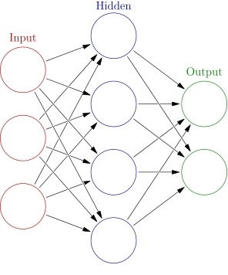

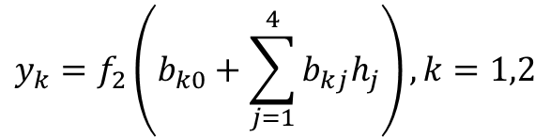


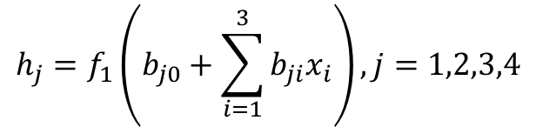











Simple Feed Forward Neural Network (FFNN)
Concepts stated as early as 1940s!
$$h_{1}$$
$$h_{j}=f_{1}\left(b_{j0}+\sum_{i=1}^{3}{b_{ji}x_{i}}\right), j=1,2,3,4$$
$$x_{1}$$
$$h_{2}$$
$$y_{1}$$
$$x_{2}$$
$$y_{k}=f_{2}\left(b_{k0}+\sum_{j=1}^{4}{b_{kj}h_{j}}\right), k=1,2$$
$$h_{3}$$
$$y_{2}$$
$$x_{3}$$
$$h_{4}$$
$$y=f_{1}\left(f_{2}\left(x,b_{2}\right),b_{1}\right)$$
$$\left[x_{1},x_{2},x_{3}\right]:$$
Input features vector for one observation
$$\left[y,y_{2} \right]:$$
Actual output outcome for one observation
$$f_{1}\left(∙\right),f_{2}\left(∙\right):$$
Activation functions, usually non-linear
$$L\left(y,\hat{y}\left(b,x\right) \right):$$
Loss function where $\hat{y}$ the model forecast response
Total number of parameters (i.e. size of a NN): (3+1)*4 + (4+1)*2 = 26

Slide 4
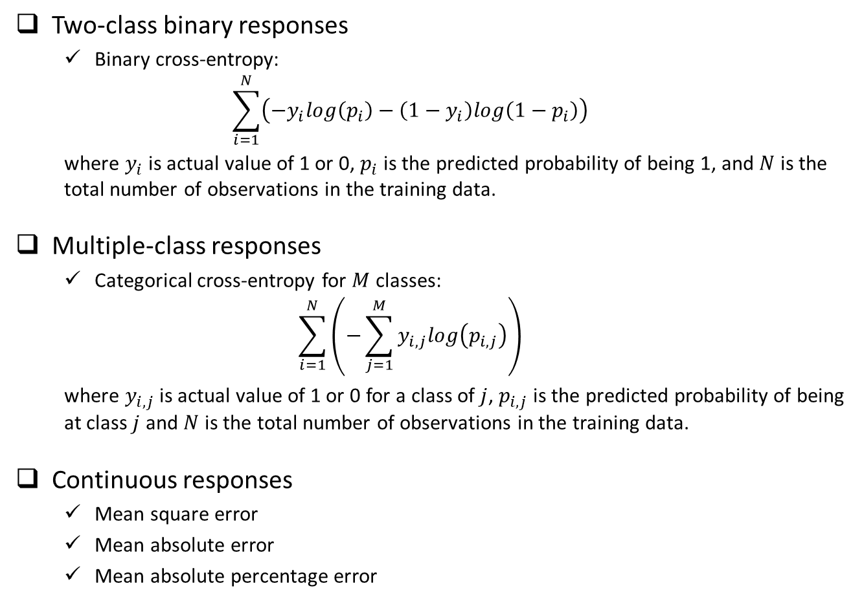
Typical Loss Functions
Two-class binary responses
  Binary cross-entropy:
  $$\sum_{i=1}^{N}{\left(−y_{i}log\left(p_{i}\right)−\left(1−y_{i}\right)log\left(1−p_{i}\right)\right)}$$
  where $y_{i}$ is actual value of 1 or 0, $p_{i}$ is the predicted probability of being 1, and $N$ is the total number of observations in the training data.
Multiple-class responses
  Categorical cross-entropy for $M$ classes:
  $$\sum_{i=1}^{N}{\left(−\sum_{j=1}^{M}{y_{i,j}log\left(p_{i,j}\right)}\right)}$$
  where $y_{i,j}$ is actual value of 1 or 0 for a class of $j$, $p_{i,j}$ is the predicted probability of being at class $j$ and $N$ is the total number of observations in the training data.
Continuous responses
  Mean square error
  Mean absolute error
  Mean absolute percentage error

Slide 5
From Slow Progress to Wide Adoption
1940s – 1980s, very slow progress due to:
Computation hardware capacity limitation
Number of observations with labeled results in the dataset
Lack efficient algorithm to estimate the parameters in the model
1980s – 2010, a few applications in real word due to:
Moore’s Law + GPU
Internet generated large labeled dataset
Efficient algorithm for optimization and better activation functions
2010-Now, very broad application in various areas:
Near-human-level image classification
Near-human-level handwriting transcription
Much improved speech recognition
Much improved machine translation
Now we know working neural network models usually contains many layers (i.e. the depth of the network is deep), and to achieve near-human-level accuracy the deep neural network need huge training dataset (for example millions of labeled pictures for image classification problem).

Slide 6
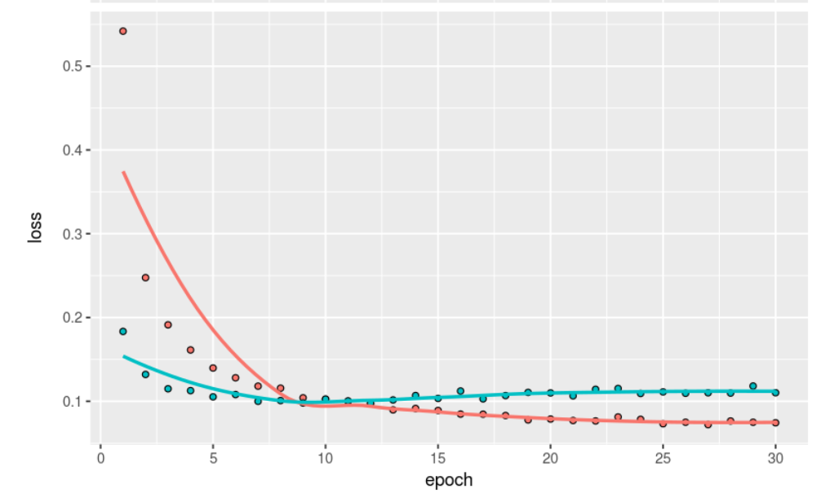
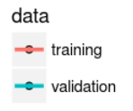
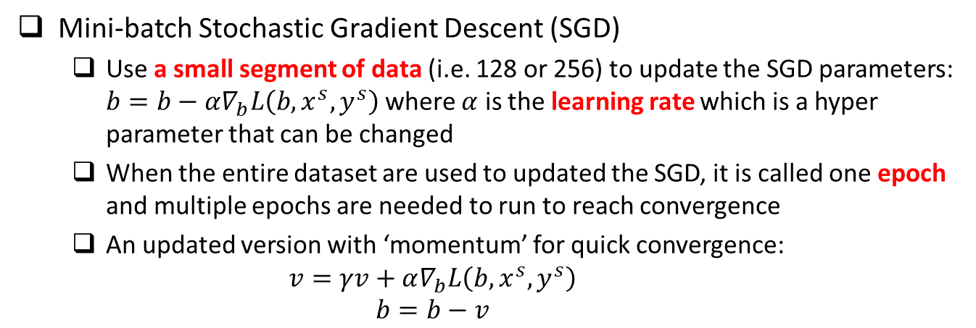
Optimization Methods
Mini-batch Stochastic Gradient Descent (SGD)
  Use a small segment of data (i.e. 128 or 256) to update the SGD parameters: $b=b−α∇_{b}L\left(b,x^{s},y^{s}\right)$ where $α$ is the learning rate which is a hyper parameter that can be changed
  When the entire dataset are used to updated the SGD, it is called one epoch and multiple epochs are needed to run to reach convergence
  An updated version with ‘momentum’ for quick convergence:
    $$v=γv+α∇_{b}L\left(b,x^{s},y^{s}\right)$$
    $$b=b−v$$

Slide 7


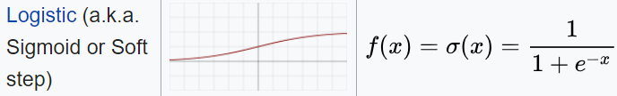
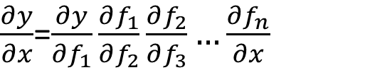

Activation Functions
$\frac{∂y}{∂x}$=$\frac{∂y}{∂f_{1}}\frac{∂f_{1}}{∂f_{2}}\frac{∂f_{2}}{∂f_{3}}…\frac{∂f_{n}}{∂x}$
$$y=f_{1}\left(f_{2}\left(f_{3}\left(…f_{n}\left(x,b_{n}\right),b_{3}\right),b_{2}\right),b_{1}\right)$$
Intermediate layers
  Relu (i.e. rectified linear unit) is usually a good choice which has the following good properties: (1) fast computation; (2) non-linear; (3) reduced likelihood of the gradient to vanish; (4) Unconstrained response
  Sigmoid, studied in the past, not as good as Relu in deep learning, due to the gradient vanishing problem when there are many layers
Last layer which connects to the output
  Binary classification: sigmoid with binary cross entropy as loss function
  Multiple class, single-label classification: softmax with categorical cross entropy for loss function
  Continuous responses: identity function (i.e. y = x)

Slide 8
Deal With Overfitting
Huge number of parameters, even with large amount of training data, there is a potential of overfitting
  Overfitting due to size of the NN (i.e. total number of parameters)
  Overfitting due to using the training data for too many epochs
Solution for overfitting due to NN size
  Dropout: randomly dropout some proportion (such as 0.3 or 0.5) of nodes at each layer, which is similar to random forest concept
  Using L1 or L2 regularization in the activation function at each layer
Solution for overfitting due to using too many epochs
  Run NN with large number of epochs to reach overfitting region through cross validation from training/validation vs. epoch curve
  Choose the model with number of epochs that have the minimum validation accuracy as the final NN model

Slide 9
Recap of A Few Key Concepts
Data: Require large well-labeled dataset
Computation: intensive matrix-matrix operation
Structure of fully connected feedforward NN
  Size of the NN: total number of parameters
  Depth: total number of layers (this is where deep learning comes from)
  Width of a particular layer: number of nodes (i.e. neurons) in that layer
Activation function
  Intermediate layers
  Last layer connecting to outputs
Loss function
  Classification (i.e. categorical response)
  Regression (i.e. continuous response)
Optimization methods (SGD)
  Batch size
  Learning rate
  Epoch
Deal with overfitting
  Dropout
  Regularization (L1 or L2)

Slide 10
Deep Learning Models Across Platforms

Slide 11
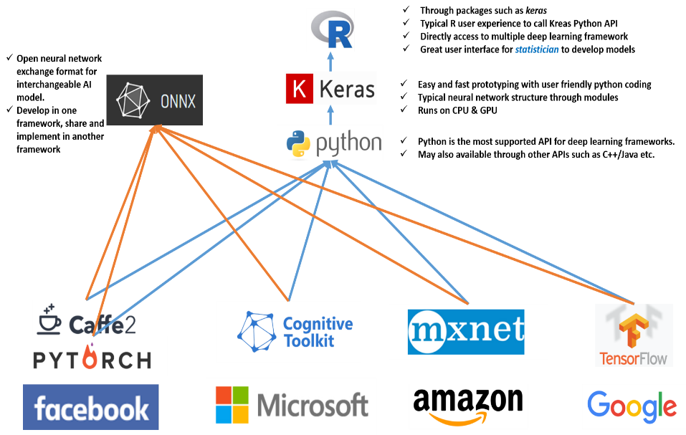
Open NN Exchange Format (ONNX)

Slide 12
The MNIST Dataset

Slide 13
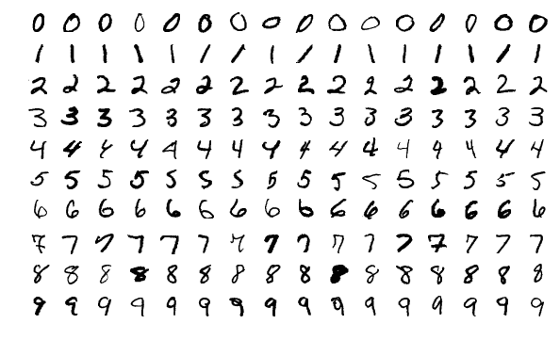
MNIST Dataset
Originally created by NIST, then modified for machine leaning training purpose
Contains 70000 handwritten digit images and the label of the digit in the image where 60000 images are the training dataset and the rest 10000 images are the testing dataset.
Census Bureau employees and American high school students wrote these digits
Each image is 28x28 pixel in greyscale
Yann LeCun used convolutional network LeNet to achieve < 1% error rate at 1990s

Slide 14
Using Keras R Package To Build Deep Neural Network Model

Slide 15
Procedures
Data preprocessing (from image to list of input features)
  One image of 28x28 grey scale value matrix → 784 column of features
  Scale the value to between 0 and 1, by divide each value by 255
  Make response categorical (i.e. 10 columns with the corresponding digit column 1 and rest columns zero.
Load keras package and build a neural network with a few layers
  Define a placeholder object for the NN structure
  1st layer using 256 nodes, fully connected, using ‘relu’ activation function and connect from the input 784 features
  2nd layer using 128 nodes, fully connected, using ‘relu’ activation function
  3rd layer using 64 nodes, fully connected, using ‘relu’ activation function
  4th layer using 10 nodes, fully connected, using ‘softmax’ activation function and connect to the output 10 columns
  Add drop out to the first three layers to prevent overfitting
Compile the NN model, define loss function, optimizer, and metrics to follow
Fit the NN model using the training dataset, define epoch, mini batch size, and validation size used in the training where the metrics will be checked
Predict using the fitted NN model using the testing dataset

Slide 16
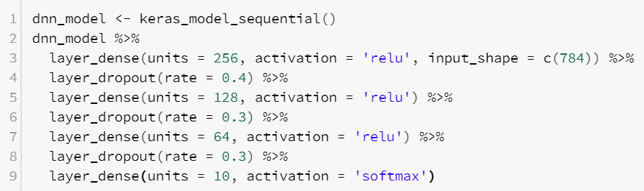
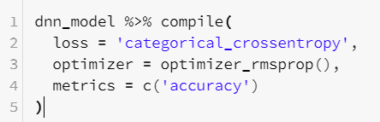
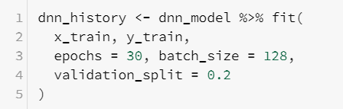

R Scripts
Define NN Structure
Compile and define loss function, optimizer and metrics to monitor during the training
Fit the model using training dataset and define epochs, batch size and validation data
Predict new outcomes using the trained model

Slide 17
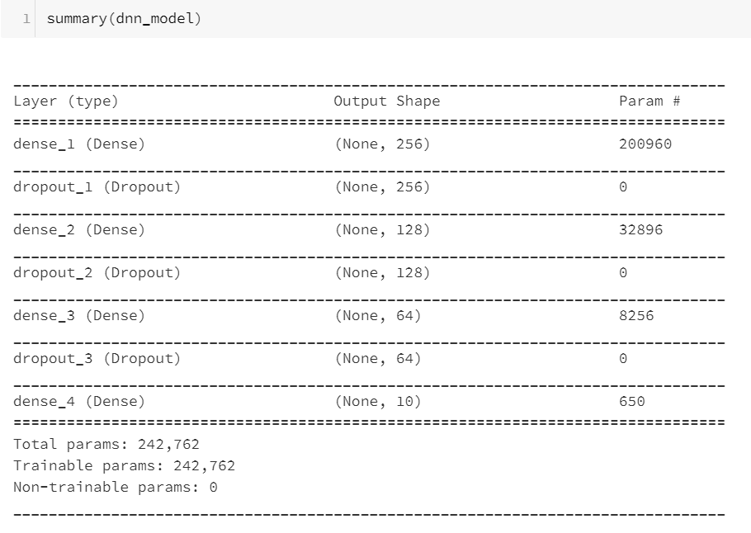
Size of the Model

Slide 18
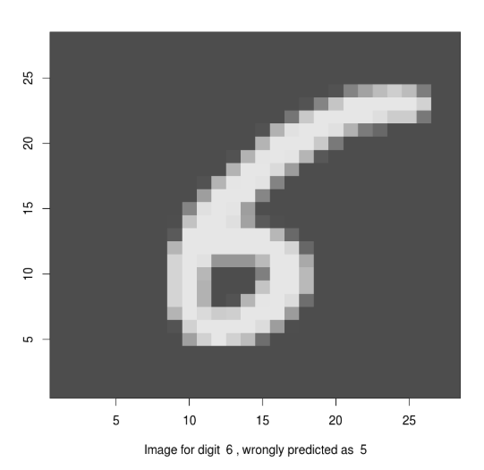
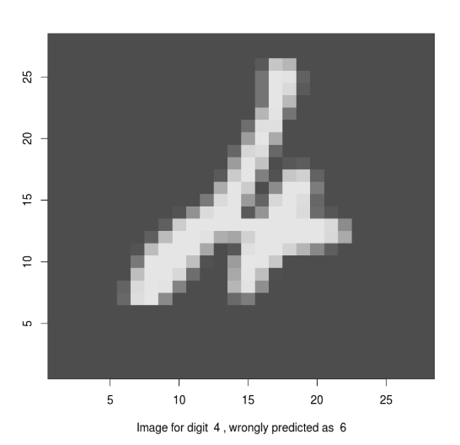
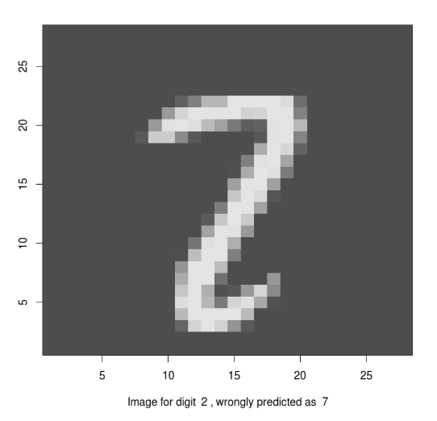
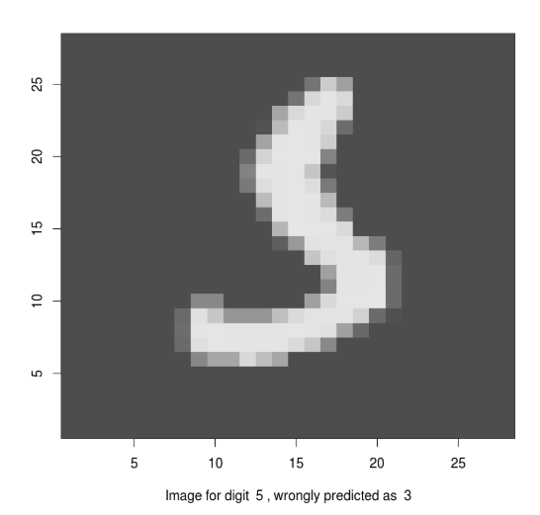
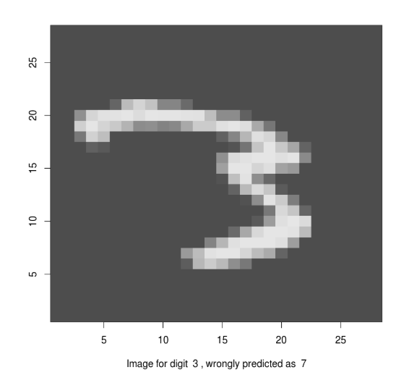
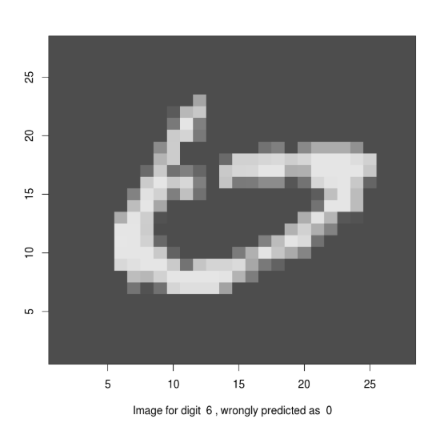
Performance
Accuracy: 97.99% without much fine tuning
A few misclassified images:

Slide 19
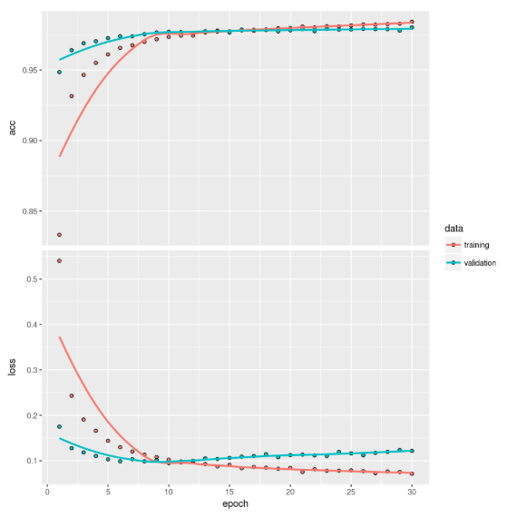
Cross-Validation Curve

Slide 20
Now Let’s Do It In The Cloud!
Databrick free community edition account open: https://accounts.cloud.databricks.com/registration.html#signup/community
Notebook contains all the material for this section:
https://databricks-prod-cloudfront.cloud.databricks.com/public/4027ec902e239c93eaaa8714f173bcfc/2961012104553482/1430974153588517/1806228006848429/latest.html

