Slide 1
Using Keras R Package To Build Convolutional Neural Network Model

Slide 2
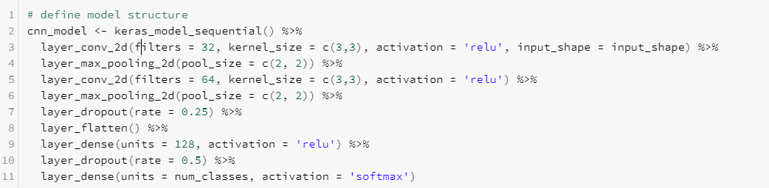
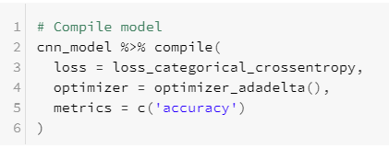
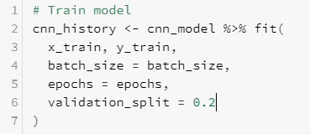

R Scripts

Slide 3
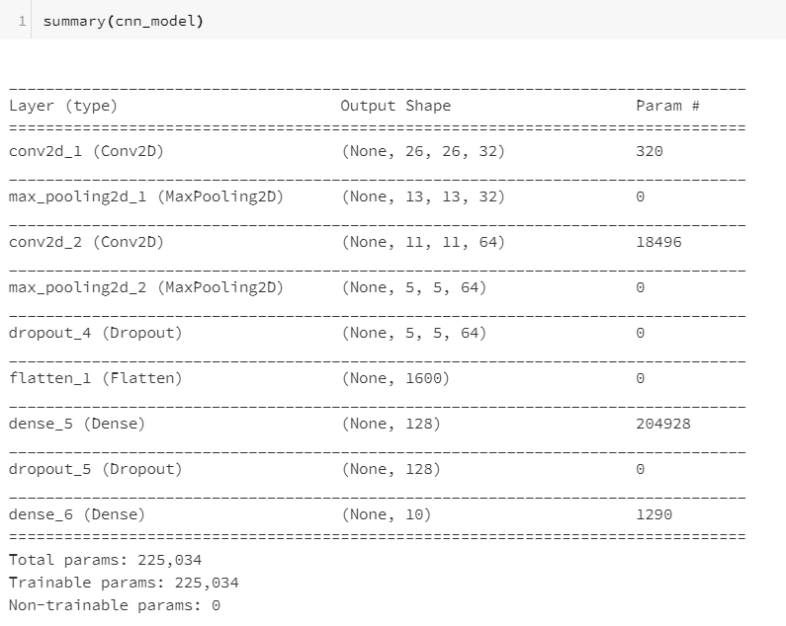
Size of the Model

Slide 4
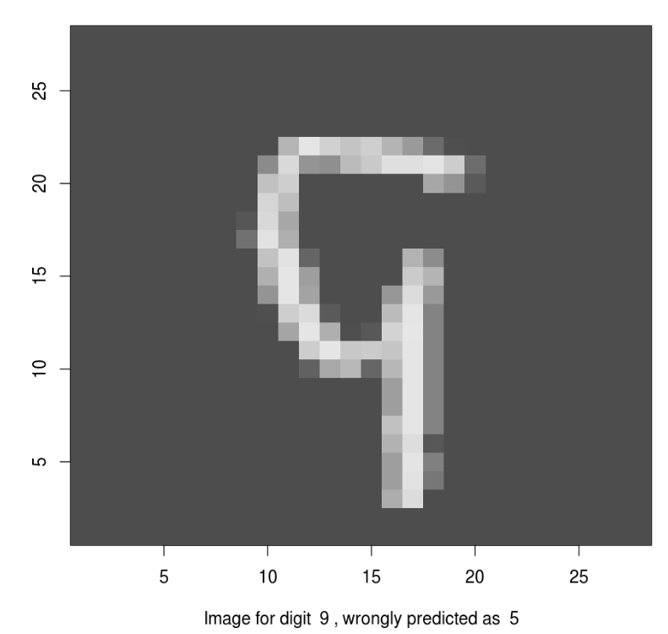
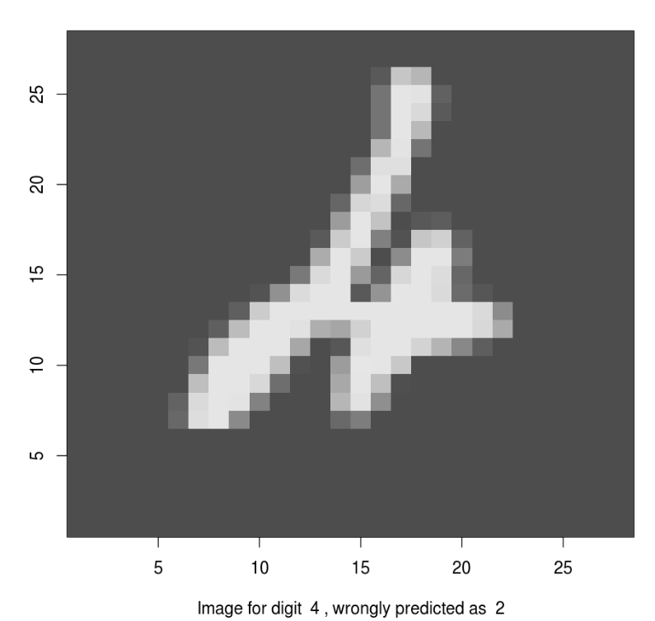
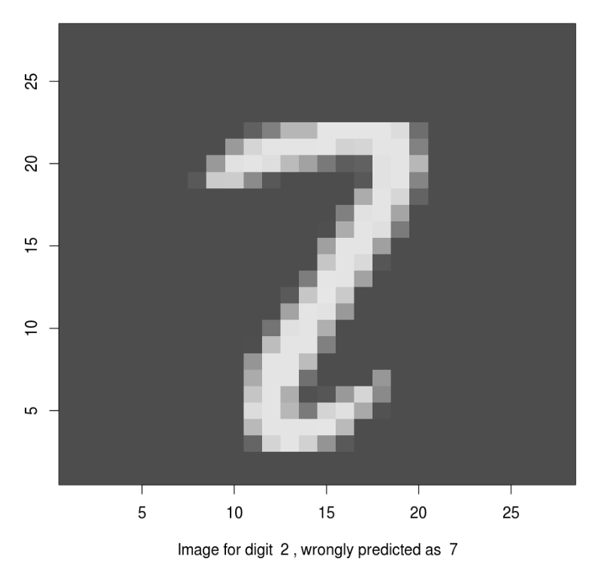
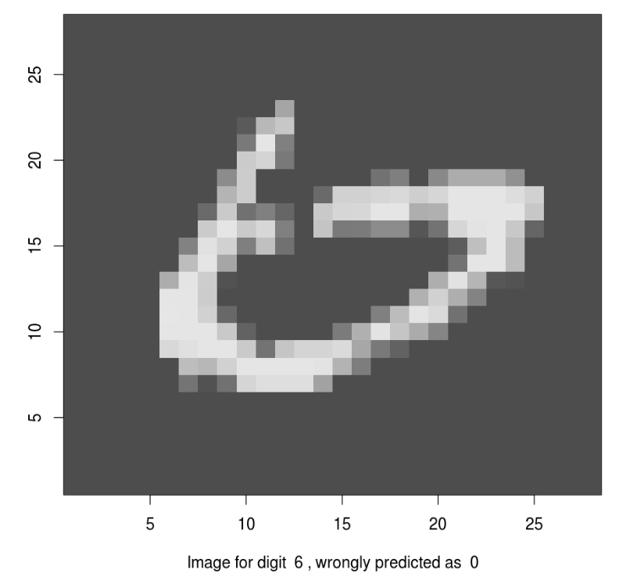
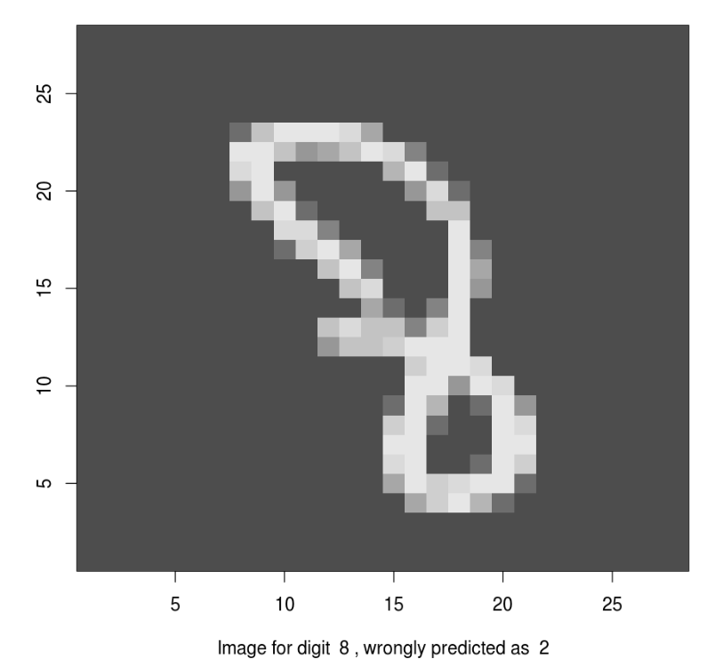
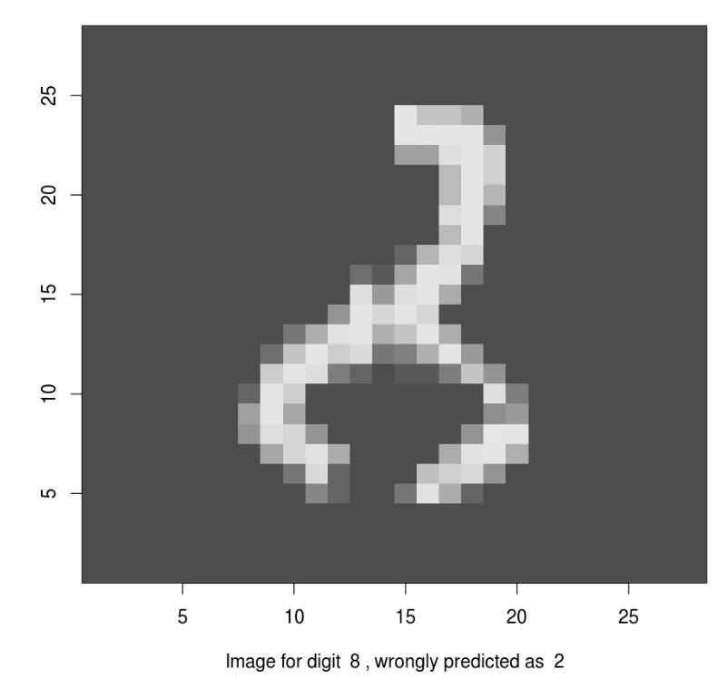
Performance
Accuracy: 99.31% without much fine tuning
A few misclassified images:

Slide 5
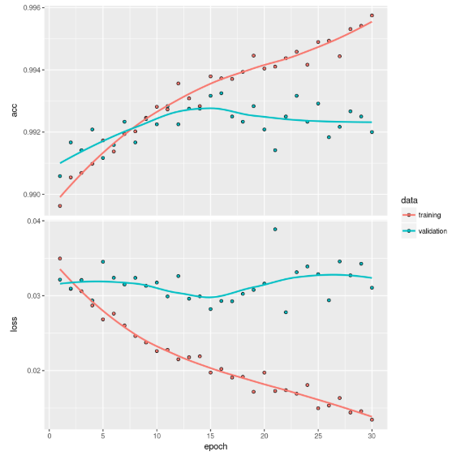
Cross-Validation Curve

Slide 6
Now Let’s Do It In The Cloud!
Databrick free community edition account open: https://accounts.cloud.databricks.com/registration.html#signup/community
Notebook contains all the material for this section:
https://databricks-prod-cloudfront.cloud.databricks.com/public/4027ec902e239c93eaaa8714f173bcfc/2961012104553482/1430974153588517/1806228006848429/latest.html

