Slide 1
Capstone Project – The Battle of Neighborhoods
Where to open a new Chinese restaurant?
Yang Cao
6/7/2019

Slide 2
Contents
Introduction
Data sets
Methodology
Results
Conclusion & Suggestion

Slide 3
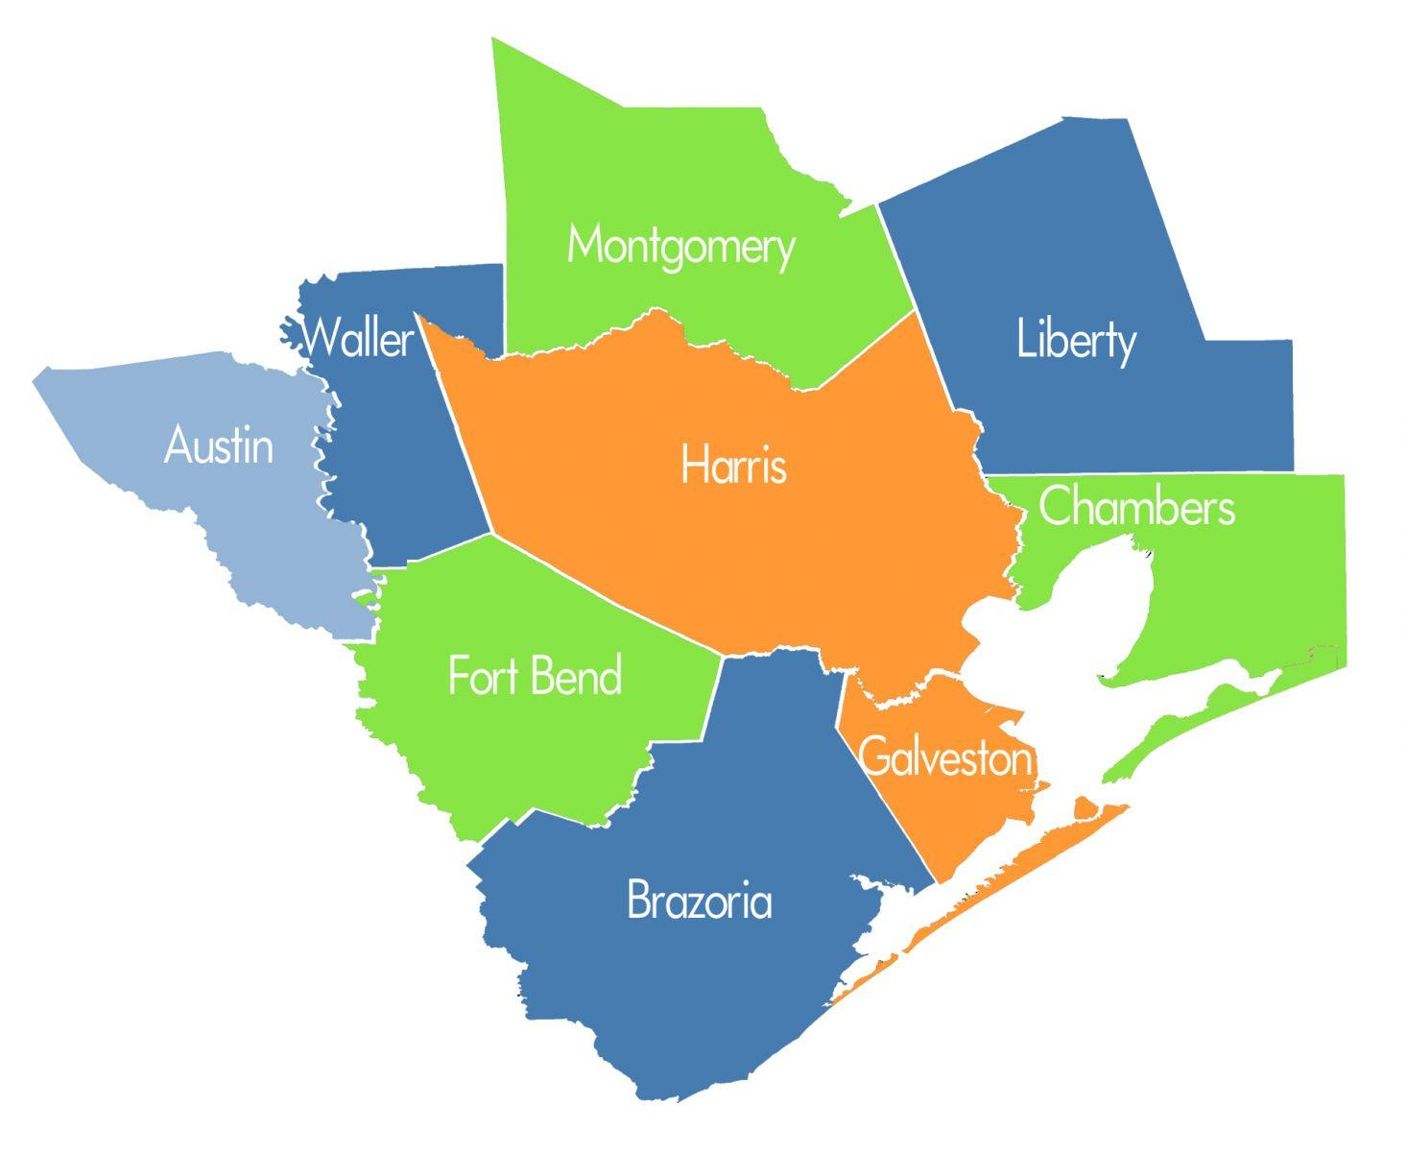
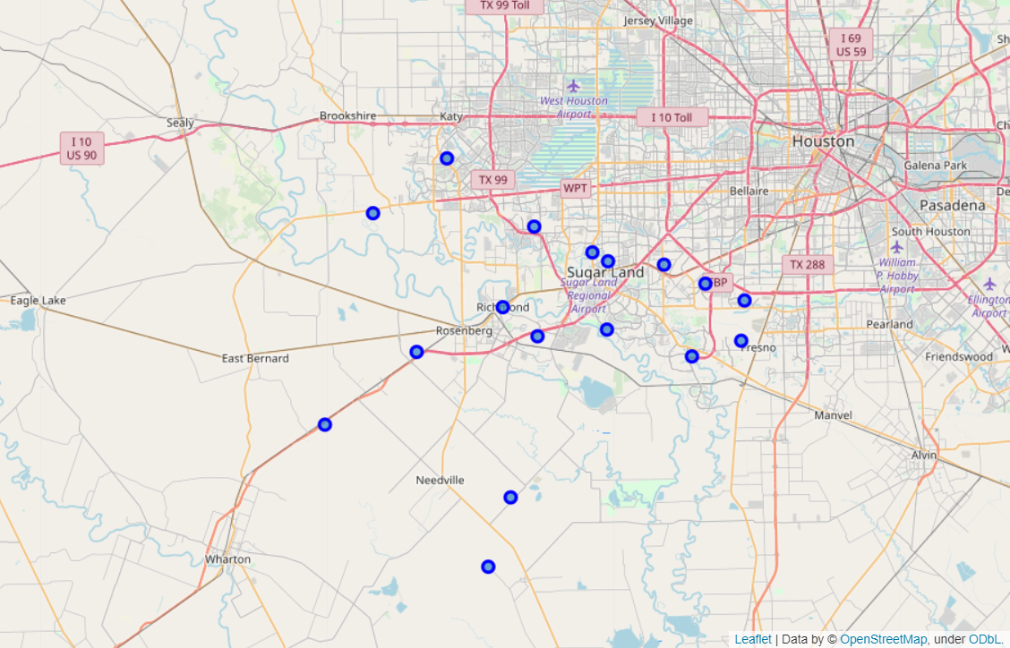
Introduction
Objective: where to open a Chinese restaurant in Ford Bend, TX?
Draw prediction model from nearby Harris, TX.
Counties in Houston, TX
Zip Regions in Ford Bend, TX

Slide 4
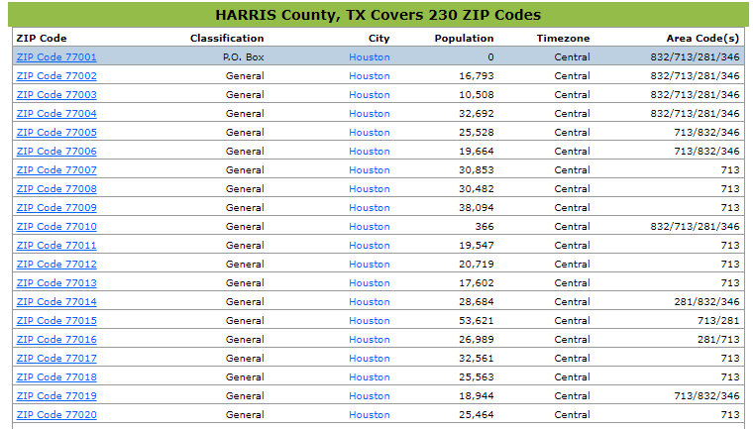
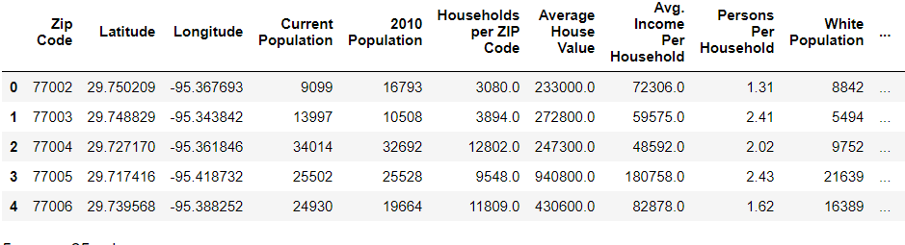
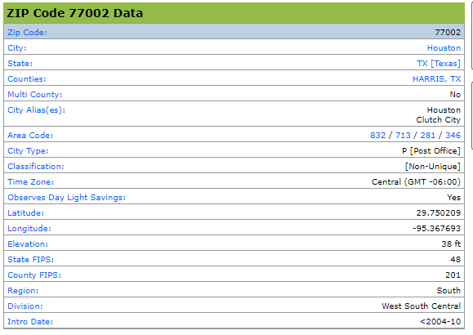
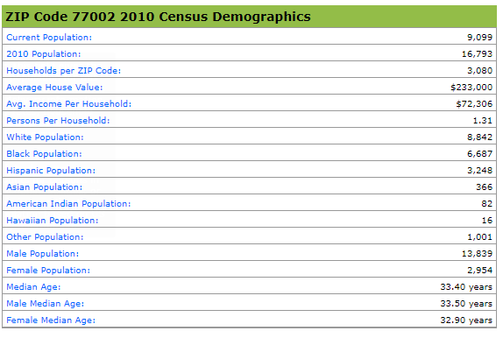
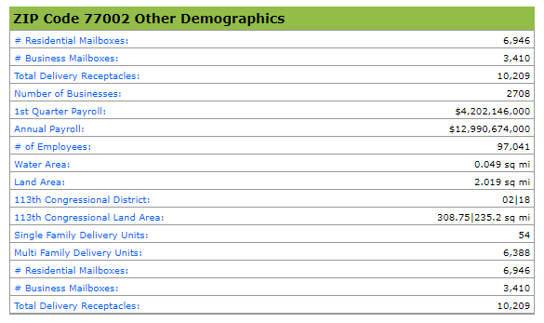
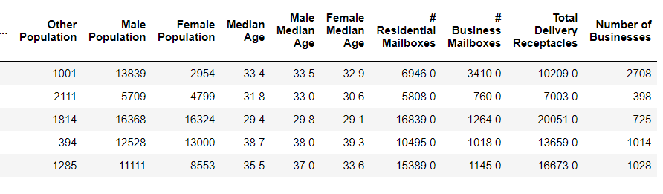
Data sets-I
Data set from zip-codes.com
data scraping and processing
by self-developed
read_data.py & process_data.py
Data frame acquired
Target tables on the website
See: https://www.zip-codes.com/county/tx-harris.asp.

Slide 5
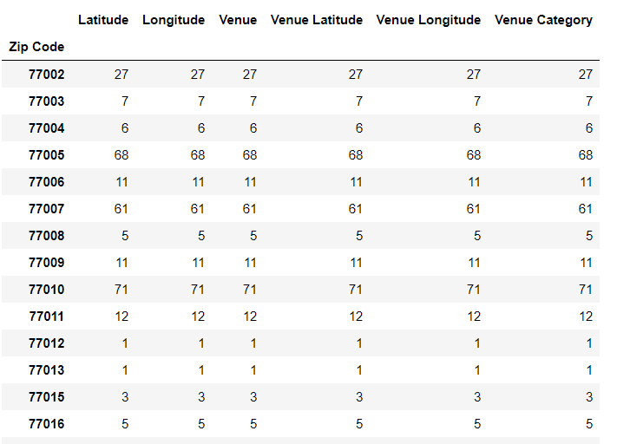
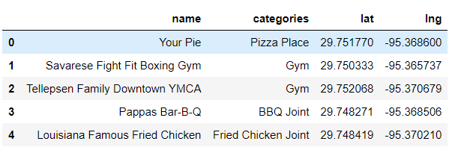
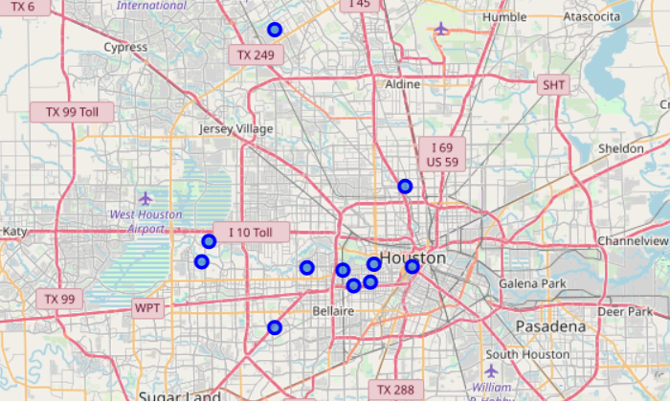
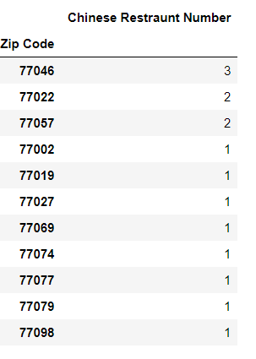
Data sets-II
Data set from Foursquare
Get avenue info for each zip region
Explore neighborhoods for zip region
Filter out regions with Chinese restaurants

Slide 6

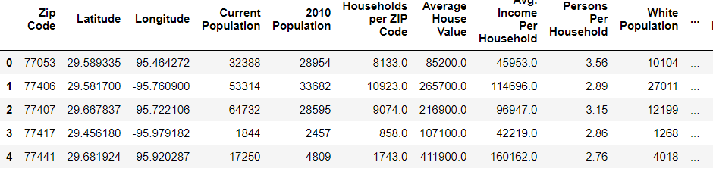




Methodology-I
Workflow
$$X_{H}$$
$$y_{H}$$
Classification model
(unbalanced class)
Data set for Harris County, TX
$$X_{F}$$
Location suitable vector
1: suitable, 0: no
$$y_{F}$$
Data set for Ford Bend, TX

Slide 7
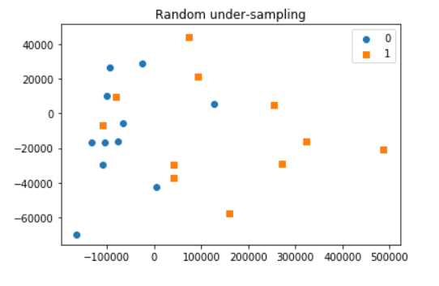
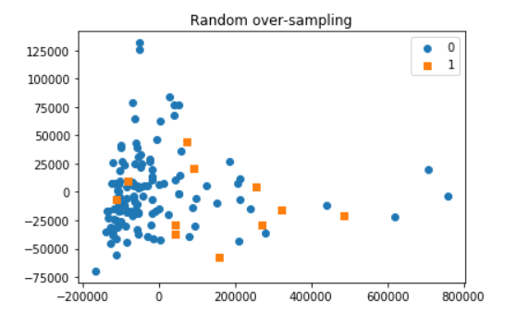
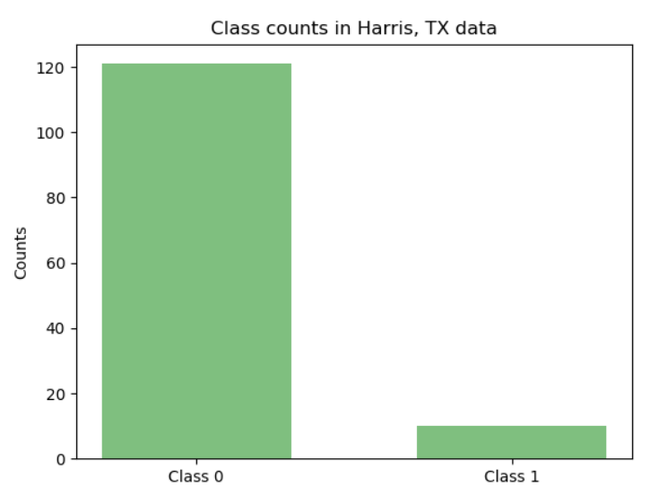
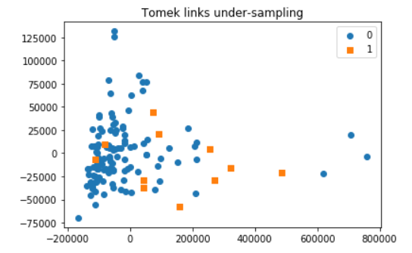
Results-I
Unbalanced classification
Module : imblearn
Random under-sampling (rus)
Random over-sampling (ros)
Tomek links under-sampling (tl)
Unbalanced classes
class 1: 10, class 0: 121

Slide 8
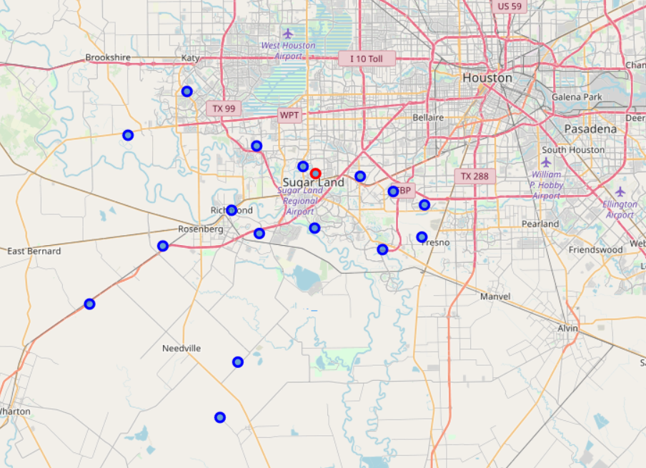
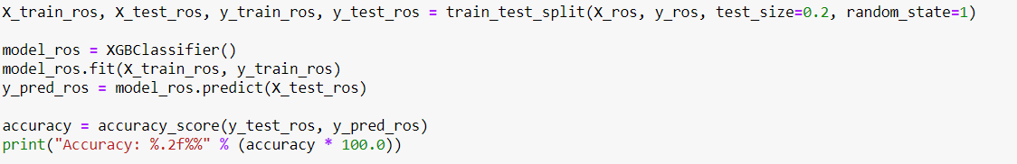
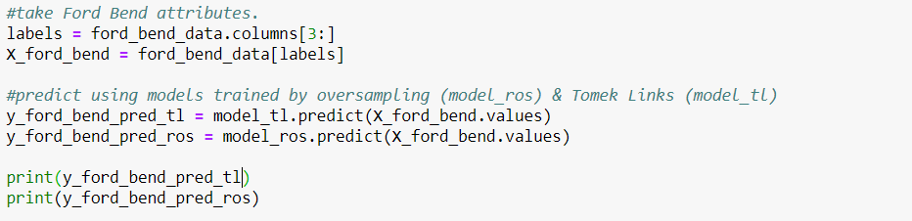
Results-II
Best location Zip 77478
Model development & Prediction
Code of training/verification
Resampling method based model | Accuracy, %
RUS | 60.00
ROS | 92.83
TL | 84.62
Code of prediction

Slide 9
Conclusions & Suggestions
Conclusions:
Developed codes for scrape and process
Explored avenues through Foursquare
Conducted unbalanced classification (RUS, ROS, TL)
Developed/verified classification model using Harris, TX data
Best Chinese restaurant location Zip 77478 in Ford Bend, TX
Suggestions
Gather more data on attributes reflecting restaurant profitability
Develop multi-classification model

Slide 10
Thanks
Q&A

