Slide 1

WaveCon Telecom Analysis
Divya K Verma

Slide 2

Agenda
Significance of the 5G launch and the need to analyze its impact on revenue.
Data analysis approach and key metrics considered.
Comparative analysis of revenue trends before and after the 5G launch.
Identification of the KPI showing decline post-5G launch and its implications.
Evaluation of revenue performance for different plans after the 5G launch.
Analysis of the plan(s) largely impacted by 5G launch and recommendation for continuation or discontinuation.
Summary of findings, recommendations, and importance of ongoing analysis for revenue optimization.

Slide 3
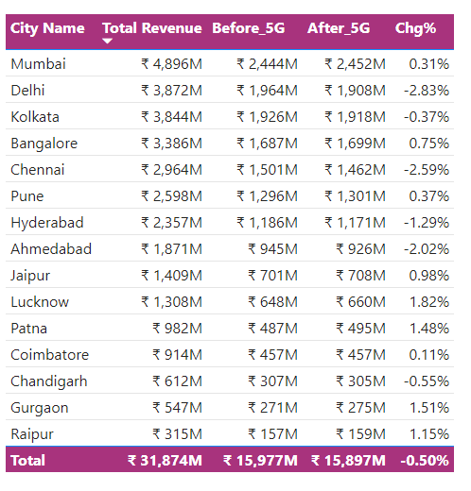
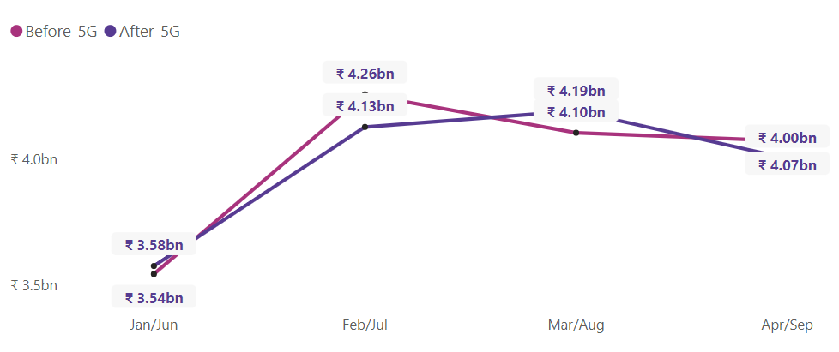
Impact of 5G launch on revenue
Total revenue decreased by 0.5% (approx. $120 million) following the 5G launch.
40% of cities experiencing negative revenue change.
60% of cities show revenue growth post 5G launch.
Revenue
Months

Slide 4

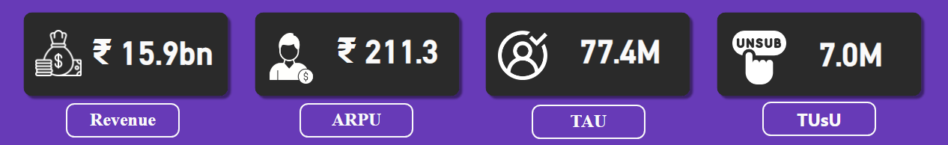
Underperforming KPI after 5G
Before 5G
After 5G
77.4 M
After 5G
84.4 M
Before 5G
TAU
TUsU
Before 5G
5.6 M
After 5G
7.0 M
ARPU - Average Revenue Per User, TAU - Total Active Users, TUsU - Total unsubscribed Users

Slide 5
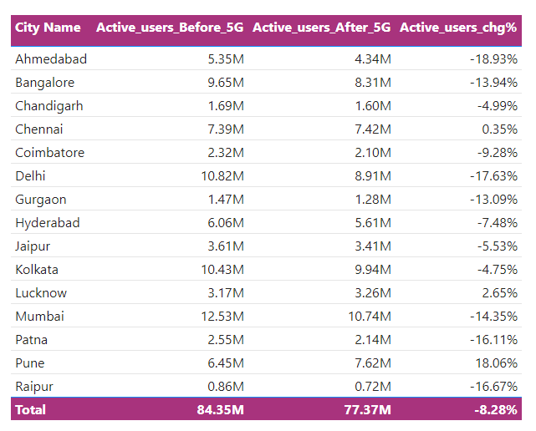
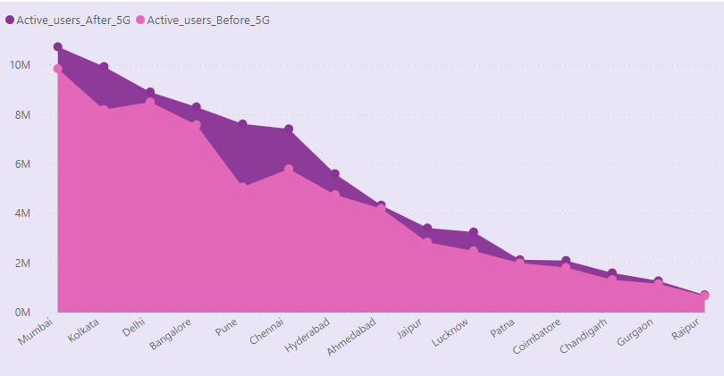
Underperforming KPI after 5G
Total Active Users
Active user base decreased by 7 million after 5G launch.
Positive user growth in 13% of cities (Pune, Lucknow, Chennai) post-5G launch.
18.93% decrease in active users observed in Ahmedabad after 5G launch.

Slide 6
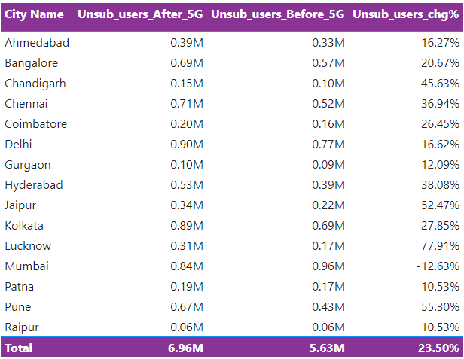
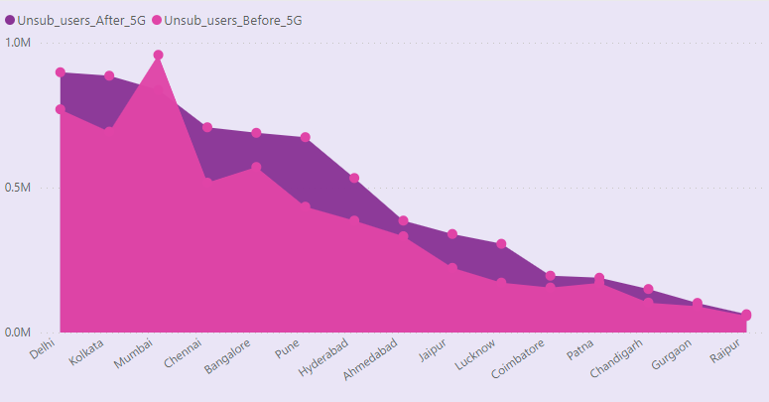
Underperforming KPI after 5G
Total Un-subscribe Users
13 million users have unsubscribed to date.
53.84% of users (13 million) unsubscribed after the 5G launch, except in Mumbai where the unsubscribe rate decreased.

Slide 7
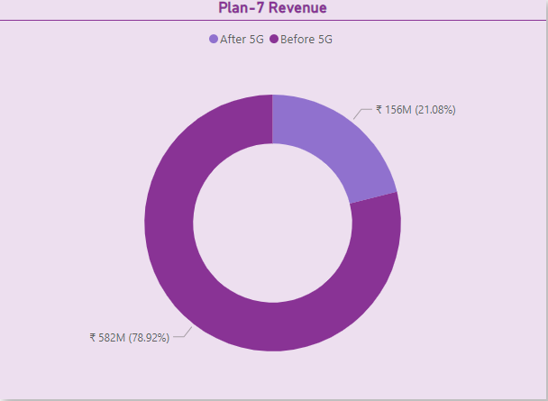
Plan Insight’s
Plan P1 has shown significant revenue growth of 33.33% after the 5G launch.
Plans P2 and P3 have maintained stable revenue performance.
Plans P4 to P7 have experienced a decline in revenue.
Plan P7 is underperforming with a significant revenue reduction of 73.28% after the 5G launch, possibly due to its nature as a 3G/4G pack without a per-day data limit.
Considering these factors, discontinuing plan P7 could be a strategic decision to reallocate resources towards plans that align better with customer preferences and offer more lucrative revenue opportunities in the 5G era.
However, it is essential to conduct a thorough analysis of customer feedback, market trends, and potential alternatives before finalizing the decision.

Slide 8
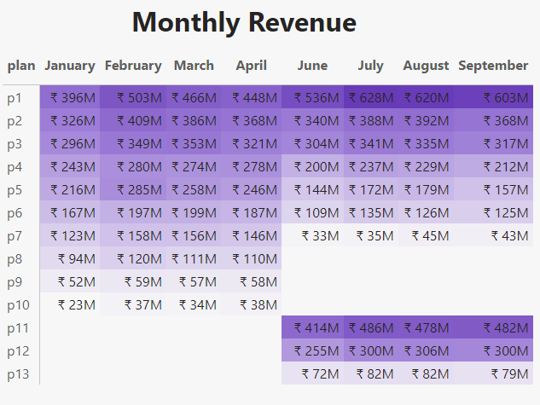
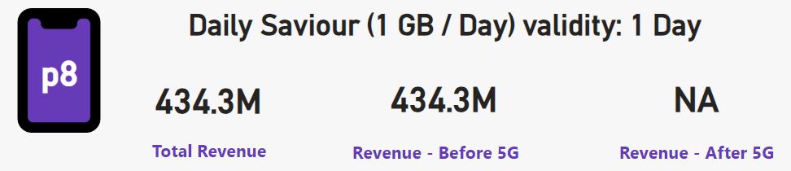
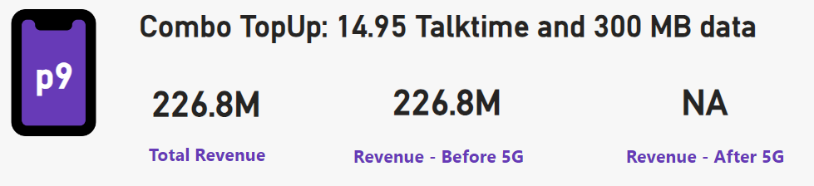
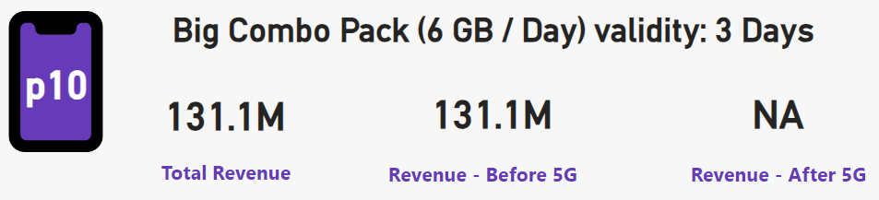
Discontinued Plans After 5G
Plans P8, P9, and P10 have been discontinued due to low revenue generation (8.24%) and short validity periods.

Slide 9


