Slide 1
Vehicle Fuel Efficiency
&
Carbon Dioxide Emissions
A study in factors affecting fuel efficiency, and CO2 emissions as well as building Machine Learning models to predict fuel efficiency
Paul Shoop
Booz | Allen | Hamilton
Shoop_paul@bah.com

Slide 2
Goal
Create a machine learning model capable of predicting fuel efficiency based on certain variables
Make the machine learning model accurate enough that it could potentially replace costly and time consuming laboratory tests for fuel efficiency

Slide 3
The Data:
Open source data available of fueleconomy.gov
Compilation of vehicle data from 1985-2018
Over 40,000 entries and 83 variables
Data contains both traditional and hybrid/electric vehicles*
The data dictionary is here: http://www.fueleconomy.gov/feg/ws/index.shtml#vehicle

Slide 4
First Question:
Have fuel efficiency standards had an impact on CO2 emissions and overall fuel efficiency over time
Second Question:
Which factors, based on available data, most affect fuel efficiency
Third Question:
Can a Machine Learning Model be built to predict fuel efficiency

Slide 5
First Question

Slide 6
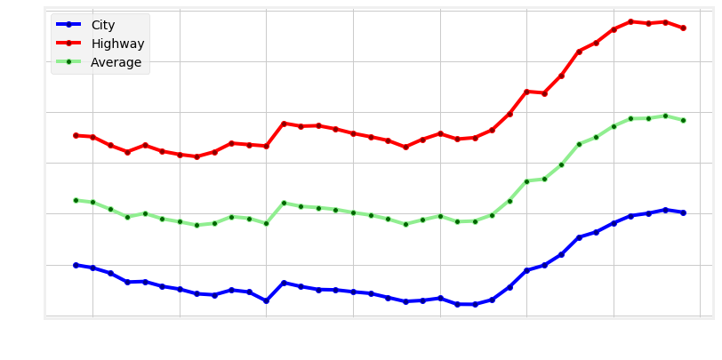
Fuel Efficiency over Time

Slide 7
Second Question

Slide 8
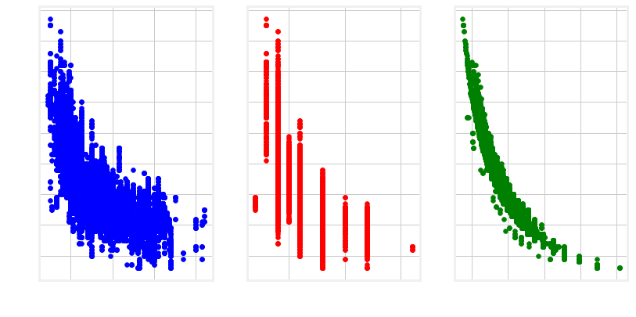
Relationship Between MPG and Displacement, Cylinders, and CO2 Emissions

Slide 9
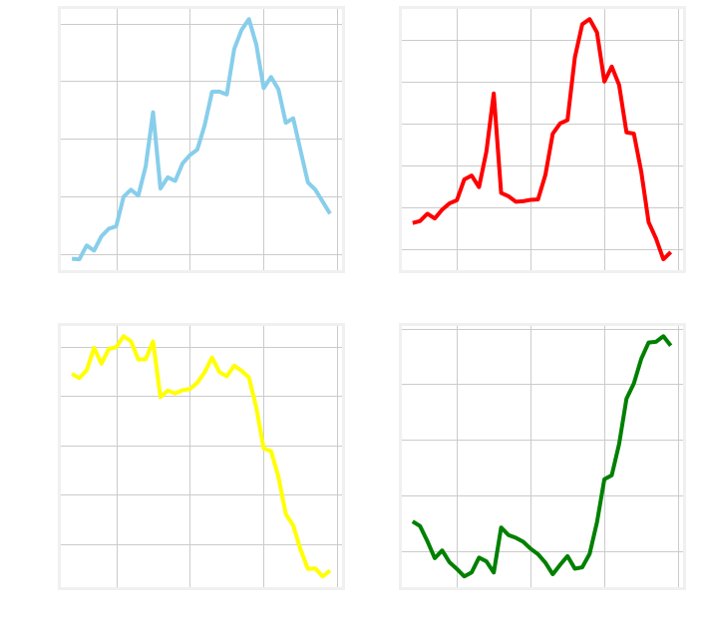
Averages of Major Variables over Time

Slide 10
Energy Independence and Security Act of 2007
raised the fuel economy standards of America's cars, light trucks, and SUVs to a combined average of at least 35 miles per gallon by 2020—a 10 mpg increase over 2007 levels
Vehicle Sales
The number of SUVs in 2009 in this data set dwarfed all other vehicle types

Slide 11
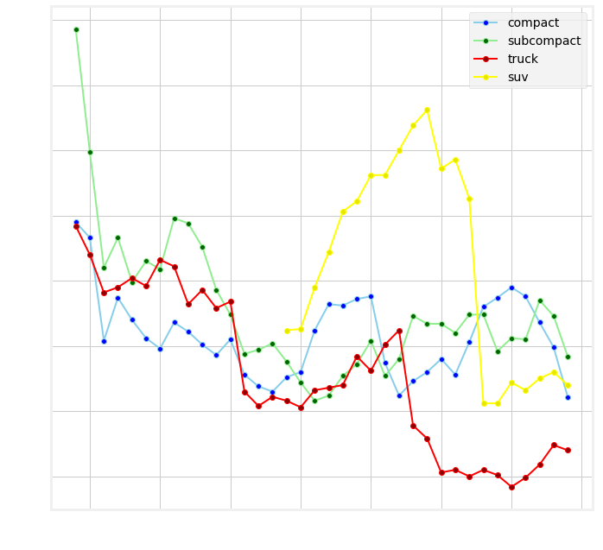
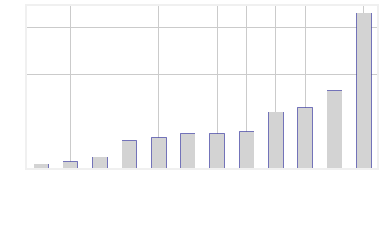
Vehicles by Type over Time
Vehicles by Type in 2009

Slide 12
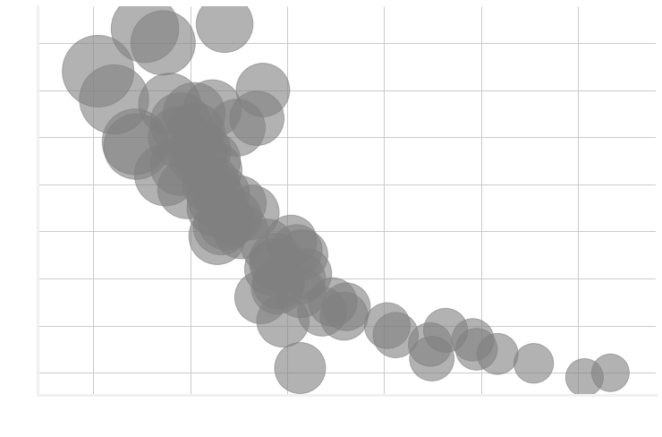
The Relationship Between MPG, Displacement & CO2

Slide 13
Third Question
Machine Learning Demonstration

Slide 14
Averages of Major Variables over Time

Slide 15
Considerations:
This data does not capture all variables that could affect fuel efficiency and CO2 emissions
Hybrid and Electric Vehicles may skew data
The Way Ahead:
Build a separate machine learning model specifically for hybrid and electric vehicles
Build a separate machine learning model specifically for predicting CO2 emissions based on available data
Deploy a front-end user model on a webpage for educational purposes
Deploy a machine learning model for making predictions over large sets of new data for EPA, DOE, and other Agencies and NGOs

Slide 16
Questions

