Slide 1
>
Lab 1
Shell Script
TA: 葉弘堯
Prof.: 張軒彬
NCHU System & Network Lab

Slide 2
Outline
$
Introduction
Vim Basics
Bash Shell Scripting Tutorial
Exercise
2
NCHU System & Network Lab

Slide 3
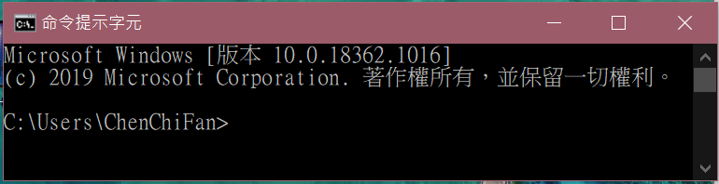
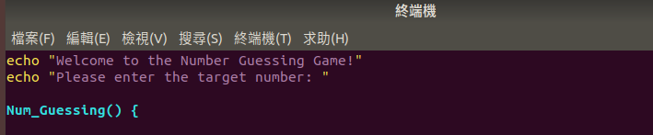
Introduction (1/3)
$
CMD
Window:
指令程式
shell
Linux:
Shell script
3
NCHU System & Network Lab

Slide 4
Introduction (2/3)
$
shell script: 在shell裡我們通常只會一次下一個指令，shell解讀這些指令後再讓OS幫我們執行。
我們也可以將多個指令寫在文字檔裡面，再透過shell解讀這個文字檔讓OS執行多個指令，這個文字檔就叫shell script。
最常見的用處是將要重複執行的指令寫成一個檔案直接執行。
4
NCHU System & Network Lab

Slide 5
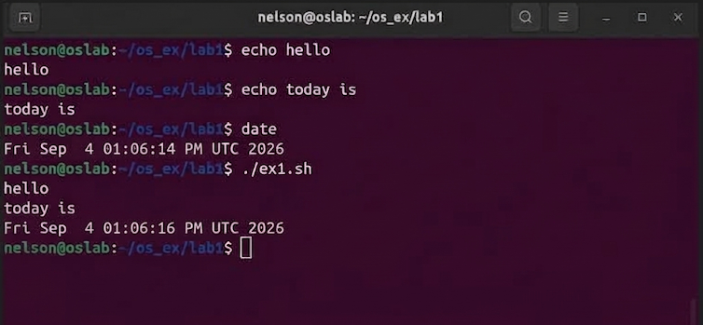
Introduction (3/3)
$
將三個指令包在一起執行
5
NCHU System & Network Lab

Slide 6
Outline
$
Introduction
Vim Basics
Bash Shell Scripting Tutorial
Exercise
6
NCHU System & Network Lab

Slide 7
Vim Basics (1/11)
$
Vim 是一個文字編輯器
開啟terminal: ctrl + alt + t
輸入 vim /路徑/檔名 (建立)開啟檔案(進入後在normal mode)
按i進入編輯模式(insert mode)
編輯完成後按esc進入一般模式(normal mode)
一般模式下按:會進入命令模式(command line mode)
命令模式下輸入w後按enter會儲存檔案 輸入q後按enter會離開vim 輸入wq後按enter會儲存並退出
7
NCHU System & Network Lab

Slide 8
Vim Basics (2/11)
$
Normal Mode
Type “i”
Insert Mode
Type “Esc”
Normal Mode
Type “:”
command Mode
Type “w” and enter
Type “wq” and enter
Type “q” and enter
Save file
Save and quit
Quit vim
8
NCHU System & Network Lab

Slide 9
Vim Basics (3/11)
$
在Shell中安裝並更新vim:
  輸入 sudo apt-get update 更新套件列表
  輸入 sudo apt-get install vim 安裝vim編輯器
9
NCHU System & Network Lab

Slide 10
Vim Basics (4/11)
$
  Hello vim !
    Install Vim through apt command in shell
    Create a file named “helloworld”
    Type “Hello World!” using insert mode
    Return to normal mode by pressing Ese
    Save and quit the file
10
NCHU System & Network Lab

Slide 11
$
Vim Basics (5/11)
Step1: Create a file named helloworld
11
NCHU System & Network Lab

Slide 12
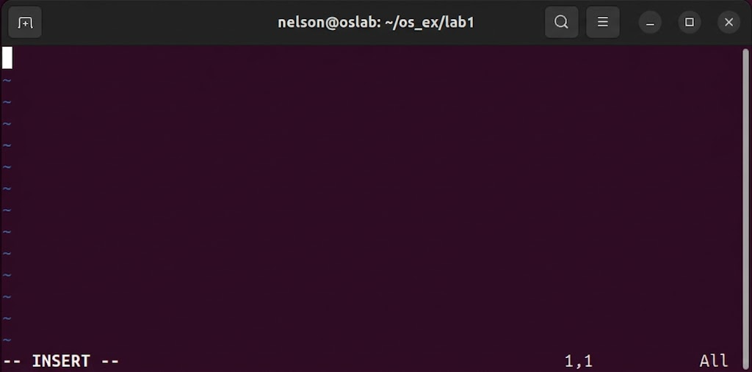
$
Vim Basics (6/11)
Step2: Enter Insert Mode by pressing “i”
12
NCHU System & Network Lab

Slide 13
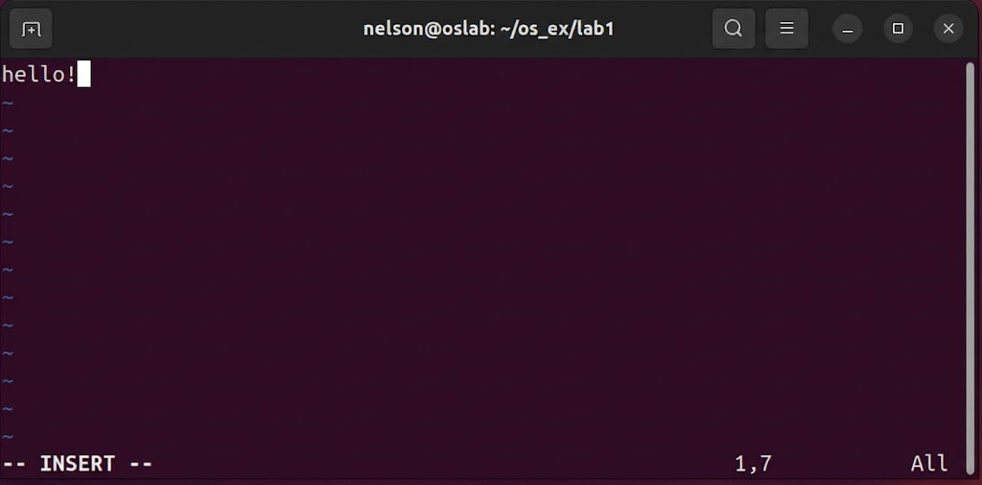
$
Vim Basics (7/11)
Step3: Notice the --INSERT--” on bottom Left and you can type something now
13
NCHU System & Network Lab

Slide 14
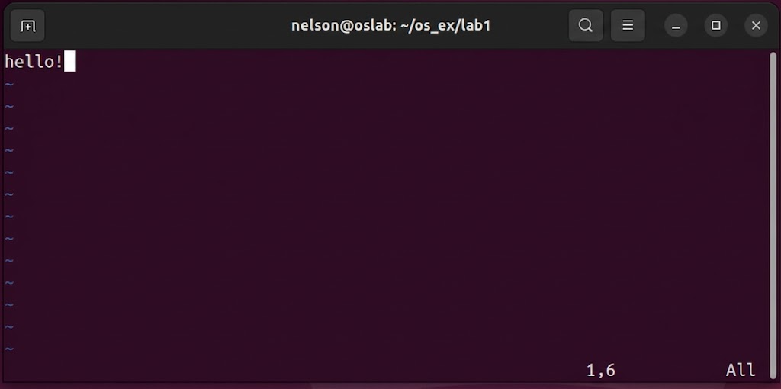
$
Vim Basics (8/11)
Step4: Press “Esc” to return to normal mode
14
NCHU System & Network Lab

Slide 15
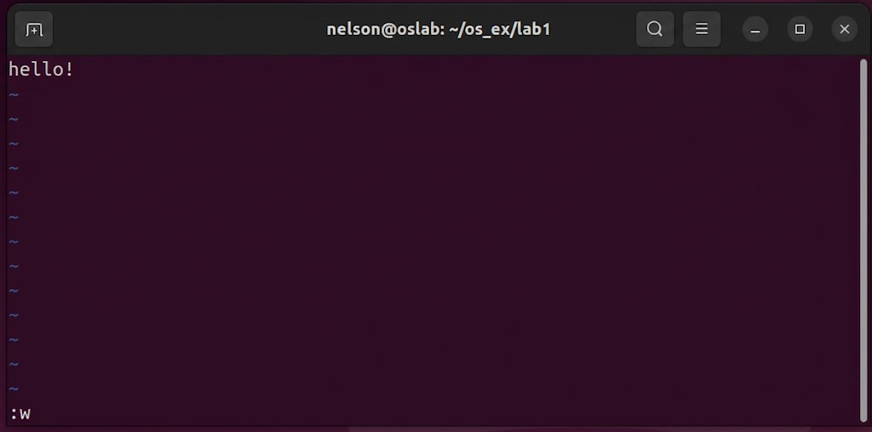
$
Vim Basics (9/11)
Step5: Type “w” in and press “enter” command line mode to save your file
15
NCHU System & Network Lab

Slide 16
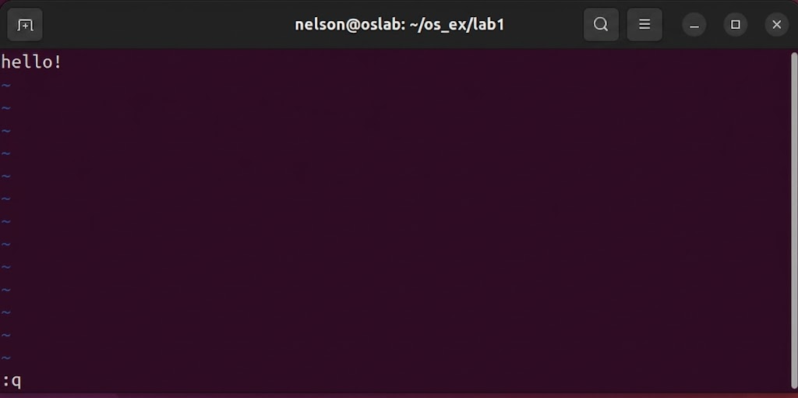
$
Vim Basics (10/11)
Step6: Type “q” and press “enter” in command line mode to quit Vim
16
NCHU System & Network Lab

Slide 17
$
Vim Basics (11/11)
Note
1) Shell open : ctrl + alt + t
2) vim open : vim helloworld.sh
3) before typing : i
4) Return to normal mode : Esc
5) Save the File : w + Enter
6) Quit Vim : q + Enter
7) Save and Quit : wq + Enter
17
NCHU System & Network Lab

Slide 18
Outline
$
Introduction
Vim Basics
Bash Shell Scripting Tutorial
Exercise
18
NCHU System & Network Lab

Slide 19
Bash Shell Scripting Tutorial (1/28)
$
Bash :
  為GNU專案所編寫的自由軟體Unix Shell。
  為大多數Linux kernel系統、Mac OS X、Darwin的默認Shell。
  可以使用其他語言(EX: Perl、Python)做到一樣的事情。
19
NCHU System & Network Lab

Slide 20
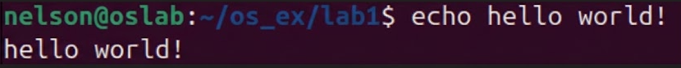
$
Bash Shell Scripting Tutorial (2/28)
echo
The simplest Hello World example
Just simply type “echo Hello World!” in your shell and it’s done!
20
NCHU System & Network Lab

Slide 21
$
Bash Shell Scripting Tutorial (3/28)
Hello World using .sh File
  Now let’s use .sh file to do the same thing
21
NCHU System & Network Lab

Slide 22
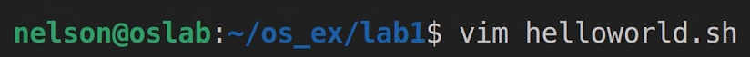
$
Bash Shell Scripting Tutorial (4/28)
Step1: Type “vim helloworld.sh” in shell to create a new shell file
22
NCHU System & Network Lab

Slide 23
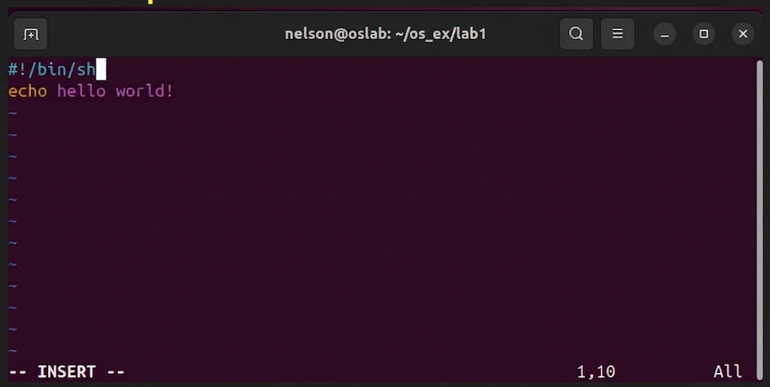
$
Bash Shell Scripting Tutorial (5/28)
Step2: Enter the insert mode to write our hello world script
23
NCHU System & Network Lab

Slide 24
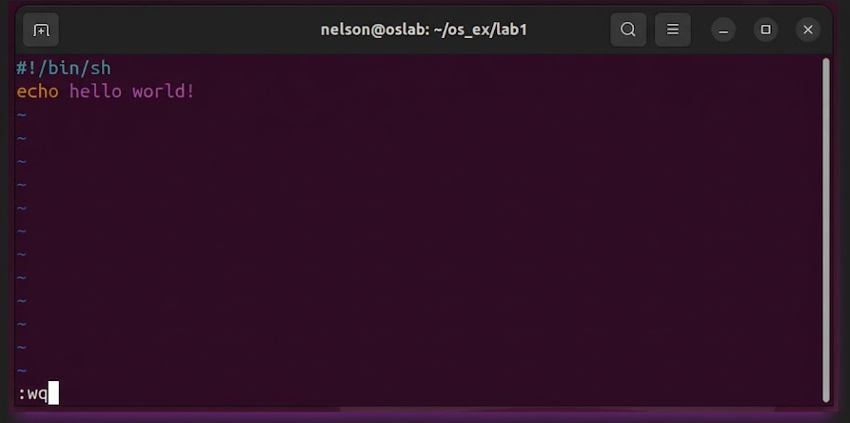
$
Bash Shell Scripting Tutorial (6/28)
Step3: Return to the normal mode and type “:wq” to save and quit the file
24
NCHU System & Network Lab

Slide 25
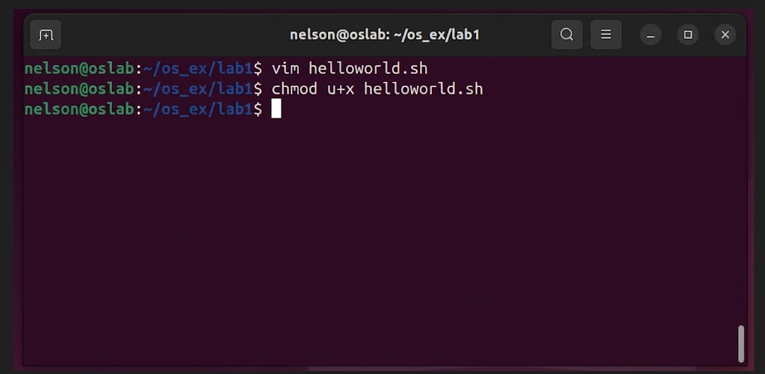
$
Bash Shell Scripting Tutorial (7/28)
Step4: Use chmod command to grant execute permission to the shell file
25
NCHU System & Network Lab

Slide 26
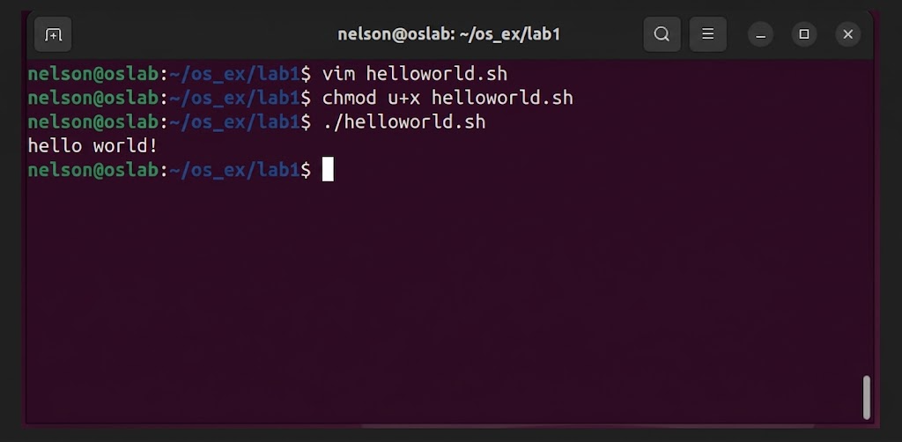
$
Bash Shell Scripting Tutorial (8/28)
Step5: Now we can execute the script directly by “./helloword.sh” command
26
NCHU System & Network Lab

Slide 27
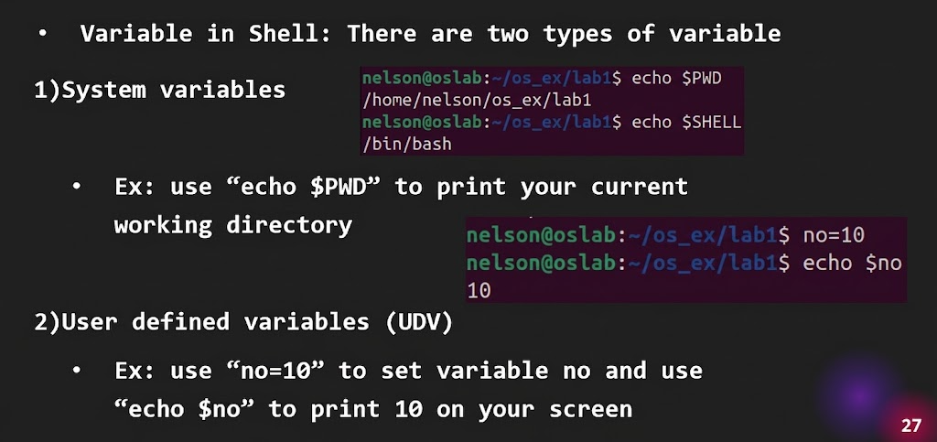
$
Bash Shell Scripting Tutorial (9/28)
Variable in Shell: There are two types of variable
1)System variables
  Ex: use “echo $PWD” to print your current working directory
2)User defined variables (UDV)
  Ex: use “no=10” to set variable no and use “echo $no” to print 10 on your screen
27
NCHU System & Network Lab

Slide 28
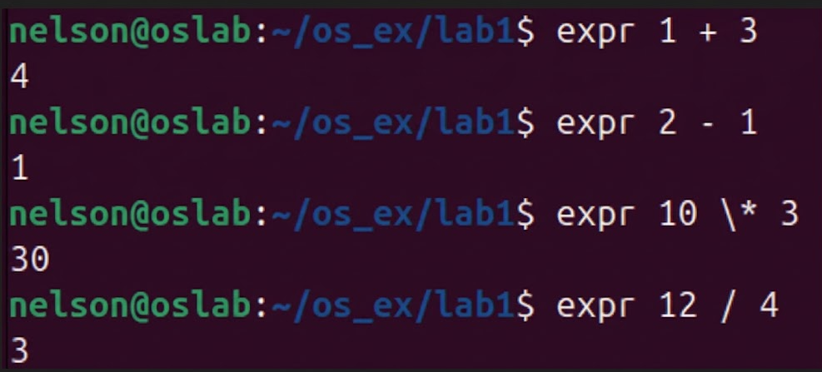
$
Bash Shell Scripting Tutorial (10/28)
Expr: shell arithmetic ( )
Syntax: expr op1_math-operator_op2
+ - * /
space
在shell下*會被解讀成目前路徑下的所有檔名
加\把他當一般字元解讀
28
NCHU System & Network Lab

Slide 29
$
Bash Shell Scripting Tutorial (11/28)
More about Quotes
  雙引號("): 會解讀字串裡的變數 ($) 與反引號 (`)，但會將多數特殊字元視為純文字。
  單引號('): 全部視為純文字。
  反引號(`): 執行引號內的指令並將結果放回原位
29
NCHU System & Network Lab

Slide 30
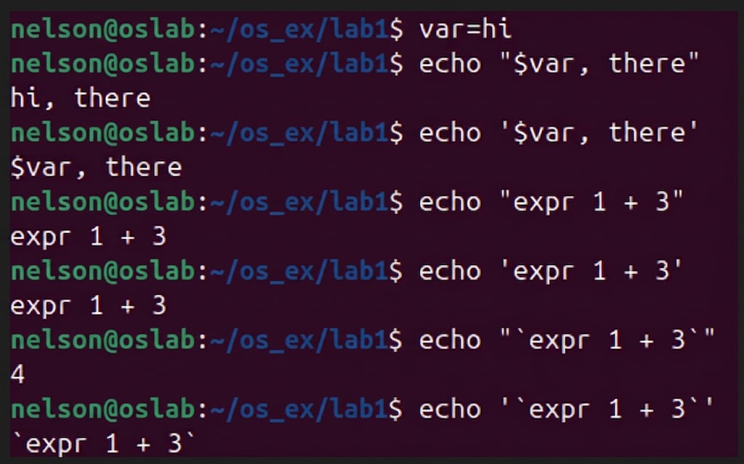
$
Bash Shell Scripting Tutorial (12/28)
More about Quotes
30
NCHU System & Network Lab

Slide 31
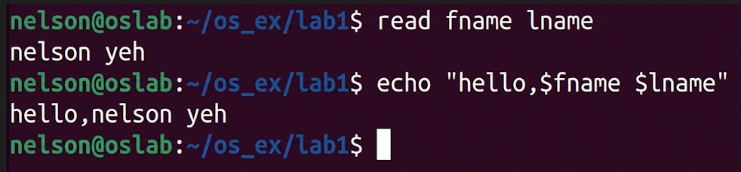
$
Bash Shell Scripting Tutorial (13/28)
The read Statement
Syntax: read variable1 variable2 …
31
NCHU System & Network Lab

Slide 32
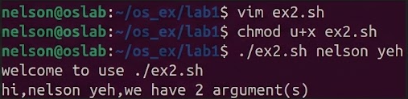
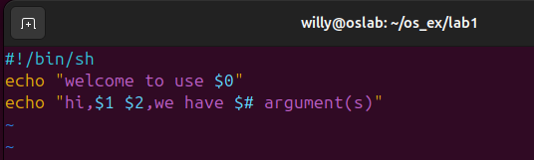
$
Bash Shell Scripting Tutorial (14/28)
Arguments
# myshell.sh
echo “Welcome to use $0”
echo “Hi, $1 $2, we have $# argument(s).”
$ ./ex2.sh nelson yeh
Welcome to use ./myshell.sh
Hi, nelson yeh, we have 2 argument(s).
step1
step3
step4
step2
32
NCHU System & Network Lab

Slide 33
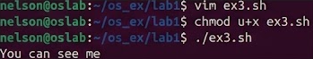
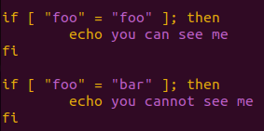
$
Bash Shell Scripting Tutorial (15/28)
Conditionals
if-then
  if [ “foo” = “foo” ]; then
  echo you can see me
  fi
  if [ “foo” = “bar” ]; then
  echo you cannot see me
  fi
Linux shell中,
比較時,等號左右必須有空格
賦值時,等號旁邊不能有空格
33
NCHU System & Network Lab

Slide 34
$
Bash Shell Scripting Tutorial (16/28)
test command or [ expr ]
  used to see if an expression is true
  returns 0 for true and nonzero for false
  Use test command:
  if test “foo” = “bar”; then
  echo You cannot see me
  fi
  Use [ expr ]:
  if [ “foo” = “bar” ]; then
  echo You cannot see me
  fi
34
NCHU System & Network Lab

Slide 35
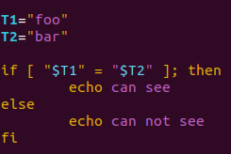
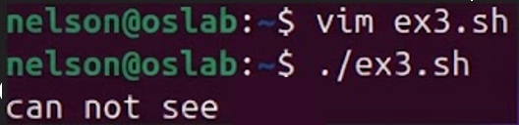
$
Bash Shell Scripting Tutorial (17/28)
Conditionals
Conditionals with variables
  T1=”foo”
  T2=”bar”
  if [ “$T1” = “$T2” ]; then
  echo can see
  else
  echo can not see
  fi
35
NCHU System & Network Lab

Slide 36
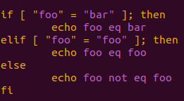
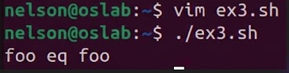
$
Bash Shell Scripting Tutorial (18/28)
Conditionals
if-then-elif-then-else
  if [ “foo” = “bar” ]; then
  echo foo eq bar
  elif [ “foo” = “foo” ]; then
  echo foo eq foo
  else
  echo foo not eq foo
  fi
36
NCHU System & Network Lab

Slide 37
$
Bash Shell Scripting Tutorial (19/28)
Conditionals
  Ex: if [ “$a“ –lt “$b” ]; then
-eq | is equal to
-ne | is not equal to
-lt | is less than
-le | is less than or equal to
-gt | is greater than
-ge | is greater than or equal to
37
Operators for Mathematics
NCHU System & Network Lab

Slide 38
$
Bash Shell Scripting Tutorial (20/28)
Conditionals
  Ex: if [ -n str1 ]; then
str1 = str2 | str1 is equal to str2
str1 != str2 | str1 is NOT equal to str2
str1 | str1 is NOT empty
-n str1 | str1’s length>0
-z str1 | str1’s length=0
Operators for Strings
38
NCHU System & Network Lab

Slide 39
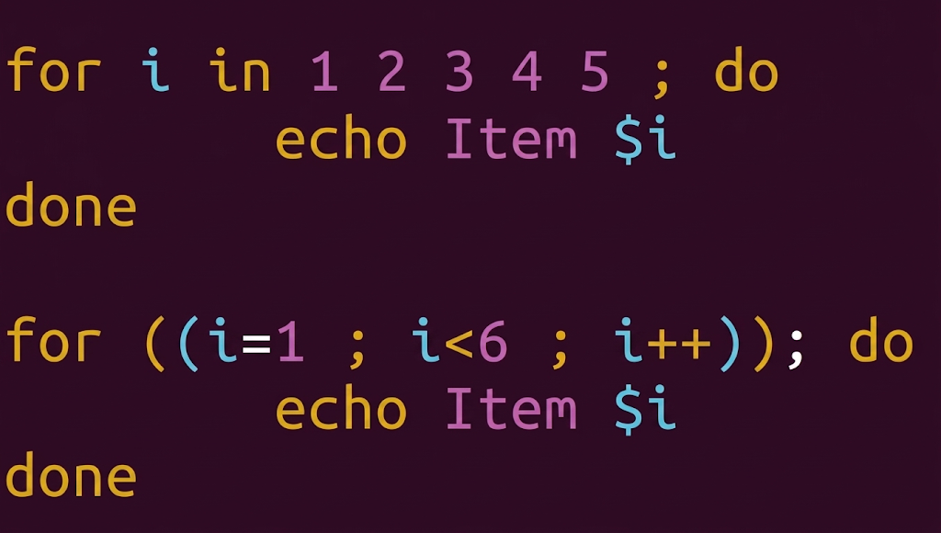
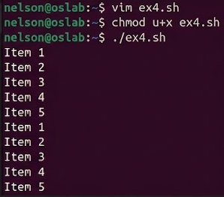
$
Bash Shell Scripting Tutorial (21/28)
Loops
for loop
for loop
  for i in 1 2 3 4 5; do
  echo Item $i
  done
  for ((i=1; i<6; i++)); do
  echo Item $i
  done
39
NCHU System & Network Lab

Slide 40
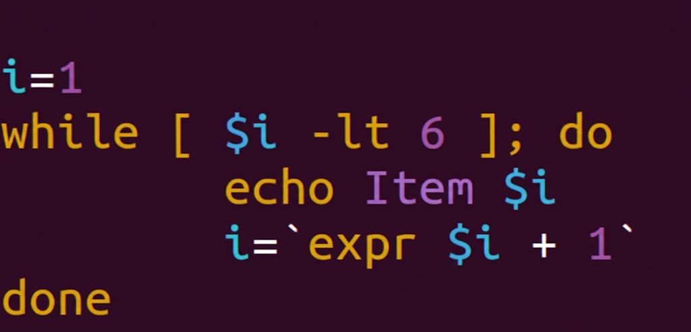
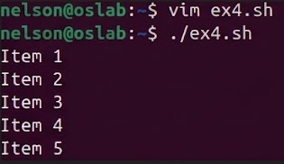
$
Bash Shell Scripting Tutorial (22/28)
Loops
while loop
  i=1
  while [ $i -lt 6 ]; do
  echo Item $i
  i=`expr $i + 1`
  done
可用:
((i++))
((i=i+1))
((i+=1))
40
NCHU System & Network Lab

Slide 41
$
Bash Shell Scripting Tutorial (23/28)
The case Statement
Syntax
  case $var in
  pattern1) command;;
  pattern2) command;;
  patternN) command;;
  *) command;;
  esac
41
NCHU System & Network Lab

Slide 42
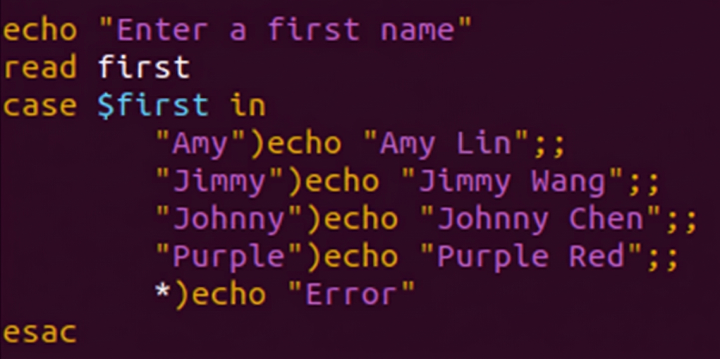
$
Bash Shell Scripting Tutorial (24/28)
The case Statement
Example: name.sh
  case $1 in
  “Amy") echo “Amy Lin";;
  “Jimmy") echo “Jimmy Wang";;
  “Johnny") echo “Johnny Chen";;
  “Purple") echo “Purple Red";;
  *) echo “Error"
  esac
42
NCHU System & Network Lab

Slide 43
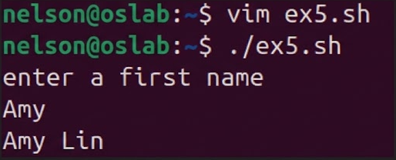
$
Bash Shell Scripting Tutorial (25/28)
The case Statement
Result
  $ ./ex5.sh
  Enter a first name
  Amy
  Amy Lin
43
NCHU System & Network Lab

Slide 44
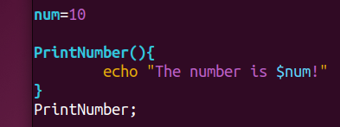
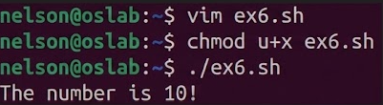
$
Bash Shell Scripting Tutorial (26/28)
Function
Example
num=10
  PrintNumber() {
  echo “The number is $num!”
  }
  PrintNumber;
Result
The number is 10!
44
NCHU System & Network Lab

Slide 45
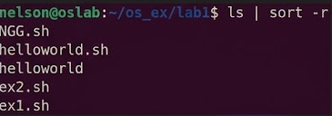
$
Bash Shell Scripting Tutorial (27/28)
Pipes |
  A pipe is a way to connect the output of one program to the input of another without any temporary file
  Ex: We can use “ls | sort -r” to list sorted directory contents reversely
A
B
將A的輸出丟到B的輸入
45
NCHU System & Network Lab

Slide 46
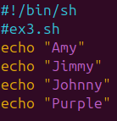
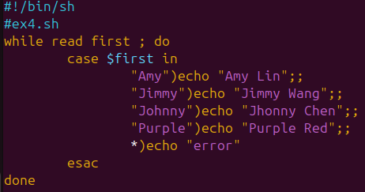
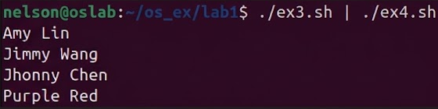
$
Bash Shell Scripting Tutorial (28/28)
46
NCHU System & Network Lab

Slide 47
Outline
$
Introduction
Vim Basics
Bash Shell Scripting Tutorial
Exercise
47
NCHU System & Network Lab

Slide 48
$
Exercises (1/3)
Number Guessing Game
  Define the number range between 1 and 10
  Ask the user to enter a target number at beginning
  Keep narrowing down the number range until the player guessing the right target number
48
NCHU System & Network Lab

Slide 49
$
Exercises (2/3)
Use echo, read, loop and conditionals
Use function to ask for guessing number
49
NCHU System & Network Lab

Slide 50
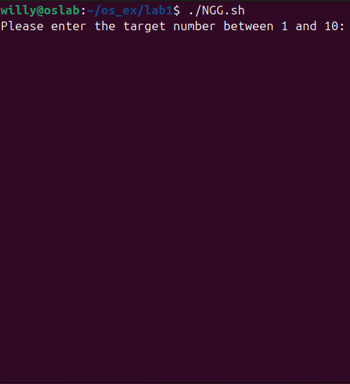
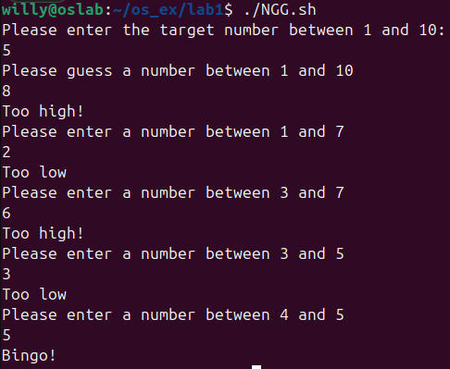
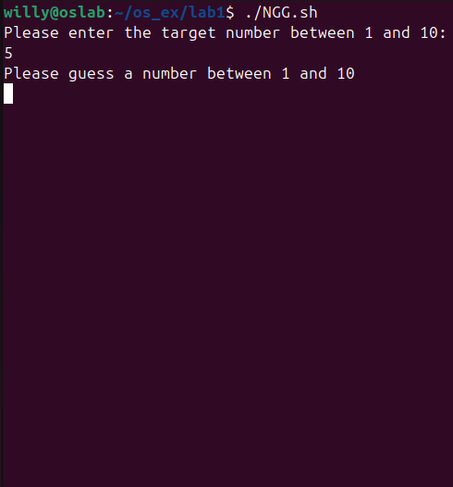
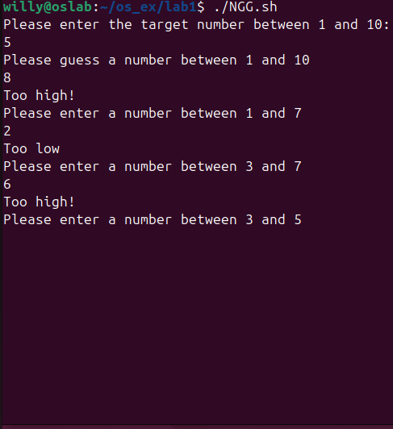
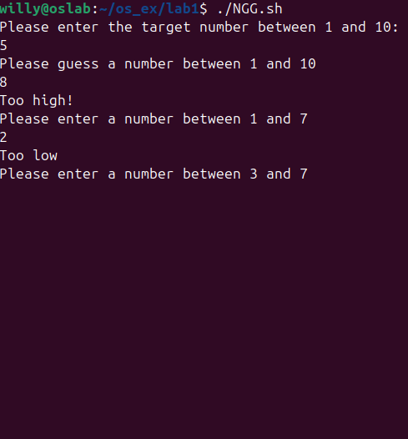
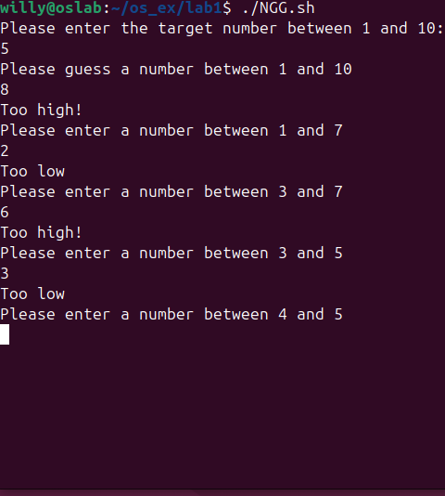
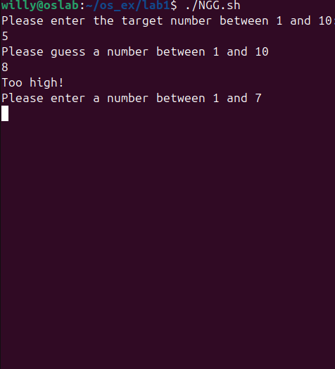
$
Exercises (3/3)
Result
50
NCHU System & Network Lab

Slide 51
$
References
Shell script
Advanced Packaging Tool (APT)
New to Vim
BASH Programming - Introduction
Linux Shell Scripting Tutorial
Common LINUX Command
51
NCHU System & Network Lab

Slide 52
$
附錄
其他常用指令
  查看目錄 : ls
  目錄切換 : cd
  切換到home目錄 : cd ~
  查看當前目工作錄 : pwd
  創建目錄 : mkdir
  創建文件 : touch
  查看文件 : cat
  複製文件/文件夾 : cp
  移動文件/文件夾 : mv
  刪除文件/文件夾 : rm
  輸入指定內容 : echo
  更改權限 : chmod
  搜尋 : find
  檔案中找關鍵字 : grep
52
NCHU System & Network Lab

Slide 53
$
附錄
其他常用快捷鍵
  Ctrl + Shift + T : 開啟terminal分頁
  Ctrl + L : 清空terminal
  Ctrl + C : 強制停止
  Ctrl + D : 關閉
  Ctrl + S : 鎖定
  Ctrl + Q : 解除鎖定
53
NCHU System & Network Lab

Slide 54
Thanks for
your listening
>

