Slide 1
DATA ANALYTICS PROJECT “Prognosis And Analysis Of Accidents And Severity”
Name : Priyanka G Name : N. Meghana Reddy Name : Harshapriya C R
SRN : PES1201801797 SRN : PES1201801272 SRN : PES1201801774

Slide 2
INTRODUCTION :
Traffic and Road accidents are one the major issue in most of the countries.
Around 1.35 million lives are lost per year because of accidents. The latest report on road safety given by ’ World Health Organization (WHO) ’ says 65 percent of deaths due to accidents are from high-income nations like the USA. This costs nearly 3 percent of GDP in most of the countries.
The motto of the project is to examine and study data of 50 states in the US and to study about trends and possible causes of traffic accidents and what could be done to reduce them.
Thousands of pedestrians, children, animals, and travelers are losing their lives which includes not only physical damage and property damage but also emotional damage.
Reducing traffic accidents is one of the most crucial public safety challenges, so analysis and prediction of severity of road accidents have been a trending topic of research in most recent years.

Slide 3
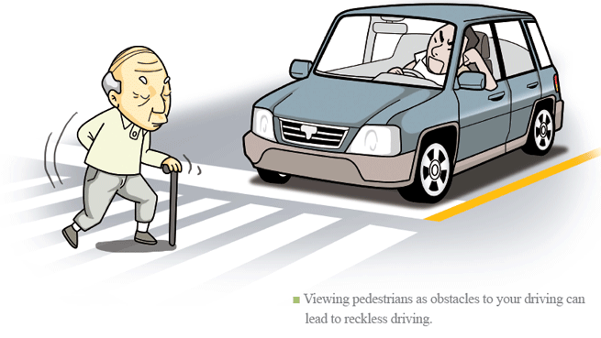
The problem that we have selected is “Prediction And Analysis Of Accidents Severity”
The dataset that we have used is US Traffic Accidents Dataset.
Url: https://www.kaggle.com/sobhanmoosavi/us-accidents

Slide 4
Project Scope
Problem statement
Dataset
Challenges
Prediction And Analysis Of Accidents Severity
Public safety
Analyse the factors increasing the accidents
Accident severity prediction
The dataset consists of 3.5 million records and 49 columns
Contains labels as the severity of the accident ranging from 0 to 4.
Employing the huge dataset.
The labels of this dataset are skewed
Lots of categorical variables.
Determining the actual features that lead to accidents.

Slide 5
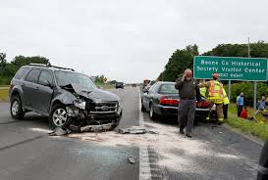
The dataset that we have selected has about 3.5 million records of accident cases registered officially in US with 49 features.
This helped us to predict the severity of accidents that has been taking place in United States and to find major factors that influence accident severity.

Slide 6
Data cleaning, data transformation, dimensionality reduction, scaling and normalization
Data Visualization for understanding the data distribution and features
Accuracy score, Confusion matrix
Preprocessing
Feature Selection
Exploratory Data Analysis
Model Selection
Evaluation
Selecting relevant features that contribute to the prediction of severity of accidents
Modeling and ensemble modeling

Slide 7
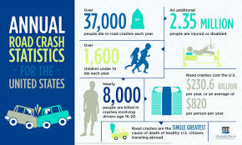
As the dataset has huge amount of data, first we have to pre-process the dataset and then need do analysis based on different models and predict severity.

Slide 8
Preprocessing
Handling null values
Label Encoding
Scaling & Normalization
Standard scaling
Normalization
Removed missing values for certain columns and rows
We removed some of the columns and combined them into one
Removal of useless features
Label encoding to change categorical columns to numerical
One hot encoding for certain columns
Frequency Encoding

Slide 9
Selected Features
Start_Lat, Start_Lng, Amenity, Bump, Crossing, Give_Way,
Junction, No_Exit, Railway, Roundabout, Station, Stop,
Source, TMC, Severity, Start Time, End Time , End_Lat,
End_Lng ,Distance(mi), Description , Number , Street ,
Side, City ,County, State, Zipcode.

Slide 10
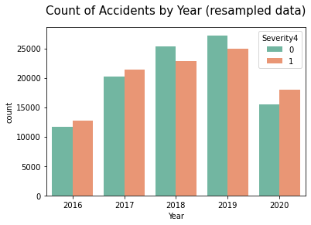
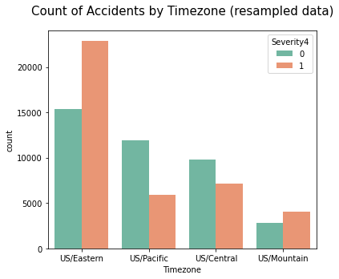
Exploratory Data Analysis

Slide 11
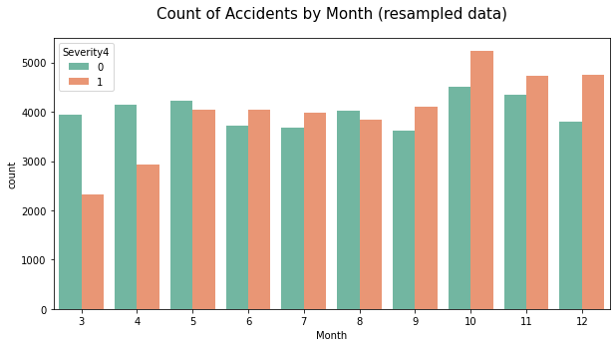
Exploratory Data Analysis

Slide 12
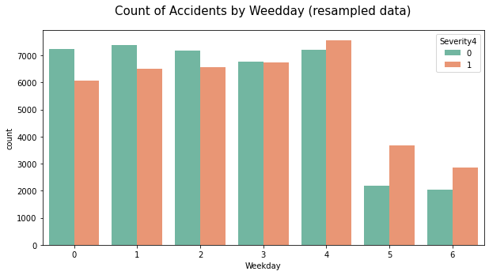
Exploratory Data Analysis: Count of accidents by weekday

Slide 13
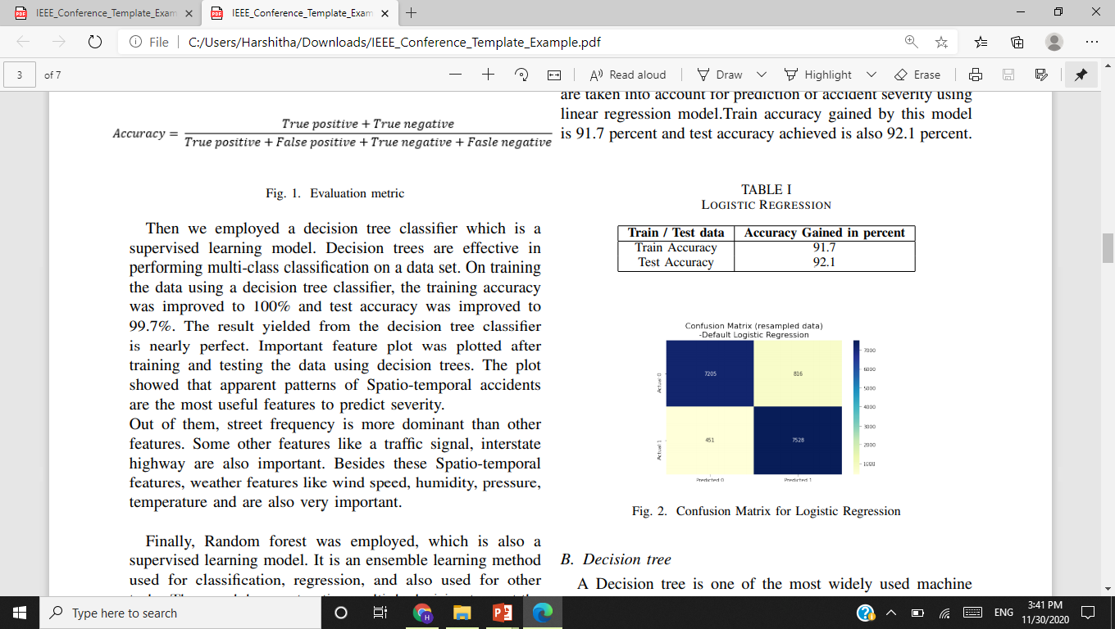
Model:
LOGISTIC REGRESSION:
Logistic regression is a statistical supervised learning model that uses the logistic function to model a binary dependent variable.

Slide 14
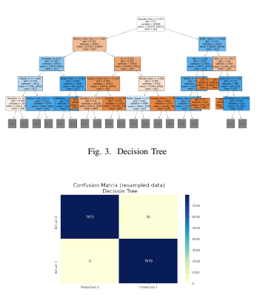
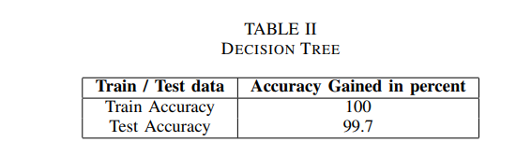
Model:
DECISION TREE CLASSIFIER:
Decision trees are effective in performing
multi-class classification on a data set.
Decision tree is a supervised learning model.

Slide 15
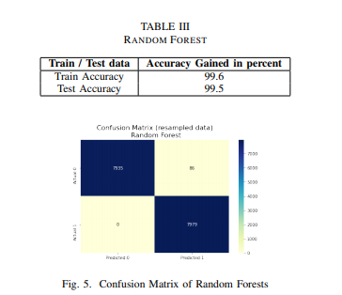
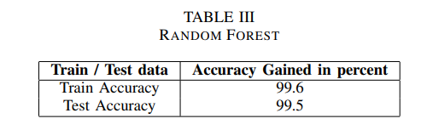
Model:
RANDOM FOREST:
Another Supervised learning model is ’Random Forest’.
These are often referred as an ensemble method of learning for classification, regression and other tasks that work by constructing a multitude of decision trees at training time and returning the class that is the mode or mean of each tree

Slide 16
Evaluation:
Accuracy Metrics: Accuracy score metrics for the test data is captured for all the models.
Confusion Matrix: It is plotted to visualize the number of correct predictions in the test data.

Slide 17
Experimental Results:
Accuracy comparison table between different algorithms.
S.no | Algorithms | Accuracy(%)
1. | Decision Tree | 99.7%
2. | Random Forest | 99.5%
3. | Logistic Regression | 92.1%

Slide 18
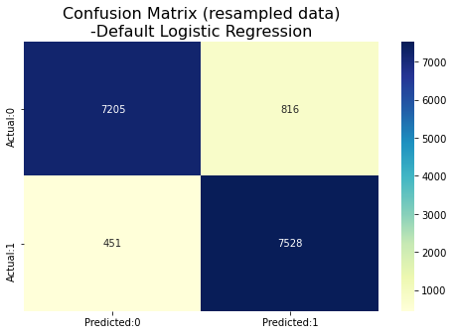
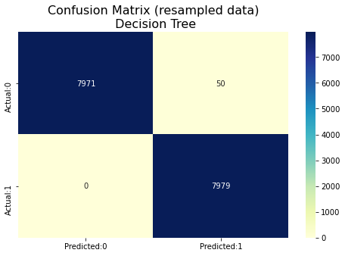

Confusion Matrix:
Logistic Regression
Decision tree Classifier
Random Forest Classifier

Slide 19
Conclusion And Key Findings:
Key Findings:
Find major factors that influence Accident Severity.
Road Accident severity can be predicted accurately even when we have only limited features.
After deep analyzing of data, Weather attributes like temperature, pressure , wind chill , humidity and Time also plays important role in prediction of severity.
Conclusion:
The maximum accuracy score that we got is for Decision trees which is 99.7%.

Slide 20
Individual Contributions:
Name | Contribution
Harshapriya C R - 1774 | Literature survey on a paper about Accident Risk Prediction based on Heterogeneous Sparse data. Worked on logistic regression model, pre-processing of data is handled and took part in preparing IEEE format paper.
N. Meghana Reddy - 1272 | Literature survey on a paper about Analysis of US accidents and solutions. Worked on Random Forest model , Exploratory data Analysis is handled and took part in preparing IEEE format paper.
Priyanka G - 1797 | Literature survey on a paper about Catastrophic factors involved in road accidents: Underlying causes and descriptive analysis. Worked on Decision Tree model , Exploratory data Analysis is handled and took part in preparing IEEE format paper.

Slide 21
References:
Moosavi, Sobhan, Mohammad Hossein Samavatian, Srinivasan Parthasarathy, Radu Teodorescu, and Rajiv Ramnath. "Accident Risk Prediction based on Heterogeneous Sparse Data: New Dataset and Insights." arXiv preprint arXiv:1909.09638 (2019).
Imran Ashraf, Soojung Hur, Muhammad Shafiq and Yongwan Park, “Catastrophic factors involved in road accidents: Underlying causes and descriptive analysis,”, October 9 2019.
Swapnil Kisan Nikam , “Analysis of US Accidents and solutions,” 3-2020.

Slide 22
THANK YOU!!!

