Slide 1
DY Emergency Response Report 1 - Introduction
Supervisor:
Ngô Đăng Hà An
Team members:
Ngô Thục Thiên Bình
Mohammad Firdaus bin Haji Jais
Phạm Thị Xuân Hạ
Muhd. Wafi Nur Arif bin Shamdi
Hoàng Nhựt Vũ

Slide 2
AGENDA
Project information
Introduction
Current situation
Problem definition
Proposed solution
Functional requirements
Roles and responsibilities

Slide 3

Project information
Project name : DY Emergency Response
Project Code : DYER
Product Type : Mobile Application & Website Administrator
Start Date : 1st October 2018
End Date : TBC

Slide 4
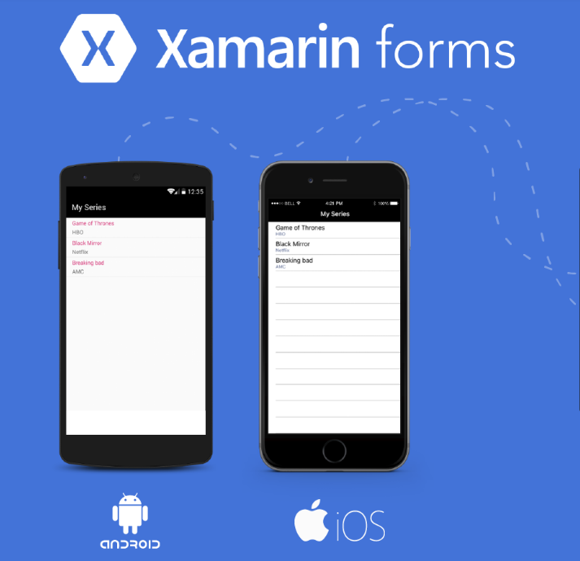
Introduction
The main function of the system focuses on allowing the administrators and coordinators to send notifications to a student’s mobile device to either warn or ask for their status in cases of emergency.
UBD administrators
UBD coordinators
UBD students

Slide 5


Current situation
Currently, Discovery Years (DY) is 80% of their student will go out of country, and there is no program or system can help teacher of UBD can quickly know their student’s status.
They need an application can help them easy to make a notification and receive student’s answer status automatically not manually like now.

Slide 6

Problem definition
The current problem with the system being currently implemented is regarded by the client as being too inefficient and time-consuming
AVC
DY coordinators
Students
Report
Responded by message
Manually check and total count
When they are abroad, they are significantly harder to contact.

Slide 7


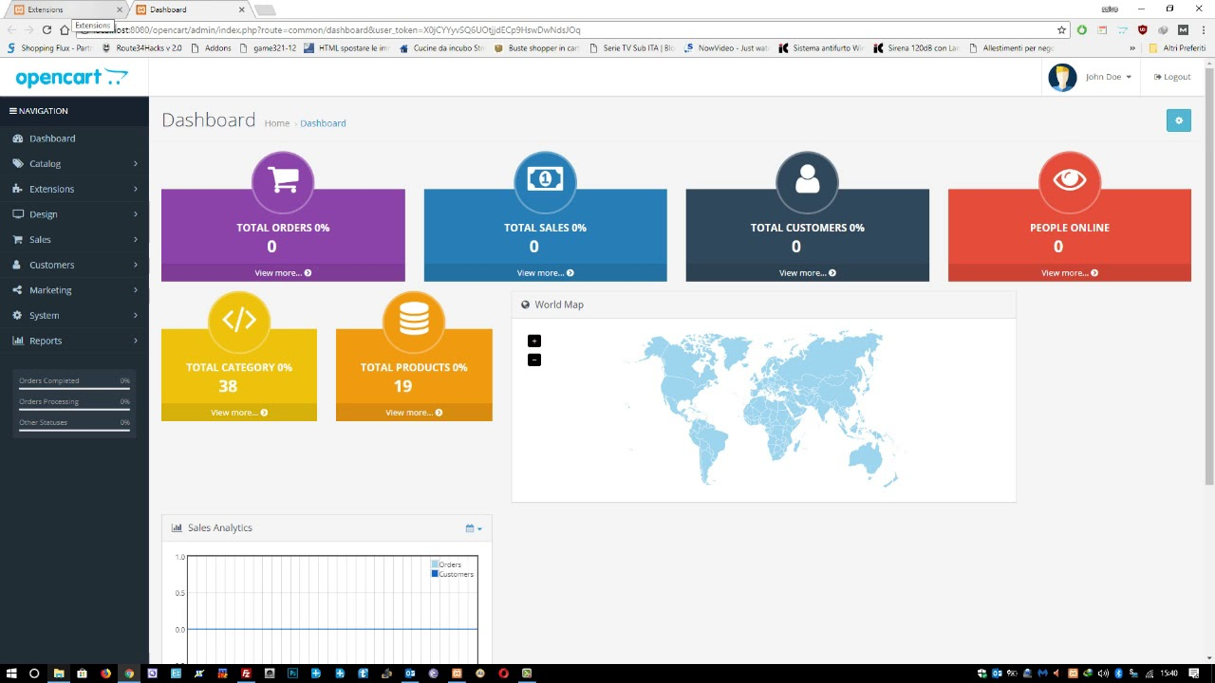
Proposed solution
DYC App
Student App
Web Admin
Feature Functions
Coordinators can only see information about their own faculties’ students.
Coordinators can only send notifications to their faculty’s students.
Coordinators are able to view responses to their notifications.
Student can view information about themselves and their host organization and country.
Student can respond to notifications from their coordinators.
Website administrator are able to view all information of the students.
Website administrator are able to create notifications for all students.
Website administrator can review a report from the website.

Slide 8
Proposed solution
Student :
Students that are going abroad for their Discovery Year are able to log into this mobile application.
Prompted to log into the application once. Subsequent logins on the same device do not ask for authentication.
The account expire at the end of their Discovery Year.
See basic information of the organization they are sent to.
Give report to their DYC in cases of emergency.
Receive notification from their teachers.
Respond to notifications.
Ability to update their new phone number while in host country.
Submit their coordinates when click “Emergency Button”

Slide 9
Proposed solution
Coordinator :
Prompted to log into the application once. Subsequent logins on the same device do not ask for authentication.
Able to view information about their own faculties’ students.
Able to view list of their students by country.
Create notification to one or more students at a time.
View students’ responses to their notifications.
View number of students who have or have not responded to their notifications as well as the information pertaining to those students.
Receive notification from Administrator.
Create report to Administrator.

Slide 10

Proposed solution
Administrator :
Log in to website.
Manage accounts of other coordinators and students.
Manage every aspect of information in user-friendly database.
Create notification to one or more groups of students at the same time.
Create notification to DYC.
View number of students who have or have not responded to their notifications as well as the information pertaining to those students
Review report.

Slide 11
Roles and responsibilities
No | Full name | Role | Position | Contact
1 | Ngô Đăng Hà An | Project manager | Supervisor | AnNDH@fpt.edu.vn
2 | Ngô Thục Thiên Bình | Developer | Leader | binhnttse61953@fpt.edu.vn
3 | Mohammad Firdaus bin Haji Jais | Developer | Member | Daus_Alias@hotmail.com
4 | Hoàng Nhựt Vũ | Developer | Member | vuhnse62243@fpt.edu.vn
5 | Muhd. Wafi Nur Arif bin Shamdi | Developer | Member | Wafihs275@gmail.com
6 | Phạm Thị Xuân Hạ | Developer | Member | haptxse62665@fpt.edu.vn

Slide 12
THANKS FOR WATCHING

