Slide 1


X3DOM – Declarative (X)3D in HTML5
Introduction and Tutorial
Yvonne Jung
Fraunhofer IGD Darmstadt, Germany yvonne.jung@igd.fraunhofer.de www.igd.fraunhofer.de/vcst

Slide 2
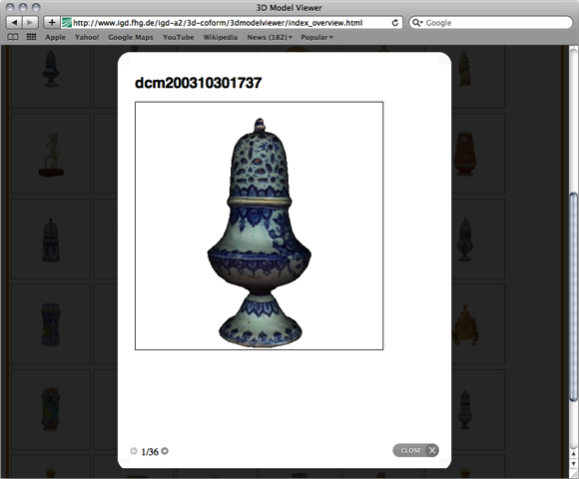
3D Information inside the Web
Websites (have) become Web applications
Increasing interest in 3D for
Product presentation
Visualization of abstract information (e.g. time lines)
Enriching experience of Cultural Heritage data
Enhancing user experience with more sophisticated visualizations
Today: Adobe Flash-based site with videos
Tomorrow: Immersive 3D inside browsers
Example Coform3D: line-up of scanned historic 3D objects

Slide 3
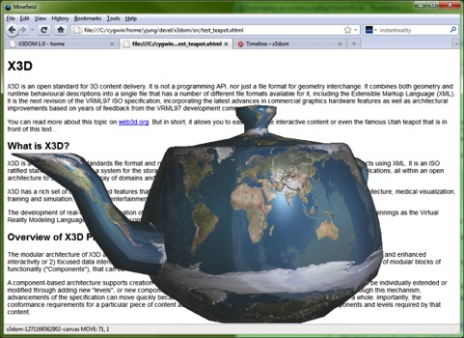
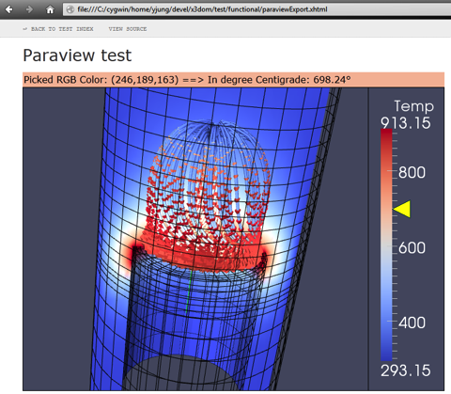
OpenGL and GLSL in the Web: WebGL
JavaScript Binding for OpenGL ES 2.0 in Web Browser
→ Firefox, Chrome, Safari, Opera
Only GLSL shader based, no fixed function pipeline mehr
No variables from GL state
No Matrix stack, etc.
HTML5 <canvas> element provides 3D rendering context
gl = canvas.getContext(’webgl’);
API calls via GL object
X3D via X3DOM framework
http://www.x3dom.org

Slide 4
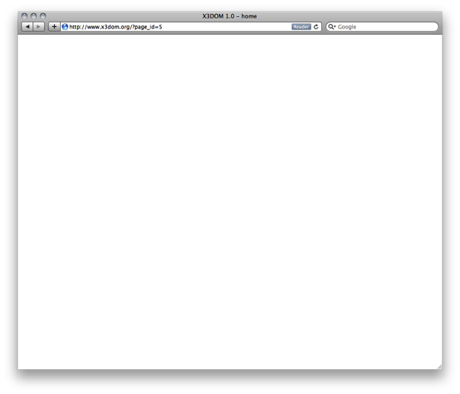
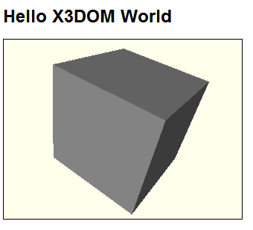
X3DOM – Declarative (X)3D in HTML5
Allows utilizing well-known JavaScript and DOM infrastructure for 3D
Brings together both
declarative content design as known from web design
“old-school” imperative approaches known from game engine development
<html>
<body>
<h1>Hello X3DOM World</h1>
<x3d>
<scene>
<shape>
<box></box>
</shape>
</scene>
</x3d>
</body>
</html>

Slide 5
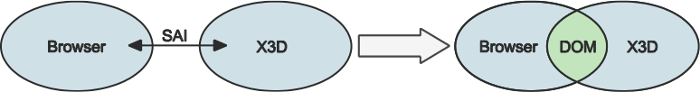
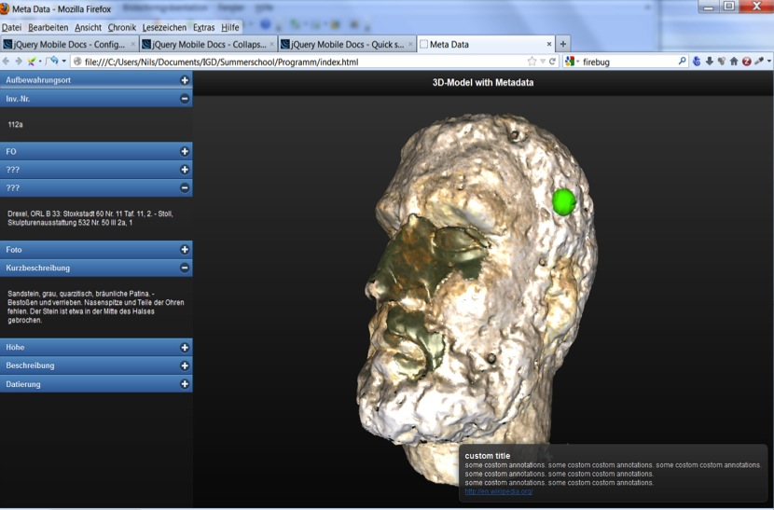
X3DOM – Declarative (X)3D in HTML5
X3DOM := X3D + DOM
DOM-based integration framework for declarative 3D graphics in HTML5
Seamless integration of 3D contents in Web Browser

Slide 6

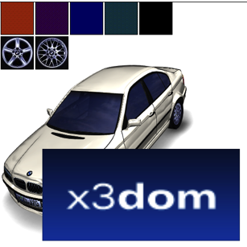
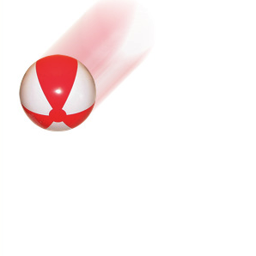

X3DOM – Declarative (X)3D in HTML5 Completes todays graphics technologies
2D
(Final HTML5 spec)
3D
(No W3C spec yet)
Declarative
Scene-graph
Part of HTML document
DOM Integration
CSS / Events
Imperative
Procedural API
Drawing context
Flexible
<canvas>

Slide 7
Benefits: Why Declarative 3D in HTML?
Native Web Bbrowser integration
Plugin/ App free
No issues with user permissions, installation, and security
OS independent, especially on mobile devices
Cluttered: Symbian, Windows Phone, Android, iOS, …
Web Browsers for most devices available
Browser already provides complete deployment structure
Eases proliferation of technology and accessibility of content
No special APIs (such as in game engines)
No expert knowledge required (OpenGL, mathematics, …)
Integrates with standard Web techniques (e.g. DHTML, Ajax)

Slide 8
Benefits: Why Declarative 3D in HTML?
Declarative, open, human-readable (wraps low-level graphics)
Utilizing standard Web APIs for integrating content and user interactions
Open architectures (also for authoring) and ease of access
Integration into HTML document instead of closed systems
Metadata: index and search “content” on WebGL apps?
Allows “mash-ups” (i.e. recombination of existing contents)
Open formats enable automated connection of existing data (e.g., geo-information, Flickr) with 3D content
Unify 2D and 3D media development
Declarative content description
Flexible content (cultural heritage, industry,…)
Interoperability: Write once, run anywhere (web/ desktop/ mobile)
Rapid application development

Slide 9
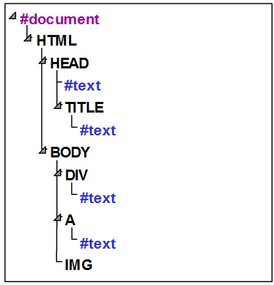
Excursus: Web-based APIs and DOM
Browser provides complete deployment structure
Document Object Model (DOM) is standardized interface that allows manipulating content, structure and style of (X)HTML/ XML documents
Document is structured as tree with nodes
document.getElementById(„myID“);
Nodes/ tags and attributes can be added, removed and modified (usually with JavaScript)
document.createElement(), appendChild(), removeChild()
setAttribute(), getAttribute()
UI events (e.g. ‘mouseover’) can be attached to most elements (e.g. <img>, <a>, <div>, etc.)
Separation of style and content via CSS
DOM structure (example)

Slide 10
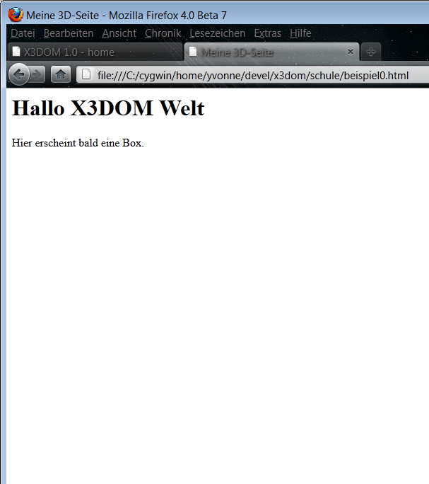
Short introduction of HTML
<html>
<head>
<title>My 3D page</title>
</head>
<body>
<h1>Hello X3DOM World</h1>
<p>
A blue box will soon appear.
</p>
</body>
</html>

Slide 11
First HTML needs to know about (X)3D
<html>
<head>
<title>My 3D page</title>
<link rel="stylesheet" type="text/css"
href="http://www.x3dom.org/x3dom/release/x3dom.css">
</link>
<script type="text/javascript"
src="http://www.x3dom.org/x3dom/release/x3dom.js">
</script>
</head>
…

Slide 12
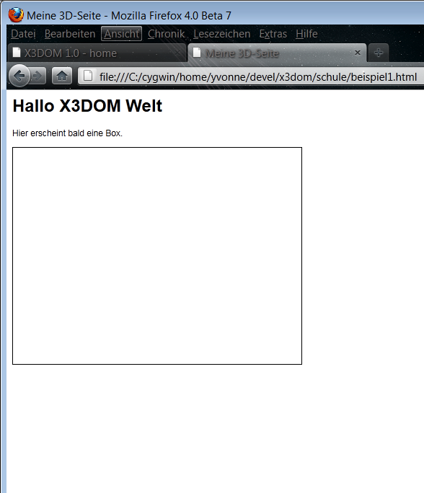
3D only works inside the <X3D> tag
…
<body>
<h1>Hello X3DOM World</h1>
<p>
A blue box will soon appear.
</p>
<x3d width="400" height="300">
</x3d>
</body>
</html>

Slide 13
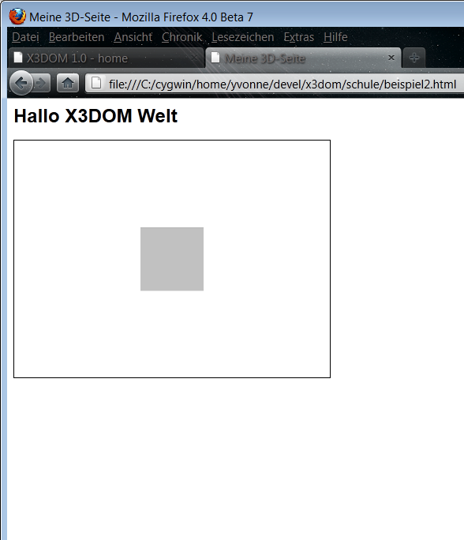
All 3D objects are children of the <scene> element
…
<body>
<h1>Hello X3DOM World</h1>
<x3d width="400" height="300">
<scene>
<shape>
<box></box>
</shape>
</scene>
</x3d>
</body>
</html>

Slide 14
Every object has a <shape>
…
<body>
<h1>Hello X3DOM World</h1>
<x3d width="400" height="300">
<scene>
<shape>
<box></box>
</shape>
</scene>
</x3d>
</body>
</html>

Slide 15
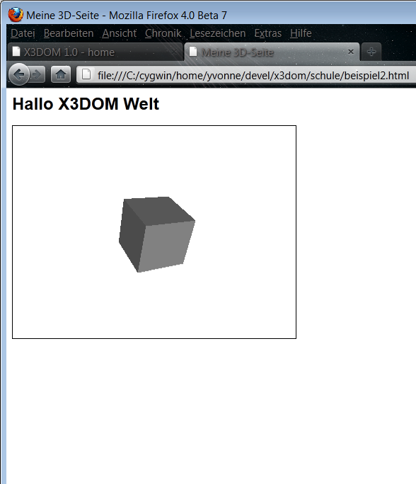
…and a geometry, like e.g. a <box>
…
<body>
<h1>Hello X3DOM World</h1>
<x3d width="400" height="300">
<scene>
<shape>
<box></box>
</shape>
</scene>
</x3d>
</body>
</html>

Slide 16
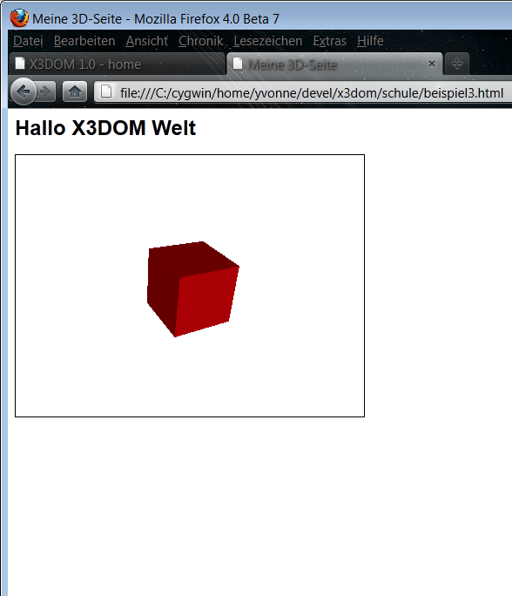
…and an <appearance>
<x3d width="400" height="300">
<scene>
<shape>
<appearance>
<material diffuseColor="red">
</material>
</appearance>
<box></box>
</shape>
</scene>
</x3d>

Slide 17
…with a (e.g. red) <material>
<x3d width="400" height="300">
<scene>
<shape>
<appearance>
<material diffuseColor="red">
</material>
</appearance>
<box></box>
</shape>
</scene>
</x3d>

Slide 18
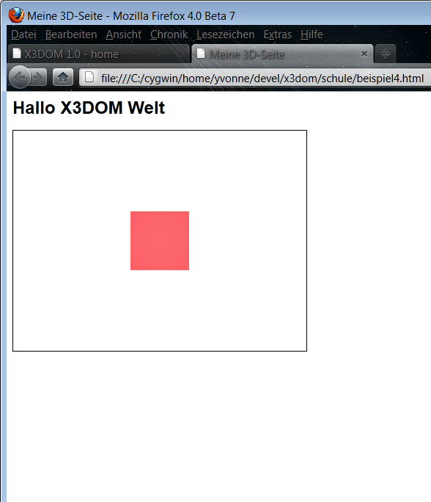
Materials with specular highlights
<x3d width="400" height="300">
<scene>
<shape>
<appearance>
<material diffuseColor="red"
specularColor="#808080">
</material>
</appearance>
<box></box>
</shape>
</scene>
</x3d>

Slide 19
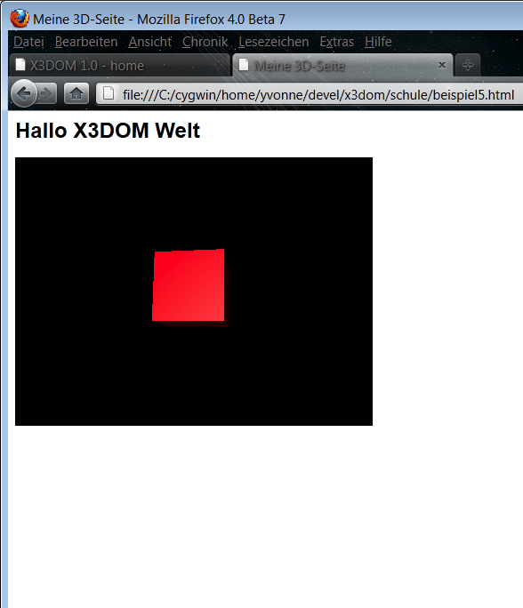
Change Background Colors in (R,G,B) with red/green/blue ∈ [0,1]
<scene>
<shape>
<appearance>
<material diffuseColor="red"
specularColor="#808080">
</material>
</appearance>
<box></box>
</shape>
<background skyColor="0 0 0">
</background>
</scene>

Slide 20
Change Background (now using CSS)
<x3d style="background-color: #00F;">
<scene>
…
</scene>
</x3d>
Change size of <x3d> element to full size
<x3d style="left:0px; top:0px; width:100%; height:100%; border:none;">
…
</x3d>

Slide 21
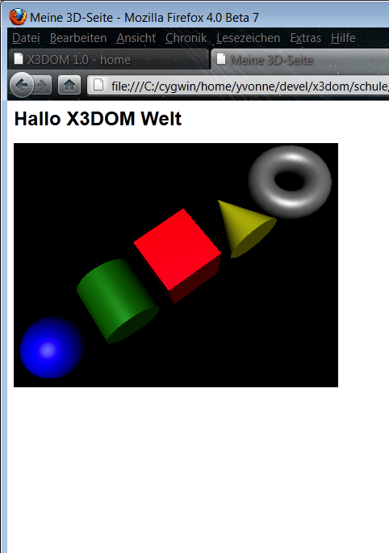
Geometric base objects
See screenshot – from left to right:
<sphere radius=“1.0”>
<cylinder radius=“1.0” height=“2.0”>
<box size=“2.0 2.0 2.0”>
<cone bottomRadius=“1.0” height=“2.0”>
<torus innerRadius=“0.5” outerRadius=“1.0”>

Slide 22
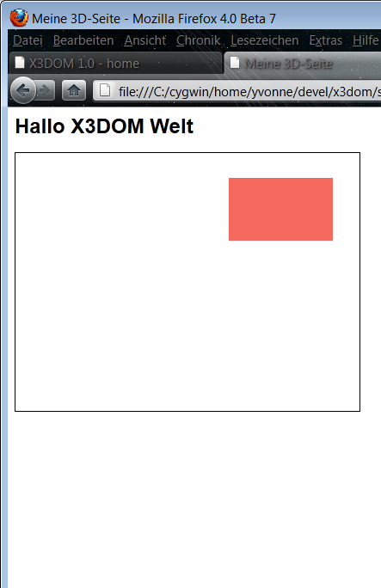
Defining own geometries Example: simple rectangle with an <indexedFaceSet>
<scene>
<shape>
<appearance>
<material diffuseColor="salmon">
</material>
</appearance>
<indexedFaceSet coordIndex="0 1 2 3 -1">
<coordinate point="2 2 0, 7 2 0, 7 5 0, 2 5 0">
</coordinate>
</indexedFaceSet>
</shape>
<viewpoint position="0 0 15"></viewpoint>
</scene>

Slide 23

Defining own geometries Example: simple rectangle with an <indexedFaceSet>
<indexedFaceSet coordIndex="0 1 2 3 -1">
<coordinate point= "2 2 0, 7 2 0, 7 5 0, 2 5 0"> </coordinate>
</indexedFaceSet>
Important building blocks
The vertices of a Polygon (here “face”), given as <coordinate>
The index to a vertex, given as list: “coordIndex”
y
(2, 5, 0)
(7, 5, 0)
5
(2, 2, 0)
(7, 2, 0)
1
1
5
x
1
z

Slide 24
Defining own geometries Example: simple rectangle with an <indexedFaceSet>
<indexedFaceSet coordIndex="0 1 2 3 -1">
<coordinate point= "2 2 0, 7 2 0, 7 5 0, 2 5 0"> </coordinate>
</indexedFaceSet>
The end of one polygon and the begin of a new one is marked as “-1” in the index array
This way arbitrarily complex 3D objects can be created
y
(2, 5, 0)
(7, 5, 0)
5
(2, 2, 0)
(7, 2, 0)
1
1
5
x
1
z

Slide 25
Defining own geometries Example: simple rectangle with an <indexedFaceSet>
<indexedFaceSet coordIndex="0 1 2 3 -1">
<coordinate point= "2 2 0, 7 2 0, 7 5 0, 2 5 0"> </coordinate>
</indexedFaceSet>
The indices (except “-1”) refer to the array position of a 3D coordinate in <coordinate>
The coordinates of a certain polygon are listed counterclockwise
y
(2, 5, 0)
(7, 5, 0)
5
3
2
0
1
(2, 2, 0)
(7, 2, 0)
1
1
5
x
1
z

Slide 26
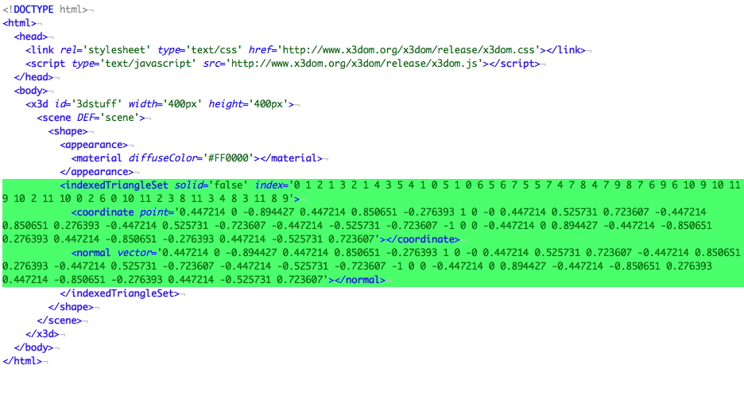
DOM holds structure and data More than 95% are usually unstructured data

Slide 27
New Geometry node types
<binaryGeometry vertexCount='1153083' primType='"TRIANGLES"'
position='19.811892 -57.892578 -1.699294'
size='92.804482 159.783081 26.479685'
coord='binGeo/BG0_interleaveBinary.bin#0+24' coordType='Int16'
normal='binGeo/BG0_interleaveBinary.bin#8+24' normalType='Int16‘
color='binGeo/BG0_interleaveBinary.bin#16+24‘ colorType='Int16' >
</binaryGeometry>
Data transcoding (example with input file „model.ply“)
Without mesh optimization
aopt -i model.ply -G binGeo/:saI -x model-bg.x3d -N model-bg.html
With mesh optimization (cleanup, patching, and binary creation)
aopt -i model.ply -u -b model-clean.x3db
aopt -i model-clean.x3db -F Scene -b model-opt.x3db
aopt -i model-opt.x3db -G binGeo/:saI -N model-bg.html

Slide 28
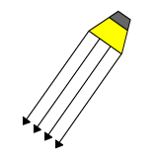
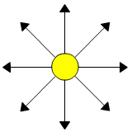
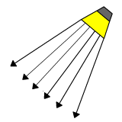
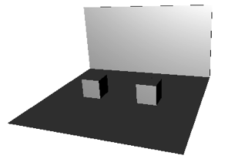
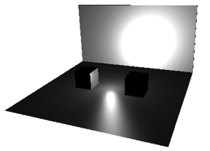
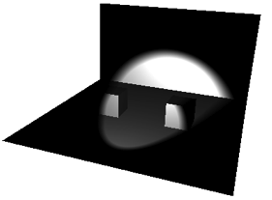
Light sources in X3DOM …are part of the <scene>
Directional light
Point light
Spot light
<directionalLight direction='0 0 -1' intensity='1'> </directionalLight >
<pointLight location='0 0 0' intensity='1'> </pointLight >
<spotLight direction='0 0 -1' location='0 0 0' intensity='1'> </spotLight >

Slide 29
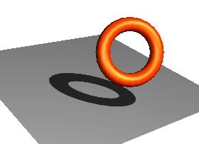
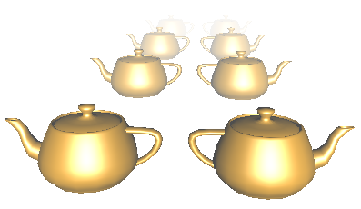
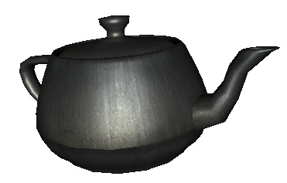
Other rendering effects
shadows
fog
textures
<directionalLight direction='0 0 -1' intensity='1' shadowIntensity='0.7'>
</directionalLight >
Note: only implemented for the first <directionalLight> in the sene
<fog visibilityRange='1000'></fog>
<imageTexture url=“myTextureMap.jpg“></ imageTexture>
Note: like <material> only as child node of <appearance> possible!

Slide 30
Appearance example: a textured box
<x3d width="500px" height="400px">
<scene>
<shape>
<appearance>
<imageTexture url="logo.png"></imageTexture>
</appearance>
<box></box>
</shape>
</scene>
</x3d>
Interesting alternative – using a video as texture:
<movieTexture url=’”foo.mp4″,”foo.ogv”‘></movieTexture>

Slide 31
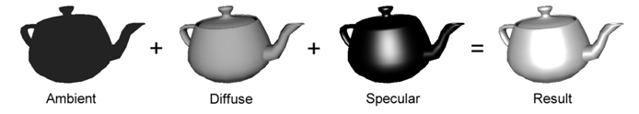
Excursus: the lighting model (diffuse and specular reflection)
Final color I := ambient material + diffuse material * (N·L) + specular material * (N·H)
For more light sources:

Slide 32
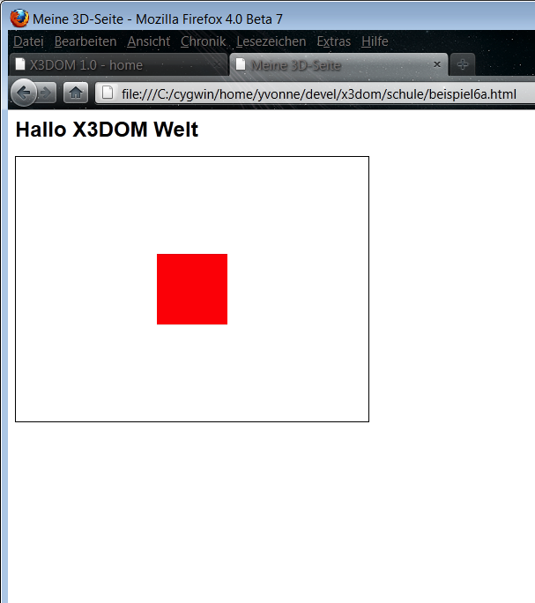
Two objects in one scene (?!)
<scene>
<shape>
<appearance>
<material diffuseColor='red'></material>
</appearance>
<box></box>
</shape>
<shape>
<appearance>
<material diffuseColor='blue'></material>
</appearance>
<sphere></sphere>
</shape>
</scene>
…
OK
???

Slide 33
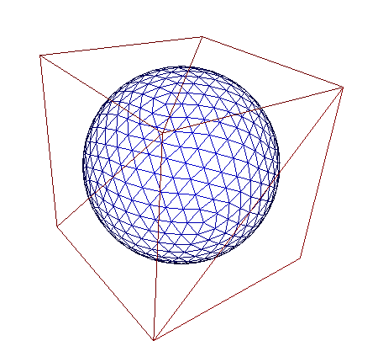
Two objects in one scene Problem: both appear at same position
<scene>
<shape>
<appearance></appearance>
<box></box>
</shape>
<shape>
<appearance></appearance>
<sphere></sphere>
</shape>
</scene>

Slide 34
Two objects in one scene Problem: both appear at same position
<scene>
<shape>
<appearance></appearance>
<box></box>
</shape>
<shape>
<appearance></appearance>
<sphere></sphere>
</shape>
</scene>
Reason: 3D objects are usually created in coordinate origin and need to be repositioned afterwards
y
1
x
1
3
1
z

Slide 35
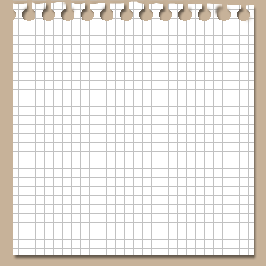
Excursus: (2D) coordinate systems Object coordinates in image plane (given by x & y)
y
(2, 5)
(7, 5)
5
(2, 2)
(7, 2)
1
1
5
x

Slide 36
Excursus: (3D) coordinate systems Object coordinates in 3D space (z orthogonal on x & y)
y
(2, 5, 0)
(7, 5, 0)
5
(2, 2, 0)
(7, 2, 0)
1
1
5
x
1
z

Slide 37
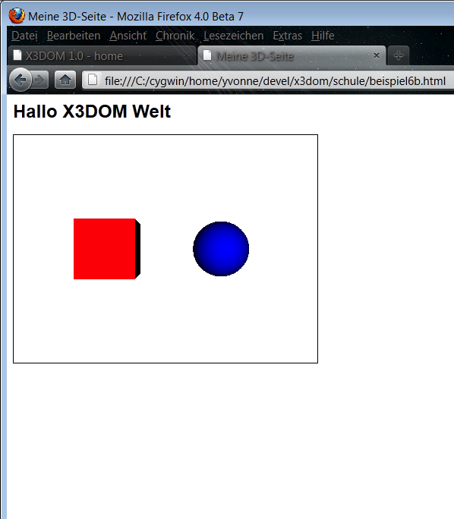
Two objects in one scene Now with translation
<transform translation="-2 0 0">
<shape>
<appearance>
<material diffuseColor="red"></material>
</appearance>
<box></box>
</shape>
</transform>
<transform translation="2 0 0">
<shape>
<appearance>
<material diffuseColor="blue"></material>
</appearance>
<sphere></sphere>
</shape>
</transform>

Slide 38
Two objects in one scene Now with translation
<transform translation="-2 0 0">
<shape>
<appearance>
<material diffuseColor="red"></material>
</appearance>
<box></box>
</shape>
</transform>
<transform translation="2 0 0">
<shape>
<appearance>
<material diffuseColor="blue"></material>
</appearance>
<sphere></sphere>
</shape>
</transform>
y
1
1
3
x
1
z

Slide 39
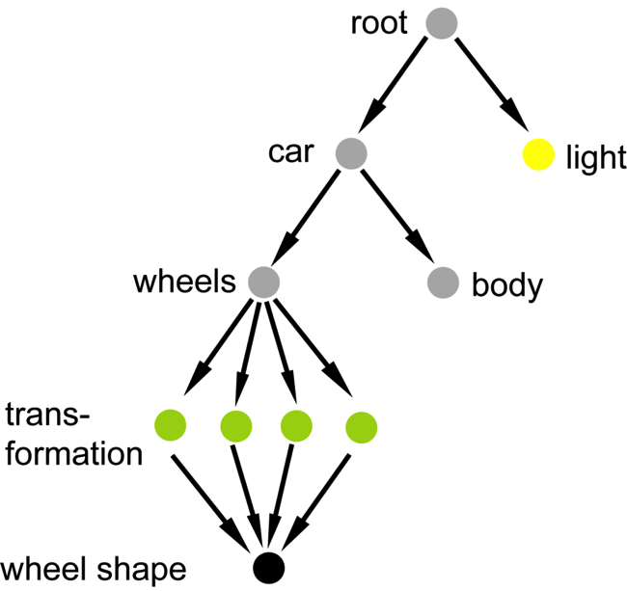
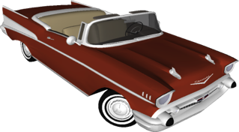
The scene graph: Grouping and transformations
3D elements are usually organized hierarchically
Starting from the root node (i.e. from <scene> element) all 3D elements (e.g. <shape>, <box> etc.) are inserted into the “tree” (scene graph) as child or sibling elements
Note: tree ≠ graph
<group> and <transform> elements help to group and reposition objects:
<transform translation="0 0 0" rotation="0 1 0 0" scale="1 1 1"> … </transform>

Slide 40
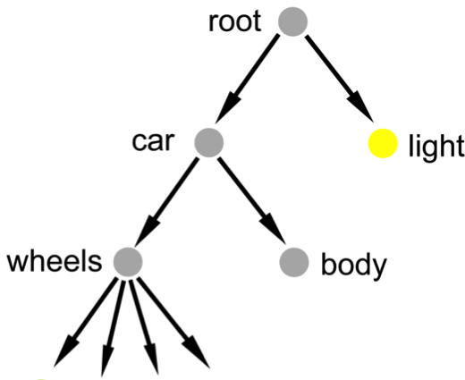
DOM Manipulation: Node appending / removal
HTML/X3D code:
<group id=‘root’></group>
…
JS script to add nodes:
root = document.getElementByid(‘root’);
trans = document.createElement('Transform');
trans.setAttribute(‘translation’, ‘1 2 3’ );
root.appendChild(trans);
JS script to remove nodes:
root.removeChild(trans);
JS script with setAttribute() (also useful for libs like jQuery):
document.getElementById(‘mat’).setAttribute(‘diffuseColor’,’red’);
Notes:
X3d defines a namespace for all his children. Does not need any prefix. Size attribute in question

Slide 41
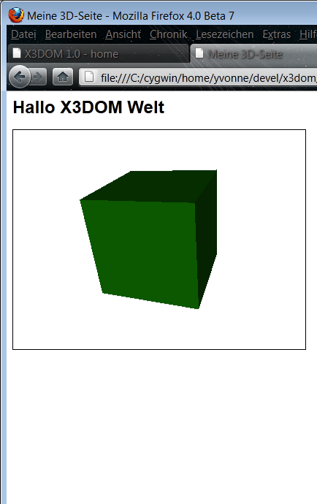
HTML Events: user interaction through DOM Events
<shape>
<appearance>
<material id="mat" diffuseColor="red">
</material>
</appearance>
<box onclick=" document.getElementById('mat'). setAttribute('diffuseColor', 'green');" >
</box>
</shape>
…

Slide 42
HTML Events: user interaction through DOM Events - V2
<shape>
<appearance>
<material id="mat" diffuseColor="red"></material>
</appearance>
<box id="box"></box>
</shape>
<script type="text/javascript">
document.onload = function() {
document.getElementById('box').addEventListener('click', function() {
document.getElementById('mat').setAttribute('diffuseColor', 'olive');
}, false) };
</script>

Slide 43
HTML Events: 3DPickEvent extends DOM MouseEvent
interface 3DPickEvent : MouseEvent {
readonly attribute float worldX; // 3d world coordinates at pick position
readonly attribute float worldY;
readonly attribute float worldZ;
readonly attribute float normalX; // picked surface normal
readonly attribute float normalY;
readonly attribute float normalZ;
…
}
<group onmousemove="updateTrafo(event); "> … </group>
<transform id="trafo"><shape isPickable="false"> … </shape></transform>
function updateTrafo(event) {
var t = document.getElementById(‘trafo‘);
var norm = new x3dom.fields.SFVec3f(event.normalX, event.normalY, event.normalZ);
var qDir = x3dom.fields.Quaternion.rotateFromTo(new x3dom.fields.SFVec3f(0, 1, 0), norm);
var rot = qDir.toAxisAngle();
t.setAttribute('rotation', rot[0].x+' '+rot[0].y+' '+rot[0].z+' '+rot[1]);
t.setAttribute('translation', event.worldX+' '+event.worldY+' '+event.worldZ);
}

Slide 44
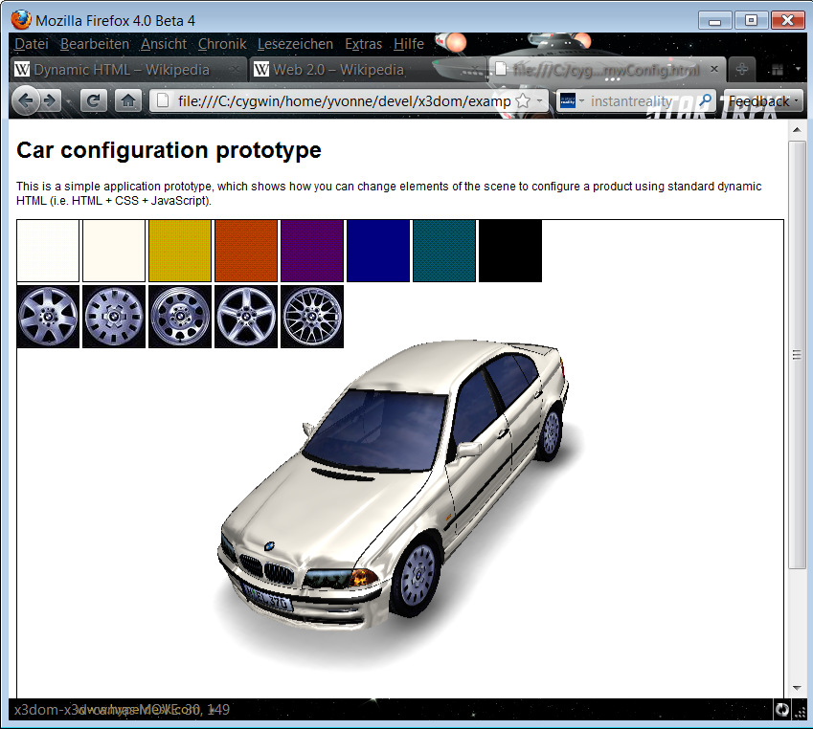
Example 1: Interactive Car Configurator
Interaction via standard Web technologies (e.g. JavaScript Events etc.)
Using HTML + JavaScript, to change color and rims
<img src="felge1_64.jpg“ onclick="..." style="…">
Click on <img> element…
document.getElementById('body_color'). setAttribute("diffuseColor", '#000066');
<x3d> element
Part of DOM/ HTML document like every other HTML element (e.g. <p>, <img> etc.)
…causes attribute change of <texture> url (i.e., other wheel rims appear)

Slide 45
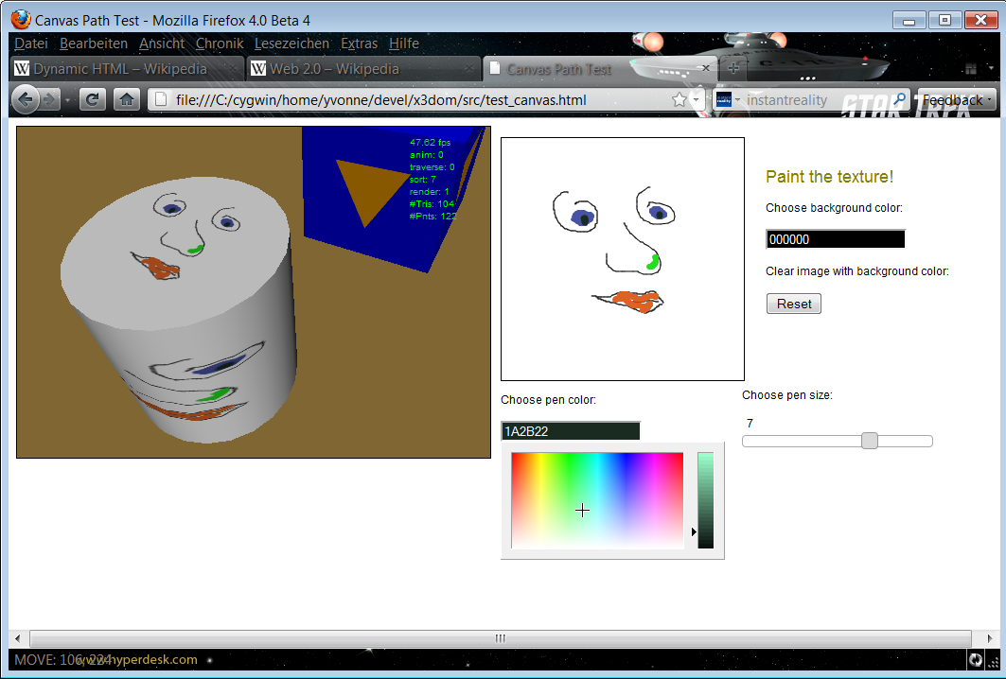
Example 2: Painting Textures of 3D Objects
HTML5 <canvas> element
Painted image used as texture on 3D object
<x3d> element
Part of DOM/ HTML document like every other HTML element
(JavaScript implementation based on new WebGL API of HTML5 <canvas> element)
jQuery UI (User Interface)
jQuery JavaScript library: http://jqueryui.com/

Slide 46
Navigation: moving the virtual camera interactively
Built-in navigation modes
Examine, walk, fly, lookat, game and none <navigationInfo type=“any”></navigationInfo>
Abstract behavior dynamically maps to various user inputs: mouse, keys, multi-touch
Application-specific navigation
Use ‘none’ mode
Move camera by updating position and orientation of <viewpoint>

Slide 47
Animations CSS 3D Transforms & CSS Animation
Utilized to transform and update <transform> nodes (only in WebKit)
<style type="text/css">
#trans {
-webkit-animation: spin 8s infinite linear;
}
@-webkit-keyframes spin {
from { -webkit-transform: rotateY(0); }
to { -webkit-transform: rotateY(-360deg); }
}
</style>
…
<transform id="trans">
<transform style="-webkit-transform: rotateY(45deg);">
Notes:
X3d defines a namespace for all his children. Does not need any prefix. Size attribute in question

Slide 48
Animations X3D TimeSensor and Interpolator nodes
<scene>
<transform id="trafo" rotation="0 1 0 0">
<shape>
<appearance>
<material diffuseColor="red">
</material>
</appearance>
<box></box>
</shape>
</transform>
<timeSensor id="ts" loop="true" cycleInterval="2">
</timeSensor>
<orientationInterpolator id="oi" key="0.0 0.5 1.0"
keyValue="0 1 0 0, 0 1 0 3.14, 0 1 0 6.28">
</orientationInterpolator>
<ROUTE fromNode='ts' fromField='fraction_changed'
toNode='oi' toField='set_fraction'></ROUTE>
<ROUTE fromNode='oi' fromField='value_changed'
toNode='trafo' toField='set_rotation'></ROUTE>
</scene>
The <timeSensor> „ts“ triggers via the first ROUTE the <orientationInterpolator> „oi“, which provides the values for the rotation around the y-axis (0,1,0)
The resulting value is then ROUTE‘d to the field ‘rotation’ of the <transform> node “trafo”, which results in an animation

Slide 49

Entry points for getting started
Some books
“X3D: Extensible 3D Graphics for Web Authors”
“The Annotated VRML 97 Reference” (explains concepts)
X3DOM online documentation and code examples
http://x3dom.org/docs/dev/ (tutorials and docs)
http://www.x3dom.org/school/ (12 simple examples)
http://www.x3dom.org/iX/ (7 examples with animation)
http://www.x3dom.org/x3dom/test/functional/ (lots of feature tests)
More docs and tools
http://www.instantreality.org/downloads/ (InstantPlayer and aopt converter)
http://doc.instantreality.org/documentation/getting-started/ (links to X3D)

Slide 50
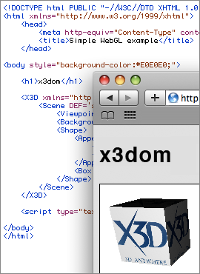
Declarative 3D Graphics in the Web Browser
Introduction and Tutorial
http://www.x3dom.org/

