Slide 1

Design and Development of a Smart Electronic Pen
Group Members
Haq Nawaz (p20-0057)
Aqil Umar (P19-0034)
Noman Yousaf (p20-0614)
Project Supervisor
Dr. Ali Sayyed

Slide 2
Introduction
We are designing a smart pen using the KA8 optical sensor chip and the Teensy 4.1 microcontroller. The goal of this pen is to capture real-time X and Y movement data and store it on an SD card.
The pen tracks the user’s hand movements using the KA8 chip, while the Teensy processes the data and save it for later use.
Offering a seamless way to bridge the gap between traditional note taking and modern digital note taking.

Slide 3
System Integration
KA8 Optical Chip
Teensy 4.1
TP 4056
Battery
Led

Slide 4
Data Representation Of KA8
X values represent the horizontal movement of the pen.
Y values represent the vertical movement of the pen.
X | Y
0 | -5
0 | -5
0 | -5
4 | 5
4 | 5
4 | 5
6 | 0
6 | 0

Slide 5
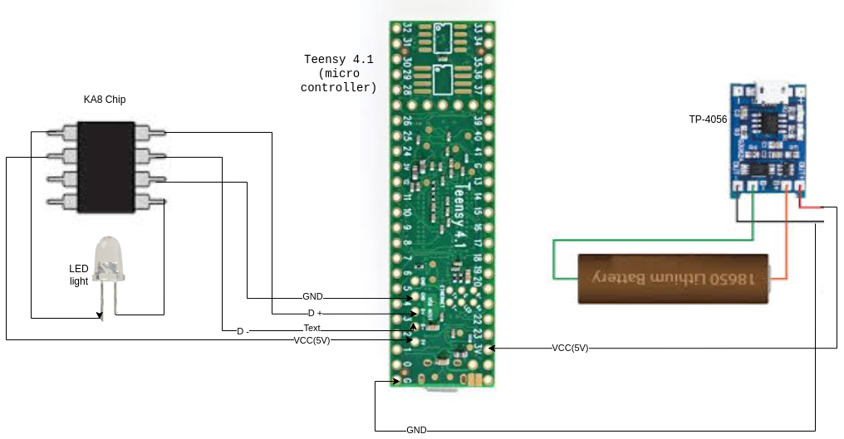
Circuit Diagram

Slide 6
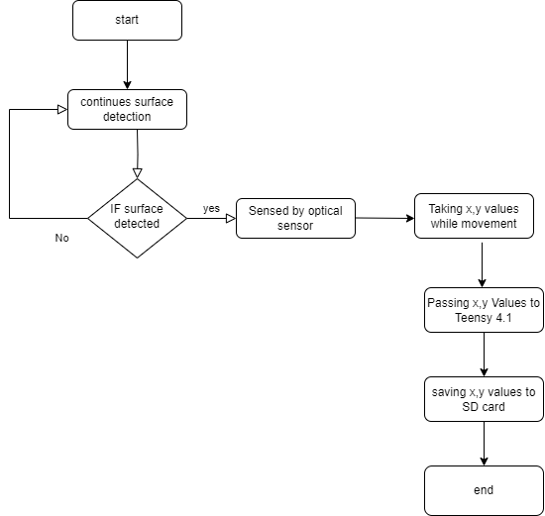
Flow Diagram

Slide 7
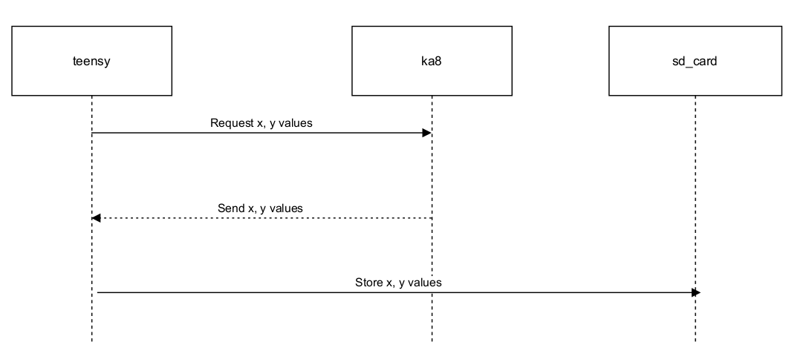
Sequence Diagram

Slide 8
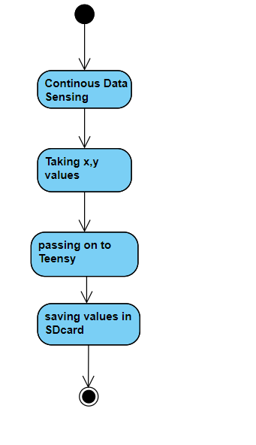
Activity Diagram

Slide 9
Technical Difficulties
MPU6050 (Gyro-Accelo sensor) –too much Noise !
Replacing with Optical Sensor (KA8)
Interfacing the KA8 chip with the Teensy 4.1
Challenges in ensuring that the X and Y data was accurate
Surface Issues (too smooth / too rough )
Insufficient Lighting
Sensor Obstruction or Dust or Heat Up Issues
Electrical Noise ( power )

Slide 10
Web Development
Streamlit - Python

Slide 11
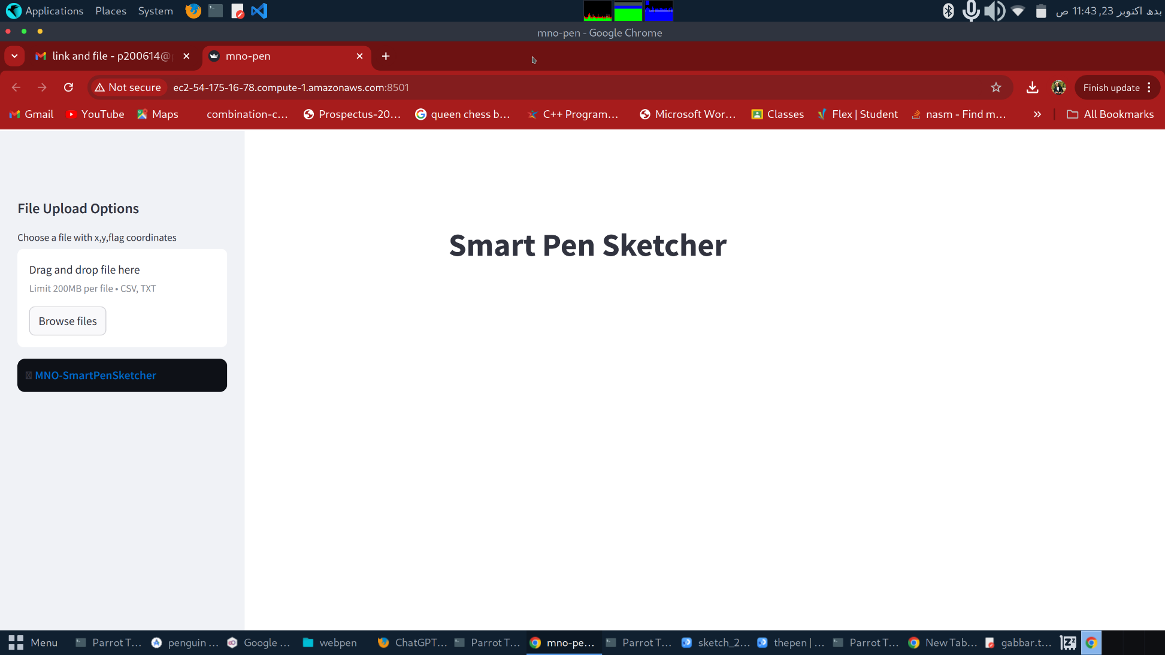
Home Page

Slide 12
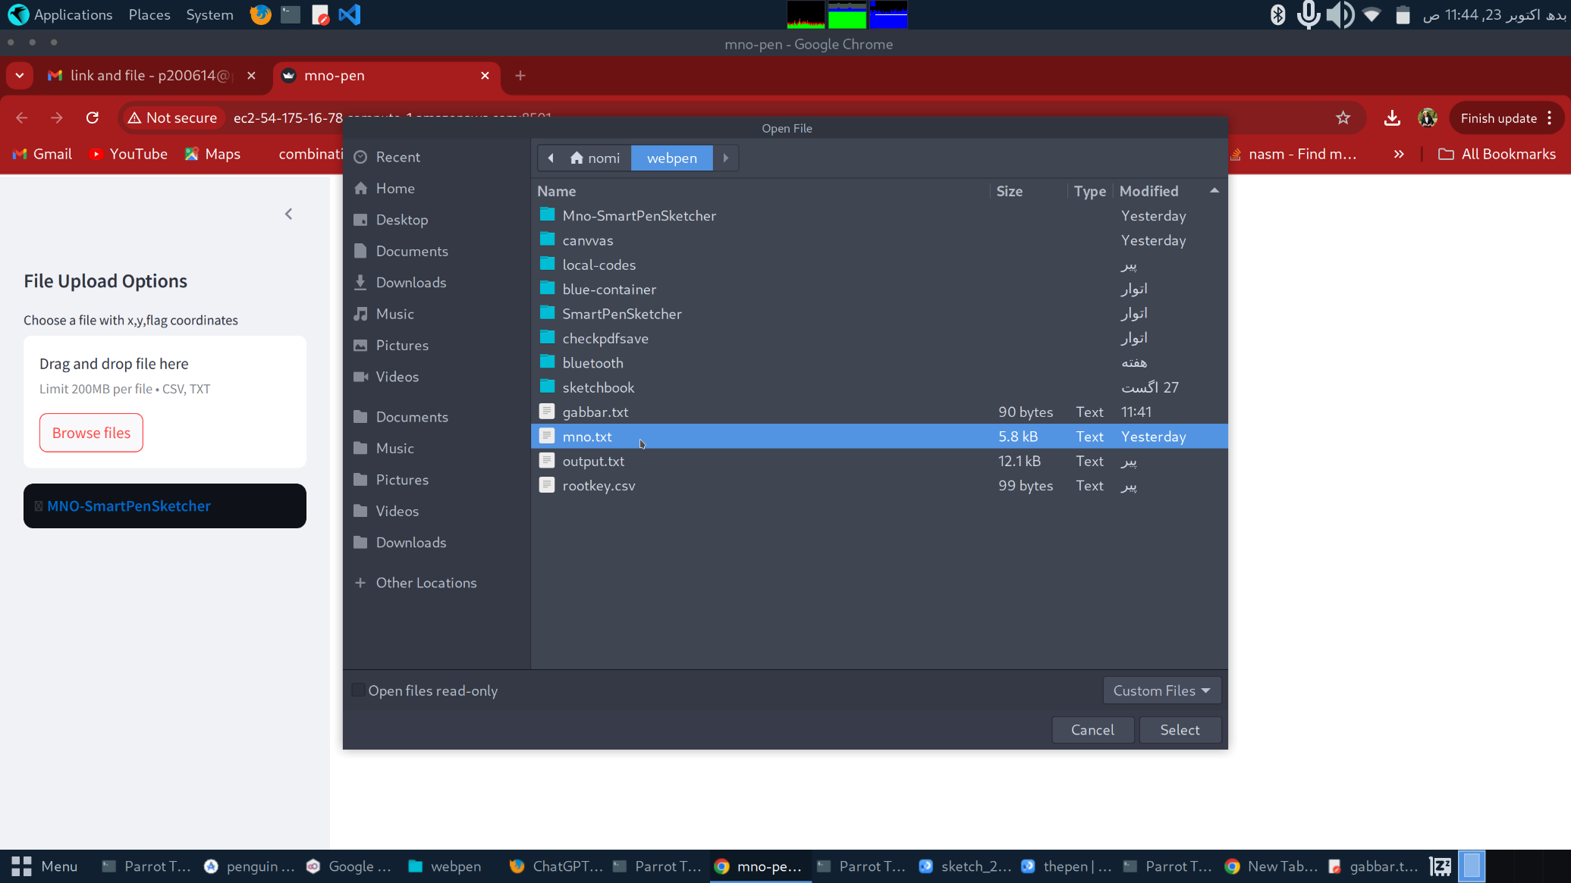
Browsing File to upload

Slide 13
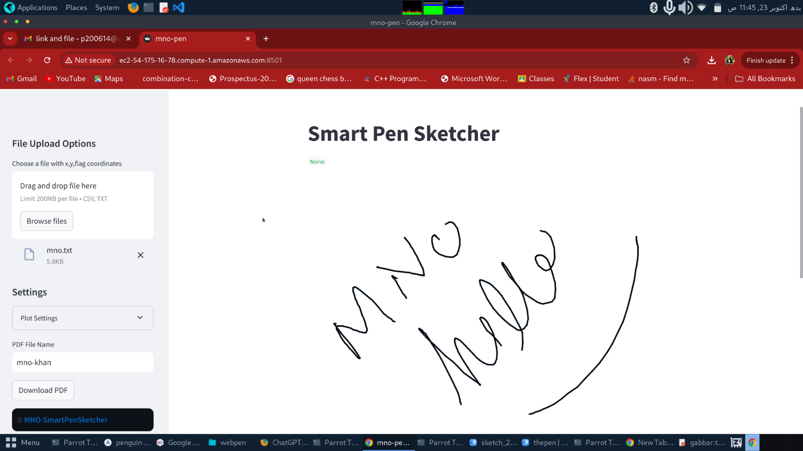
File Opened

Slide 14
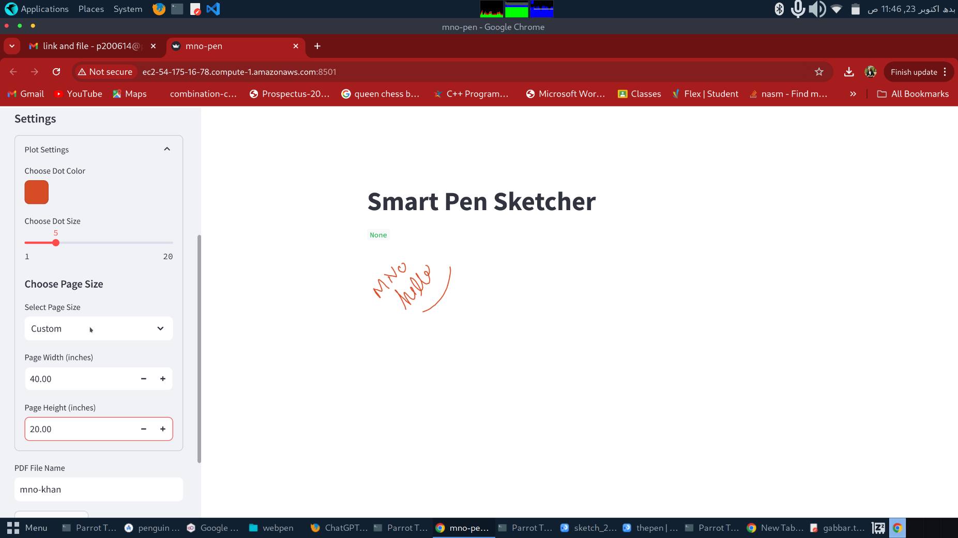
Coloring Options

Slide 15
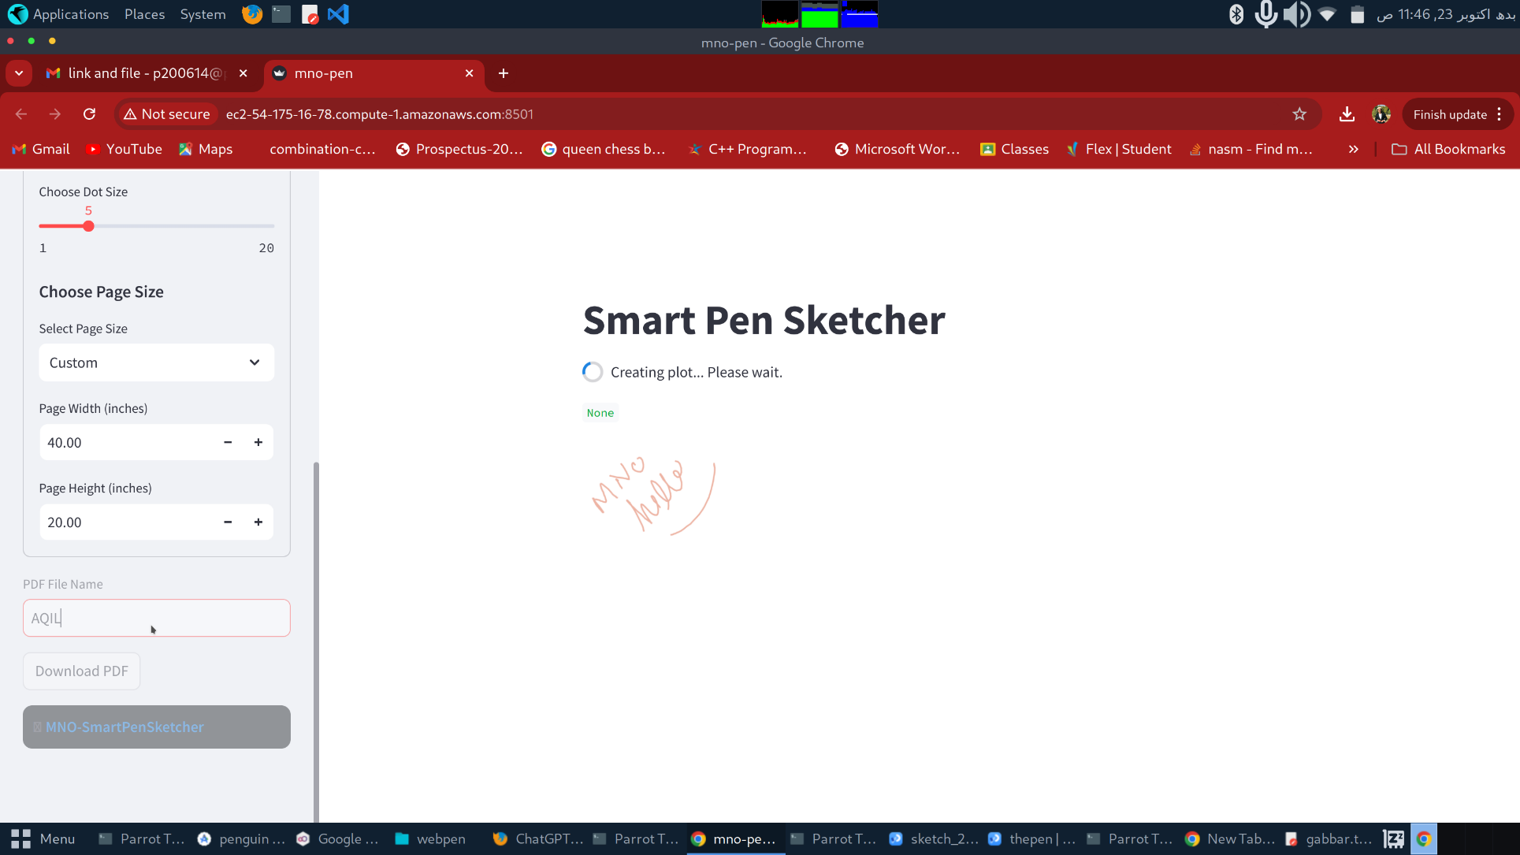
Saving File - Naming

Slide 16
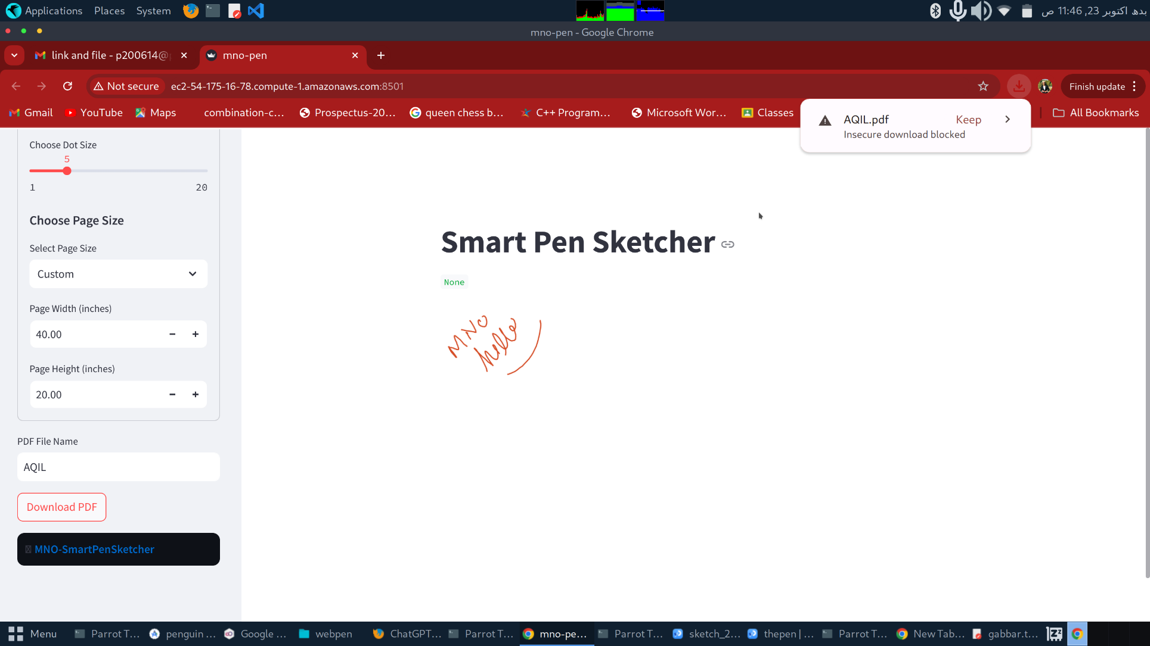
PDF File Saved

Slide 17
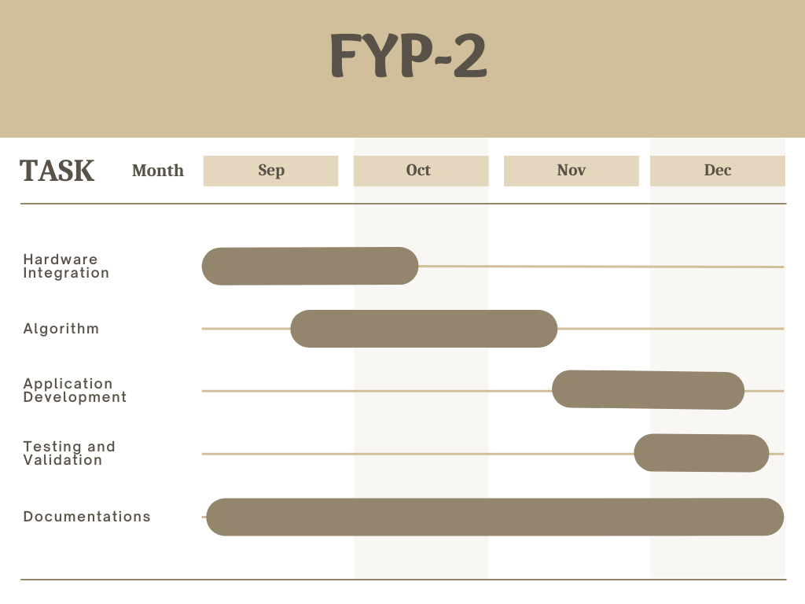
Objectives

Slide 18
Team Work
Haq Nawaz:
Research
Hardware Integration
Testing and Analysis
Aqil Umar:
Hardware Integration
Testing and Analysis
Documentation
Noman Yousaf:
Front End Web Development

