Slide 1

Design and Development of Smart Electronic Pen
Project Supervisor
Dr. Ali Sayyed
Group Members
Noman Yousaf (20P-0614)
Haq Nawaz (20P-0057)
Aqil Umar(19P-0034)

Slide 2
Table of content
Introduction
Problem Statement
Literature Review
System Diagram
Sequence Diagram
Algorithm Flowchart
Objective
Technical Difficulties
Issue Resolving and Efficiency
Goal Achievement
Expected Output
Work Distribution
Gantt Chart
References
2

Slide 3
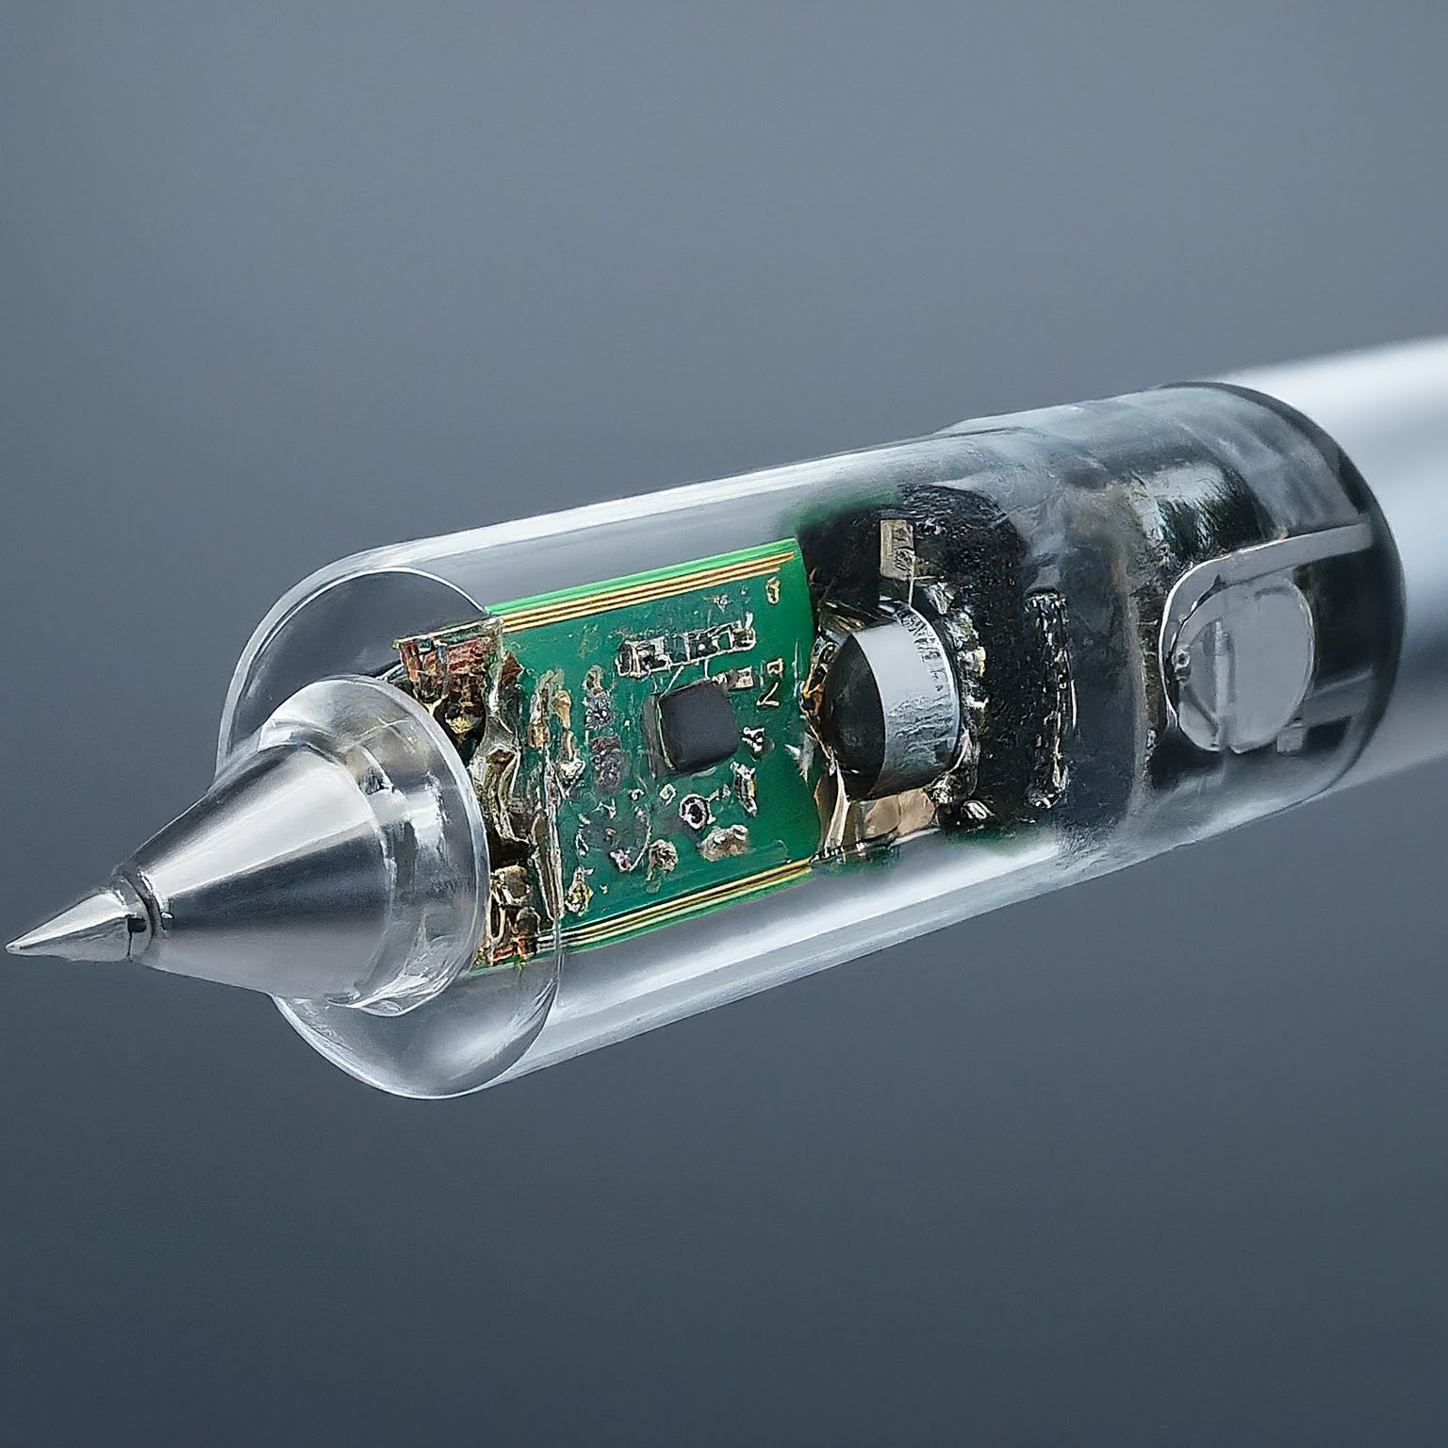
Introduction
The project aim to develop a revolutionary digital pen that combines traditional writing with modern sensor technology.
The pen will utilize gyroscopes and accelerometers to capture hand movements and convert them into digital writing. This innovative device will store handwritten data and allow users to transfer it to a computer for further processing and storage.
Generated by: Gemini
3

Slide 4

Problem Statement
Traditional pens lack the ability to digitize handwritten content, leading to limitations in data capture, storage, and accessibility. This project addresses the need for a digital pen that can seamlessly integrate handwritten notes into digital workflows, enhancing productivity and convenience for users.
4
Generated by : Gemini

Slide 5
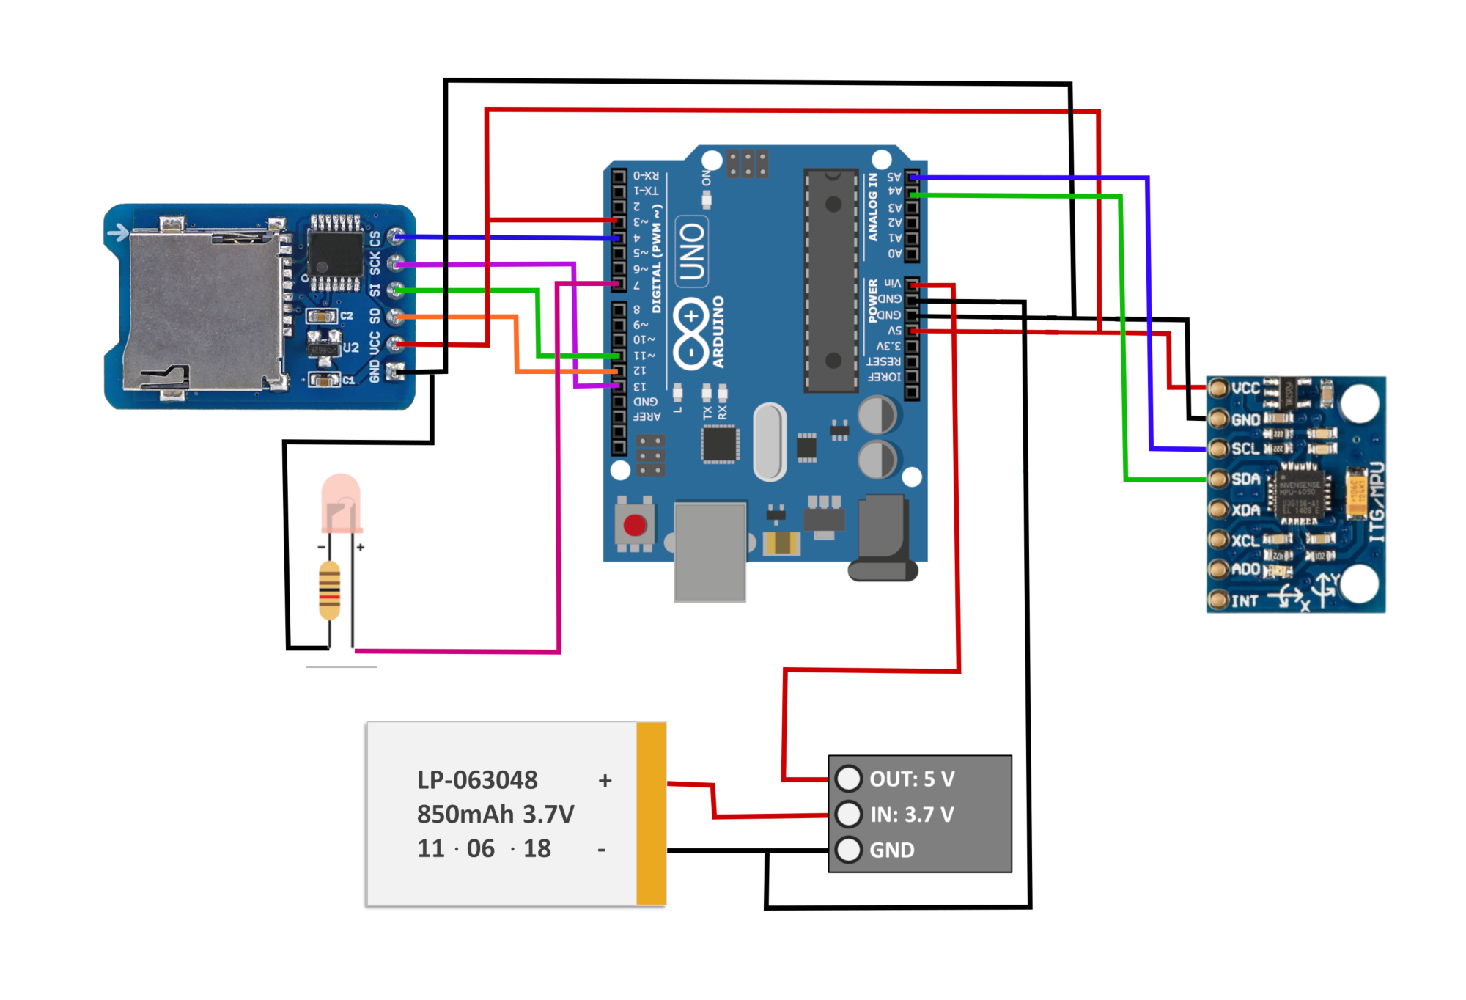
Architectural Circuit Diagram:
Ardino Uno
SD card
MPU6050 (gyroscope and accelerometer sensors)

Slide 6
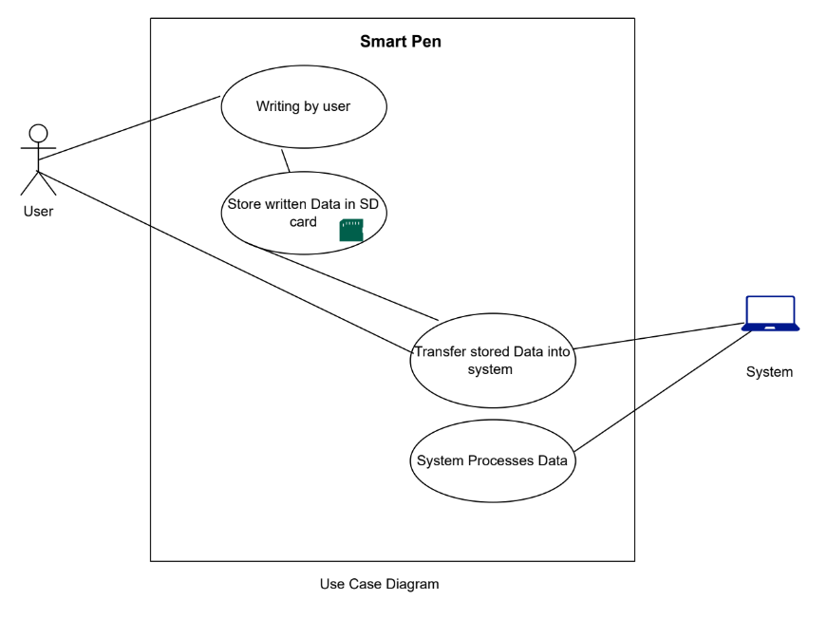
Use Case Diagram

Slide 7
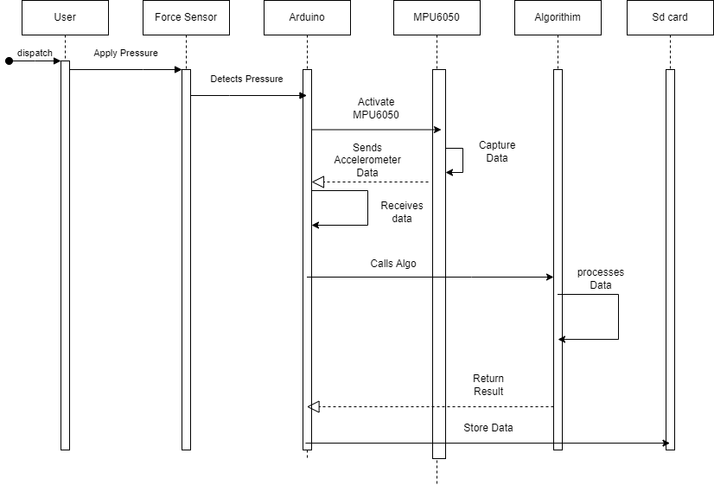
Sequence Diagram
10

Slide 8
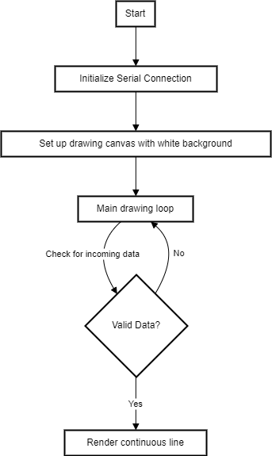
Algorithm Flow Chart
8

Slide 9
Literature Review
Sr. no | Year | Title | Basic Idea | Methodologies | Results
1 | 2019 | GyroPen: Gyroscopes for Pen-Input with Mobile Phones by Thomas Deselaers, Daniel Keysers, Jan Hosang, Henry A. Rowley | The basic idea is to utilize gyroscopes in pens for input with mobile phones. | The methodologies likely involve designing and implementing a pen with gyroscopes, testing its functionality with mobile phones, and evaluating its performance. | The results would include the effectiveness of using gyroscopes in pens for input with mobile phones, such as improved accuracy or usability.
2 | 2018 | Interactive Smart Writing Technology (ISWT): An Assistance to Paperless Documentation by Sadiq Ur Rehman, Shariq Ahmed Khan, Iqbal Uddin Khan, Halar Mustafa, Muhammad Ahsan Shaikh | The basic idea is to develop smart writing technology to assist in paperless documentation. | The methodologies likely involve designing and implementing smart writing devices or software, conducting user studies or surveys to evaluate user experience, and assessing the feasibility of paperless documentation. | The results would include the effectiveness of ISWT in assisting paperless documentation, user feedback or satisfaction, and potential improvements or enhancements.
3 | 2021 | Digitizing Handwriting with a Sensor Pen: A Writer-Independent Recognizer by Mohamad Wehbi, Tim Hamann, Jens Barth, Bjoern Eskofier | The basic idea is to digitize handwriting using a sensor pen and develop a writer-independent recognizer. (Latin alphabets, Right handed,diverse styles) | The methodologies likely involve designing and testing sensor pens capable of digitizing handwriting, developing machine learning algorithms for writer-independent recognition, and evaluating the accuracy and performance of the recognizer. | The results would include the accuracy of digitizing handwriting with the sensor pen, the effectiveness of the writer-independent recognizer, and potential applications in digital note-taking or document processing.

Slide 10
References to Research Papers
[1] A. K. Priya, S. Mishra, S. A. Raj, S. Mandal, and S. Data, “Online and offline character recognition: A survey,” 2016 International Conference on Communication and Signal Processing (ICCSP), pp. 0967–0970, 2016.
[2] R. Palacios, A. Gupta, and P. S. Wang, “Handwritten bank check recognition of courtesy amounts,” International Journal of Image and Graphics, vol. 04, pp. 203–222, 2004.
[3] S. N. Srihari, “Recognition of handwritten and machine-printed text for postal address interpretation,” Pattern Recognit. Lett., vol. 14, pp. 291–302, 1993.
[4] M. D. Garris, “Intelligent system for reading handwriting on forms,” Proceedings of the Thirty-First Hawaii International Conference on System Sciences, vol. 3, pp. 233–242 vol.3, 1998.

Slide 11
Objective
The main objective of this project is to develop a functional prototype of a digital pen that accurately captures and stores handwritten data using gyroscopes and accelerometers.
We aim to showcase the potential of this technology in revolutionizing traditional writing tools and enhancing digital note-taking experiences.
13

Slide 12
Technical Difficulties
Writing in downward/ground direction
Writing continuity
Alignment and synchronization of hardware components
Saving values in SD card
Issues in built-in libraries
Distance measurement during sketching

Slide 13
Issue Resolving /solutions
Writing in downward/ground direction : 1. Adding Z coordinate for the tilting effect while writing
2. Setting Gravity according to the need

Slide 14
Goal Achieved
What changes were made and how it turned out to be ?

Slide 16
Expected Output
Precision in Digital Writing:
Our project ensures pinpoint accuracy in digitizing handwriting using gyroscopic data. This precision mirrors the user's handwriting style seamlessly.
Efficient Storage and Access:
Our system offers secure storage and easy accessibility for managing digital notes across devices, enabling versatile applications like note-taking and sketching with ease.
13

Slide 17
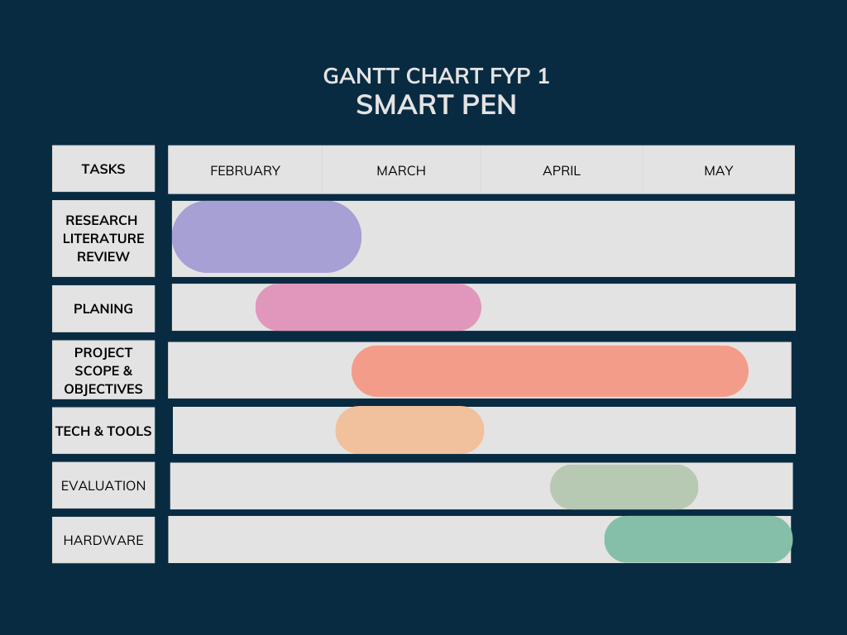
Gantt Chart
13

Slide 18
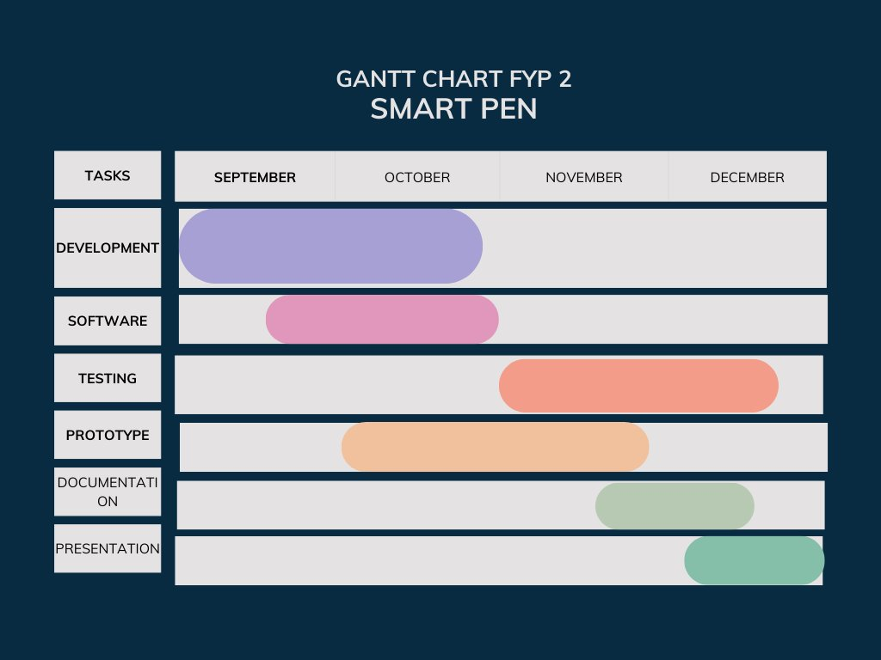
Gantt Chart
13

Slide 19
Team Work
Nouman : Algorithm and code work, hardware testing Haqnawaz : Hardware synchronization, digrames , hardware testing Aqil Umar : Research ,saving mapped data, report writing and documentation, hardware testing

Slide 20
Effectiveness of Work Distribution
Task Allocation: Work was distributed based on individual strengths and expertise. For instance, team members with experience in hardware development focused on the pen’s physical design, while those with software skills worked on data processing and application development.
Balanced Workload: Efforts were made to ensure that the workload was evenly distributed among team members. This prevented burnout and ensured that all aspects of the project received adequate attention.
Adaptability: The team was flexible in adjusting work distribution as needed. When unexpected challenges arose, tasks were reassigned to leverage available skills and resources effectively.
Milestone Reviews: The project was divided into milestones, with regular reviews to assess progress. This approach allowed for timely adjustments in work distribution, ensuring that all project phases were completed efficiently.
Regular Meetings with supervisor: We held regular meetings to discuss progress, address challenges, and realign tasks as necessary. This kept everyone informed and ensured that the project stayed on track.

Slide 21
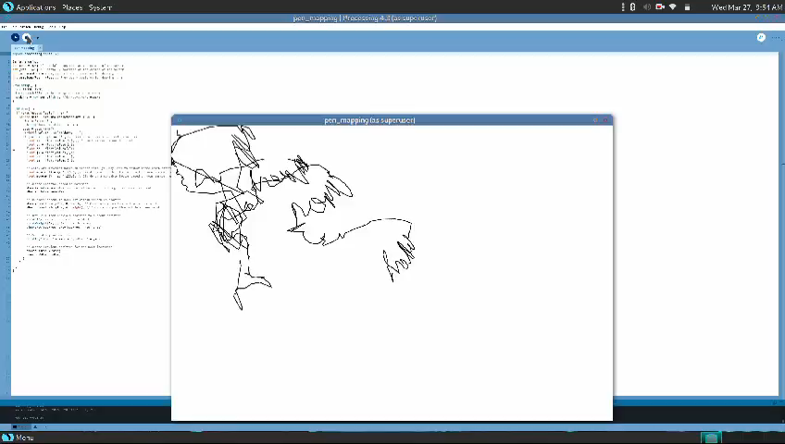
Project Demo (video)

Slide 22
References
1. M. Wehbi, T. Hamann, J. Barth and B. Eskofier, "Digitizing Handwriting with a Sensor Pen: A Writer-Independent Recognizer," 2020 17th International Conference on Frontiers in Handwriting Recognition (ICFHR), Dortmund, Germany, 2020, pp. 295-300, doi: 10.1109/ICFHR2020.2020.00061.
2.
3.
4.

Slide 23
Suggestions given by the Jury
To label the structure circuit diagram (its done – kindly review)
To add a function to pause and resume writing
Work on the sensor to write in downward/ground direction
to control the continuity in the writing (to separate letters, avoid joint writing )
To consider adding ink initially so that we can compare the written thing on the paper and with the mapped sketch captured shown on screen
To write REFERENCES properly ( links references has to be mentioned in proper way)

Slide 24
Add new slides for ; Final fyp1 presentation- rubrics
A.
Technical Difficulties
Issue resolving (how?)
Efficiency
Goal achieve
B.
1. Ppt and answers
2. Project report (updated timeline and all)
C.
Management of work among group members
How effective was work distribution?
Meeting with supervisor – at least 1 per week

Slide 25
D.
Poster design ( done)
E.
Project demo on poster ( make change)

Slide 26
22

