Slide 1
Bingle
Search Speech Sell
By: TEAM-6

Slide 2
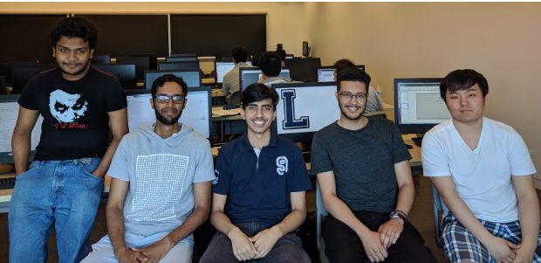
The B Team
Sadman Marion Yasir Kareem Sol

Slide 3



The Full Stack
Spring boot
Mongo DB
Bootstrap

Slide 4
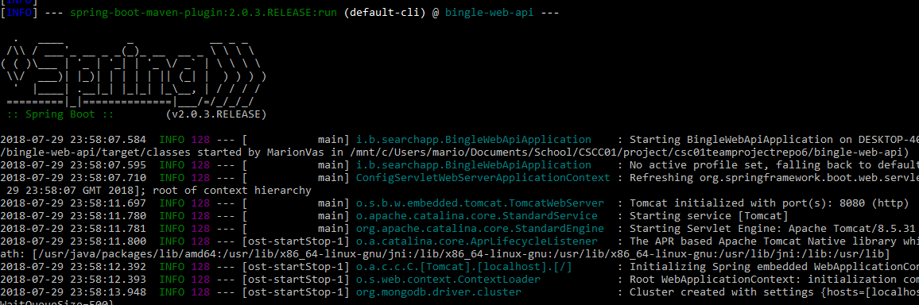

Spring Boot

Slide 5


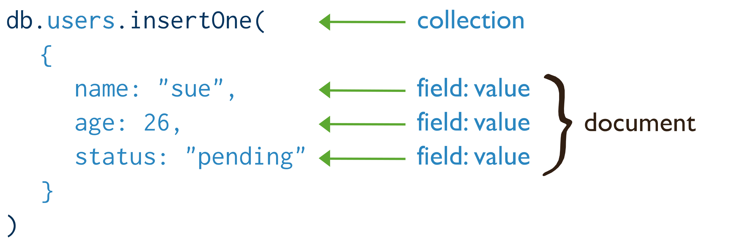
Mongo DB
A No-SQL database

Slide 6
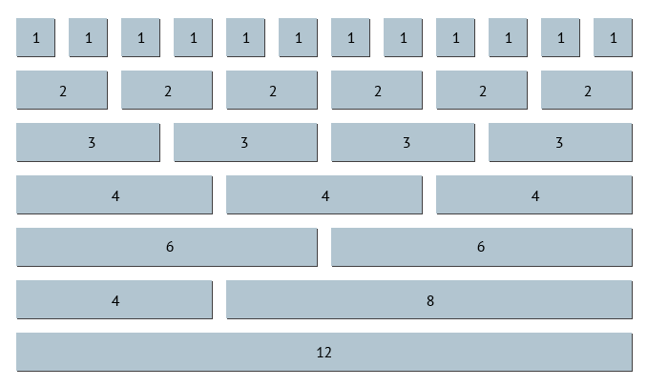

Bootstrap

Slide 7




Other APIs
Apache Lucene
Google Cloud Vision
Tika
Mockito

Slide 8



Features
Search
Discussion
Marketplace
Crawler
Auto Image analysis and searching
Profile page w/ user data analysis

