Slide 1


Slide 2


Content
What is Random Forest?
How Does Predictor Work?
Benefits.
Limitations.
Conclusion.

Slide 3


Introduction
Home ownership is a dream for many people, but the process of obtaining a home loan can be daunting. Lenders use various factors to determine whether or not to approve a loan, including credit score, income, and debt-to-income ratio. Predicting the outcome of a loan application can be difficult, but with the help of machine learning models like random forest, it's becoming easier.

Slide 4
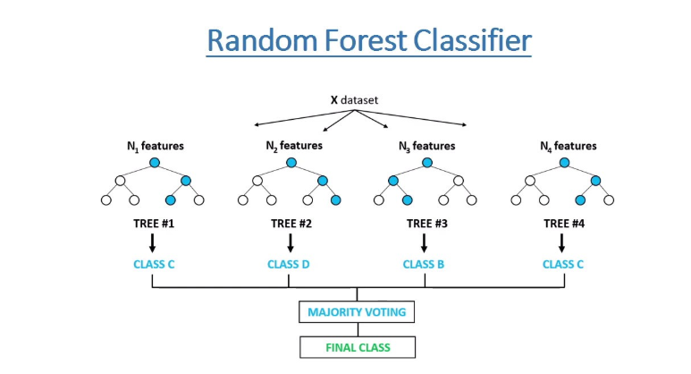
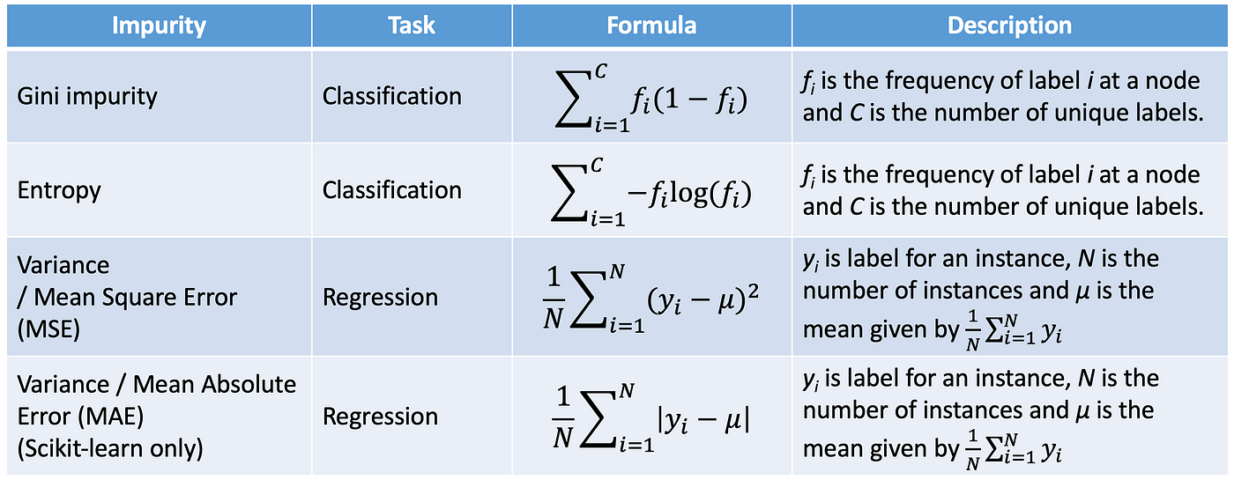
Random Forest
Random forest is a machine learning algorithm that uses multiple decision trees to make predictions.
It's called 'random' because each tree is built using a random subset of the available features, which helps to reduce overfitting and improve accuracy.
Random forest is bagging ensemble technique.
Random forest is scalable, and easy to use. It's also less prone to overfitting than other machine learning models

Slide 5
Model
The home loan predictor using random forest works by using historical data to train the model. The model learns from this data to identify patterns and make predictions about new loan applications.
The predictor takes into account various factors such as credit score, income, employment history, and debt-to-income ratio to predict the likelihood of a loan being approved. The output is a probability score between 0 and 1, with higher scores indicating a higher likelihood of approval.
HOME LOAN PREDICTOR

Slide 6
Using a home loan predictor has several benefits for both lenders and borrowers:
For lenders, it can help to reduce the risk of default by providing more accurate predictions. This can lead to better loan portfolio management and increased profits.
For borrowers, a home loan predictor can provide more transparency about the loan application process. By understanding the factors that influence their loan approval, borrowers can take steps to improve their chances of success. Additionally, borrowers may benefit from faster loan processing times due to the efficiency of the predictor.{customer satisfaction}
Personalized loan offers: Machine learning models can take into account a range of factors, such as income, credit history, and employment status, to provide borrowers with personalized loan offers that are tailored to their specific financial circumstances.

Slide 7
While the home loan predictor using random forest has many benefits, it's important to note its limitations:
The predictor relies on historical data, which may not always be indicative of future trends. Additionally, the predictor may not take into account certain factors that could impact loan approval, such as changes in the economy or unexpected life events.
It's also important to remember that the predictor is just one tool in the loan approval process. Lenders should still conduct thorough assessments of loan applications and consider other factors beyond the predictor's output.

Slide 8
CONCLUSION
IN CONCLUSION, THE HOME LOAN PREDICTOR IS A POWERFUL TOOL THAT CAN BENEFIT BOTH LENDERS AND BORROWERS. BY LEVERAGING MACHINE LEARNING ALGORITHMS, LENDERS CAN MAKE MORE ACCURATE PREDICTIONS ABOUT LOAN OUTCOMES, LEADING TO BETTER PORTFOLIO MANAGEMENT AND INCREASED PROFITS. BORROWERS CAN BENEFIT FROM INCREASED TRANSPARENCY AND FASTER LOAN PROCESSING TIMES.

