Slide 1

Notes:
Logical frame 0, overlay 1.
SGM means Spectral Graph Model. The reproduction uses supplied fitted parameters. A verified cohort MLP experiment has not been run.
The visible slide is a rendered Beamer page. Edit src/main.tex and rebuild to change its content.
Sources: Raj et al. (2020), https://pmc.ncbi.nlm.nih.gov/articles/PMC7336150/; local source hashes and fresh replay results in figures/evidence.json.

Slide 2
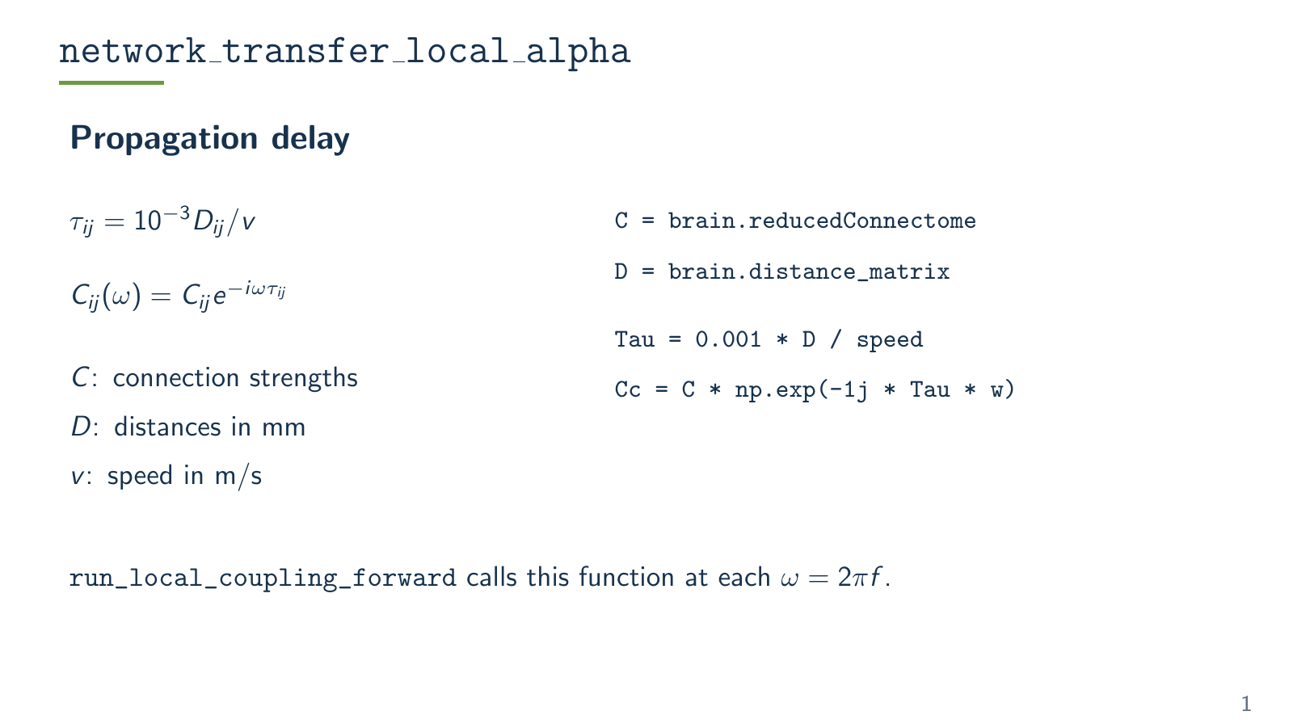
Notes:
Logical frame 1, overlay 1.
Equations describe the repository local-alpha function. They are algebraically equivalent to the displayed source excerpts. Degree scaling uses inverse square root of rowdegree times coldegree plus machine epsilon, with low-degree nodes masked to zero scaling. The code sorts by absolute eigenvalue and skips zero-indexed mode 0. The wrapper run_local_coupling_forward sweeps angular frequency 2*pi*f.
The visible slide is a rendered Beamer page. Edit src/main.tex and rebuild to change its content.
Sources: Raj et al. (2020), https://pmc.ncbi.nlm.nih.gov/articles/PMC7336150/; local source hashes and fresh replay results in figures/evidence.json.

Slide 3
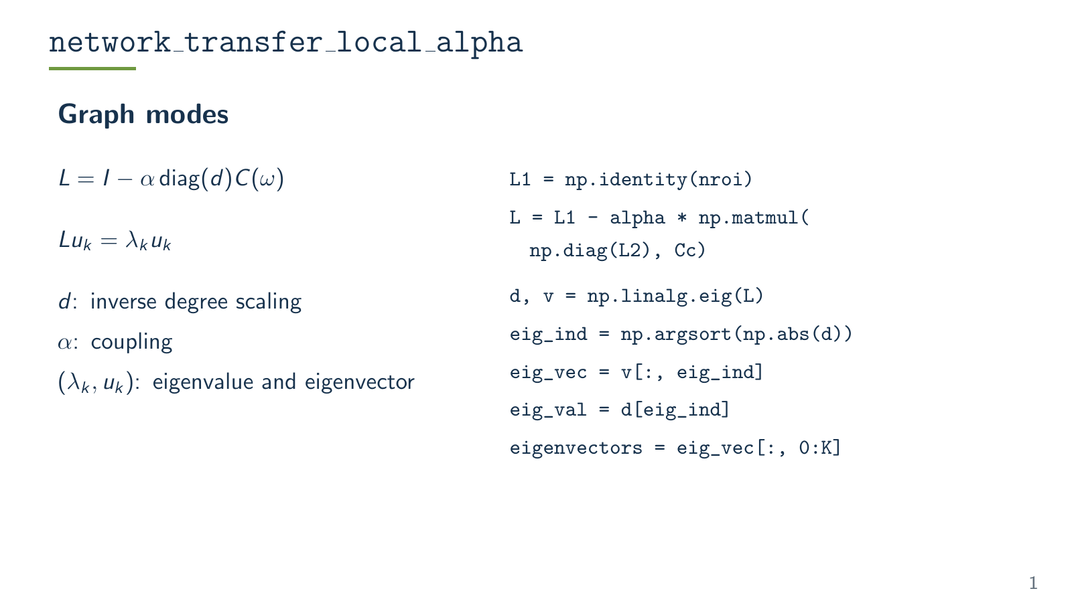
Notes:
Logical frame 1, overlay 2.
Equations describe the repository local-alpha function. They are algebraically equivalent to the displayed source excerpts. Degree scaling uses inverse square root of rowdegree times coldegree plus machine epsilon, with low-degree nodes masked to zero scaling. The code sorts by absolute eigenvalue and skips zero-indexed mode 0. The wrapper run_local_coupling_forward sweeps angular frequency 2*pi*f.
The visible slide is a rendered Beamer page. Edit src/main.tex and rebuild to change its content.
Sources: Raj et al. (2020), https://pmc.ncbi.nlm.nih.gov/articles/PMC7336150/; local source hashes and fresh replay results in figures/evidence.json.

Slide 4
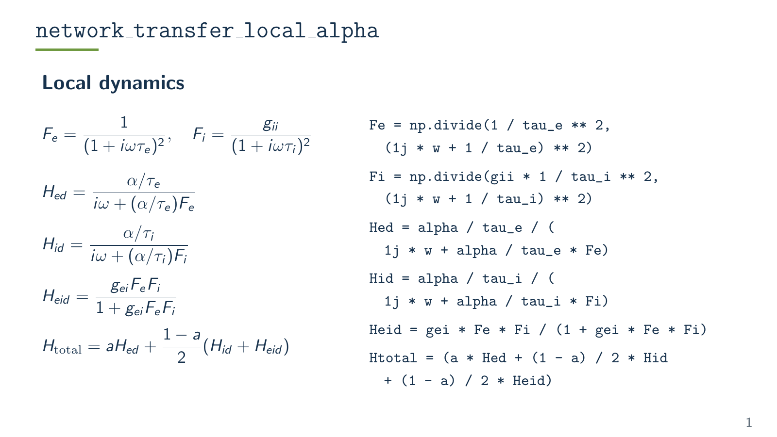
Notes:
Logical frame 1, overlay 3.
Equations describe the repository local-alpha function. They are algebraically equivalent to the displayed source excerpts. Degree scaling uses inverse square root of rowdegree times coldegree plus machine epsilon, with low-degree nodes masked to zero scaling. The code sorts by absolute eigenvalue and skips zero-indexed mode 0. The wrapper run_local_coupling_forward sweeps angular frequency 2*pi*f.
The visible slide is a rendered Beamer page. Edit src/main.tex and rebuild to change its content.
Sources: Raj et al. (2020), https://pmc.ncbi.nlm.nih.gov/articles/PMC7336150/; local source hashes and fresh replay results in figures/evidence.json.

Slide 5
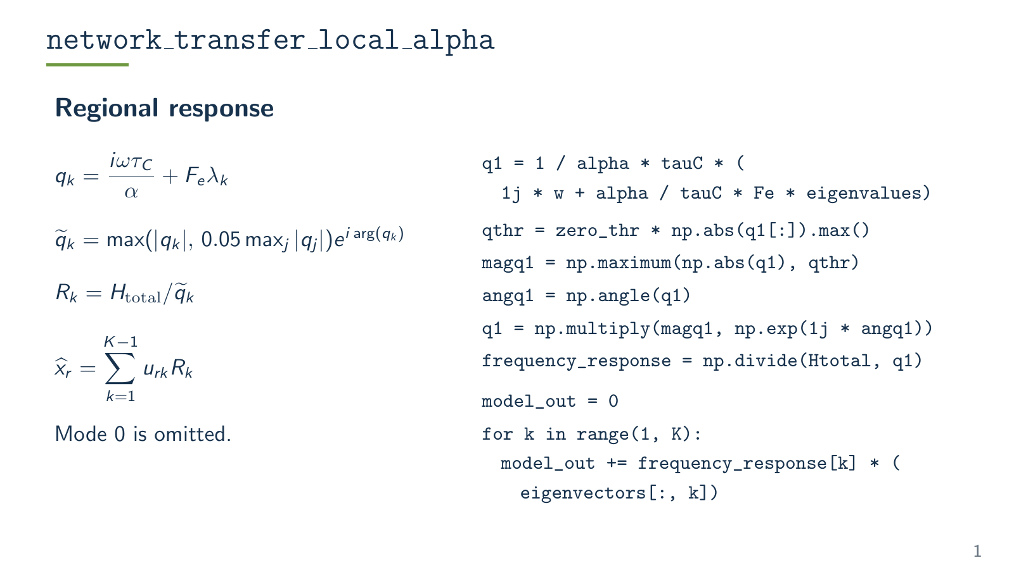
Notes:
Logical frame 1, overlay 4.
Equations describe the repository local-alpha function. They are algebraically equivalent to the displayed source excerpts. Degree scaling uses inverse square root of rowdegree times coldegree plus machine epsilon, with low-degree nodes masked to zero scaling. The code sorts by absolute eigenvalue and skips zero-indexed mode 0. The wrapper run_local_coupling_forward sweeps angular frequency 2*pi*f.
The visible slide is a rendered Beamer page. Edit src/main.tex and rebuild to change its content.
Sources: Raj et al. (2020), https://pmc.ncbi.nlm.nih.gov/articles/PMC7336150/; local source hashes and fresh replay results in figures/evidence.json.

Slide 6
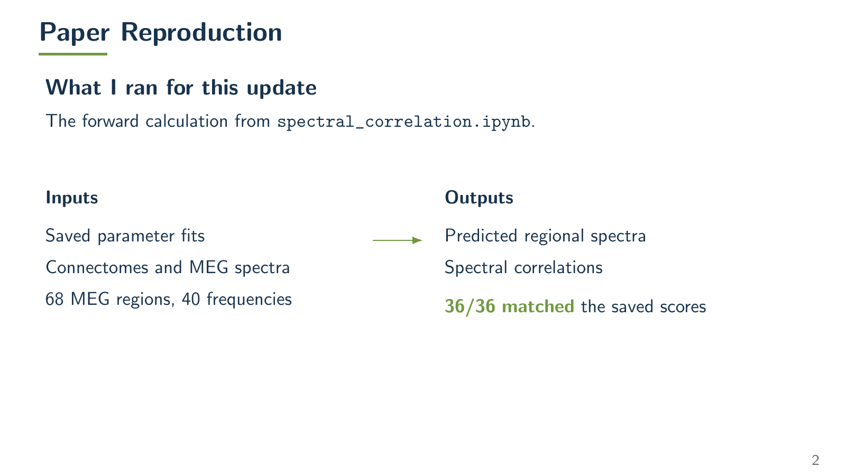
Notes:
Logical frame 2, overlay 1.
Paper https://pmc.ncbi.nlm.nih.gov/articles/PMC7336150/ Figures 3 and 4c are corresponding analyses. The 36/36 check compares replayed cohort scores with individualC_optP.mat within 1e-9. The figure shows retained record 1 from the current historical cohort replay, selected previously as the lower median correlation. A single-record forward rerun verified the displayed data against figures/historical_spectra.npz. It uses individual connectivity at historical compacted index 0 and the corresponding retained MEG and fitted parameters. The plotting operations follow reproduce_MEG_spectra.ipynb: magnitude smoothing and dB conversion, all 68 regions, and red/black mean curves. No extra normalization. Full source hashes and checks are in figures/replay-spectrum-provenance.json.
The visible slide is a rendered Beamer page. Edit src/main.tex and rebuild to change its content.
Sources: Raj et al. (2020), https://pmc.ncbi.nlm.nih.gov/articles/PMC7336150/; local source hashes and fresh replay results in figures/evidence.json.

Slide 7
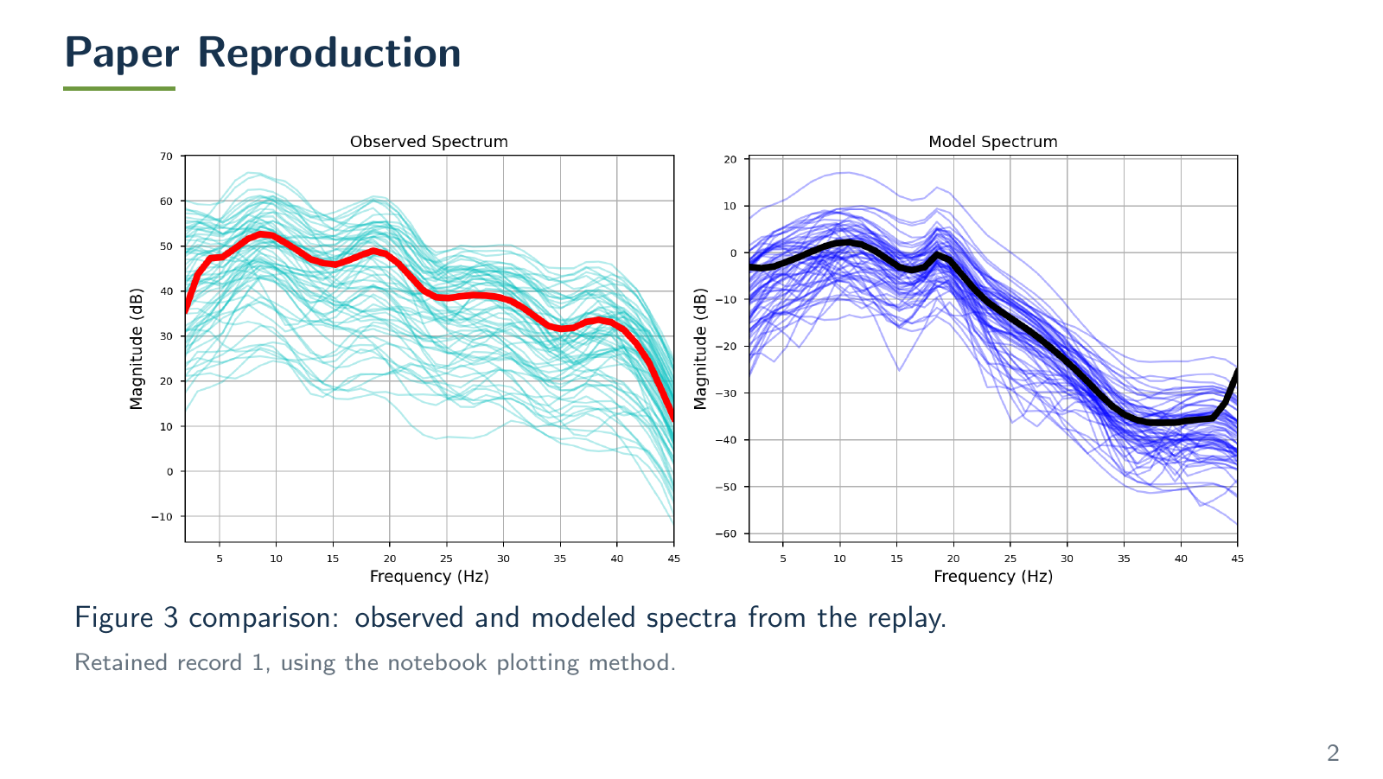
Notes:
Logical frame 2, overlay 2.
Paper https://pmc.ncbi.nlm.nih.gov/articles/PMC7336150/ Figures 3 and 4c are corresponding analyses. The 36/36 check compares replayed cohort scores with individualC_optP.mat within 1e-9. The figure shows retained record 1 from the current historical cohort replay, selected previously as the lower median correlation. A single-record forward rerun verified the displayed data against figures/historical_spectra.npz. It uses individual connectivity at historical compacted index 0 and the corresponding retained MEG and fitted parameters. The plotting operations follow reproduce_MEG_spectra.ipynb: magnitude smoothing and dB conversion, all 68 regions, and red/black mean curves. No extra normalization. Full source hashes and checks are in figures/replay-spectrum-provenance.json.
The visible slide is a rendered Beamer page. Edit src/main.tex and rebuild to change its content.
Sources: Raj et al. (2020), https://pmc.ncbi.nlm.nih.gov/articles/PMC7336150/; local source hashes and fresh replay results in figures/evidence.json.

Slide 8
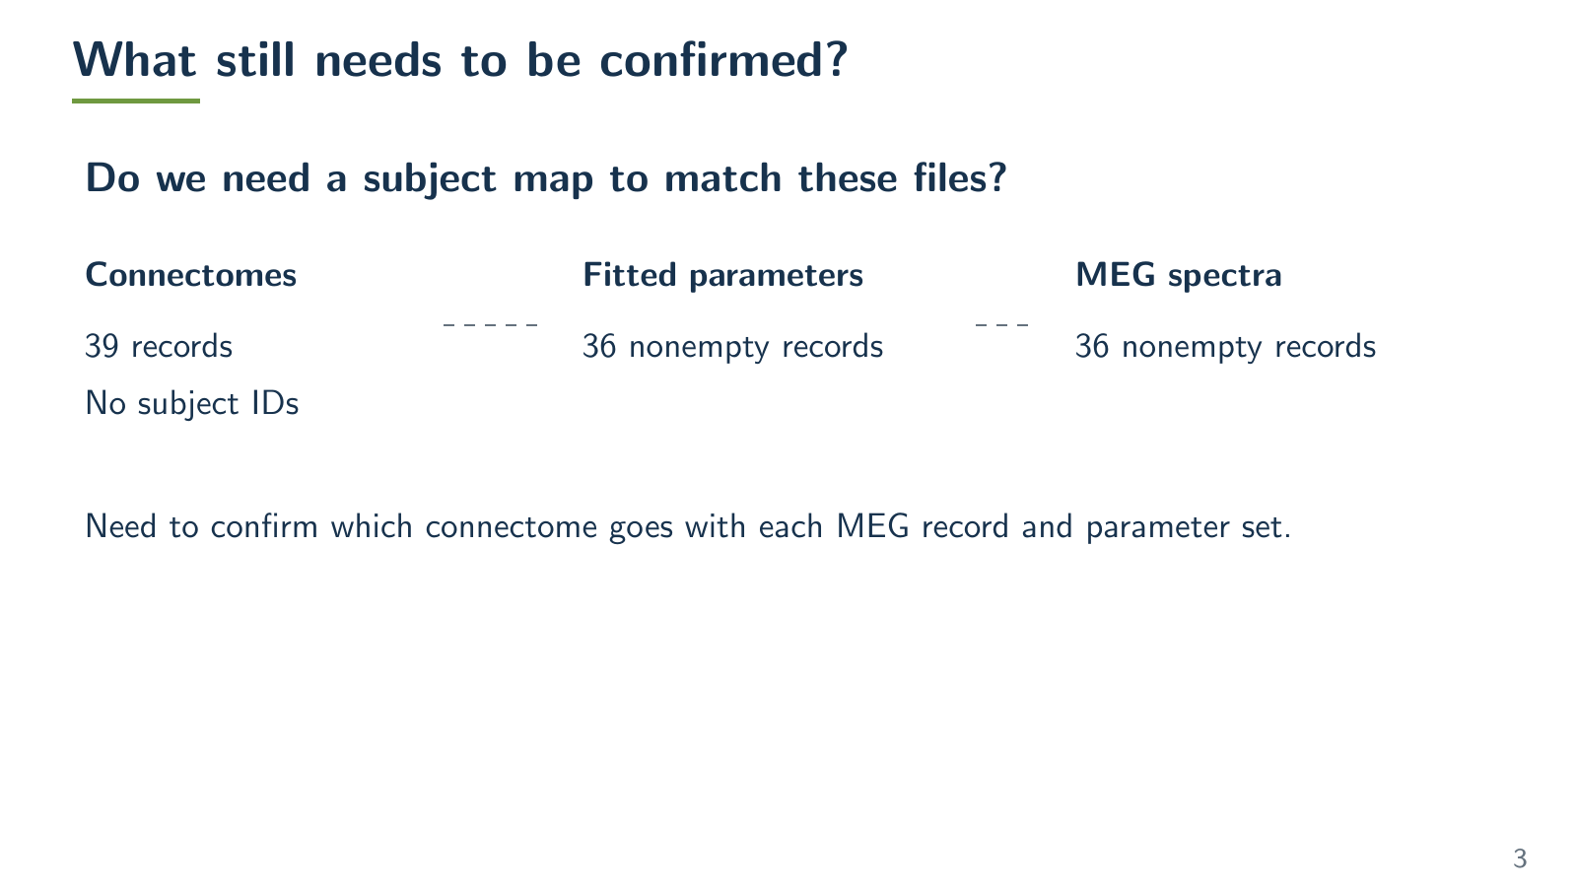
Notes:
Logical frame 3, overlay 1.
Empty parameter and MEG indices are 21,22,28, zero-based. The indexing discrepancy does not identify the true order of the unlabeled structural records. Subject mapping, ordered atlas labels and frequency metadata require confirmation before generating a training cache. Reproducing saved scores does not resolve these identities.
The visible slide is a rendered Beamer page. Edit src/main.tex and rebuild to change its content.
Sources: Raj et al. (2020), https://pmc.ncbi.nlm.nih.gov/articles/PMC7336150/; local source hashes and fresh replay results in figures/evidence.json.

Slide 9
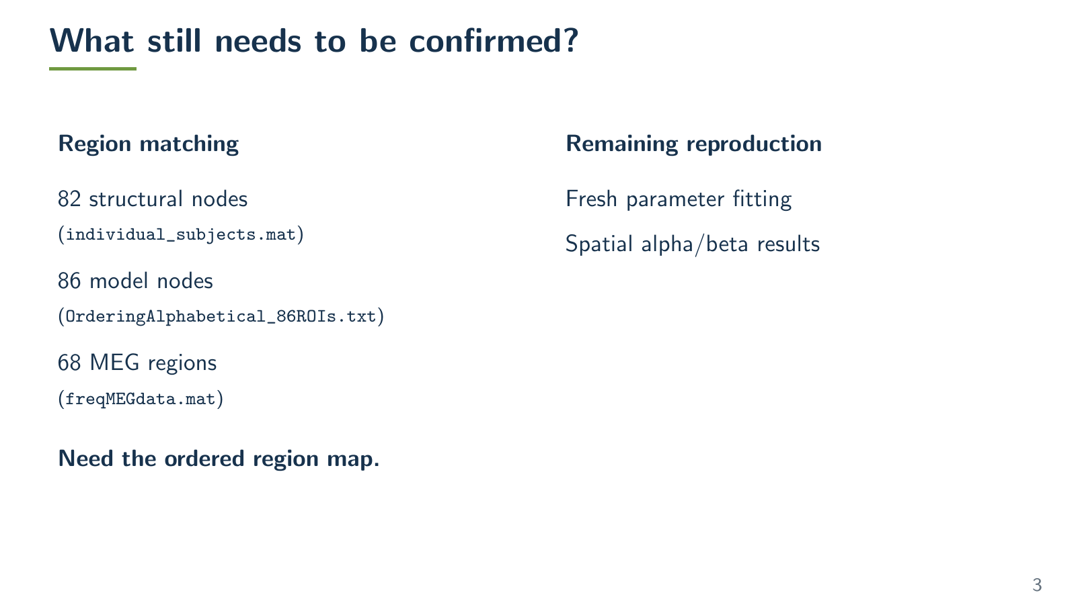
Notes:
Logical frame 3, overlay 2.
Empty parameter and MEG indices are 21,22,28, zero-based. The indexing discrepancy does not identify the true order of the unlabeled structural records. Subject mapping, ordered atlas labels and frequency metadata require confirmation before generating a training cache. Reproducing saved scores does not resolve these identities.
The visible slide is a rendered Beamer page. Edit src/main.tex and rebuild to change its content.
Sources: Raj et al. (2020), https://pmc.ncbi.nlm.nih.gov/articles/PMC7336150/; local source hashes and fresh replay results in figures/evidence.json.

Slide 10
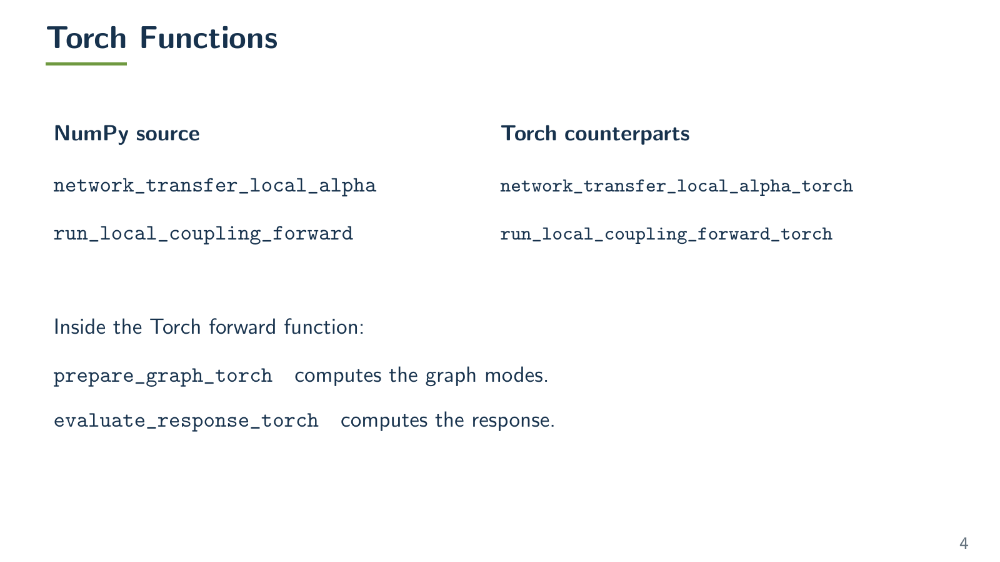
Notes:
Logical frame 4, overlay 1.
The wrapper prepares graph eigenpairs and evaluates the response. Cache reuse requires fixed connectivity, distances, angular frequency, alpha, speed and mode selection. Eigenvector phase is fixed before the phase-sensitive modal sum. The analytical graph filter defaults to Fe_local. Supplying Fe_graph changes only the graph denominator. Checks from the prior build: 14 passed and one failed because a rejection test expected unverified while the raised text was not verified. See figures/test-results.txt. Numerical parity details remain in figures/evidence.json. No model source was changed for this revision.
The visible slide is a rendered Beamer page. Edit src/main.tex and rebuild to change its content.
Sources: Raj et al. (2020), https://pmc.ncbi.nlm.nih.gov/articles/PMC7336150/; local source hashes and fresh replay results in figures/evidence.json.

Slide 11
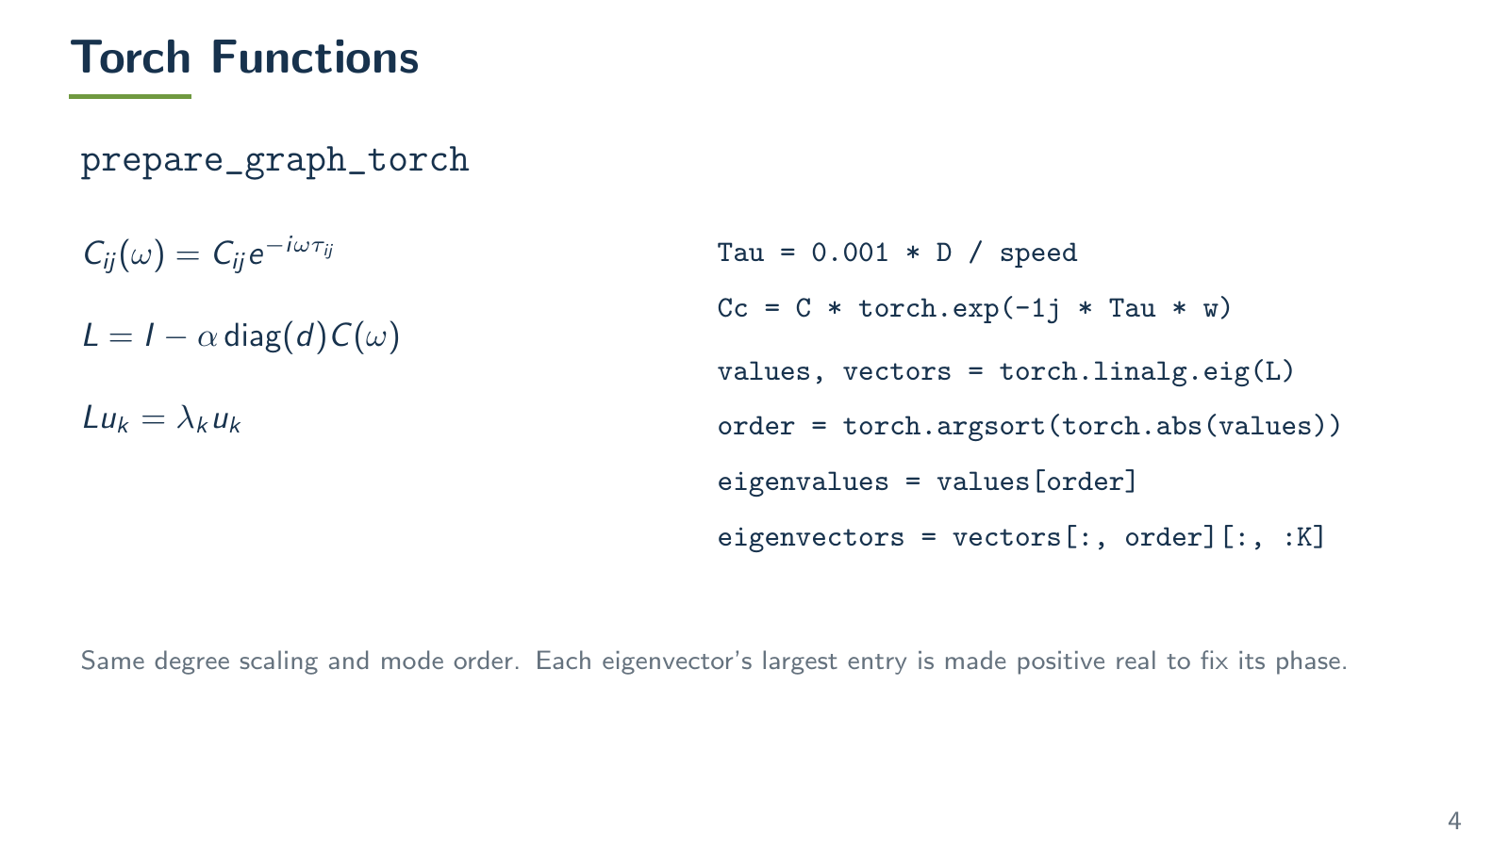
Notes:
Logical frame 4, overlay 2.
The wrapper prepares graph eigenpairs and evaluates the response. Cache reuse requires fixed connectivity, distances, angular frequency, alpha, speed and mode selection. Eigenvector phase is fixed before the phase-sensitive modal sum. The analytical graph filter defaults to Fe_local. Supplying Fe_graph changes only the graph denominator. Checks from the prior build: 14 passed and one failed because a rejection test expected unverified while the raised text was not verified. See figures/test-results.txt. Numerical parity details remain in figures/evidence.json. No model source was changed for this revision.
The visible slide is a rendered Beamer page. Edit src/main.tex and rebuild to change its content.
Sources: Raj et al. (2020), https://pmc.ncbi.nlm.nih.gov/articles/PMC7336150/; local source hashes and fresh replay results in figures/evidence.json.

Slide 12
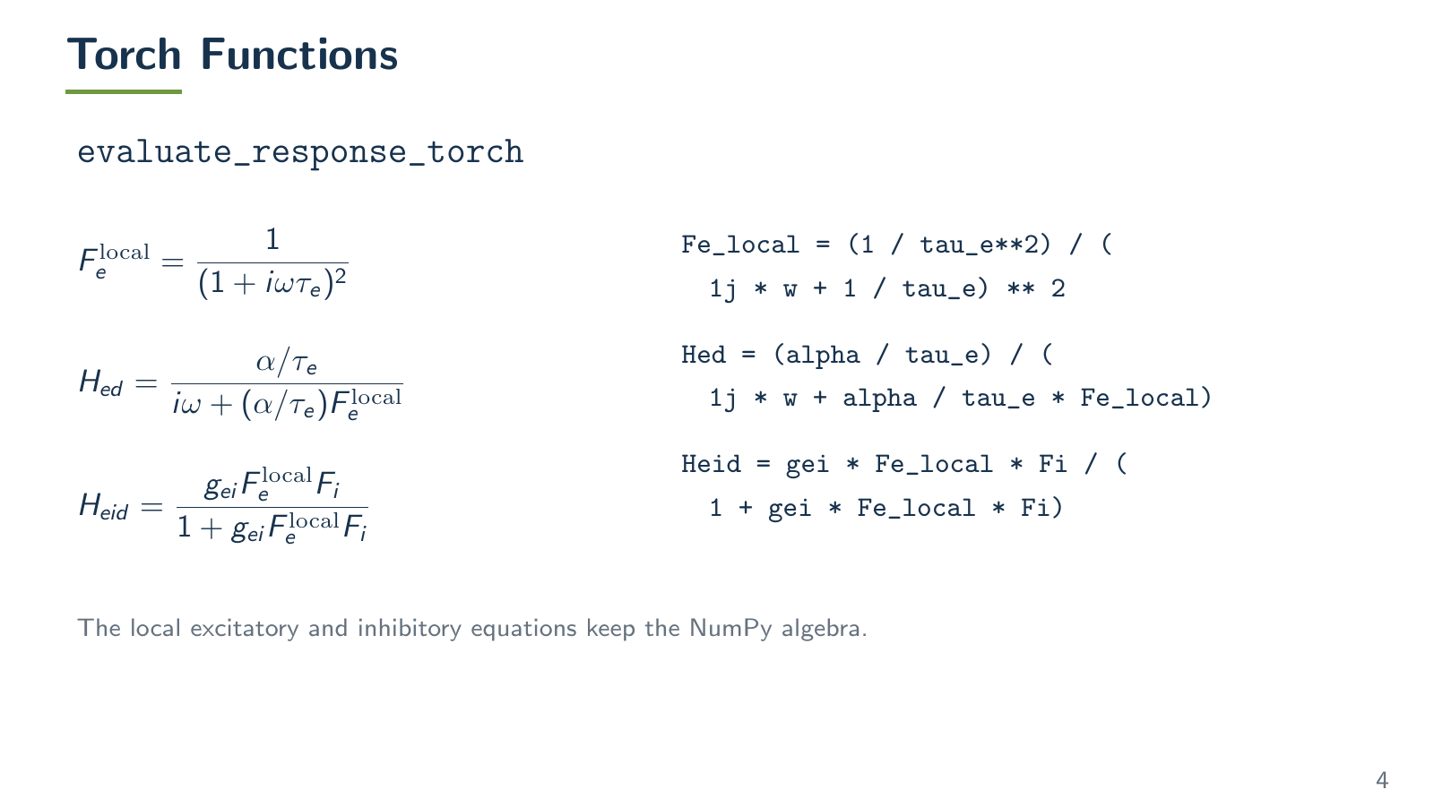
Notes:
Logical frame 4, overlay 3.
The wrapper prepares graph eigenpairs and evaluates the response. Cache reuse requires fixed connectivity, distances, angular frequency, alpha, speed and mode selection. Eigenvector phase is fixed before the phase-sensitive modal sum. The analytical graph filter defaults to Fe_local. Supplying Fe_graph changes only the graph denominator. Checks from the prior build: 14 passed and one failed because a rejection test expected unverified while the raised text was not verified. See figures/test-results.txt. Numerical parity details remain in figures/evidence.json. No model source was changed for this revision.
The visible slide is a rendered Beamer page. Edit src/main.tex and rebuild to change its content.
Sources: Raj et al. (2020), https://pmc.ncbi.nlm.nih.gov/articles/PMC7336150/; local source hashes and fresh replay results in figures/evidence.json.

Slide 13
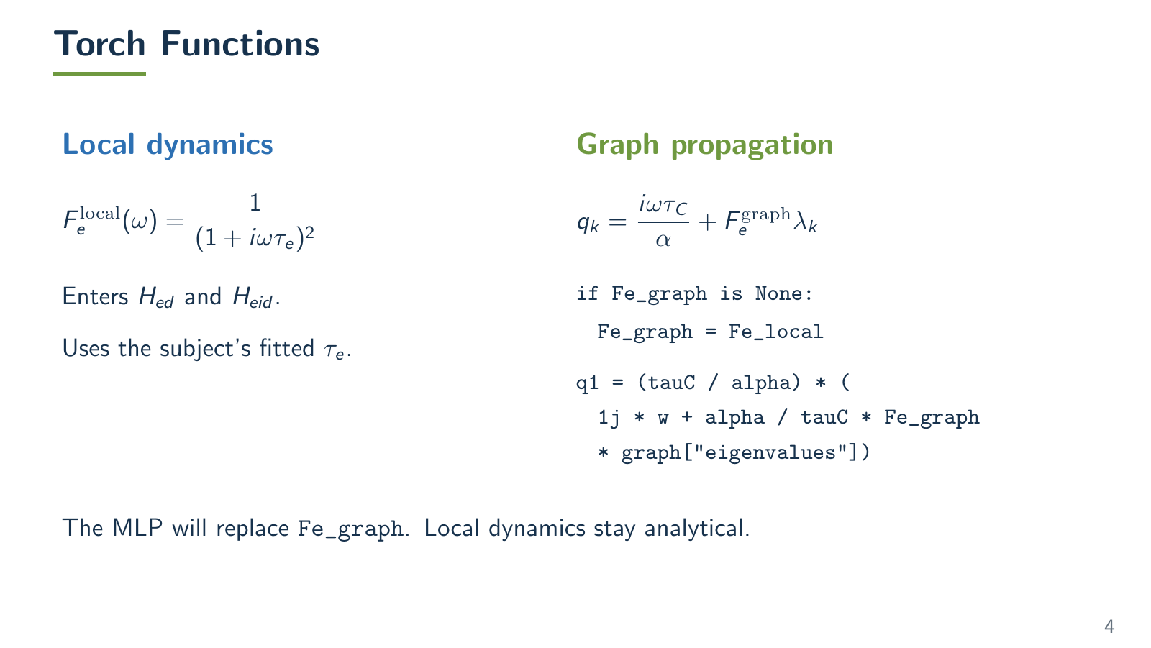
Notes:
Logical frame 4, overlay 4.
The wrapper prepares graph eigenpairs and evaluates the response. Cache reuse requires fixed connectivity, distances, angular frequency, alpha, speed and mode selection. Eigenvector phase is fixed before the phase-sensitive modal sum. The analytical graph filter defaults to Fe_local. Supplying Fe_graph changes only the graph denominator. Checks from the prior build: 14 passed and one failed because a rejection test expected unverified while the raised text was not verified. See figures/test-results.txt. Numerical parity details remain in figures/evidence.json. No model source was changed for this revision.
The visible slide is a rendered Beamer page. Edit src/main.tex and rebuild to change its content.
Sources: Raj et al. (2020), https://pmc.ncbi.nlm.nih.gov/articles/PMC7336150/; local source hashes and fresh replay results in figures/evidence.json.

Slide 14
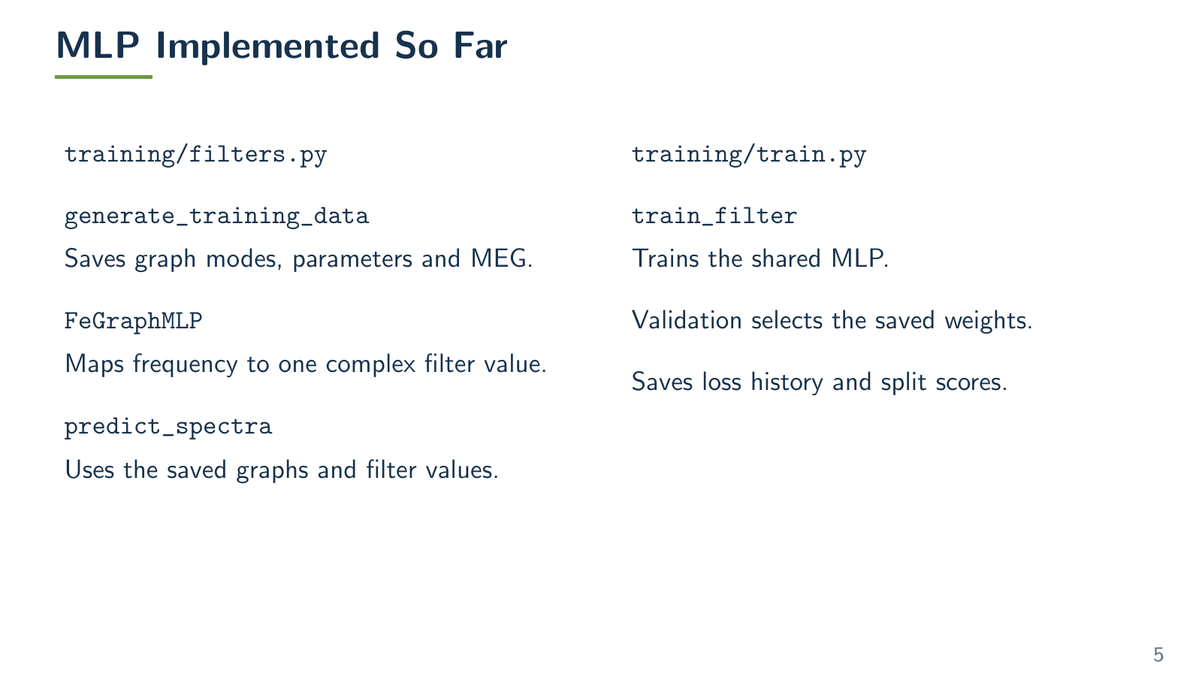
Notes:
Logical frame 5, overlay 1.
Source: spectrome/training/filters.py and train.py. FeGraphMLP accepts a tuple of hidden layer widths through hidden_sizes. Each hidden layer uses Tanh and the last layer is linear with two outputs. The complex filter is assembled from these real and imaginary components. generate_training_data saves graph modes and data with provenance; train_filter saves weights selected by validation and split scores. Data mapping remains unresolved and no cohort learning result is claimed.
The visible slide is a rendered Beamer page. Edit src/main.tex and rebuild to change its content.
Sources: Raj et al. (2020), https://pmc.ncbi.nlm.nih.gov/articles/PMC7336150/; local source hashes and fresh replay results in figures/evidence.json.

Slide 15
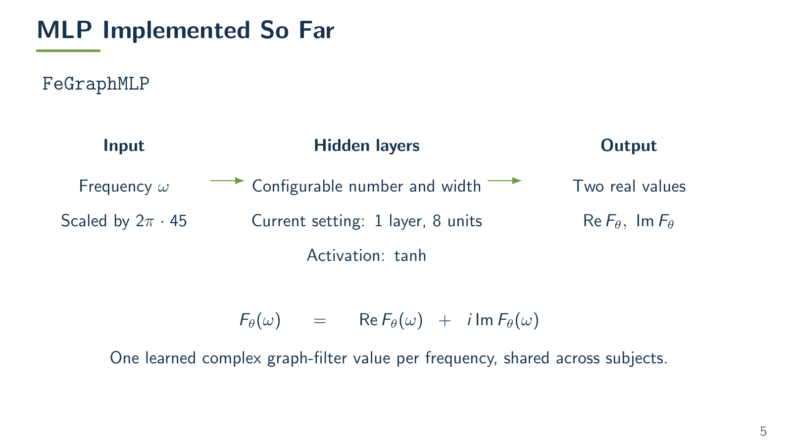
Notes:
Logical frame 5, overlay 2.
Source: spectrome/training/filters.py and train.py. FeGraphMLP accepts a tuple of hidden layer widths through hidden_sizes. Each hidden layer uses Tanh and the last layer is linear with two outputs. The complex filter is assembled from these real and imaginary components. generate_training_data saves graph modes and data with provenance; train_filter saves weights selected by validation and split scores. Data mapping remains unresolved and no cohort learning result is claimed.
The visible slide is a rendered Beamer page. Edit src/main.tex and rebuild to change its content.
Sources: Raj et al. (2020), https://pmc.ncbi.nlm.nih.gov/articles/PMC7336150/; local source hashes and fresh replay results in figures/evidence.json.

Slide 16
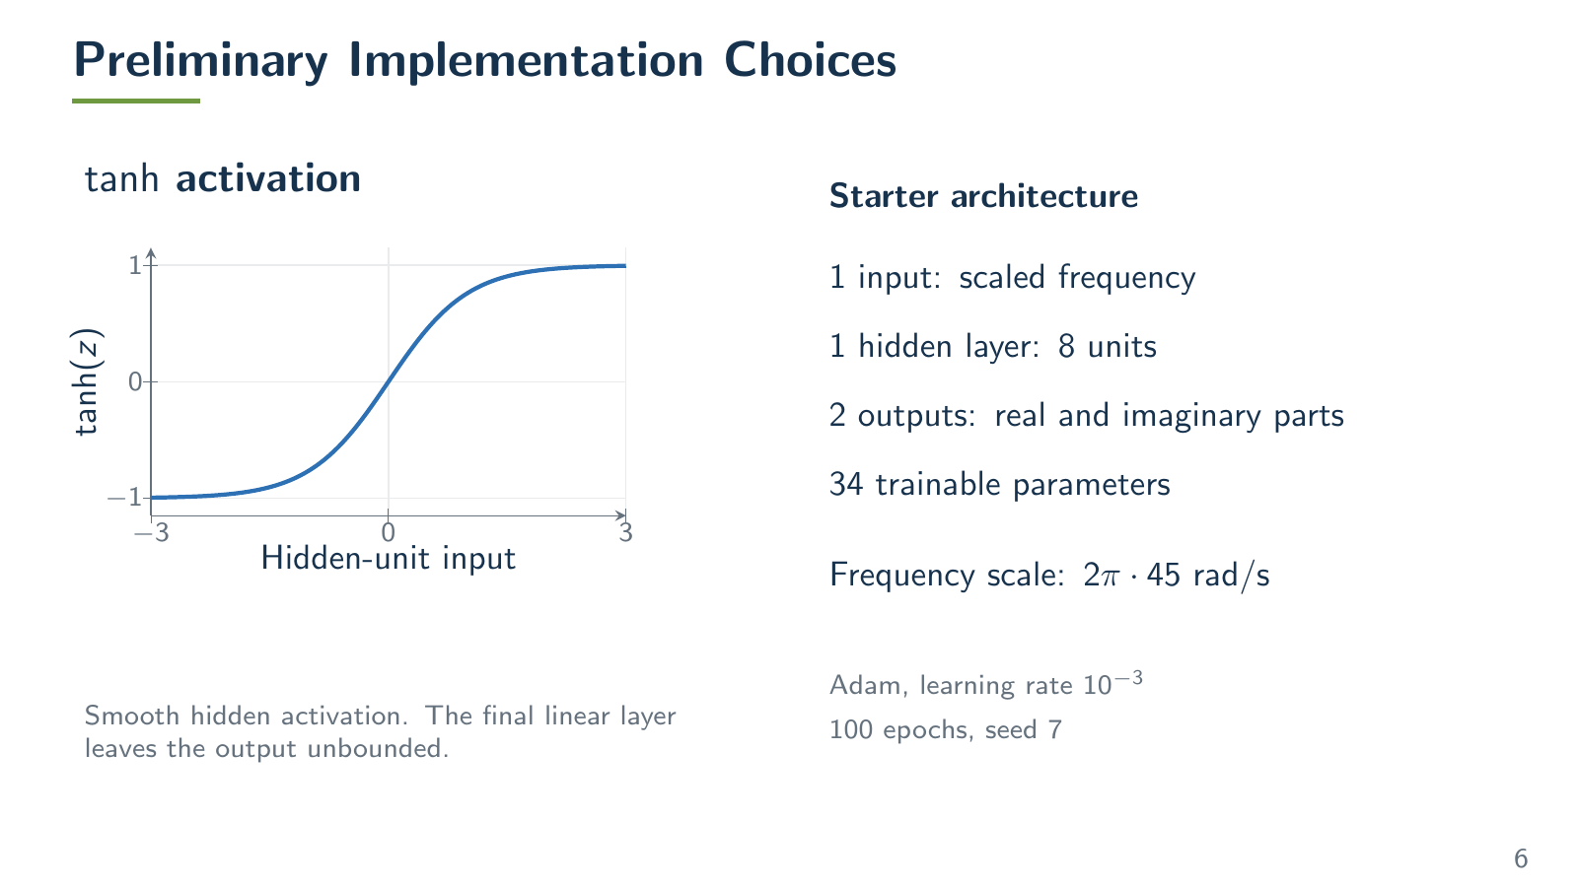
Notes:
Logical frame 6, overlay 1.
Architecture is 1 to 8 to 2, with 8+8+16+2=34 trainable parameters. Tanh is smooth and bounded internally, while the final linear output is unbounded. Smoothness is a design motivation, not evidence of better fit or a guarantee of causal or stable dynamics. Input scaling is 2*pi*45 rad/s.
The visible slide is a rendered Beamer page. Edit src/main.tex and rebuild to change its content.
Sources: Raj et al. (2020), https://pmc.ncbi.nlm.nih.gov/articles/PMC7336150/; local source hashes and fresh replay results in figures/evidence.json.

Slide 17
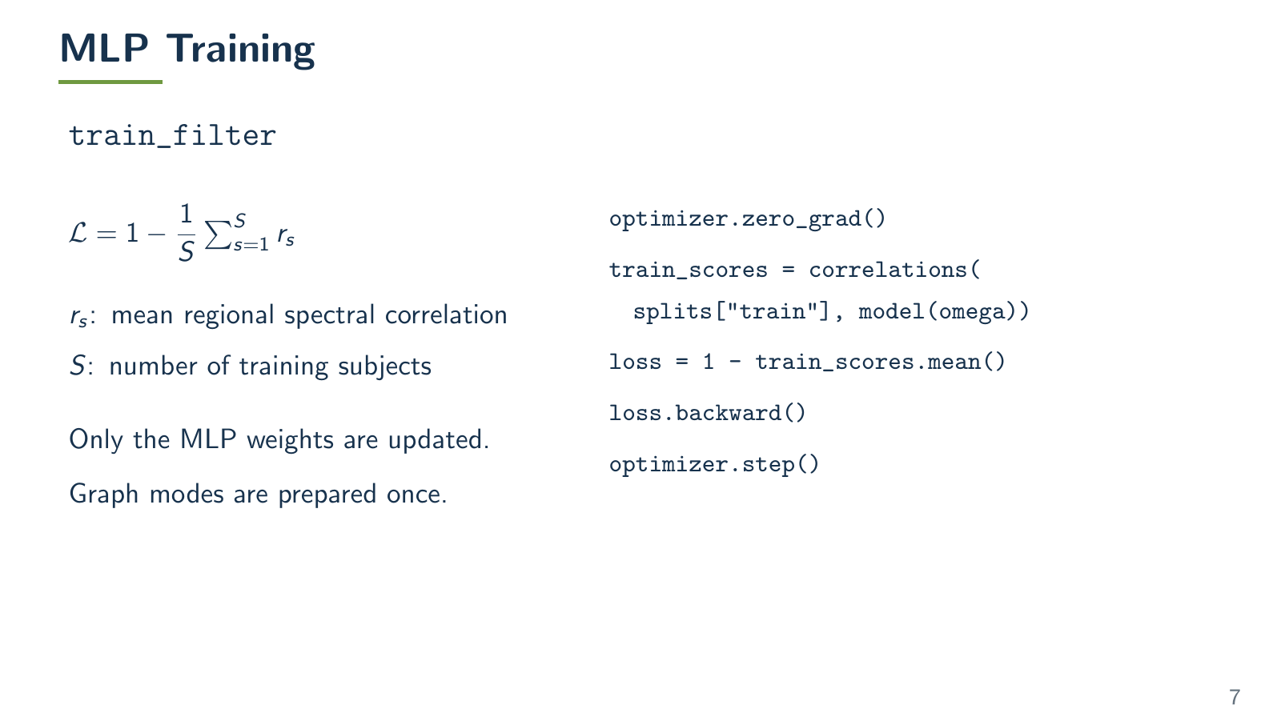
Notes:
Logical frame 7, overlay 1.
Source: spectrome/training/train.py. Each epoch is one full training-cohort Adam update, with only MLP weights trainable and graph modes cached. The loss uses magnitude, five-bin smoothing, square root with a 1e-12 floor and frequency demeaning. Validation selects the checkpoint before test scoring. The real cohort run still requires verified subject and region mappings.
The visible slide is a rendered Beamer page. Edit src/main.tex and rebuild to change its content.
Sources: Raj et al. (2020), https://pmc.ncbi.nlm.nih.gov/articles/PMC7336150/; local source hashes and fresh replay results in figures/evidence.json.

Slide 18
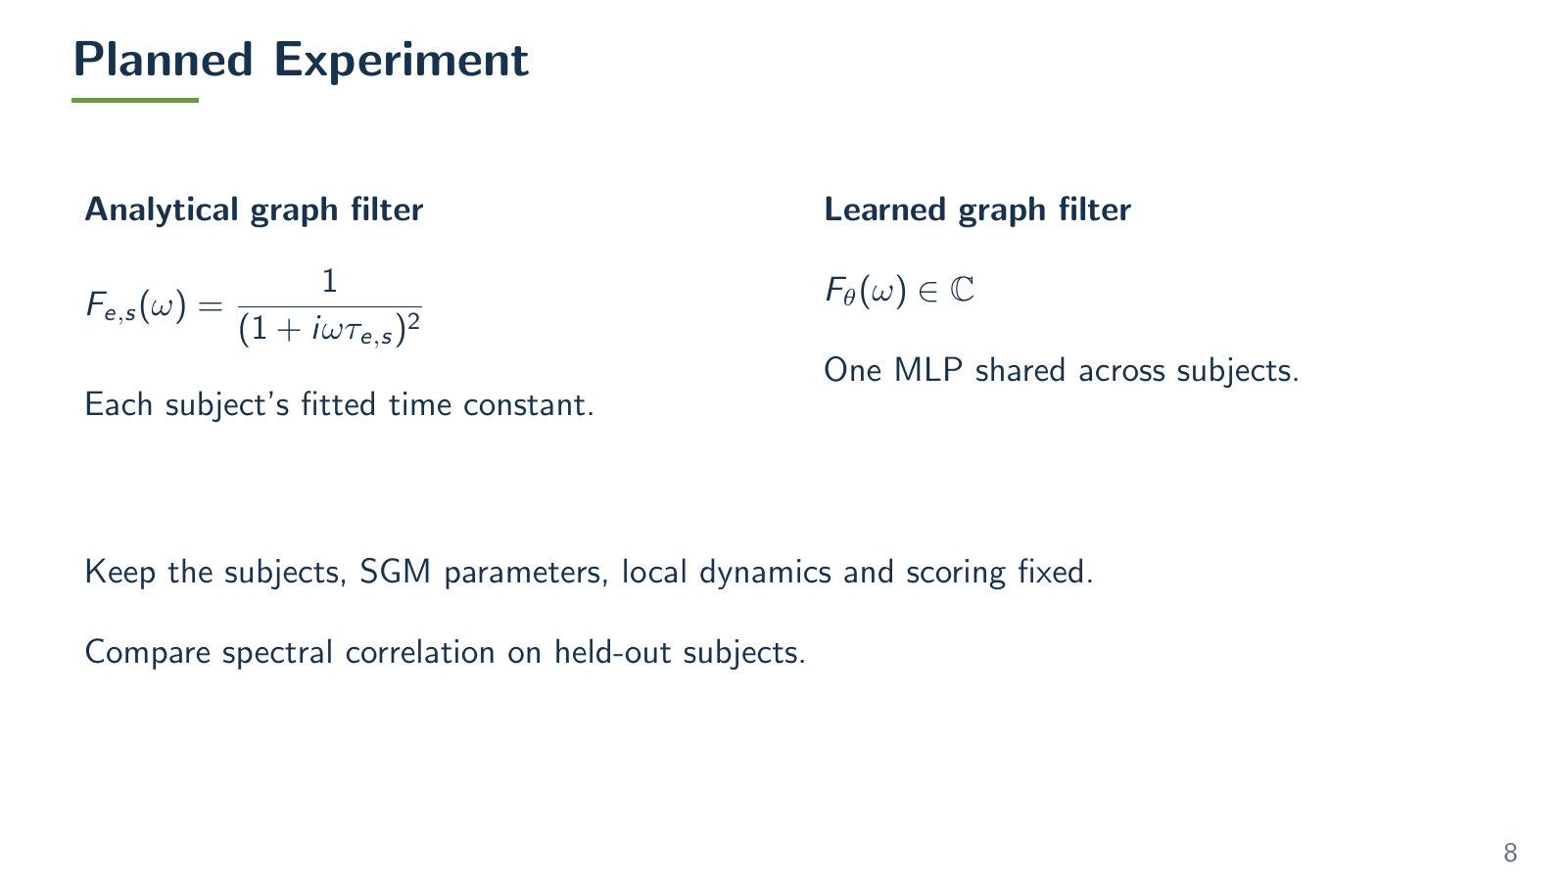
Notes:
Logical frame 8, overlay 1.
This tests a learned shared graph filter conditional on fixed, previously MEG-fitted SGM parameters. It does not establish prediction from structural data alone on unseen subjects. Activation or width comparisons are proposed follow-ups with matched data splits, seeds and training budget. Spatial alpha/beta evaluation remains to be agreed.
The visible slide is a rendered Beamer page. Edit src/main.tex and rebuild to change its content.
Sources: Raj et al. (2020), https://pmc.ncbi.nlm.nih.gov/articles/PMC7336150/; local source hashes and fresh replay results in figures/evidence.json.

