Slide 1
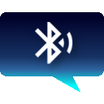
BlueChat
A Bluetooth chat app

Slide 2
Description
BlueChat is a Bluetooth chat app which has the following features:
Search for new devices.
Send messages to other devices very fast.
Show status and popup when user connects or disconnects.
Optimized to use less resources and keep it fast.
Saves chat history and highlights unread texts.
Sends notification on new messages.

Slide 3
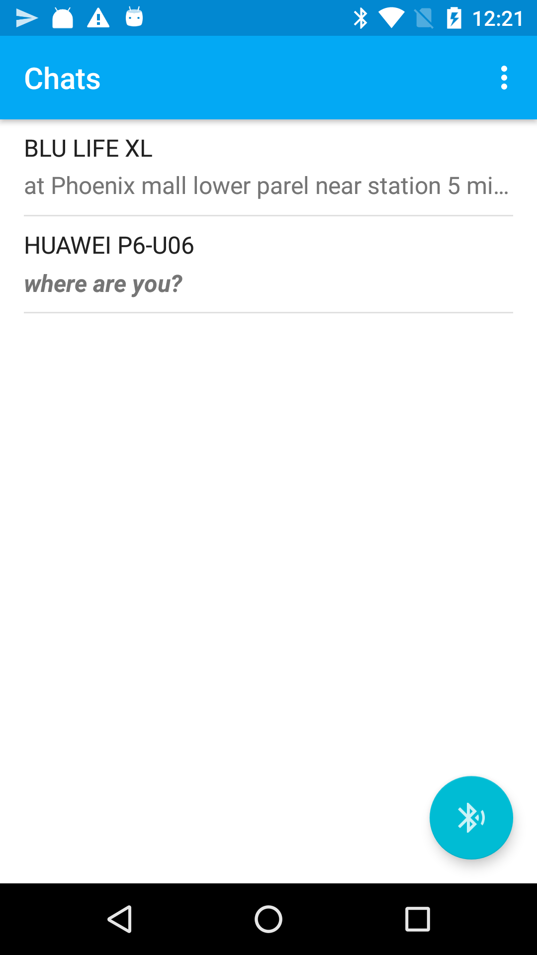
Home Screen
This is the first view shown to the user on app launch:
It consists of:
List of chats with:
Device name
Last message, text is shown in bold italic if not read.
Bluetooth Device Scan Button
Clicking on the devices, takes the user to Chat window.

Slide 4
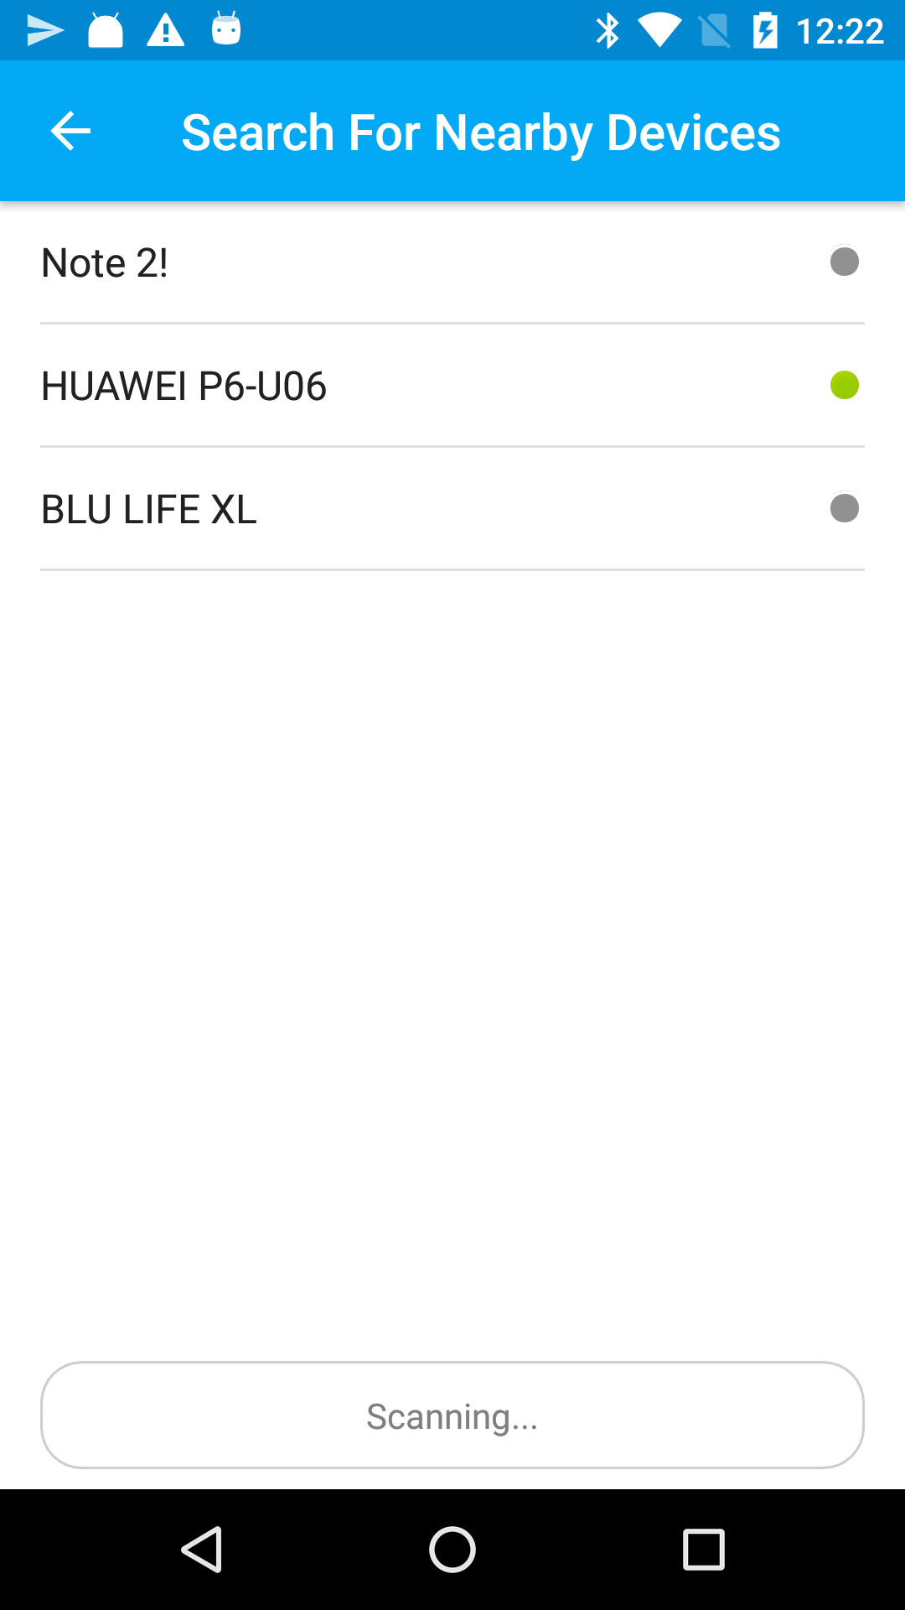
Search Screen
This is screen where Bluetooth Scans for nearby devices.
It first fills in all the already paired devices and then adds new device found to the list.
The grey icon means that device haven’t been found currently
The green means that device’s Bluetooth is currently turned on and discoverable.
The scan button starts the Bluetooth scanning
Clicking on the devices, takes the user to Chat window.

Slide 5
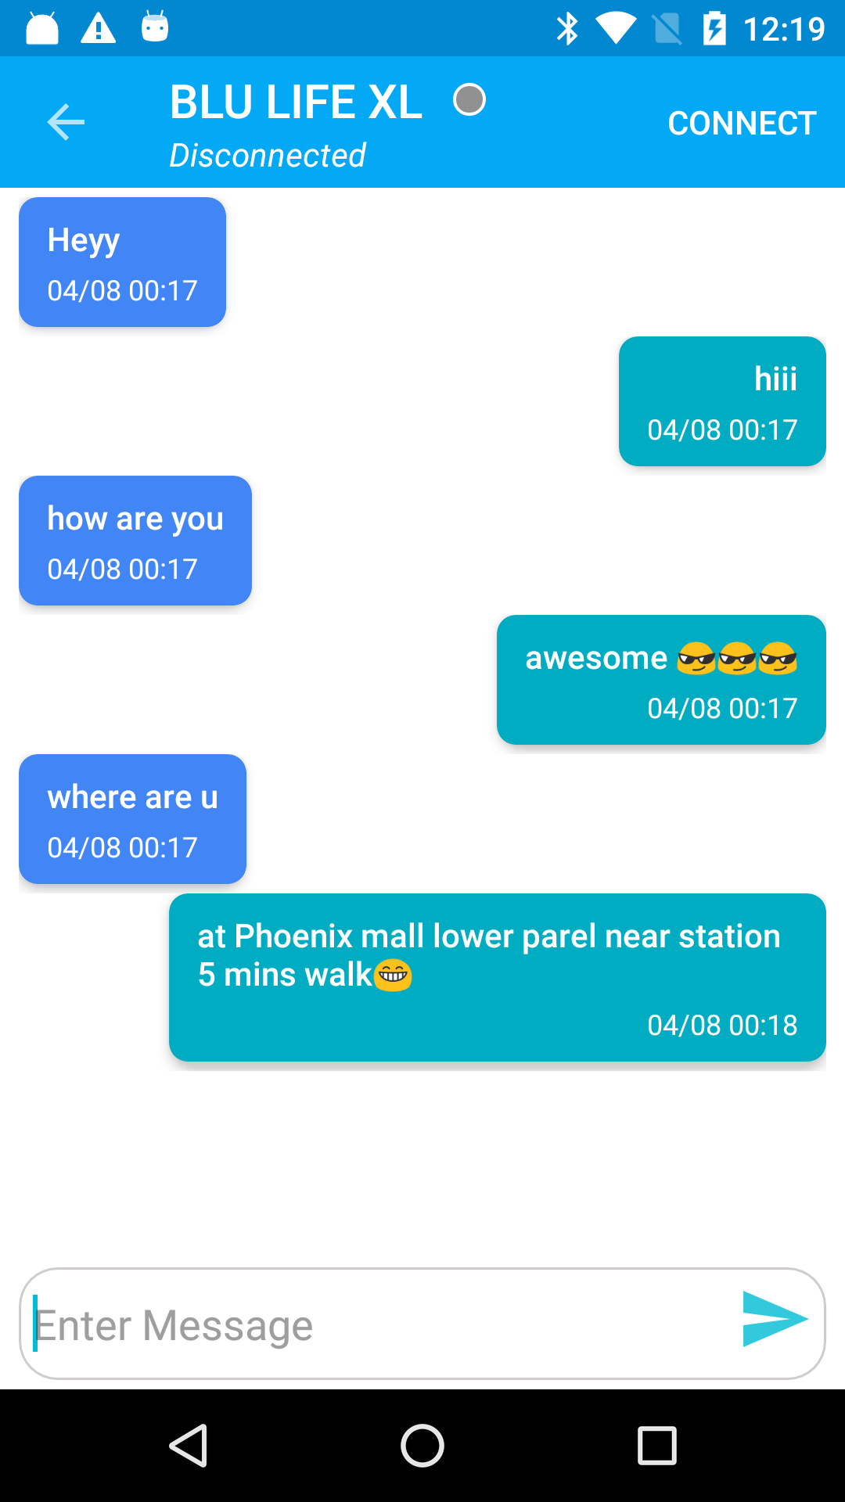
Chat Screen
This is screen where User can connect to other devices and start chatting.
If the user haven’t paired yet, it will start a pairing request with the other device.
It has chat status message.
User can connect or disconnect the chat using the menu button
First the one of the two users have to get ready to connect, so one of the users will first click Connect Button and then when the status shows “Ready to connect” the other user will click connect and both users will be ready to chat

Slide 6
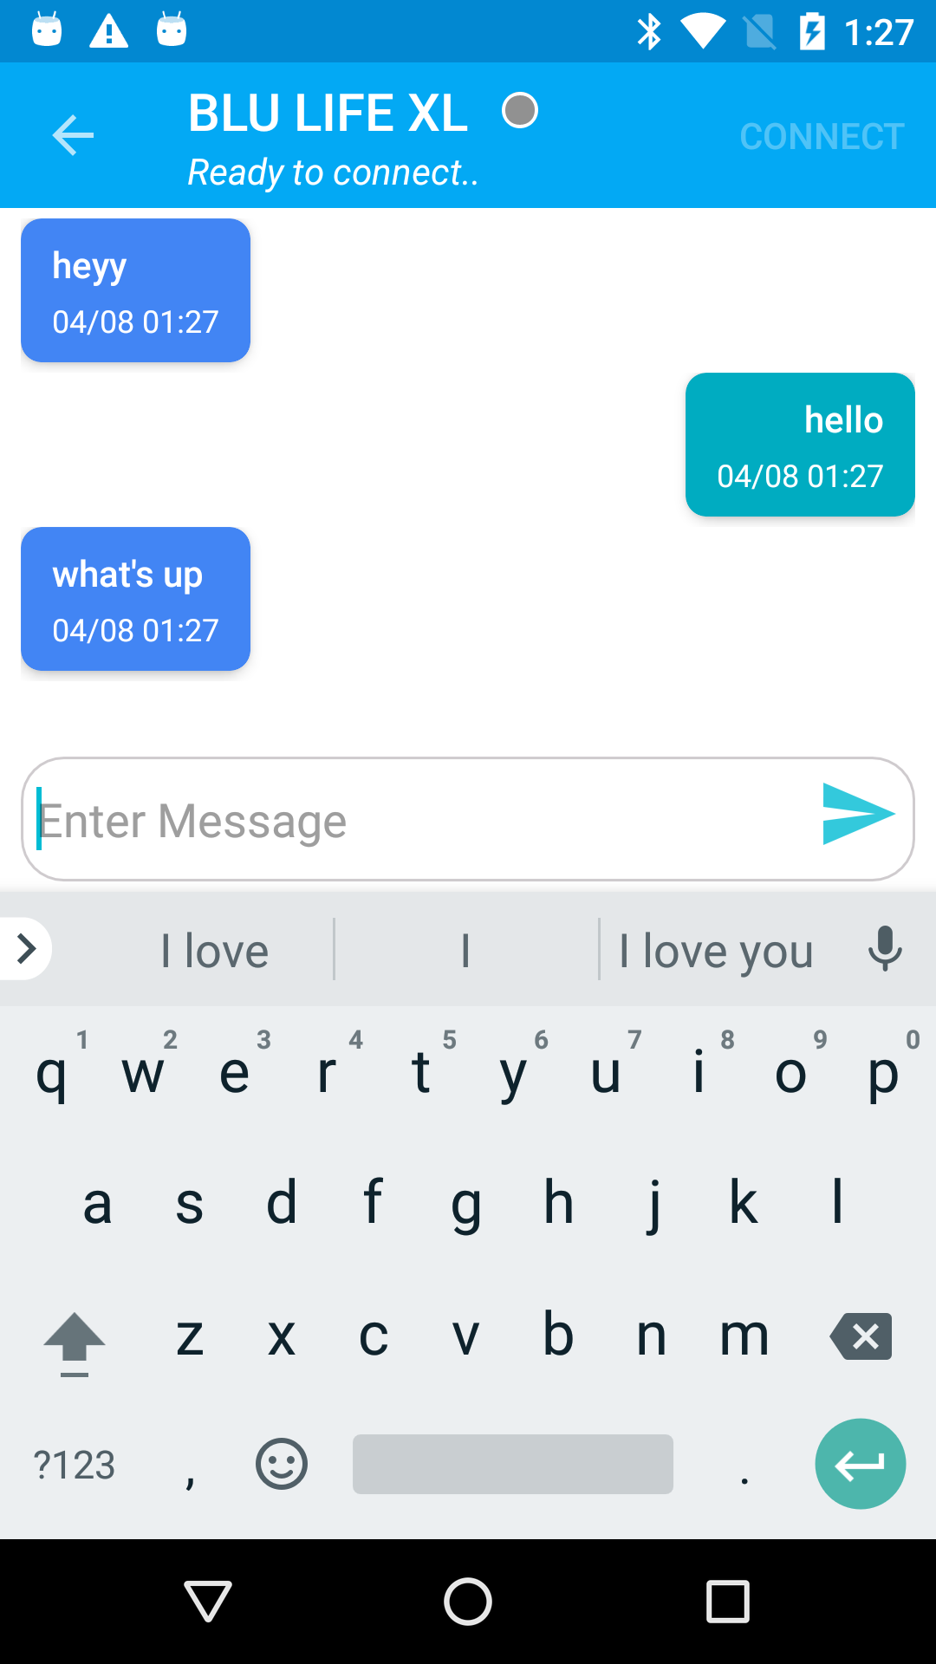

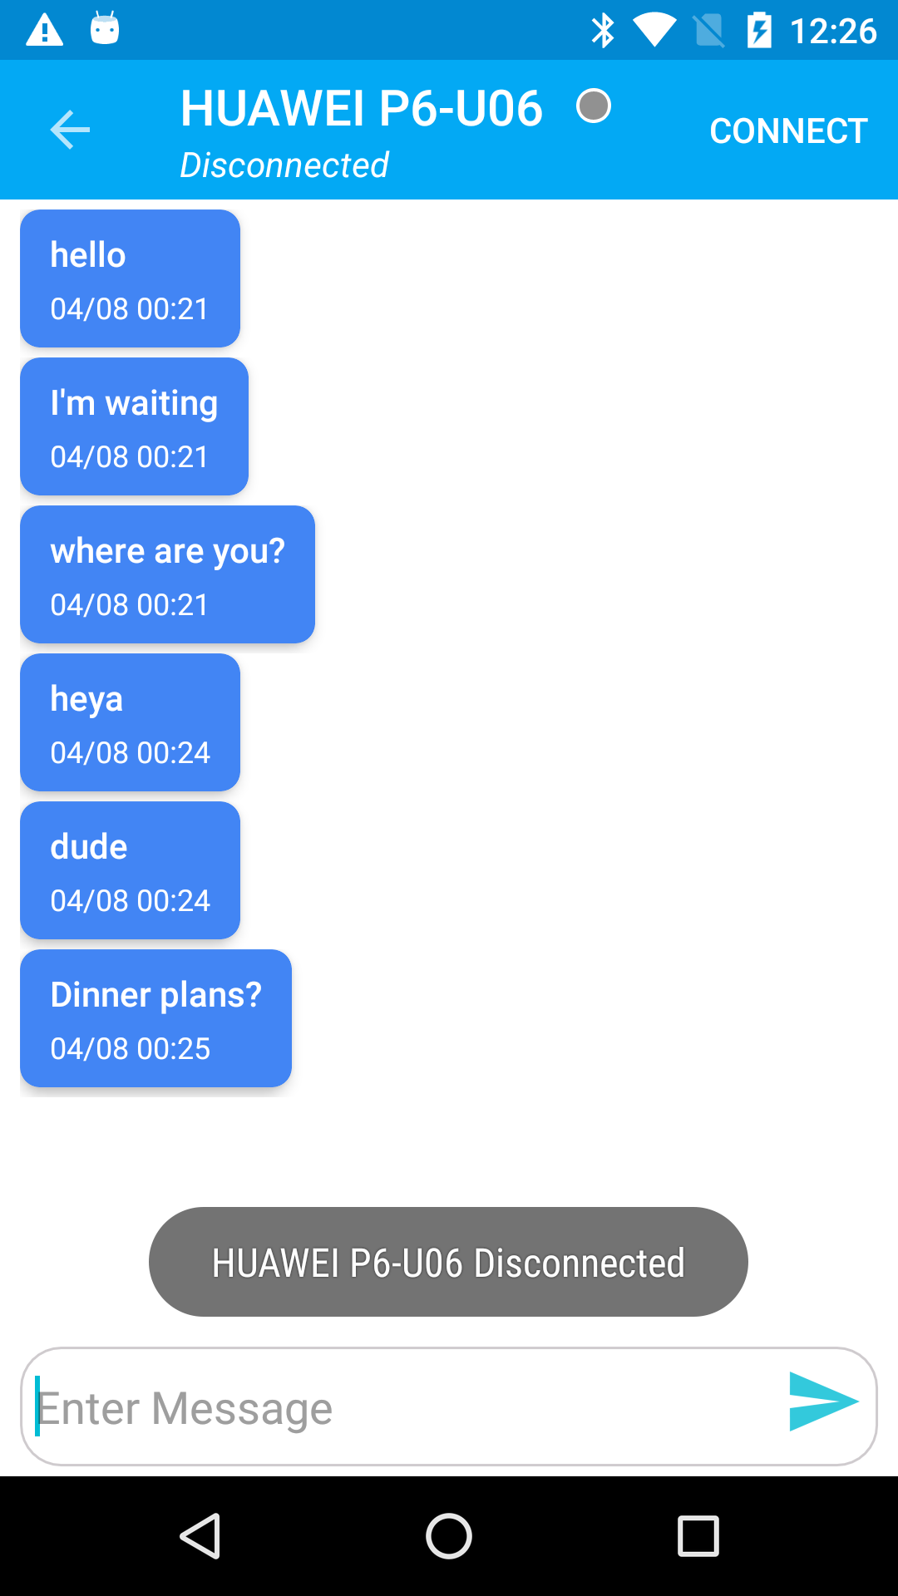
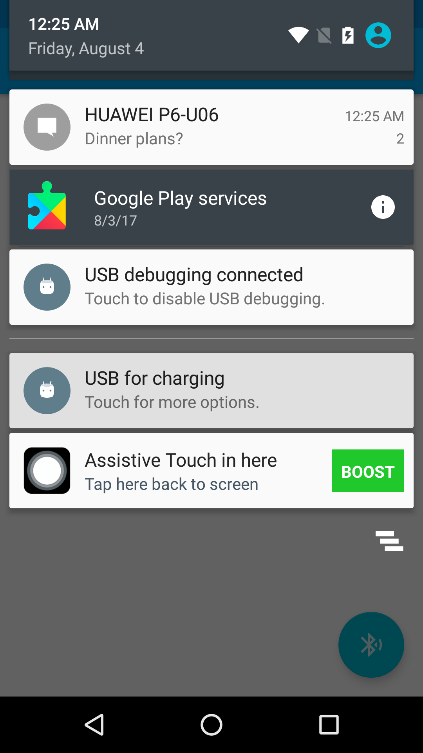
Chat Screen States and Notifications
A message notification is sent when new message comes when user is away from chat.

Slide 7
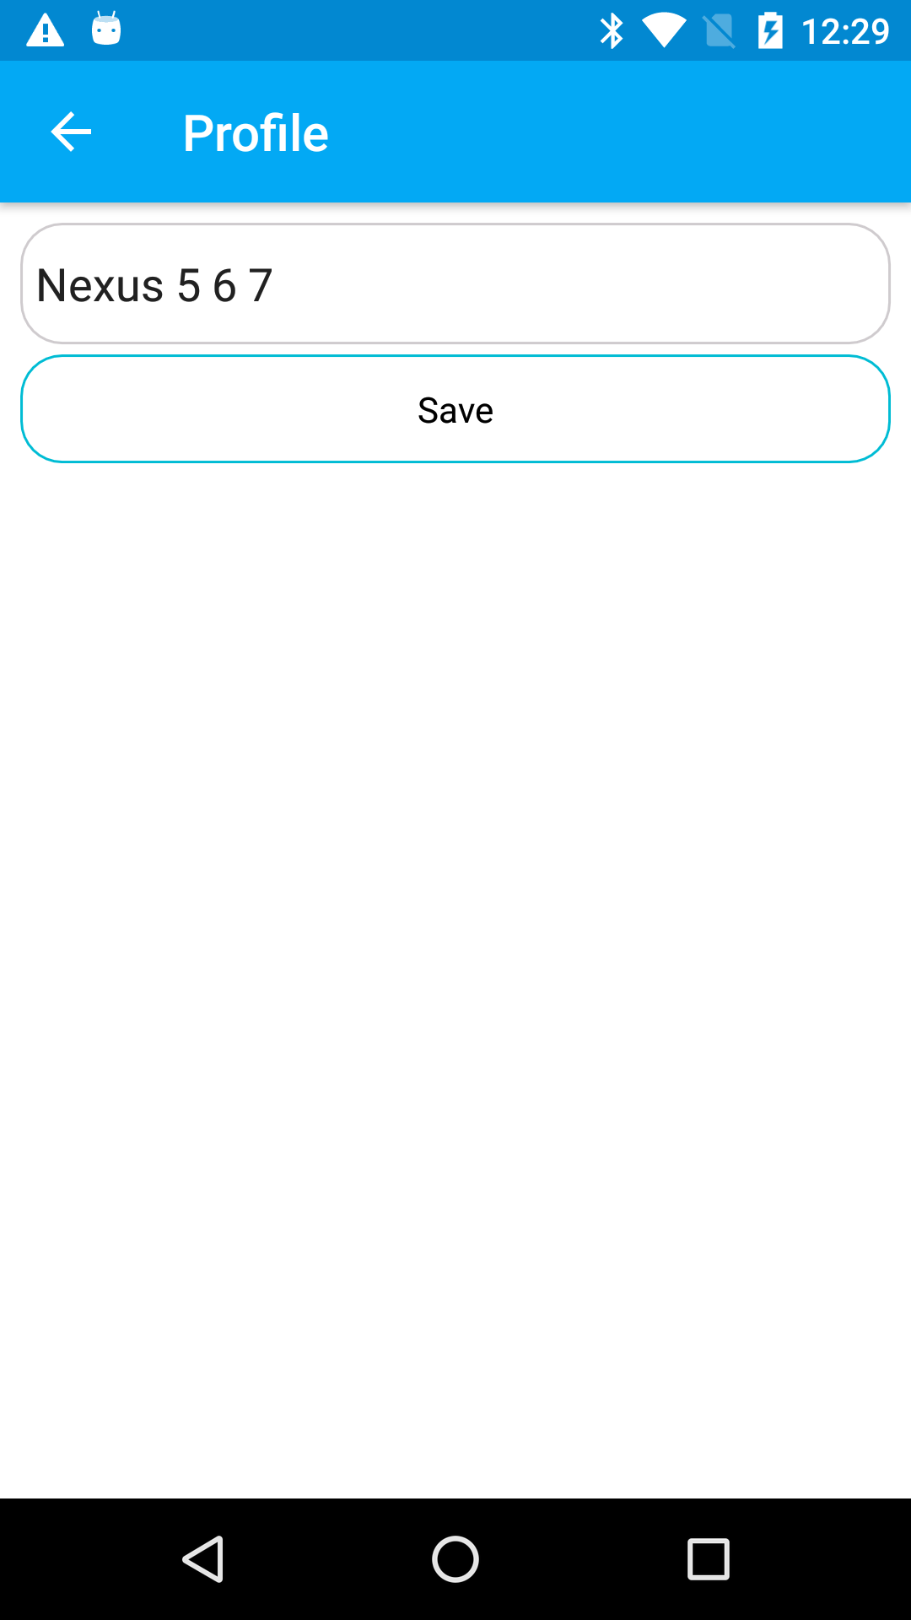
Settings
This is screen where User can change his device name which will be visible to other Bluetooth users.

Slide 8
Limitations
Due to keeping it crash free, fast for one to one chats and ability to be connected and receive messages in background. It has a limitation of only one user connection at a time.
If a user tries to connect a new device while being connected to other device, the connection with the old device will be terminated and new device connection will be established and popup will appear for the same.
This keeps the threads currently used to a minimum and safe from manipulating many Bluetooth sockets at a time and switching between them

