Slide 1

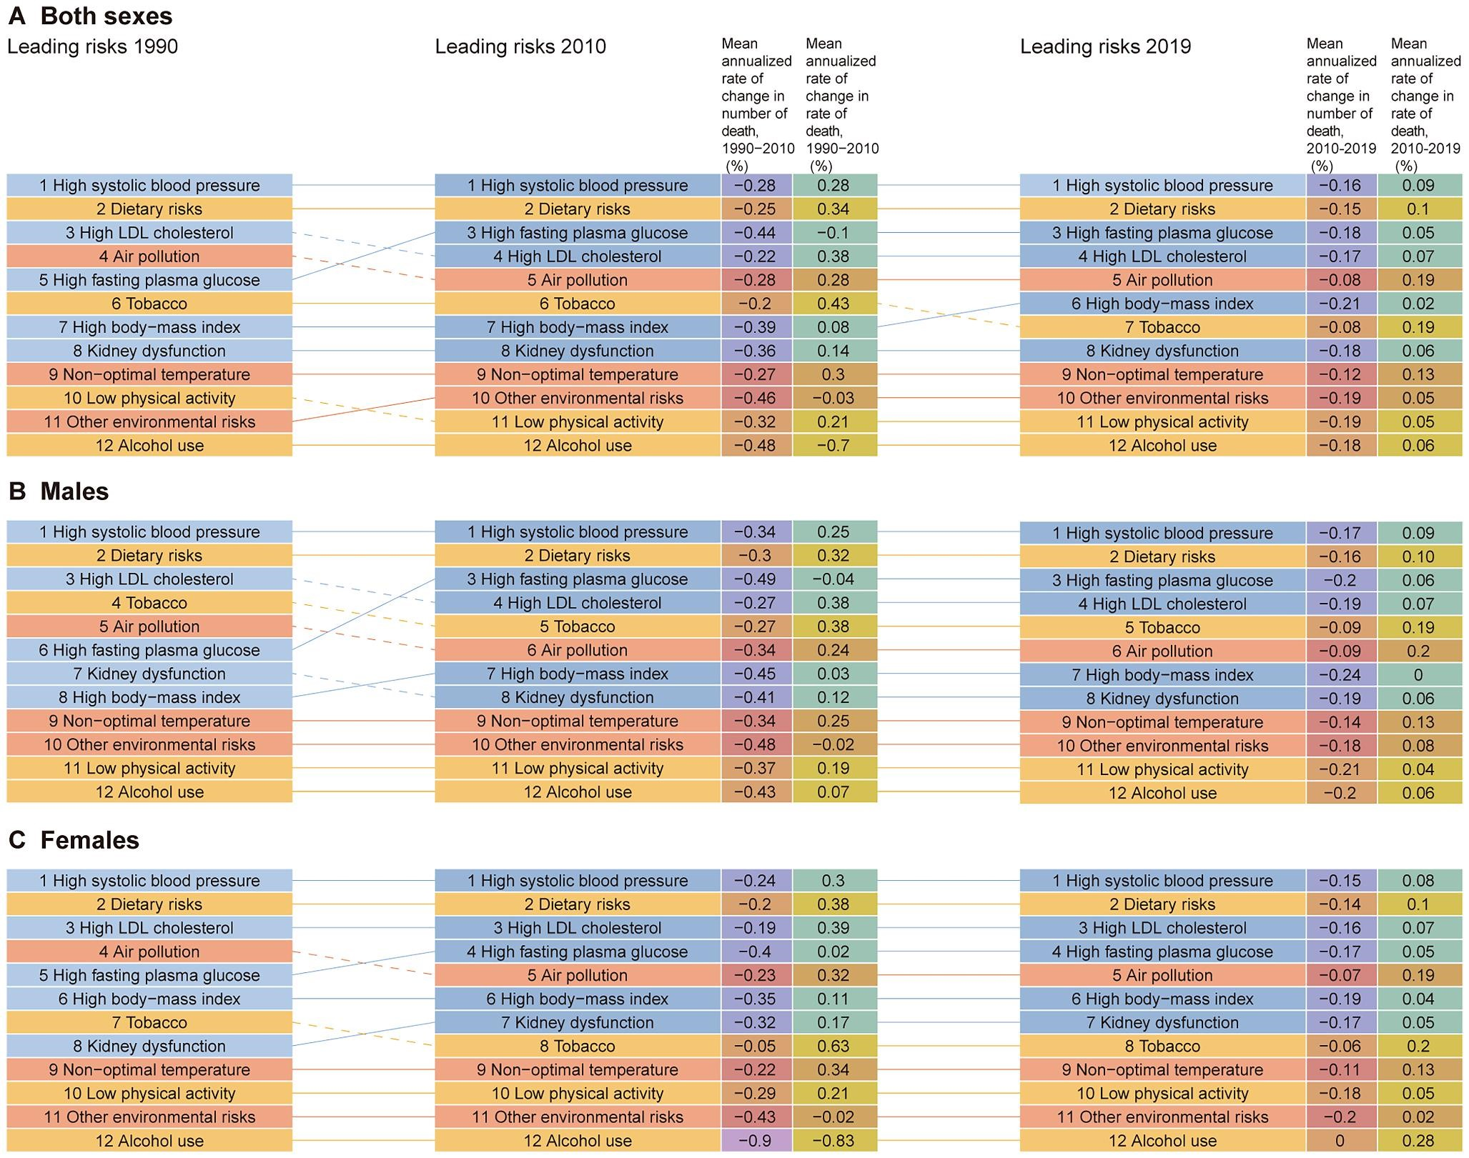

Figure 4 Mean annualized rate of change in the number and rate of death in elderly cardiovascular disease due to ...
Notes:
Figure 4 Mean annualized rate of change in the number and rate of death in elderly cardiovascular disease due to various risk factors and their ranking change between sexes from 1990 to 2010 and 2010 to 2019. Notes: Solid lines indicate a rise, and dotted lines indicate a fall. Yellow for behavioural risks, blue for metabolic risks, and red for environmental/occupational risks.
Unless provided in the caption above, the following copyright applies to the content of this slide: © The Author(s) 2023. Published by Oxford University Press on behalf of the European Society of Cardiology.This is an Open Access article distributed under the terms of the Creative Commons Attribution-NonCommercial License (https://creativecommons.org/licenses/by-nc/4.0/), which permits non-commercial re-use, distribution, and reproduction in any medium, provided the original work is properly cited. For commercial re-use, please contact journals.permissions@oup.com

