Slide 1
Docker in CITI
Sept,2018

Slide 2
Agenda
Introduction
Software Containers Revolution
Virtual Machine vs Containers
Docker Ecosystem
Citi’s Container Strategy
Enterprise Container Solution
Enterprise Container Ecosystem in CITI
Useful Links
References
Q&A

Slide 3
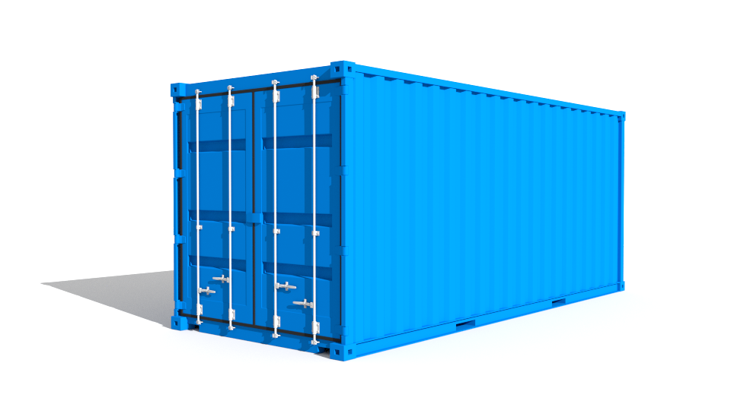
Introduction
“Docker is a Platform for building, shipping and running applications using container virtualization technology “
Build : Package a software with all of its necessary dependencies in a form of an image.
Ship: Portable software images shipped and shared through central share location called as Docker- registry .
Run : Run application as a light weight container from images.

Slide 4
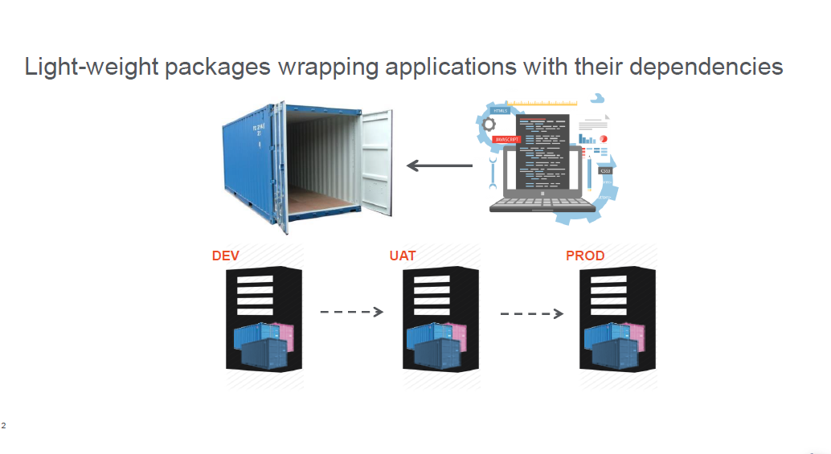
Software Containers Revolution

Slide 5
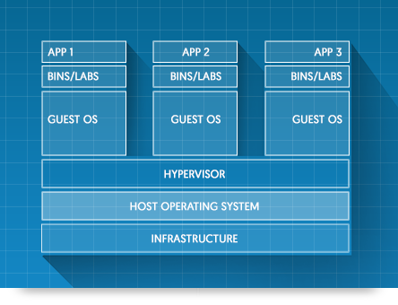
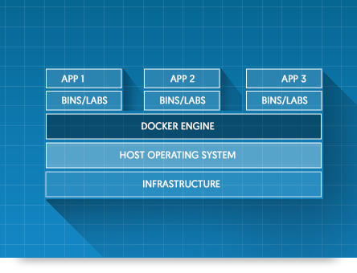
Virtual Machines vs Containers
Virtual machines
Docker Containers

Slide 6
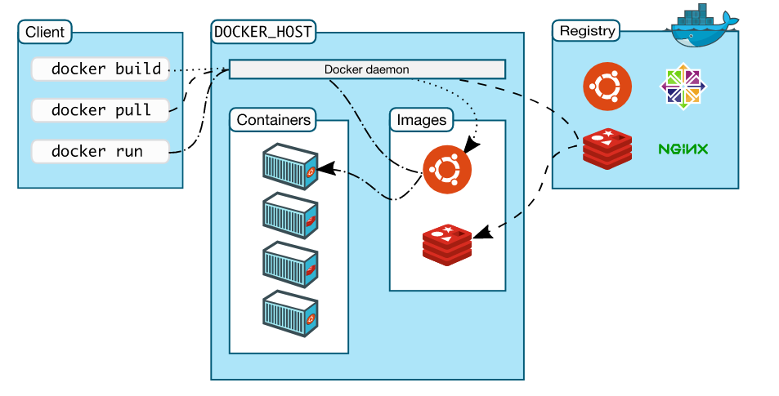
Docker Ecosystem
Docker is a platform for everyone to develop, deploy, and run applications with containers
Docker is a client-server application
Docker client (CLI talks to Docker daemon)
Docker Server (Manage containers, receives and processes API requests)
Docker registry (Public or private)

Slide 7
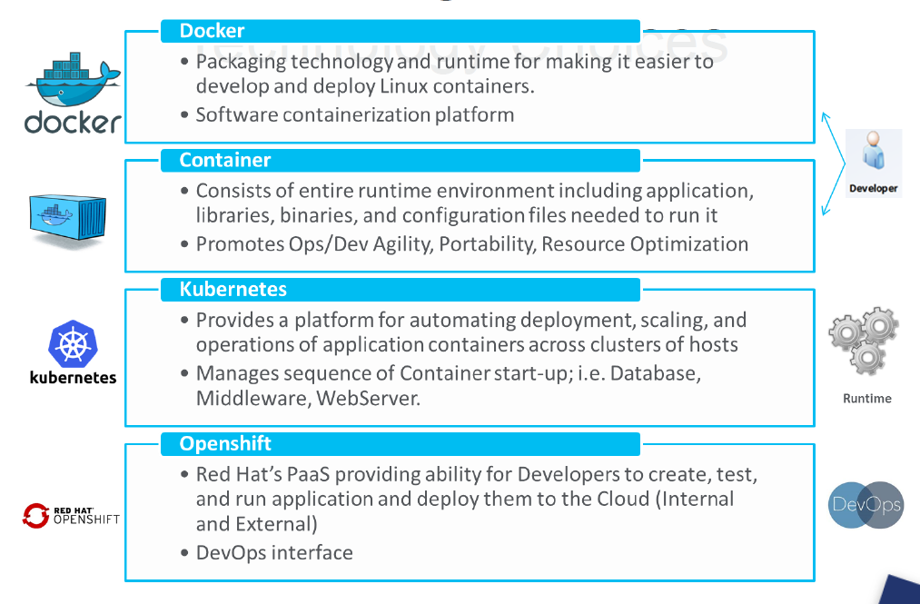
Citi’s Container Strategy

Slide 8
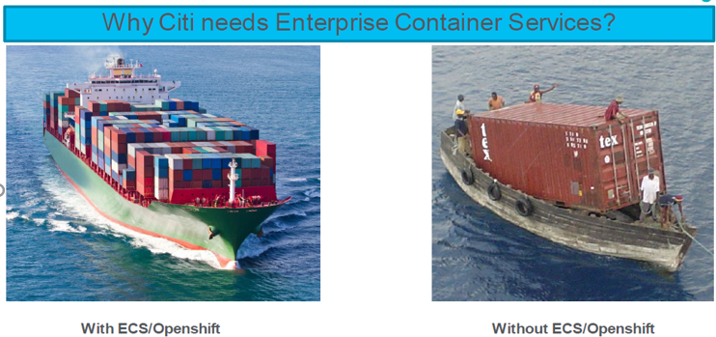
Enterprise Container Solution

Slide 9
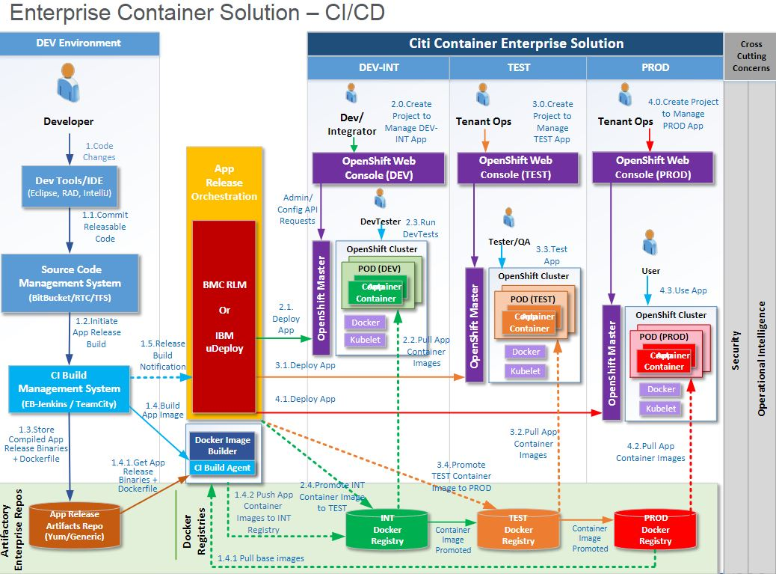
Enterprise Container Ecosystem in CITI

Slide 10
Useful Links
Enterprise Container Solution - Application Onboarding
DEV Deployment phase in OpenShift
Building Docker Images for OpenShift with ICG Build

Slide 11
References
ECS
https://collaborate.citi.net/blogs/richardshoemake/2017/10/20/ecs-cicd-containeropenshift-getting-started
https://collaborate.citi.net/groups/e4-2017-candidates/projects/e4-intra-day-deployment-using-citicloud-and-docker/blog/2017/01/17/cloudcontainer-glossary
https://collaborate.citi.net/groups/application-and-release-management/blog/2017/05/16/docker-image-deployment-in-openshift-using-ucd
https://collaborate.citi.net/docs/DOC-553010
Docker
https://collaborate.citi.net/docs/DOC-459157
https://www.docker.com/

Slide 12
Q & A
Q&A

