Slide 1
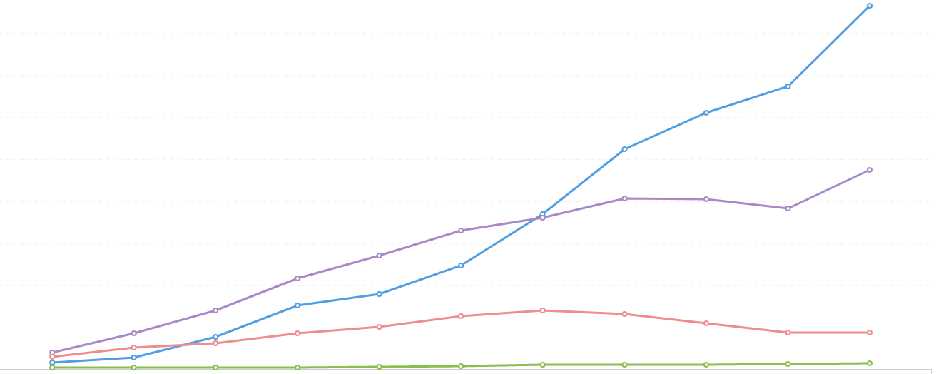
Popularity Index
400
Python (Data Science)
R
200
Scala
Julia
0
2010
2015
2020
Year

