Slide 1

t= 0
t= τ/4
t= τ/2
t= 3τ/4
L₁ = ₀
L₂ = ₀
L₁ = ₀ – δ
L₂ = ₀ + δ
L₁ = ₀
L₂ = ₀
L₁ = ₀ + δ
L₂ = ₀ – δ

Slide 2

Mirror
Laser
Beam-
splitter
Mirror
Photo- detector

Slide 4
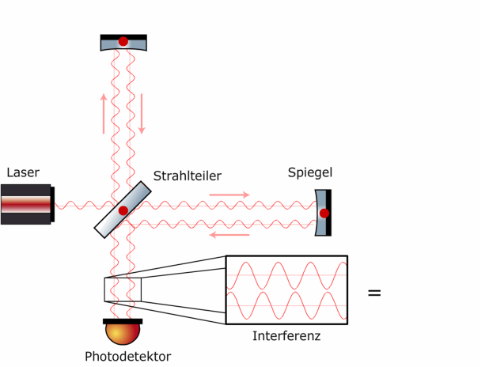
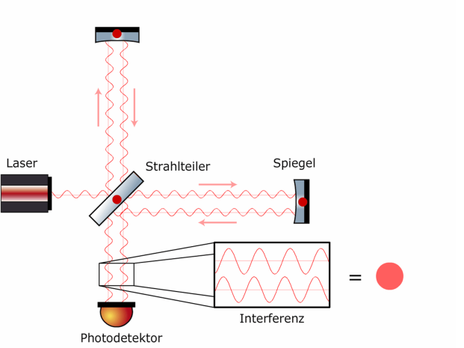
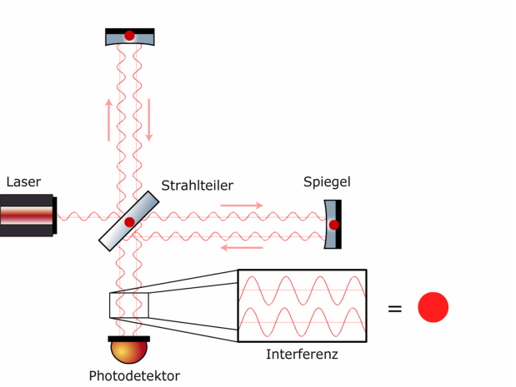
Mirror
Mirror
Mirror
Beam-
splitter
Mirror
Beam-
splitter
Mirror
Beam-
splitter
Mirror
Photodetector
Interference
Photodetector
Interference
Photodetector
Interference

