Slide 1
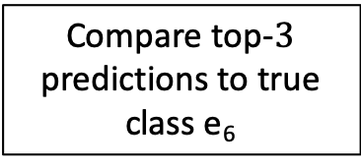
Input sequence S_{i}
Seq | True class
e₆ | 5
Output conditional probability
Seq | Template
e₁ | Creating image
e₂ | VM Lifecycle Event
e₃ | Deleting instance files
e₄ | Claim successful
e₅ | Instance successfully
Pr(e₆|S_{i})
4 | 0.56
0 | 0.25
1 | 0.11
....
template
embeddings
LSTM
Compare top-$3$ predictions to true class e₆
Anomaly
Class | Embedding
0 | Creating image
1 | VM Lifecycle Event
2 | Instance successfully
3 | Deleting instance files
4 | VM Lifecycle Event
5 | Claim successful
6 | Deletion of complete
- | Storage prepared

