Slide 1

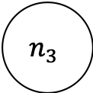

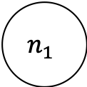

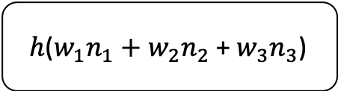
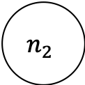
input neurons
output neuron
$$n_{1}$$
$$w_{1}$$
$$n_{2}$$
$$w_{2}$$
$h$($w_{1}n_{1}+w_{2}n_{2}$ + $w_{3}n_{3}$)
$$n_{3}$$
$$w_{3}$$

